Slide 1
Predicting Road Accidents in Seattle

Slide 2
Predicting road accidents severity considering nature factors and human factors as y-variable
According to 2017 WSDOT (Washington State Department of Transportation) data, a car accident occurs every 4 minutes and a person dies due to a car crash every 20 hours
Predicting road accidents will help Seattle Department of Transportation
To improve traffic policies
Update public facilities such as street lamp, speed bumps at proper positions
Car rental or insurance companies can also use this model to classify potential customers and design different services based on customers driving habits

Slide 3
Data acquisition and cleaning
Seattle Department of Transportation provides traffic accident data with all kinds of collisions from 2004 for almost 15 years
In total, 194673 rows and 38 features in the raw dataset
For the features, where the majority of data was missing were dropped
Cleaned data contains 31 features
To predict the damage level of road accidents, the indicator 'SEVERITUCODE' is chosen as the dependent variable

Slide 4
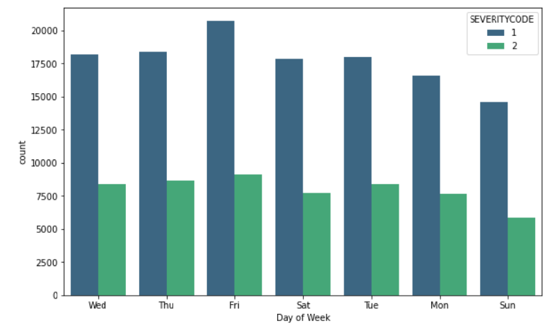
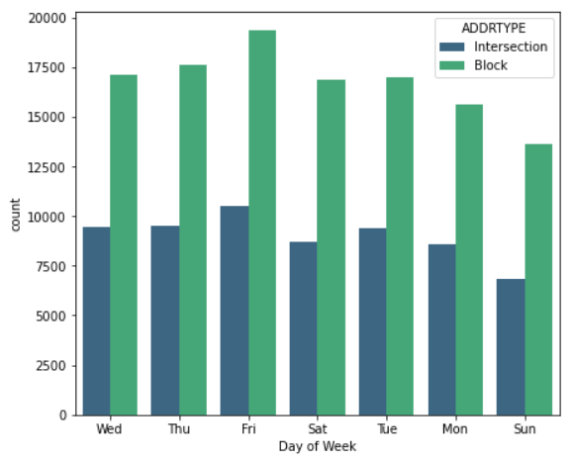
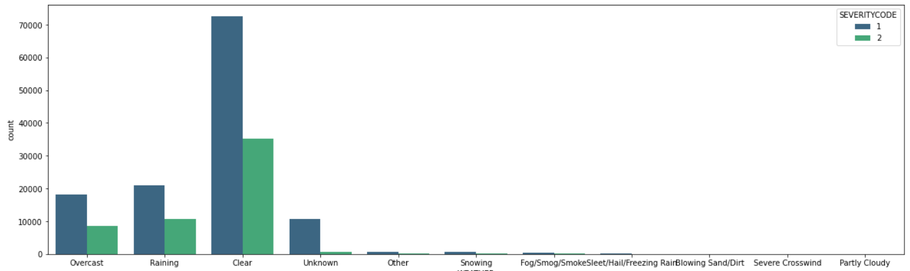
Majority of accidents happened on a Friday, around the block when the weather condition was clear

Slide 5
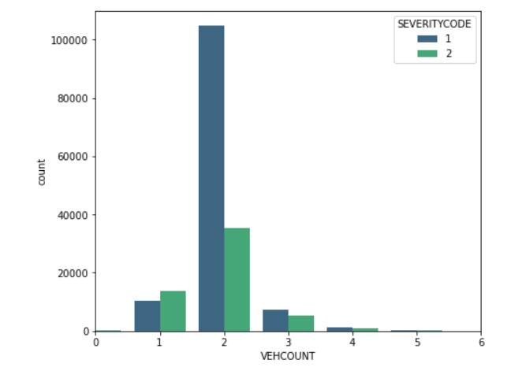
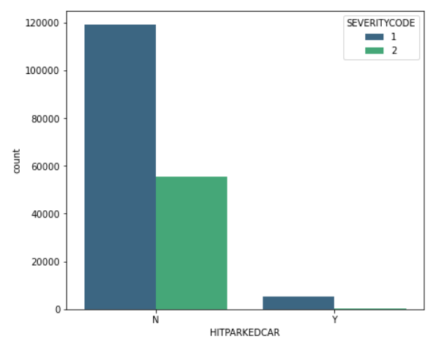
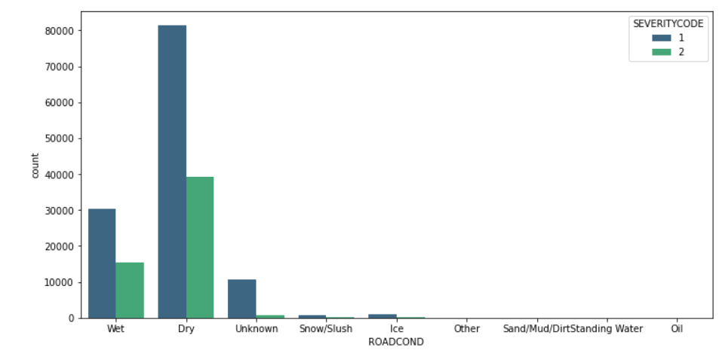
Mostly two vehicle were involved in an accident and neither of it were parked. The weather condition seems to be dry

Slide 6
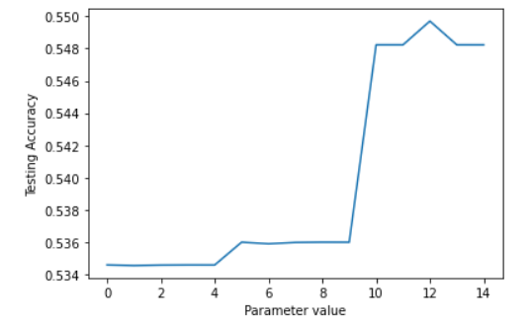
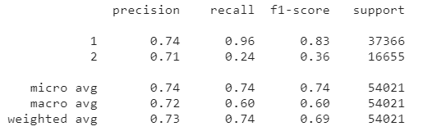

Logistic Regression
Find the right c value and solver
By setting the value of c at 0.001 and solver at liblinear maximum testing accuracy is achieved
Classification Report
The model is able to predict the severity code 1 – Property damage with a recall value of 0.96 (96% accurate)
For severity code 2 – Injury the recall value is 0.24 (24% accurate)
Overall Model Score
Confusion Matrix
The model predicted severity code 1 correctly 35,701 instances and failed in 1665 instances
The model predicted severity code 2 correctly 12,592 instances and failed in 4063 instances
Jaccard | F1-score | LogLoss
0.74 | 0.83 | 0.55

Slide 7
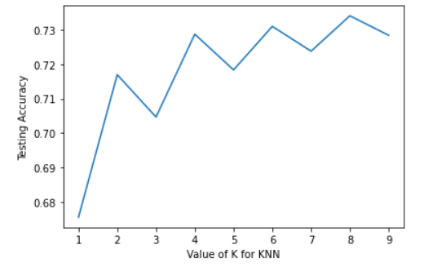
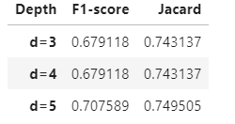
k-nearest neighbors (KNN) algorithm
Find the right k value
By setting the value of k at 8 maximum testing accuracy is achieved
Overall Model Score
Jaccard | F1-score
0.73 | 0.71
Decision tree classifier
Find the right d value
By setting the value of k at 5 maximum testing accuracy is achieved
Overall Model Score
Jaccard | F1-score
0.75 | 0.71

Slide 8
Results/Conclusion
 | Jaccard | F1-score | LogLoss
Logistic Regression | 0.74 | 0.83 | 0.55
KNN | 0.73 | 0.71
Decision tree | 0.75 | 0.71
Logistic regression model can be used for predicting the accident severity from the data provided as it has the highest F1 – score
However, model can be further improvised if we have the missing data for other critical variables like 'INATTENTIONIND','UNDERINFL', and 'SPEEDING'

