Slide 1
Introduction to Electrical & Electronics Circuits
Course Code: EE 101
Department: Electrical Engineering
Instructor Name: B.G. Fernandes
E-mail id: bgf @ee.iitb.ac.in
EE 101: Introduction to Electrical & Electronics Circuits Prof. B. G. Fernandes
Lecture 2
<number>/29

Slide 2
An achiever is an ordinary man who nurtures extraordinary thoughts
EE 101: Introduction to Electrical & Electronics Circuits Prof. B. G. Fernandes
Lecture 2
<number>/29

Slide 3
Sub-Topics:
Basic circuit elements
Circuit laws.
Series, parallel connections, Y-Δ, Δ-Y transformations
Circuit analysis : Mesh analysis, Nodal analysis
Network Theorems
Note: Course material (lecture slides, assignments, etc.. ) available at
http://sharada.ee.iitb.ac.in/~ee101
27 July 2010
EE 101: Introduction to Electrical & Electronics Circuits Prof. B. G. Fernandes
Lecture 2
<number>/29

Slide 4

Review of DC Circuit Analysis & Network Theorems:
Electric Circuit Closed path composed of active & passive elements.
Active Elements Capable of delivering power to some external device
Two types Independent source
Dependent source
Independent source Independent V source
Independent I source
⇒
⇒
EE 101: Introduction to Electrical & Electronics Circuits Prof. B. G. Fernandes
Lecture 2
<number>/29

Slide 5
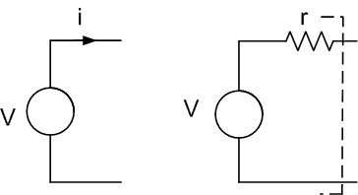
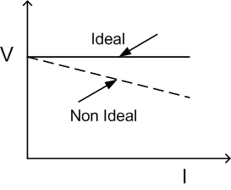
Independent V source Terminal V is INDEPENDENT of I flowing through it.
Ideal
Non-ideal
⇒
Battery
EE 101: Introduction to Electrical & Electronics Circuits Prof. B. G. Fernandes
Lecture 2
<number>/29

Slide 6
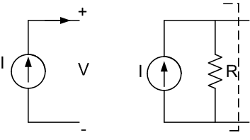
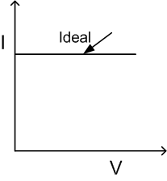



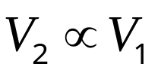
Independent I source : I is independent of ‘V’ across it
Dependent source: Source quantity depends on either ‘V’ or ‘I’ existing at some other location in the circuit.
Ideal
Non-ideal
v_{be}
EE 101: Introduction to Electrical & Electronics Circuits Prof. B. G. Fernandes
Lecture 2
<number>/29

Slide 7
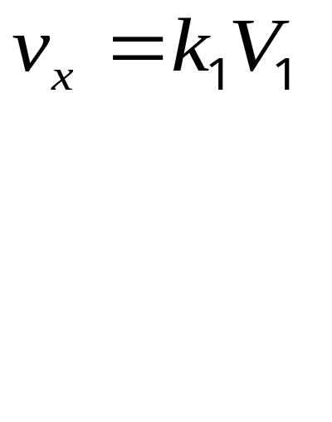
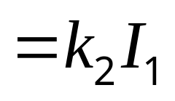

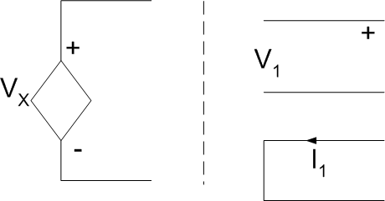
Dependent V source : Voltage V_{X} depends on either V₁ or I₁.
V dependent V source
I dependent V source
gain
Some other part of circuit
EE 101: Introduction to Electrical & Electronics Circuits Prof. B. G. Fernandes
Lecture 2
<number>/29

Slide 8
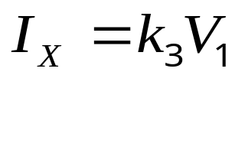
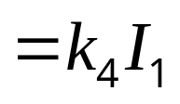
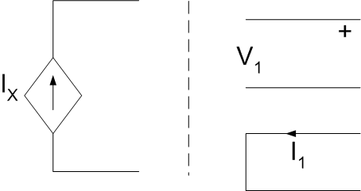
Dependent I source: Current I_{x} depends on V₁ or I₁
V dependent I source
I dependent I source
EE 101: Introduction to Electrical & Electronics Circuits Prof. B. G. Fernandes
Lecture 2
<number>/29

Slide 9
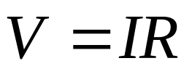

Passive Elements:
⇒
Capable of receiving power
Can not independently deliver the energy
R, L & C
⇒
⇒
Resistor
or
Conductance ‘Mho’
Power absorbed = V²/R or I²R W
EE 101: Introduction to Electrical & Electronics Circuits Prof. B. G. Fernandes
Lecture 2
<number>/29

Slide 10
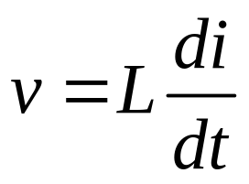
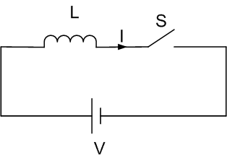
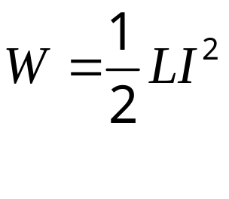
Inductor:
⇒
Stores energy in the magnetic field
‘I’ can not change instantaneously
⇒
Requires very high ‘V’
EE 101: Introduction to Electrical & Electronics Circuits Prof. B. G. Fernandes
Lecture 2
<number>/29

Slide 11
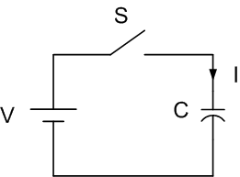
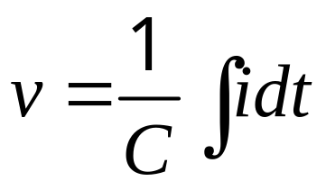
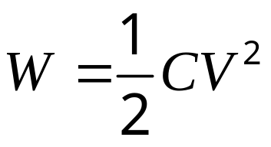
Capacitor:
⇒
‘V’ cannot change instantaneously
Requires very high I
⇒
EE 101: Introduction to Electrical & Electronics Circuits Prof. B. G. Fernandes
Lecture 2
<number>/29

Slide 12
Types of Electric circuits:
⇒
Active Network contains at least one active element
⇒
Passive network does not contain any active element
EE 101: Introduction to Electrical & Electronics Circuits Prof. B. G. Fernandes
Lecture 2
<number>/29

Slide 13
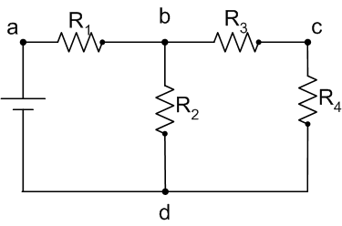
Terminologies used in Electric circuits:
Node: Point to which two or more circuit elements are joined (a, b, c, d)
Junction: Point in a network 3 or more circuit elements are joined (b&d)
Branch: Part of the circuit lies between two junction points (abd, bcd)
Loop: Any closed path of network
(abda, bcdb, abcda)
Mesh: Loop does not contain other loop within it.
EE 101: Introduction to Electrical & Electronics Circuits Prof. B. G. Fernandes
Lecture 2
<number>/29

Slide 14
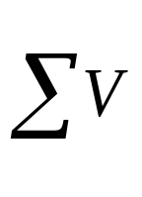
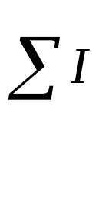
Mesh I That I which flows around the perimeter.
⇒
Clockwise is +ve
Circuit Laws:
Kirchhoff’s Voltage law: In any closed path
rise = fall
V drop +ve
V rise -ve
⇒
⇒
Kirchhoff’s Current law: At any node
Entering = Leaving
EE 101: Introduction to Electrical & Electronics Circuits Prof. B. G. Fernandes
Lecture 2
<number>/29

Slide 15
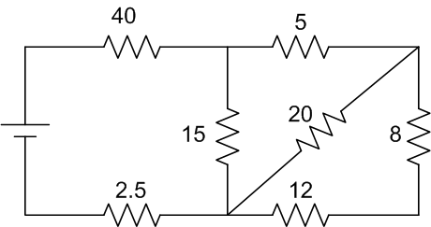
Series Connection: When I flowing is same & there should
be one mesh
Parallel connection: ‘V’ across is same & connected across
the same node
e.g: R_{eq} = 50Ω
EE 101: Introduction to Electrical & Electronics Circuits Prof. B. G. Fernandes
Lecture 2
<number>/29

Slide 16
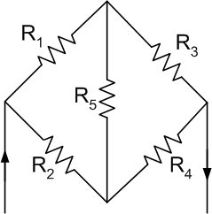
Can not be resolved by series – parallel cobination.
EE 101: Introduction to Electrical & Electronics Circuits Prof. B. G. Fernandes
Lecture 2
<number>/29

Slide 17
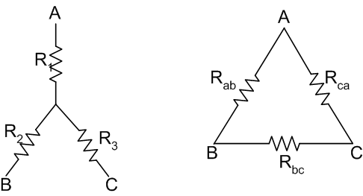

Star – Delta (Y- Δ) transformation:
⇒
Nodes are unaffected
⇒
Equivalent resistance between any two terminals
is same
EE 101: Introduction to Electrical & Electronics Circuits Prof. B. G. Fernandes
Lecture 2
<number>/29

Slide 18
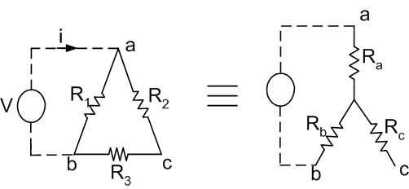
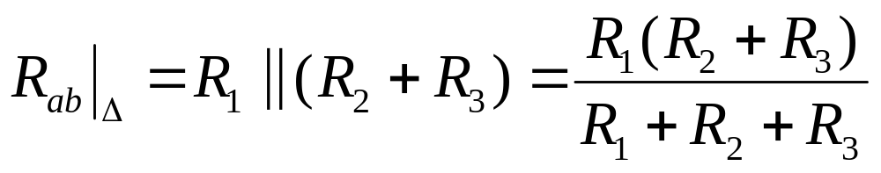
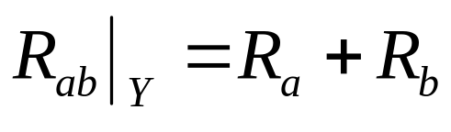
Delta – Star transformation (Δ – Y) transformation:
R_{ab} is measured by applying V across AB, keep ‘C’ open
EE 101: Introduction to Electrical & Electronics Circuits Prof. B. G. Fernandes
Lecture 2
<number>/29

Slide 19
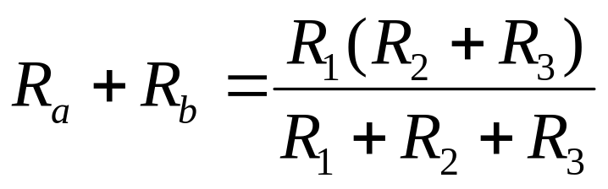
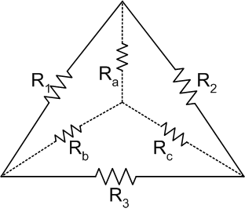
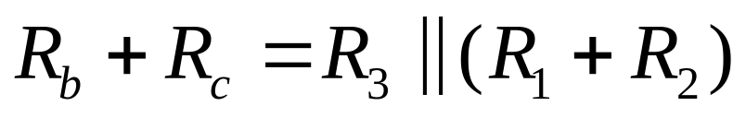
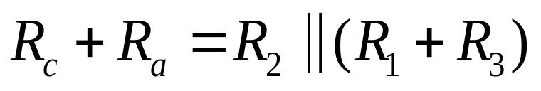
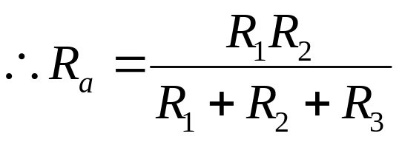
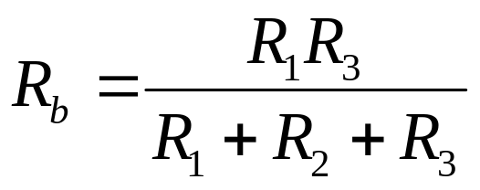
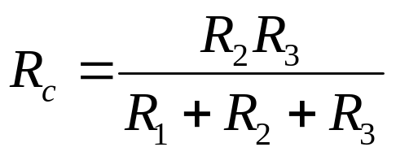
Any resistance of Y circuit = product of two adjacent Δ
resistances / sum of 3 Δ resistances
EE 101: Introduction to Electrical & Electronics Circuits Prof. B. G. Fernandes
Lecture 2
<number>/29

Slide 20
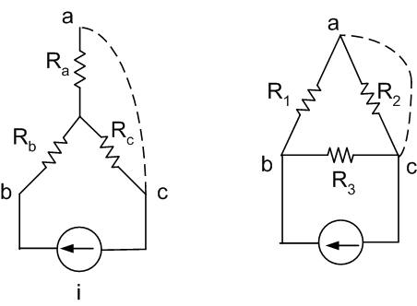
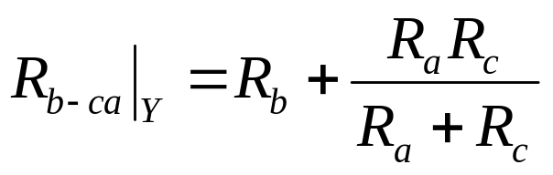
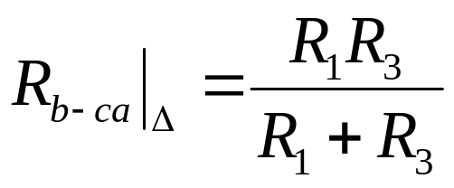
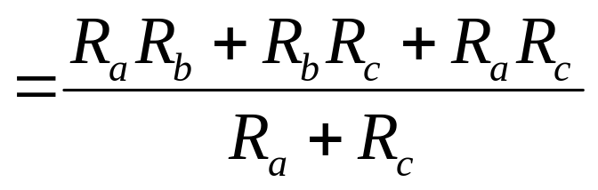
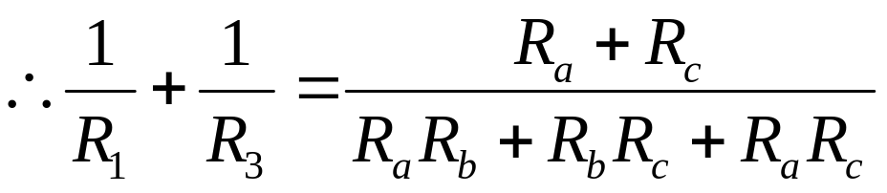
Y- Δ transformation:
⇒
EE 101: Introduction to Electrical & Electronics Circuits Prof. B. G. Fernandes
Lecture 2
<number>/29

Slide 21
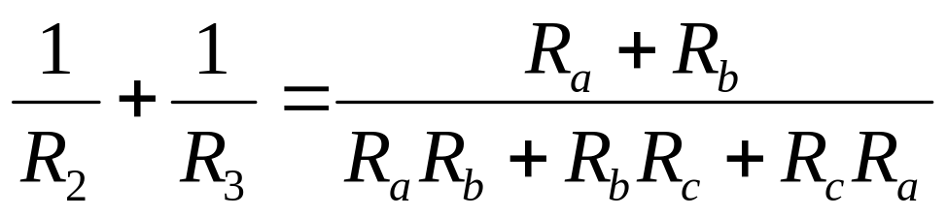
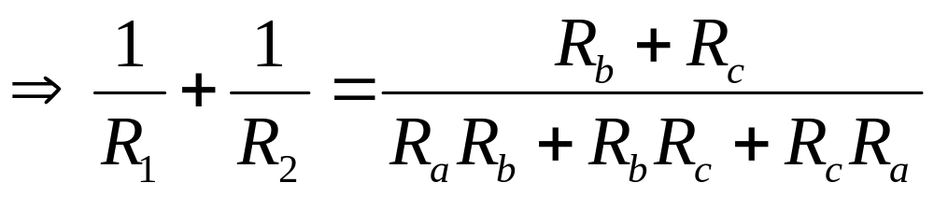
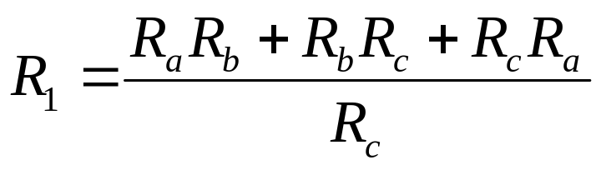
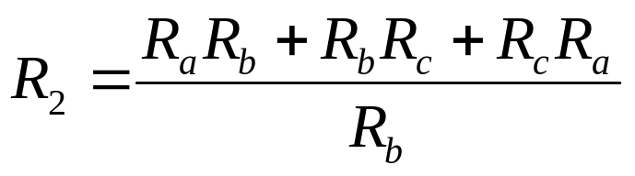

similarly
⇒
Resistance of Δ circuit = Sum of all products of all possible pairs of the Y resistance/opposite resistance of Y
EE 101: Introduction to Electrical & Electronics Circuits Prof. B. G. Fernandes
Lecture 2
<number>/29

Slide 22
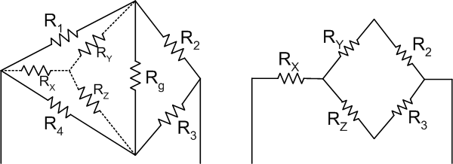
EE 101: Introduction to Electrical & Electronics Circuits Prof. B. G. Fernandes
Lecture 2
<number>/29

Slide 23

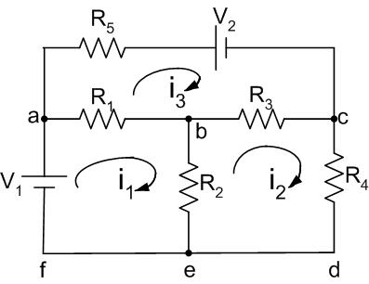
Circuit analysis:
Broadly classified into
DC circuit
Steady state analysis
AC circuit
Transient analysis behavior during transient state
Mesh I method:
KVL is used
If b No. of branches = 6
N Junctions = 4
⇒
Mesh equations = b - (n-1) = 3
EE 101: Introduction to Electrical & Electronics Circuits Prof. B. G. Fernandes
Lecture 2
<number>/29

Slide 24
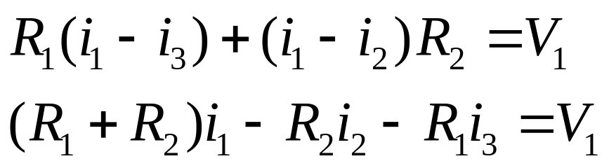
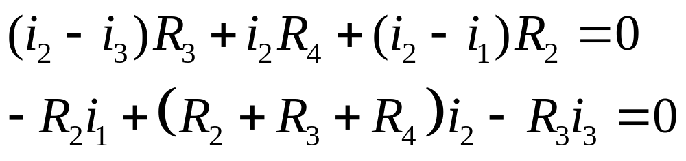
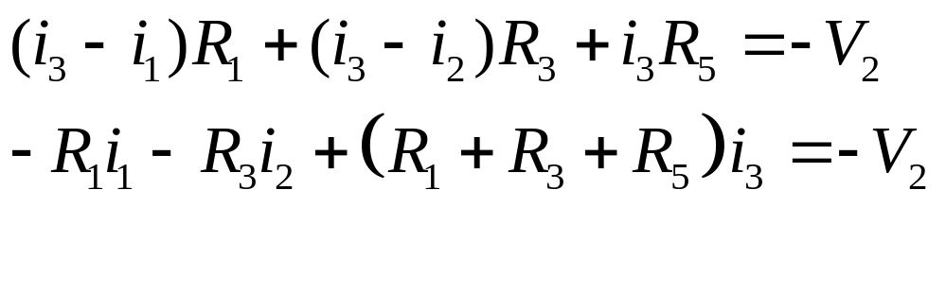
Mesh1:
Mesh2:
Mesh3:
EE 101: Introduction to Electrical & Electronics Circuits Prof. B. G. Fernandes
Lecture 2
<number>/29

Slide 25
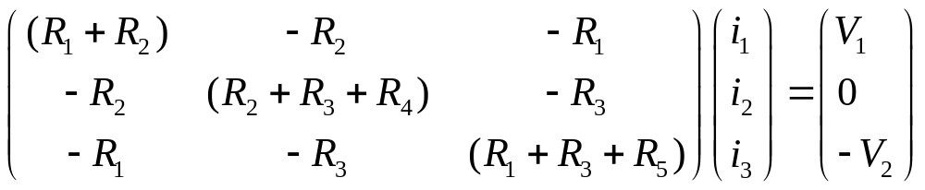
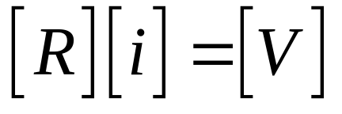

Steps:
⇒
Identify meshes
Assign clockwise I
Use KVL & write mesh equations
⇒
⇒
EE 101: Introduction to Electrical & Electronics Circuits Prof. B. G. Fernandes
Lecture 2
<number>/29

Slide 26








Circuit analysis by Node voltage method:
KCL is used
⇒
Take one reference node.
Let
⇒
‘V’ at a,b,& C
respectively
EE 101: Introduction to Electrical & Electronics Circuits Prof. B. G. Fernandes
Lecture 2
<number>/29

Slide 27


⇒
Choose a reference node
Write node V₁………V_{n-1} at their respective nodes
Assign the direction of I in each branch
Use KCL
⇒
⇒
⇒
EE 101: Introduction to Electrical & Electronics Circuits Prof. B. G. Fernandes
Lecture 2
<number>/29

Slide 28

Suppose the value of one element is varying
⇒
As R_{x} varies, [R] also varies
⇒
Assume that only i_{X} to be determined
⇒
For each value of R_{X}, [R]⁻¹ to be determined
EE 101: Introduction to Electrical & Electronics Circuits Prof. B. G. Fernandes
Lecture 2
<number>/29

Slide 29

⇒
Instead replace the network with two terminals
A & B by an Equivalent circuit
Thevenin
(French engineer)
OR
Norton’s Theorem
(Bell lab)
EE 101: Introduction to Electrical & Electronics Circuits Prof. B. G. Fernandes
Lecture 2
<number>/29

Slide 30

Thevenin’s Theorem:
Any linear active network with output terminals AB can be
replaced by an ideal voltage source V_{TH} in series with a single resistor(?) R_{TH},
Where V_{TH} Open circuit voltage measured across the
terminals AB
R_{TH} Equivalent resistance of the network at the terminals AB when all internal sources are set equal to zero.
EE 101: Introduction to Electrical & Electronics Circuits Prof. B. G. Fernandes
Lecture 2
<number>/29

