Slide 1
Introduction to Electrical & Electronics Circuits
Course Code: EE 101
Department: Electrical Engineering
Instructor Name: B.G. Fernandes
E-mail id: bgf @ee.iitb.ac.in
EE 101: Introduction to Electrical & Electronics Circuits Prof. B.G.Fernandes
Lecture 4
<number>/20

Slide 2
Sub Topics:
Norton’s theorem
Source conversion
Superposition theorem
Time domain response of RL and RC circuit
  Step response
  Pulse response
EE 101: Introduction to Electrical & Electronics Circuits Prof. B.G.Fernandes
Lecture 4
<number>/20

Slide 3
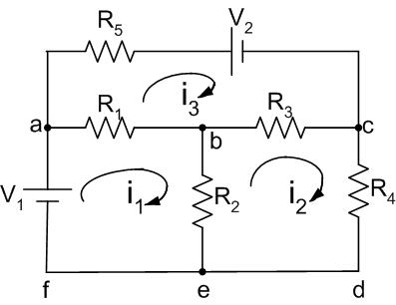
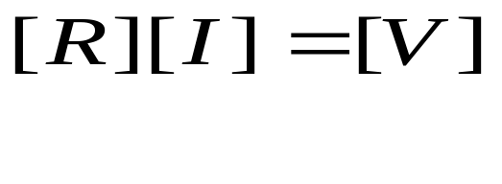
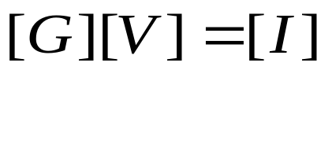
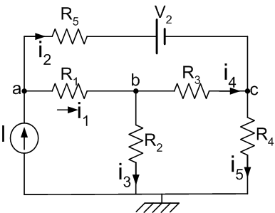
Review
Mesh current method
R – Known, V- Forcing function- known
I – to be determined
Nodal Voltage method
G – Known, I- Forcing function- known
V– to be determined
⇒
Having determined [V], branch
currents can be calculated
EE 101: Introduction to Electrical & Electronics Circuits Prof. B.G.Fernandes
Lecture 4
<number>/20

Slide 4
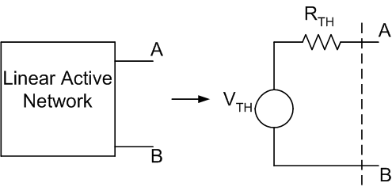
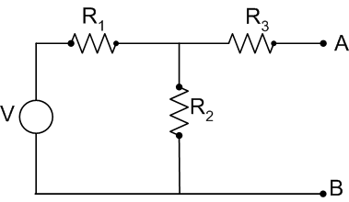
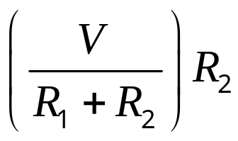
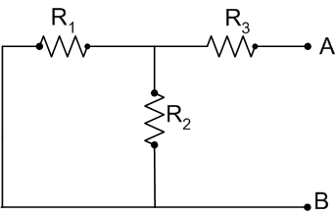
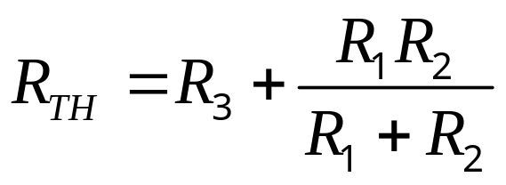
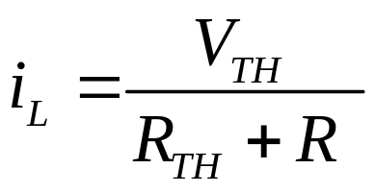
Thevenin’s Theorem
V_{TH} = ‘V’ across R₂ =
EE 101: Introduction to Electrical & Electronics Circuits Prof. B.G.Fernandes
Lecture 4
<number>/20

Slide 5
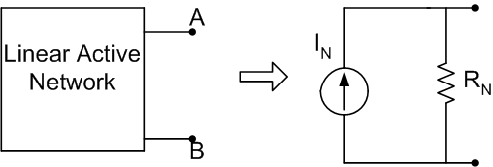
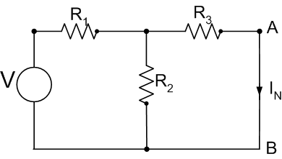
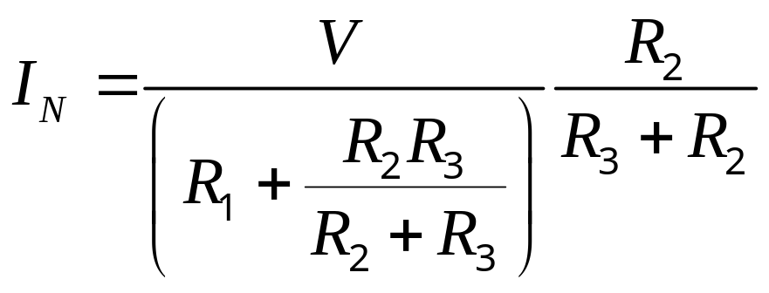
Norton’s Theorem:
I_{N} Current through the short circuit applied to
the terminals AB
R_{N} = R_{TH}
EE 101: Introduction to Electrical & Electronics Circuits Prof. B.G.Fernandes
Lecture 4
<number>/20

Slide 6
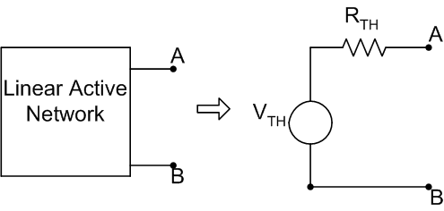
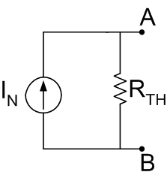

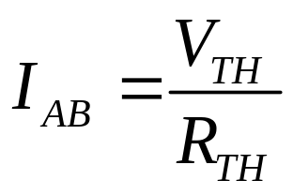
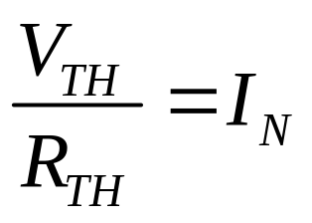
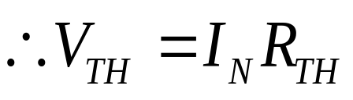
Source Conversion:
Short circuit the terminals AB
Using Thevenin’s theorem,
From Norton’s theorem,
I_{AB} = I_{N}
⇒
EE 101: Introduction to Electrical & Electronics Circuits Prof. B.G.Fernandes
Lecture 4
<number>/20

Slide 7
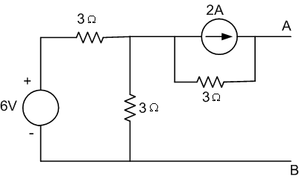
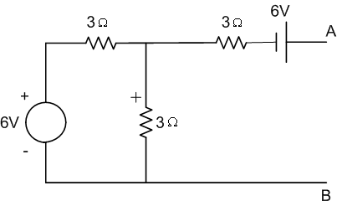
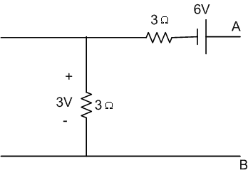

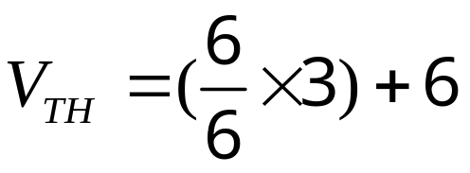
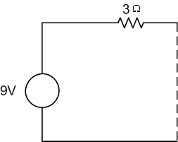

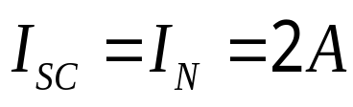
e.g.:
EE 101: Introduction to Electrical & Electronics Circuits Prof. B.G.Fernandes
Lecture 4
<number>/20

Slide 8
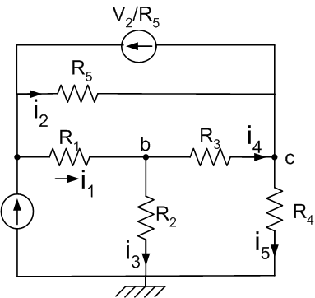
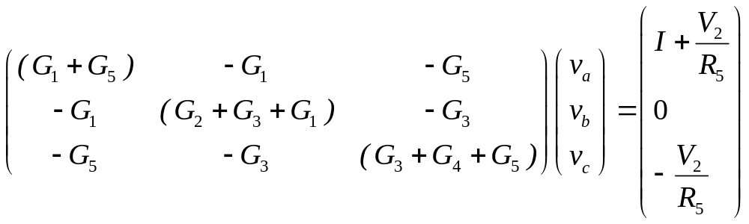
Circuit used for nodal analysis
e.g.
⇒
EE 101: Introduction to Electrical & Electronics Circuits Prof. B.G.Fernandes
Lecture 4
<number>/20

Slide 9
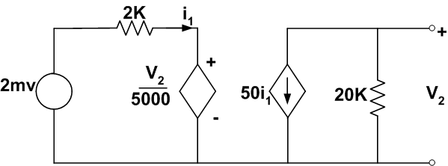
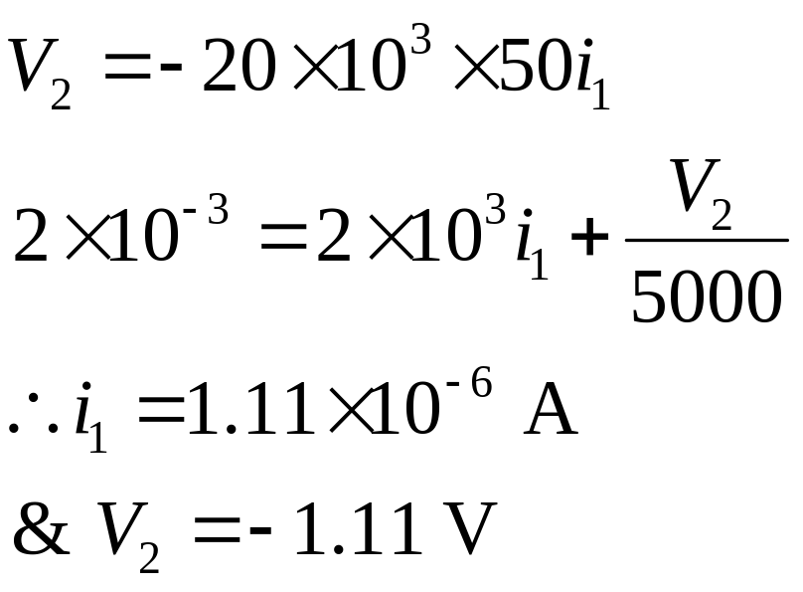
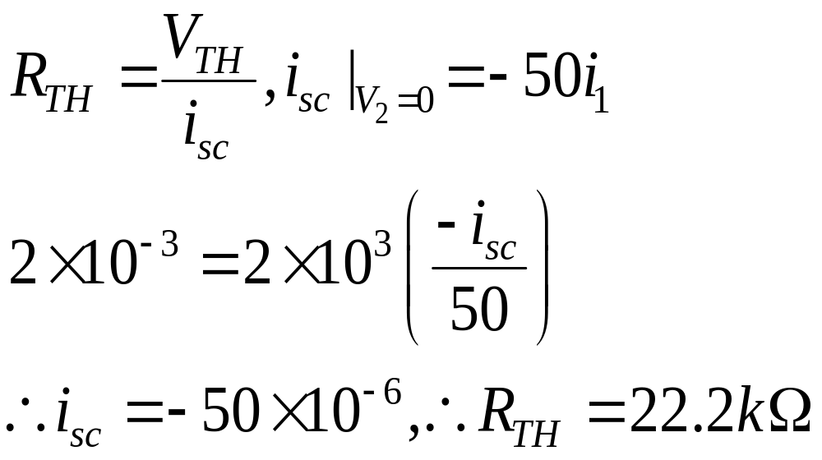
Equivalent circuit of a transistor amplifier:
Determine V₂ (V_{TH}) and R_{TH}
EE 101: Introduction to Electrical & Electronics Circuits Prof. B.G.Fernandes
Lecture 4
<number>/20

Slide 10
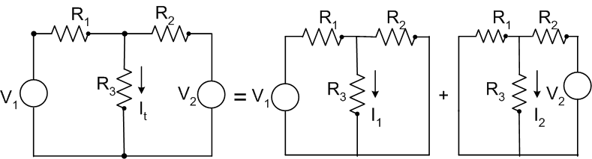
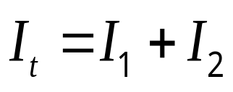
Superposition Theorem:
The response in any element of linear network having
two or more sources is the sum of responses obtained by
each source acting separately, with all other sources set
equal to zero.
If x₁ y₁
⇒
For a linear system, if (x₁+x₂) (y₁+y₂)
& x₂ y₂
EE 101: Introduction to Electrical & Electronics Circuits Prof. B.G.Fernandes
Lecture 4
<number>/20

Slide 11
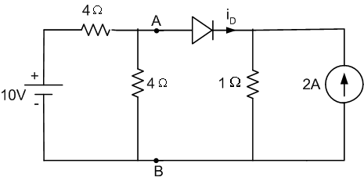
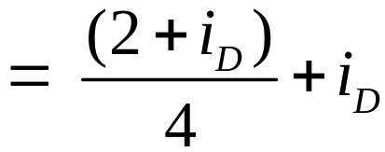
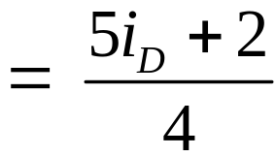
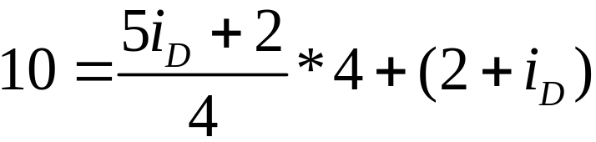

Determine i_{D}
(Assume diode is ideal)
Circuit is non-linear
‘V’ across 1Ω = (2+i_{D}) = V_{AB}
∴ ‘i’ supplied by battery
Applying KVL
EE 101: Introduction to Electrical & Electronics Circuits Prof. B.G.Fernandes
Lecture 4
<number>/20

Slide 12
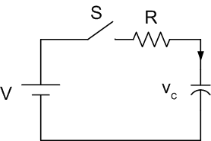
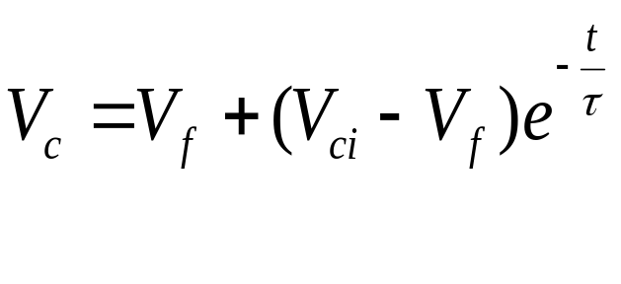
Time domain response of RC and RL circuit
No transients in purely resistive circuit
I cannot change instantaneously in an inductor
V across a capacitor cannot change instantaneously
Step response: DC voltage or current
suddenly applied to the circuit
RC circuit:
where, τ = Time constant
Circuit is assumed to attain steady state at t = 5τ
V_{ci} = capacitor voltage at t = 0, V_{f} is the final value
EE 101: Introduction to Electrical & Electronics Circuits Prof. B.G.Fernandes
Lecture 4
<number>/20

Slide 13
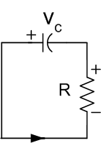
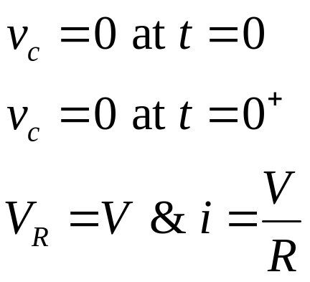
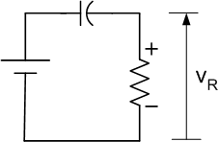
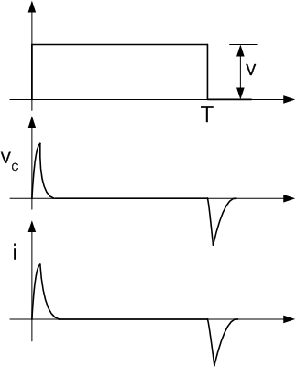
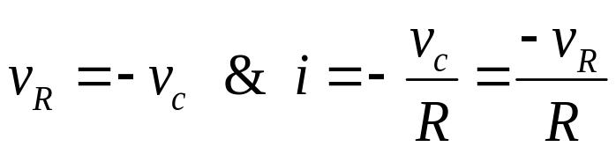
Step response of R-C circuit
Case i)
V
At steady state v_{c}= V, I = 0 ∴ V_{R} = 0
Steady state is attained at t ≈5τ
At t = T⁺
t
t
At steady state, v_{c} and i = 0.
Observation: ‘i’ through ‘C’ can
change instantaneously
t
EE 101: Introduction to Electrical & Electronics Circuits Prof. B.G.Fernandes
Lecture 4
<number>/20

Slide 14
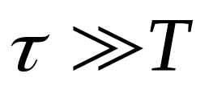
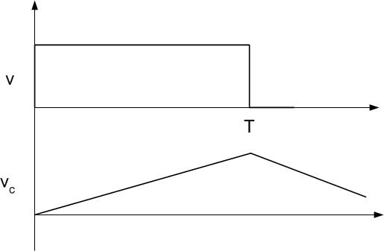
Case 2:
Vc increases gradually
So, |v_{c}| is a small fraction of
V at t = T.
Initial portion of v_{c} is linear
v_{c} integral of V
Integrator
⇒
⇒
EE 101: Introduction to Electrical & Electronics Circuits Prof. B.G.Fernandes
Lecture 4
<number>/20

Slide 15
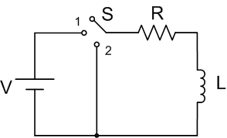
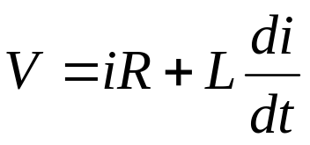
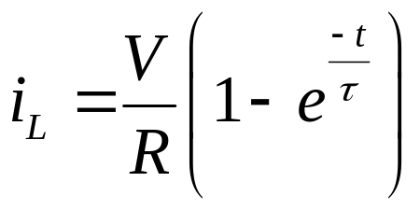
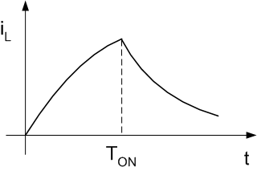
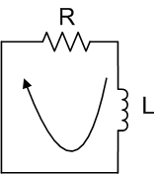
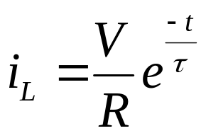
Step response of R-L circuit
‘S’ at 1:
‘S’ at 2:
‘i’ will decay
EE 101: Introduction to Electrical & Electronics Circuits Prof. B.G.Fernandes
Lecture 4
<number>/20

Slide 16









Step response of R-L circuit
at
at
V
At steady state v_{L}
⇒ 0
Steady state is attained at t ≈5τ
At t = T⁺ :
t
⇒ Differentiator
t
Observation: ‘V’ across ‘L’ can
change instantaneously
t
EE 101: Introduction to Electrical & Electronics Circuits Prof. B.G.Fernandes
Lecture 4
<number>/20

Slide 17





Problem:
a) ‘S’ is kept open for long time. ‘S’ is then closed at an instant of time considered to be t = 0 msec. Determine V_{c} & V_{o} at t= 0⁺ if R₁=1kΩ, R₂=1kΩ R₃=2kΩ & I_{s}= 5mA
1μF
Eq circuit when S is open:
I_{s} charges ‘C’
⇒
At Steady state when i_{c}= 0 & i_{R}= 5mA
EE 101: Introduction to Electrical & Electronics Circuits Prof. B.G.Fernandes
Lecture 4
<number>/20

Slide 18






OR
Steady state V_{c} = V = i_{s}R and τ = RC
V_{o} at t = 0₊?
EE 101: Introduction to Electrical & Electronics Circuits Prof. B.G.Fernandes
Lecture 4
<number>/20

Slide 19








b) For t ≥0, find the expressions for V_{o}(t) and V_{c}(t)
V_{c} attains a new value
governed by circuit parameters.
Equivalent circuit at steady state
At steady state
EE 101: Introduction to Electrical & Electronics Circuits Prof. B.G.Fernandes
Lecture 4
<number>/20

Slide 20


c) ‘S’ is again opened at t = 3msec sketch V_{o} for
0 ≤ t≤ 10msec
At t = 3msec, V_{o}=14.4V. When S is opened equivalent
circuit is
v_{o}
V_{o}→ 10 with τ= 4msec
t (msec)
EE 101: Introduction to Electrical & Electronics Circuits Prof. B.G.Fernandes
Lecture 4
<number>/20

