Slide 1
Introduction to Electrical & Electronics Circuits
Course Code: EE 101
Department: Electrical Engineering
Instructor Name: B.G. Fernandes
E-mail id: bgf @ee.iitb.ac.in
EE 101: Introduction to Electrical & Electronics Circuits Prof. B.G.Fernandes
Lecture 5
<number>/19

Slide 2
Sub-Topics:
Time domain response of RL and RC circuit
  Step response of RC circuit
  Step response of RL circuit
Sinusoidal steady state analysis
EE 101: Introduction to Electrical & Electronics Circuits Prof. B.G.Fernandes
Lecture 5
<number>/19

Slide 3
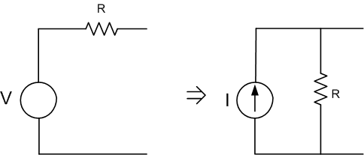
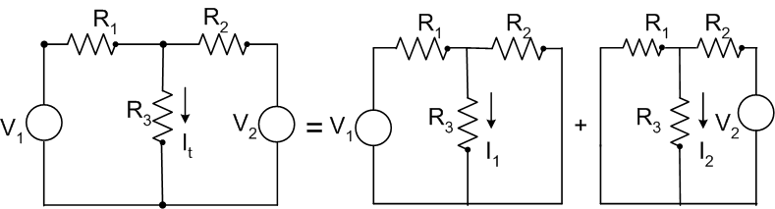
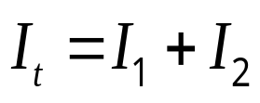
Review
Source conversion:
I=V/R
Super-position theorem:
If x₁ y₁
& x₂ y₂
⇒
For a linear system, if (x₁+x₂) (y₁+y₂)
EE 101: Introduction to Electrical & Electronics Circuits Prof. B.G.Fernandes
Lecture 5
<number>/19

Slide 4
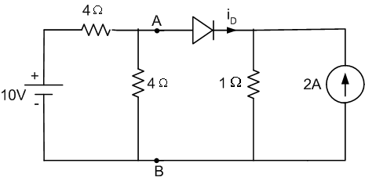
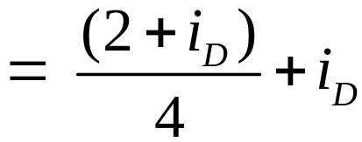
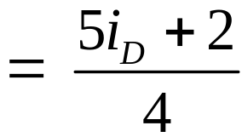
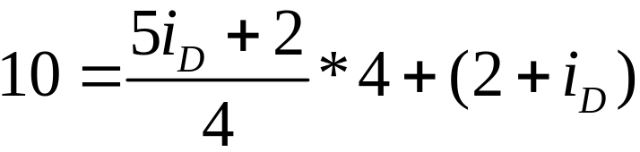

Determine i_{D}
(Assume diode is ideal)
Circuit is non-linear
‘V’ across 1Ω = (2+i_{D}) = V_{AB}
∴ ‘i’ supplied by battery
Applying KVL
EE 101: Introduction to Electrical & Electronics Circuits Prof. B.G.Fernandes
Lecture 5
<number>/19

Slide 5
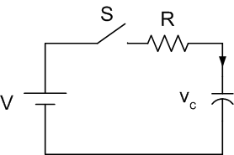
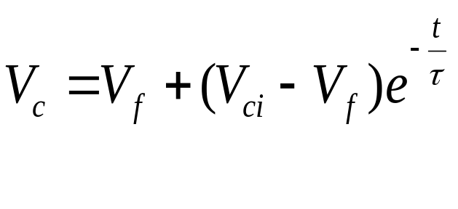
Time domain response of RC and RL circuit
No transients in purely resistive circuit
I cannot change instantaneously in an inductor
V across a capacitor cannot change instantaneously
Step response: DC voltage or current
suddenly applied to the circuit
RC circuit:
where, τ = Time constant
Circuit is assumed to attain steady state at t = 5τ
V_{ci} = capacitor voltage at t = 0, V_{f} is the final value
EE 101: Introduction to Electrical & Electronics Circuits Prof. B.G.Fernandes
Lecture 5
<number>/19

Slide 6
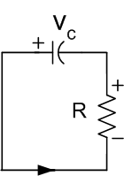
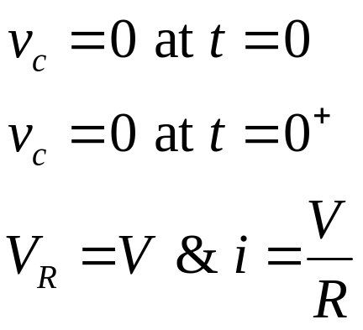
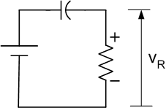
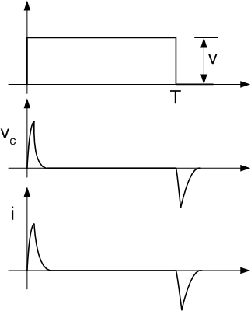
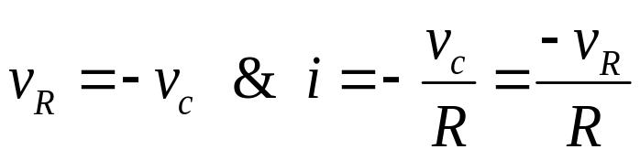
Step response of R-C circuit
Case i)
V
At steady state v_{c}= V, I = 0 ∴ V_{R} = 0
Steady state is attained at t ≈5τ
At t = T⁺
t
t
At steady state, v_{c} and i = 0.
Observation: ‘i’ through ‘C’ can
change instantaneously
t
EE 101: Introduction to Electrical & Electronics Circuits Prof. B.G.Fernandes
Lecture 5
<number>/19

Slide 7
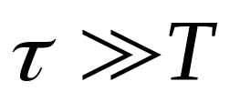
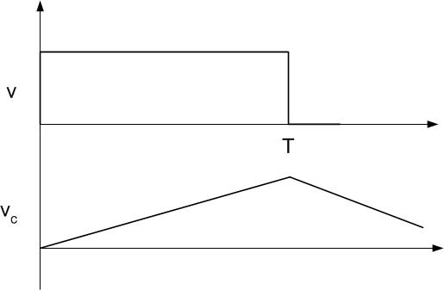
Case 2:
Vc increases gradually
So, |v_{c}| is a small fraction of
V at t = T.
Initial portion of v_{c} is linear
v_{c} integral of V
Integrator
⇒
⇒
EE 101: Introduction to Electrical & Electronics Circuits Prof. B.G.Fernandes
Lecture 5
<number>/19

Slide 8
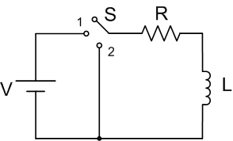
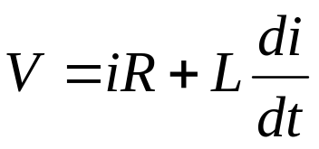
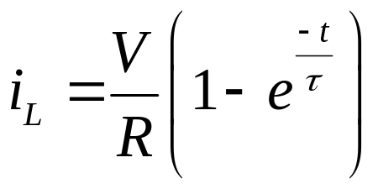
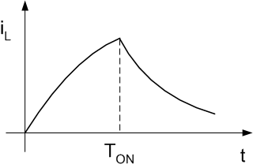
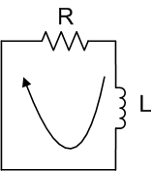
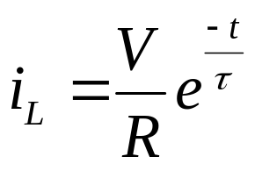
Step response of R-L circuit
‘S’ at 1:
‘S’ at 2:
‘i’ will decay
EE 101: Introduction to Electrical & Electronics Circuits Prof. B.G.Fernandes
Lecture 5
<number>/19

Slide 9

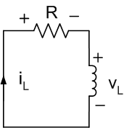
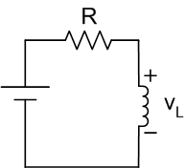


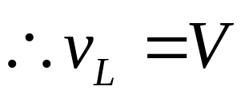

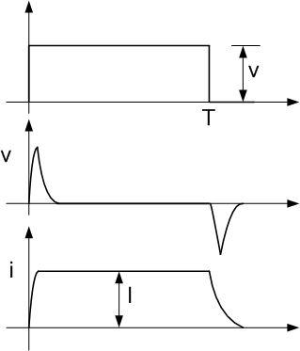
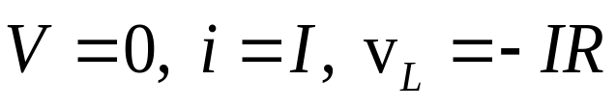
Step response of R-L circuit
at
at
V
At steady state v_{L}
⇒ 0
Steady state is attained at t ≈5τ
At t = T⁺ :
t
⇒ Differentiator
t
Observation: ‘V’ across ‘L’ can
change instantaneously
t
EE 101: Introduction to Electrical & Electronics Circuits Prof. B.G.Fernandes
Lecture 5
<number>/19

Slide 10
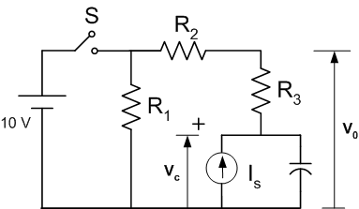
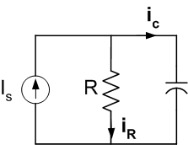
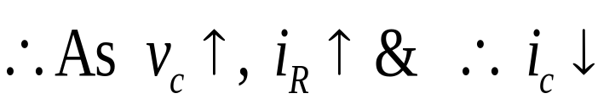
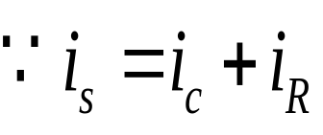

Problem:
a) ‘S’ is kept open for long time. ‘S’ is then closed at an instant of time considered to be t = 0 msec. Determine V_{c} & V_{o} at t= 0⁺ if R₁=1kΩ, R₂=1kΩ R₃=2kΩ & I_{s}= 5mA
1μF
Eq circuit when S is open:
I_{s} charges ‘C’
⇒
At Steady state when i_{c}= 0 & i_{R}= 5mA
EE 101: Introduction to Electrical & Electronics Circuits Prof. B.G.Fernandes
Lecture 5
<number>/19

Slide 11
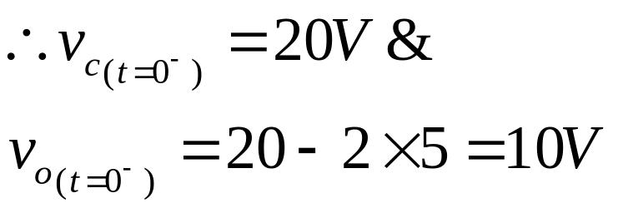
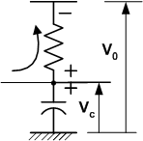
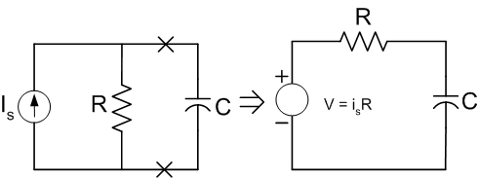
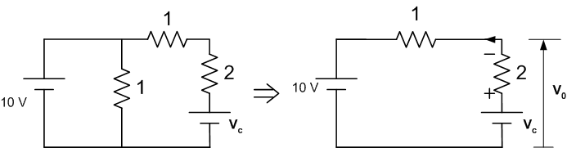
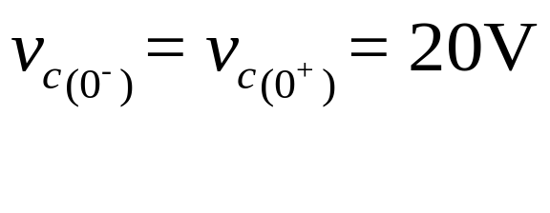
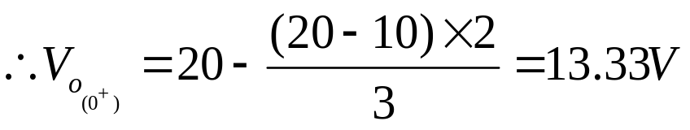
OR
Steady state V_{c} = V = i_{s}R and τ = RC
V_{o} at t = 0₊?
EE 101: Introduction to Electrical & Electronics Circuits Prof. B.G.Fernandes
Lecture 5
<number>/19

Slide 12
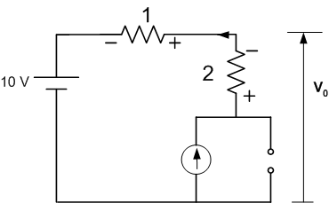
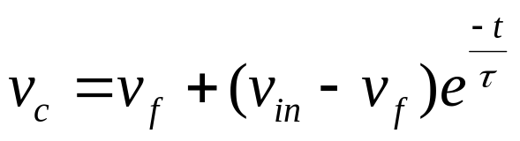

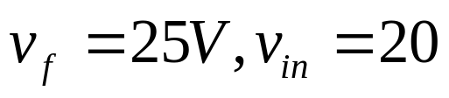

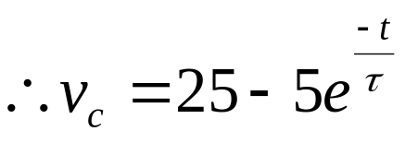
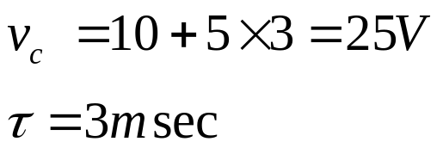
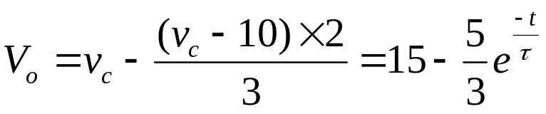
b) For t ≥0, find the expressions for V_{o}(t) and V_{c}(t)
V_{c} attains a new value
governed by circuit parameters.
Equivalent circuit at steady state
At steady state
EE 101: Introduction to Electrical & Electronics Circuits Prof. B.G.Fernandes
Lecture 5
<number>/19

Slide 13
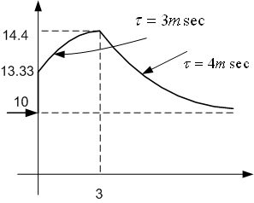
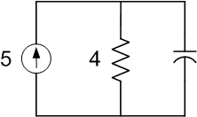
c) ‘S’ is again opened at t = 3msec sketch V_{o} for
0 ≤ t≤ 10msec
At t = 3msec, V_{o}=14.4V. When S is opened equivalent
circuit is
v_{o}
V_{o}→ 10 with τ= 4msec
t (msec)
EE 101: Introduction to Electrical & Electronics Circuits Prof. B.G.Fernandes
Lecture 5
<number>/19

Slide 14

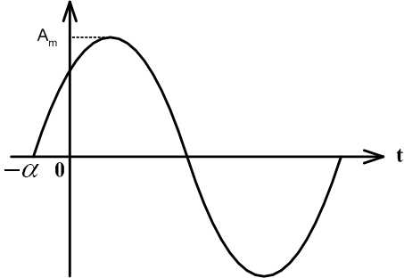
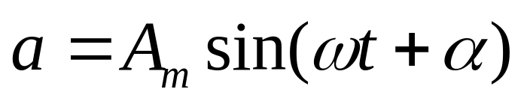

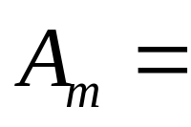

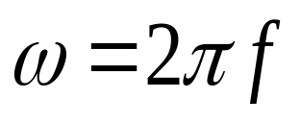

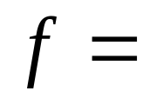
Sinusoidal steady state analysis
Sinusoidal signal :
⇒
Waveform has periodic sinusoidal variation
repeats after
Instantaneous value
Peak value
phase angle (radians)
frequency in rad/sec
frequency in Hz
EE 101: Introduction to Electrical & Electronics Circuits Prof. B.G.Fernandes
Lecture 5
<number>/19
EE 101: Introduction to Electrical & Electronics Circuits B.G.Fernandes

Slide 15






R.M.S. or Effective Value
⇒
Steady value of current effective in converting power
⇒
That current which produces same heating effect as that of DC
Phasor Representation:
In complex plane any vector can be
represented by
⇒
EE 101: Introduction to Electrical & Electronics Circuits Prof. B.G.Fernandes
Lecture 5
<number>/19

Slide 16




⇒
If this phasor is rotating at an angular frequeny
(rad/sec)
⇒
If there are several phasors rotating at same speed
They are stationary w.r.t. each other
need not to appear in the
representation
Represented by their phase angle at some ‘t’
⇒
⇒
⇒
EE 101: Introduction to Electrical & Electronics Circuits Prof. B.G.Fernandes
Lecture 5
<number>/19

Slide 17









Phasor Diagram:
&
rms value
⇒
&
EE 101: Introduction to Electrical & Electronics Circuits Prof. B.G.Fernandes
Lecture 5
<number>/19

Slide 18









Steady state analysis:
Let
or
is applied to series R-L-C circuit
or
be the current
flowing in it
EE 101: Introduction to Electrical & Electronics Circuits Prof. B.G.Fernandes
Lecture 5
<number>/19

Slide 19





EE 101: Introduction to Electrical & Electronics Circuits B.G.Fernandes
EE 101: Introduction to Electrical & Electronics Circuits Prof. B.G.Fernandes
Lecture 5
<number>/19

