Slide 1
COVID-19 Analysis: Trends, Impact, and State-wise Insights
Prepared by Udaykiran

Slide 2
Abstract
This study presents an analysis of COVID-19 case trends, recoveries, deaths, ICU admissions, and state-wise distribution using visual data analysis techniques. It highlights patterns across different timeframes and pandemic waves.

Slide 3
Introduction
COVID-19, caused by the SARS-CoV-2 virus, led to global disruptions.
This project analyzes its impact across time in India using charts and insights:
- Daily new cases trend
- Monthly spikes
- State-wise impact
- Wave-wise comparison of deaths, recoveries, and ICU admissions.

Slide 4
System Requirements
Hardware:
- Laptop/Desktop with 4GB+ RAM
Software:
- Python 3.x
- Jupyter Notebook or Google Colab
Libraries:
- pandas
- matplotlib
- seaborn

Slide 5
Architecture
1. Data Collection (CSV format)
2. Data Cleaning and Preprocessing (using Pandas)
3. Visualization (Line charts, Pie charts)
4. Insight Extraction (Pattern and trend analysis)

Slide 6
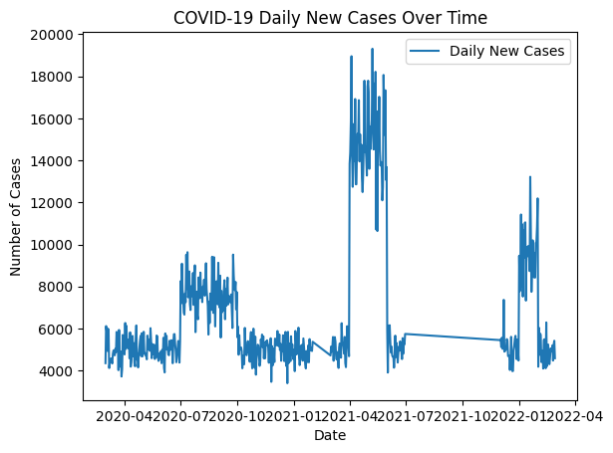
Chart 1 : Number of new cases increase and decrease for all dates
k
The cases increased and decreased sharply, indicating the start and end of different COVID-19 waves.

Slide 7
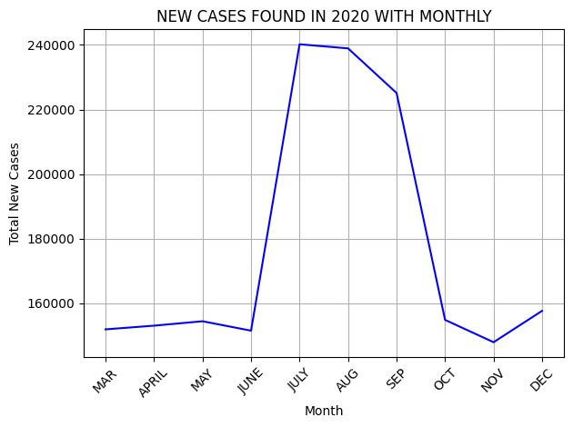
Chart 2: Monthly COVID-19 Case Trends in 2020 – Total New Cases Per Month
-
Insights from the Chart:
- Gradual Start (Mar – Jun 2020)
- Sharp Rise (Jul – Sep 2020)
- Sudden Decline (Oct – Nov 2020)

Slide 8
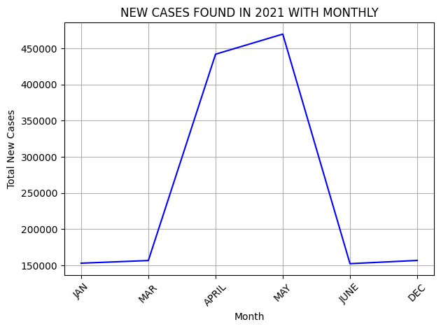
Chart 3: Monthly COVID-19 Case Surge in 2021 – Second Wave Impact Analysis
Insights from the Chart:
- Early 2021 (Jan–Mar)
- Sudden Surge (April – May)
- Rapid Decline (June)
- Data Gaps or Inactivity (Jul–Nov Missing)
- December shows a slight increase, stabilizing again near 160,000.

Slide 9
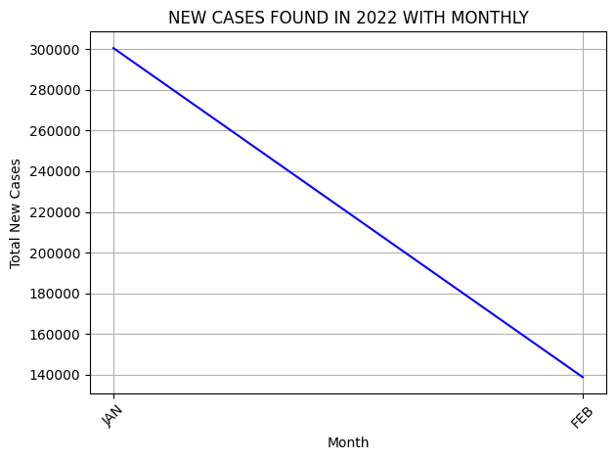
Chart 4 : Rapid Decline of COVID-19 Cases in Early 2022 – Monthly Comparison
Insights from the Chart:
- January 2022 saw a very high spike, with over 300,000 total cases.
- February shows a drastic decline to ~140,000 cases.
- That's over a 50% reduction compared to January.

Slide 10
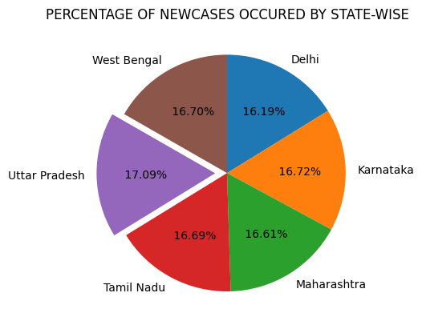
Chart 5 : State-wise Distribution of COVID-19 New Cases – Percentage Share Among Major States
Insights from the Chart:
- Uniform Spread Across States
- Uttar Pradesh at the Top
- Other major contributors include:

Slide 11
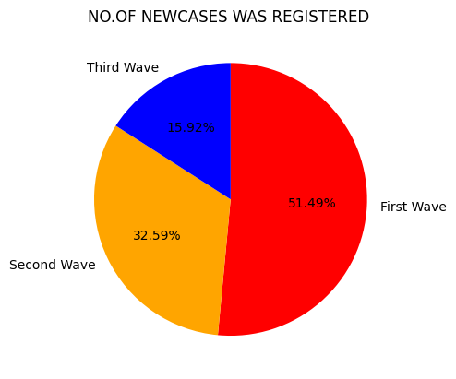
Chart 6 : COVID-19 New Case Distribution Across Waves (Wave-wise Comparison)
Insights from the Chart:
- First Wave (51.49%) – The Largest Impact
- Second Wave (32.59%) – A Severe But Shorter Spike
- Third Wave (15.92%) – Least Severe

Slide 12
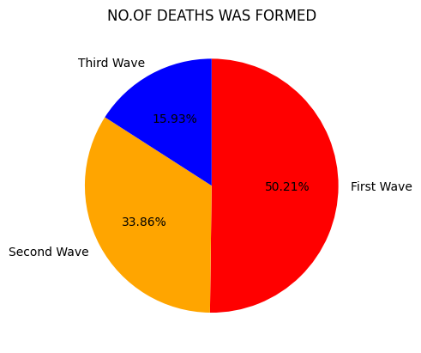
Chart 7 : Wave-wise Distribution of COVID-19 Deaths in India
Insights from the Chart:
- First Wave – 50.21% of Total Deaths
- Second Wave – 33.86% of Total Deaths
- Third Wave – 15.93% of Total Deaths

Slide 13
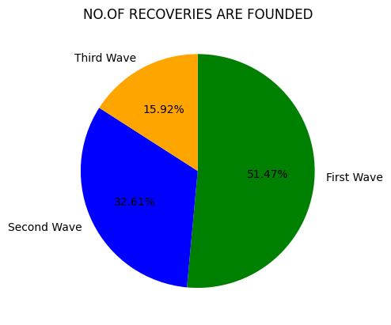
Chart 8 : Wave-wise Recovery Distribution During COVID-19 in India
Insights from the Chart:
- First Wave – 51.47% of Total Recoveries
- Second Wave – 32.61% of Recoveries
-Third Wave – 15.92% of Recoveries

Slide 14

Chart 9: Wave-wise ICU Admissions During the COVID-19 Pandemic in India
Insights from the Chart:
- First Wave – 51.36% of ICU Admissions
- Second Wave – 32.74% of ICU Admissions
- Third Wave – 15.90% of ICU Admissions

Slide 15
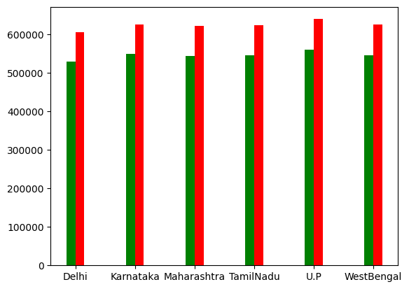
Chart 10: To show deaths and recoveries in state-wise
Red: Deaths
Greeen: Recoveries

Slide 16
Uses of Data Analysis Libraries
- pandas: Data manipulation and handling missing values
- matplotlib: Line and pie chart visualizations
- seaborn: Trend plotting and distribution visualization
- Helped uncover wave patterns, state-wise impacts, and ICU strain

Slide 17
Advantages
- Easy to understand trends visually
- Wave comparison for strategic planning
- Quick state-wise identification of case hotspots
- Supports healthcare resource management

Slide 18
Conclusion
- First wave had the longest and highest impact.
- Second wave was deadlier with high ICU and death rates.
- Third wave was mild due to vaccination and prior immunity.
- Visualization simplifies understanding of pandemic progression.
- Thank you

