Slide 1

SpeakUp
AI-powered placement preparation for every student
PRESENTED BY
SpeakUp Labs Team

Slide 2

Problem
  Students fail interviews due to:
    Lack of communication practice
    No structured feedback
    No realistic interview simulation
  Coaching is:
    Expensive
    Not scalable
    Inaccessible to Tier-2/3 colleges

Slide 3
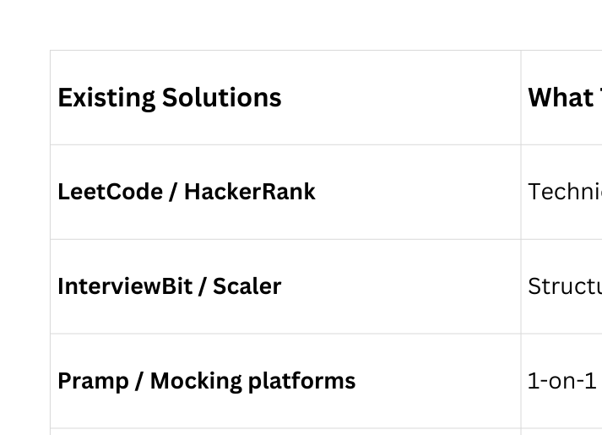
Existing Solutions & Gaps
Existing Solutions | What They Do Well | What They Lack
LeetCode / HackerRank | Technical coding practice | ❌ Communication ❌ Interviews ❌ GD
InterviewBit / Scaler | Structured content | ❌ Personalized feedback ❌ Cost
Pramp / Mocking platforms | 1-on-1 interviews | ❌ Scalability ❌ GD simulation
Resume scanners | ATS keyword checks | ❌ Interview linkage
Most platforms | Interviews OR aptitude | ❌ No Group Discussion practice

Slide 4

Solution Overview
  SpeakUp is an AI-powered practice ecosystem
  Designed to:
    Simulate real placement scenarios
    Provide structured, actionable feedback
    Build confidence through repetition
  Built by students, for students

Slide 5
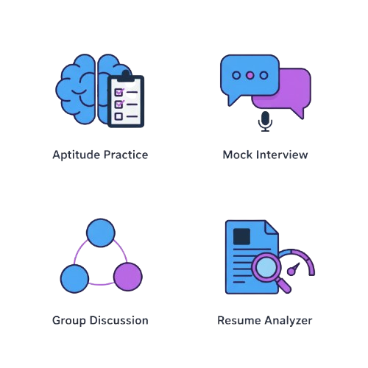
Core Modules

Slide 6

Aptitude Arena
  Quantitative • Logical • Verbal
  AI-generated questions + explanations
  Instant scoring + review mode
  Progress tracking over time

Slide 7

Mock Interview
  HR / Technical / Job-role modes
  Resume-aware interviewing option
  Difficulty progression
  End-to-end feedback scorecard
  “Teach Me” coaching per question

Slide 8

GD Simulator
  3 AI bots with unique personalities
  User debates in real-time
  Difficulty levels (easy/moderate/competitive)
  AI moderator feedback + scores

Slide 9

Resume Analyzer
  Upload PDF resume
  Azure Document Intelligence extracts content
  AI ATS scoring + keyword suggestions
  What recruiters “actually see”

Slide 10
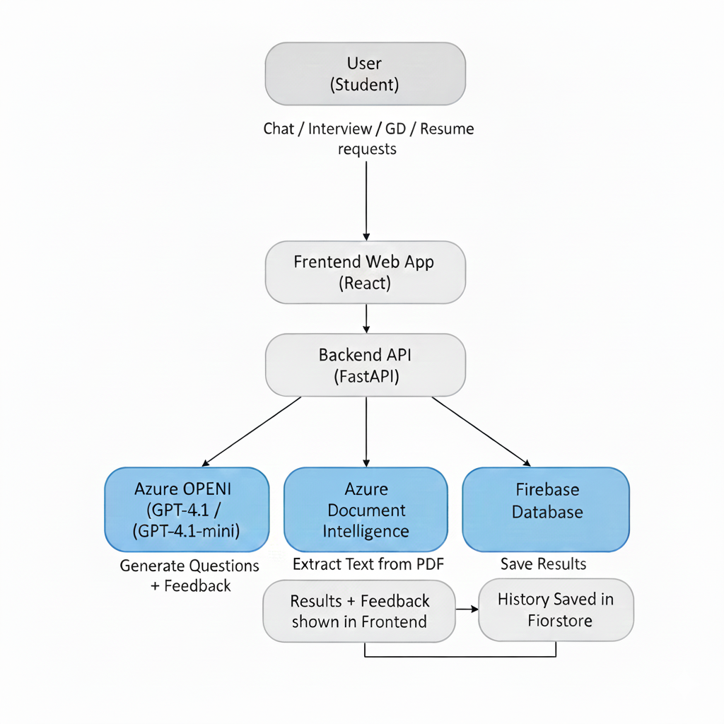
Technology Stack
  Azure OpenAI (GPT-4.1 / GPT-4.1-mini)
  Azure Document Intelligence
  Firebase Authentication + Firestore
  React + TypeScript + Tailwind
  FastAPI backend

Slide 11

Impact & Target Users
  Tier-2/3 students lack guidance & practice
  SpeakUp gives equal access to interview coaching
  Builds communication + confidence
  Directly improves employability

Slide 12
MVP & Roadmap
MVP Today
(Working Now)
🎙️Next Big Upgrade
  Text-based Interview + GD + Aptitude + Resume
  Real AI feedback & scoring
  Firebase Auth + Firestore saving results
  Dashboard metrics + history tracking
  Voice-based interviews & GD
  Speech metrics (pace, fluency, filler words, confidence)
  “Real room” experience via orbs

Slide 13
Why Imagine Cup?
  Education & Employability: Directly improves student outcomes
  Inclusive AI: Affordable access regardless of background
  Practical Impact: Solves a real, current problem
  Scalable Vision: Can grow beyond a college project

Slide 14

Thank You!
Empowering students to speak up with confidence.

