Slide 1

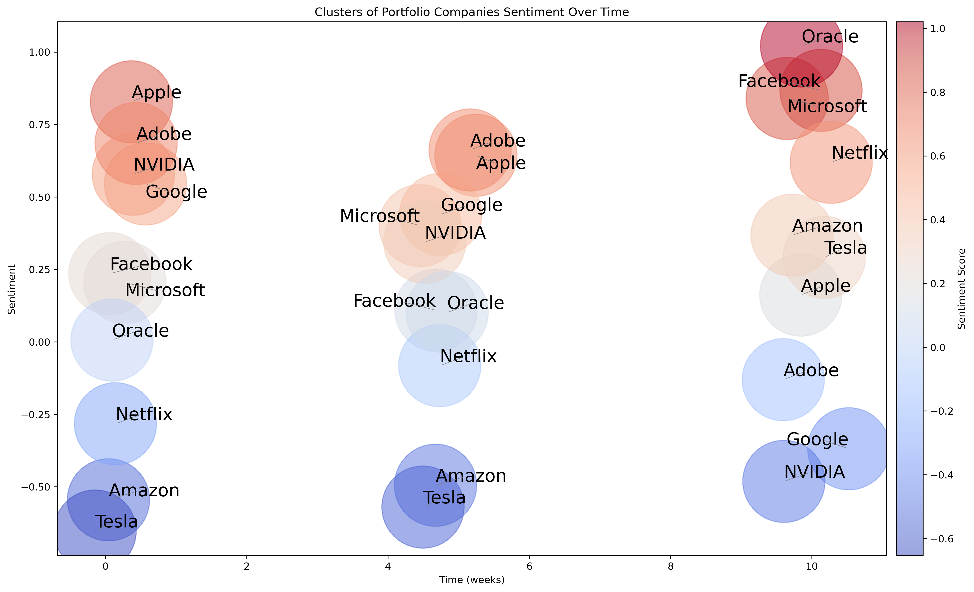
Embracing Public Sentiment: A New Dimension in Equity Portfolio Management
Uday A, Surya K, Dhrithi A, Akhil N
Instructor: Rong Liu
Business Intelligence & Analytics
Objectives
Leverage public sentiment analysis to identify emerging trends and market shifts
Detect early warnings about market changes and potential crises
Augment technical analysis with granular sentiment analysis on each equity for a robust risk management strategy
Technology
Python libraries like Beautiful Soup, Selenium and Scrapy to extract relevant information from websites
Visualization libraries like Matplotlib and Plotly to create compelling visual representations
Libraries like SpaCy and PyTorch for tokenization, feature extraction, model development and optimization
Current & Future developments
Employ web scraping tools to extract relevant data from financial news websites, and social media platforms
Utilize cutting-edge NLP techniques such as recurrent neural networks, transformers and hyperparameter tuning
Analyze and process textual data from various sources to derive sentiment scores
Employ machine learning and deep learning techniques to classify and score sentiment data
Employ advanced visualization techniques, such as heatmaps, network graphs, and sentiment score plots
Leverage cloud-based solutions and distributed computing technologies for scalability
Containerization technologies like Docker to package and deploy the project's components
Ensure the project remains efficient and reliable as data volume and complexity increase
Adapt to changes in market conditions, data sources, and investment strategies
Incorporate feedback and new insights to continuously enhance the project's effectiveness
http://www.stevens.edu/howe/academics/graduate/business-intelligence-analytics

