Slide 1
Employee Payroll
Management System
Chinni Bhanu Prakash
Kondapali Uday Kumar

Slide 2
Problem Statement & Objectives
Problem Statement - An organization needs a reliable database to manage employee details, departments, attendance and monthly payroll. Manual records make salary calculations, attendance tracking, deductions and reporting difficult. The system organizes payroll data, maintains history and supports accurate HR and finance reports.
Objectives:
To design an efficient Employee Payroll database.
To manage employee and department information.
To record daily attendance and overtime.
To calculate monthly salaries using allowances and deductions.
To maintain payroll history and payment status.
To generate useful employee and salary reports.

Slide 3
Database Design
DEPARTMENTS (DEPT_ID PK, DEPT_NAME, LOCATION)
EMPLOYEES (EMP_ID PK, EMP_NAME, PHONE, EMAIL, JOB_TITLE, HIRE_DATE, BASIC_SALARY, DEPT_ID FK, EMPLOYMENT_STATUS)
ATTENDANCE (ATTENDANCE_ID PK, EMP_ID FK, ATTENDANCE_DATE, ATTENDANCE_STATUS, OVERTIME_HOURS)
PAYROLL (PAYROLL_ID PK, EMP_ID FK, PAY_MONTH, BASIC_SALARY, ALLOWANCES, DEDUCTIONS, NET_SALARY, PAYMENT_DATE, PAYMENT_STATUS)

Slide 4
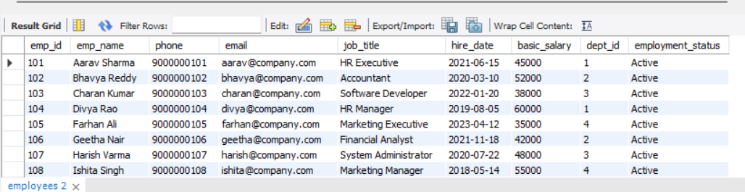
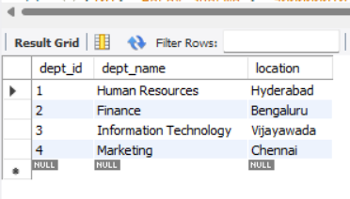
Sample Data
CREATE TABLE Departments
(DEPT_ID INT PRIMARY KEY,
DEPT_NAME VARCHAR(50),
LOCATION VARCHAR(30));
CREATE TABLE Employees
(EMP_ID INT PRIMARY KEY, EMP_NAME VARCHAR(50),
PHONE VARCHAR(15), EMAIL VARCHAR(60), JOB_TITLE VARCHAR(40),
HIRE_DATE DATE, BASIC_SALARY DECIMAL(10,2),
DEPT_ID INT, EMPLOYMENT_STATUS VARCHAR(20),
FOREIGN KEY (DEPT_ID) REFERENCES Departments(DEPT_ID));

Slide 5
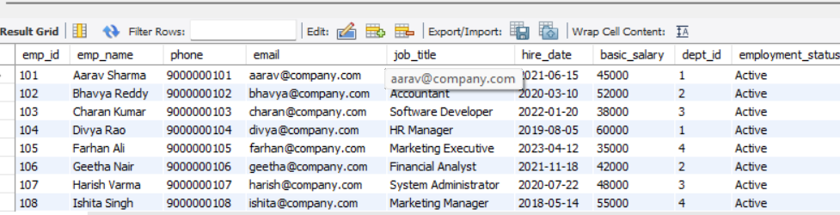
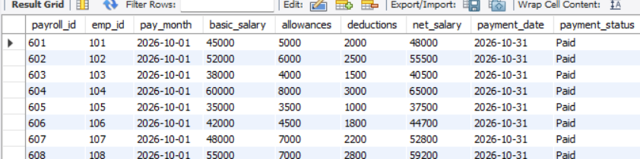
CREATE TABLE Attendance
(ATTENDANCE_ID INT PRIMARY KEY,
EMP_ID INT, ATTENDANCE_DATE DATE,
ATTENDANCE_STATUS VARCHAR(20),
OVERTIME_HOURS DECIMAL(4,1),
FOREIGN KEY (EMP_ID) REFERENCES Employees(EMP_ID));
CREATE TABLE Payroll
(PAYROLL_ID INT PRIMARY KEY, EMP_ID INT,
PAY_MONTH DATE, BASIC_SALARY DECIMAL(10,2),
ALLOWANCES DECIMAL(10,2), DEDUCTIONS DECIMAL(10,2),
NET_SALARY DECIMAL(10,2), PAYMENT_DATE DATE,
PAYMENT_STATUS VARCHAR(20),
FOREIGN KEY (EMP_ID) REFERENCES Employees(EMP_ID));

Slide 6
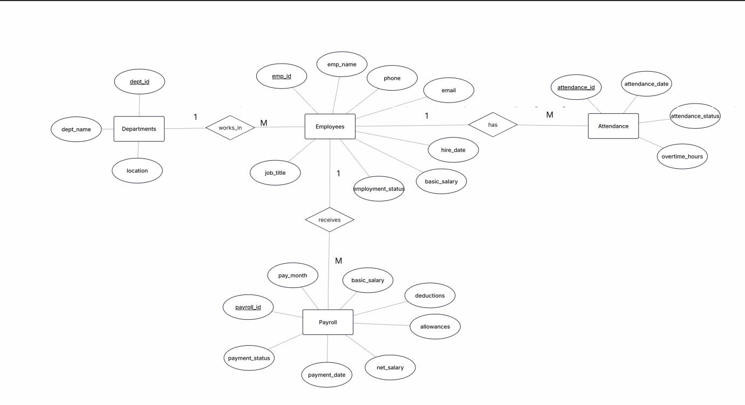
ER Diagram

Slide 7
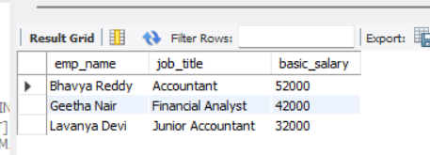
CRUD Operations queries
C – CREATE (INSERT) – Add payroll employee records
INSERT INTO Employees VALUES
(101,'Aarav Sharma','9000000101','aarav@company.com','HR Executive','2021-06-15',45000,1,'Active'),
(102,'Bhavya Reddy','9000000102','bhavya@company.com','Accountant','2020-03-10',52000,2,'Active');
R – READ (SELECT) – Retrieve employees
SELECT emp_name, job_title, basic_salary
FROM Employees
WHERE dept_id = 2;

Slide 8
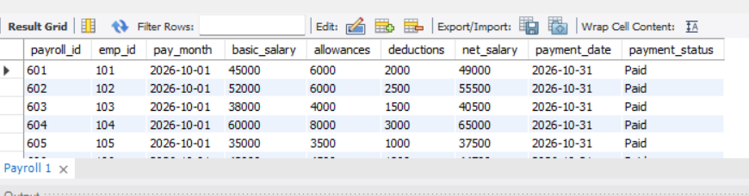
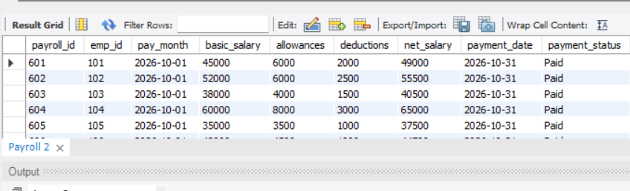
CRUD Operations queries
U – UPDATE – Modify payroll details
UPDATE Payroll
SET allowances = allowances + 1000,
net_salary = net_salary + 1000
WHERE payroll_id = 601;
D – DELETE – Remove a pending payroll record
DELETE FROM Payroll
WHERE payroll_id = 609 AND payment_status = 'Pending';

Slide 9
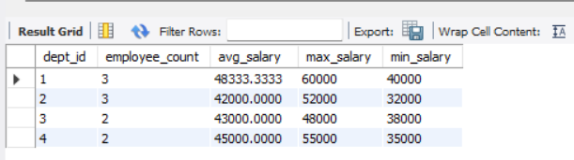
Aggregate functions queries
Aggregate functions perform calculations on multiple rows and return a single value per group.
• COUNT() – Counts records.
• SUM() – Adds values.
• AVG() – Calculates average.
• MAX() – Returns highest value.
• MIN() – Returns lowest value.
SELECT dept_id, COUNT(*) AS employee_count,
AVG(basic_salary) AS avg_salary,
MAX(basic_salary) AS max_salary,
MIN(basic_salary) AS min_salary
FROM Employees
GROUP BY dept_id;

Slide 10
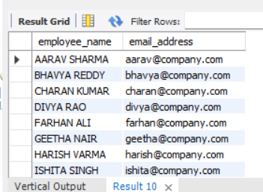
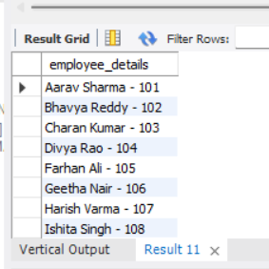
String functions queries
String functions transform text values in database columns.
• UPPER() – Converts text to uppercase.
• LOWER() – Converts text to lowercase.
• CONCAT() – Combines strings.
• LENGTH() – Returns string length.
• LEFT() – Extracts characters from the beginning.
SELECT UPPER(emp_name) AS employee_name,
LOWER(email) AS email_address
FROM Employees;
SELECT CONCAT(emp_name, ' - ', emp_id) AS employee_details
FROM Employees;
SELECT LENGTH(emp_name) AS name_length,
LEFT(emp_name, 4) AS name_prefix
FROM Employees;

Slide 11
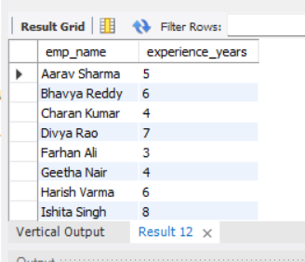
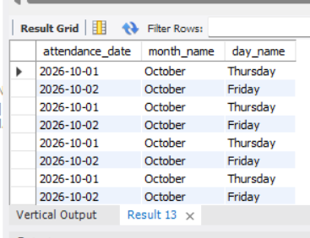
Date functions queries
Date functions retrieve and calculate date/time values.
• CURDATE() – Current date.
• NOW() – Current date and time.
• DAYNAME() – Weekday name.
• MONTHNAME() – Month name.
• TIMESTAMPDIFF() – Difference between dates.
SELECT emp_name,
TIMESTAMPDIFF(YEAR, hire_date, CURDATE()) AS experience_years
FROM Employees;
SELECT attendance_date,
MONTHNAME(attendance_date) AS month_name,
DAYNAME(attendance_date) AS day_name
FROM Attendance;

Slide 12
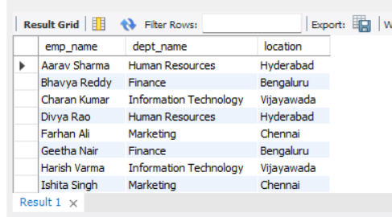
Joins
Used to combine data from two or more tables based on a related column between them.
INNER JOIN - Only matching records
LEFT JOIN - All left + matching right
RIGHT JOIN - All right + matching left
FULL JOIN - All matching and non-matching records
CROSS JOIN - All possible combinations
SELF JOIN - Joins a table with itself
SELECT e.emp_name, d.dept_name, d.location
FROM Employees e
INNER JOIN Departments d
ON e.dept_id = d.dept_id;

Slide 13
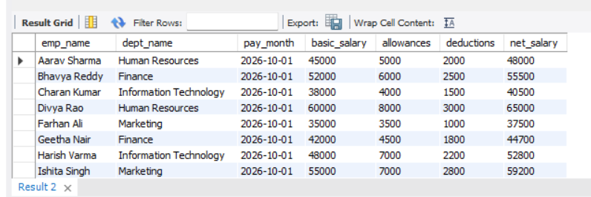
Multiple Joins
Multiple joins allow you to combine data from more than one table in a single query.
select e.emp_name, d.dept_name, p.pay_month, p.basic_salary, p.allowances, p.deductions, p.net_salary from employees e
join Departments d ON e.dept_id = d.dept_id JOIN Payroll p ON e.emp_id = p.emp_id;

Slide 14
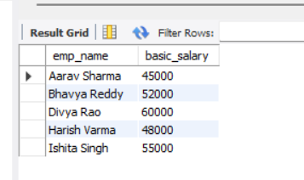
Sub Queries
A Subquery is a query written inside another SQL query. The result of the inner query is used by the outer query to retrieve or manipulate data.
Single-Row Subquery – Returns only one row from the inner query
Multiple-Row Subquery – Returns more than one row from the inner query.
Correlated Subquery – Depends on the outer query and executes logically for each row processed by it.
SELECT emp_name, basic_salary
FROM Employees
WHERE basic_salary >
(SELECT AVG(basic_salary)
FROM Employees);

Slide 15
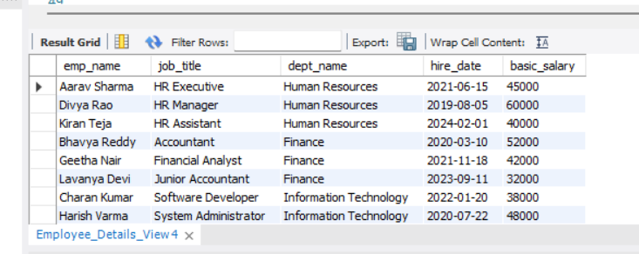
Views
Views in SQL are virtual tables created using SQL queries. They display data from one or more existing tables without storing the actual data separately. Views help simplify complex queries and provide easy access to specific data.
CREATE VIEW Employee_Details_View AS
SELECT e.emp_name, e.job_title,
d.dept_name, e.hire_date, e.basic_salary
FROM Employees e
JOIN Departments d ON e.dept_id = d.dept_id;
SELECT * FROM Employee_Details_View;

Slide 16
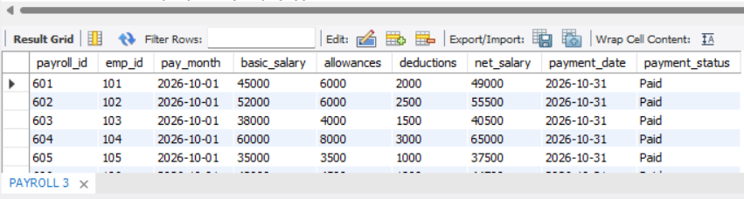
Transaction Control Language
Used to manage database transactions.
COMMIT – Permanently saves all changes made in a transaction.
ROLLBACK – Undoes changes made in the current transaction that have not been committed.
SAVEPOINT – Creates a temporary point within a transaction to which we can roll back.
start transaction;
update payroll set allowances = allowances + 2000 , net_salary = net_salary + 2000 where emp_id = 107;
savepoint sp1;
update payroll set allowances = allowances + 2000 , net_salary = net_salary + 2000 where emp_id = 109;
rollback to sp1;
commit;

Slide 17
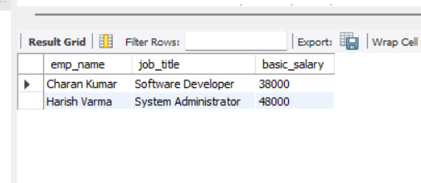
Stored Procedures
A stored procedure is reusable SQL code saved in the database. It can accept parameters and execute a sequence of SQL statements when called.
DELIMITER //
CREATE PROCEDURE Get_Employees_By_Dept(IN p_dept_id INT)
BEGIN
SELECT emp_name, job_title, basic_salary
FROM Employees
WHERE dept_id = p_dept_id;
END //
DELIMITER ;
CALL Get_Employees_By_Dept(2);

Slide 18
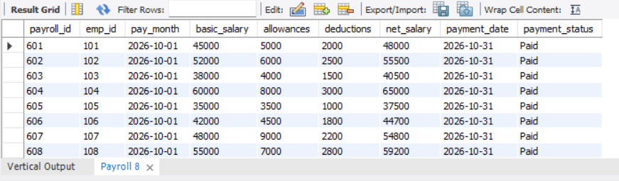
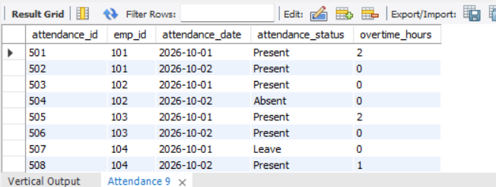
Triggers
A trigger is a database object that automatically runs when an INSERT, UPDATE or DELETE operation occurs. Triggers can automate defaults and help maintain data consistency.
(emp_id, pay_month, basic_salary, allowances, deductions, net_salary)
VALUES
(101, '2026-11-01', 30000, NULL, 2000, 30000);
SELECT * FROM Payroll;
INSERT INTO Attendance
(emp_id, attendance_date, attendance_status, overtime_hours)
VALUES
(101, '2026-11-09', NULL, 0);
SELECT * FROM Attendance;

Slide 19
THANK YOU

