Slide 1



NAAC Accredited B++ Grade
NIETM Chatbot
Presented By:-
Mr. Uday I. Lahane
Mr. Rohit M. Lohokar
Mr. Aman N. Gawai
Mr. Dhiraj M. Raut
Department of :-
CSE (AIML)

Slide 2
Index
Introduction
Problem Statement Methodology
Flowchart
Technology
Features
Result Conclusion

Slide 3
Introduction
What is a Chatbot?
This project aims to develop a college enquiry Chabot that answers any queries post by students like college details, course-related questions, location of the college, fee structure etc.
The College Chatbot is a Python-based chatbot that utilizes machine learning algorithms and natural language processing (NLP) techniques to provide automated assistance to users with college-related inquiries.
The chatbot aims to improve the user experience by delivering quick and accurate responses to their questions.
Why is Chatbot Important?
Chatbot System is a web application that provides answers to the query.
The user does not have to personally go to the college for enquiry.
What is scope of Chatbot?
The chatbot provides information about courses, departments, fee structure, admissions, campus facilities, events, placements, and contact details.
It supports text-based conversations and can be deployed on a website or internal portal.

Slide 4
Problem Statement
Students need quick information about admissions, fees, cources, and facilities.
Staff cannot respond to all queries and all time.
An automated enquiry chatbot is required which will be available for 24/7.

Slide 5
Methodology
The development of the College Enquiry Chatbot follows a systematic methodology to ensure that the chatbot is accurate, user-friendly, and capable of responding to various college-related queries. The methodology is divided into several phases as described below:
Requirement Analysis
Data Collection
Technology Selection
Chatbot design
Deployment

Slide 6
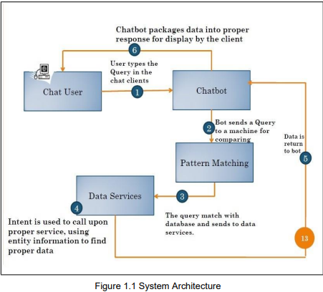
System Architecture

Slide 7
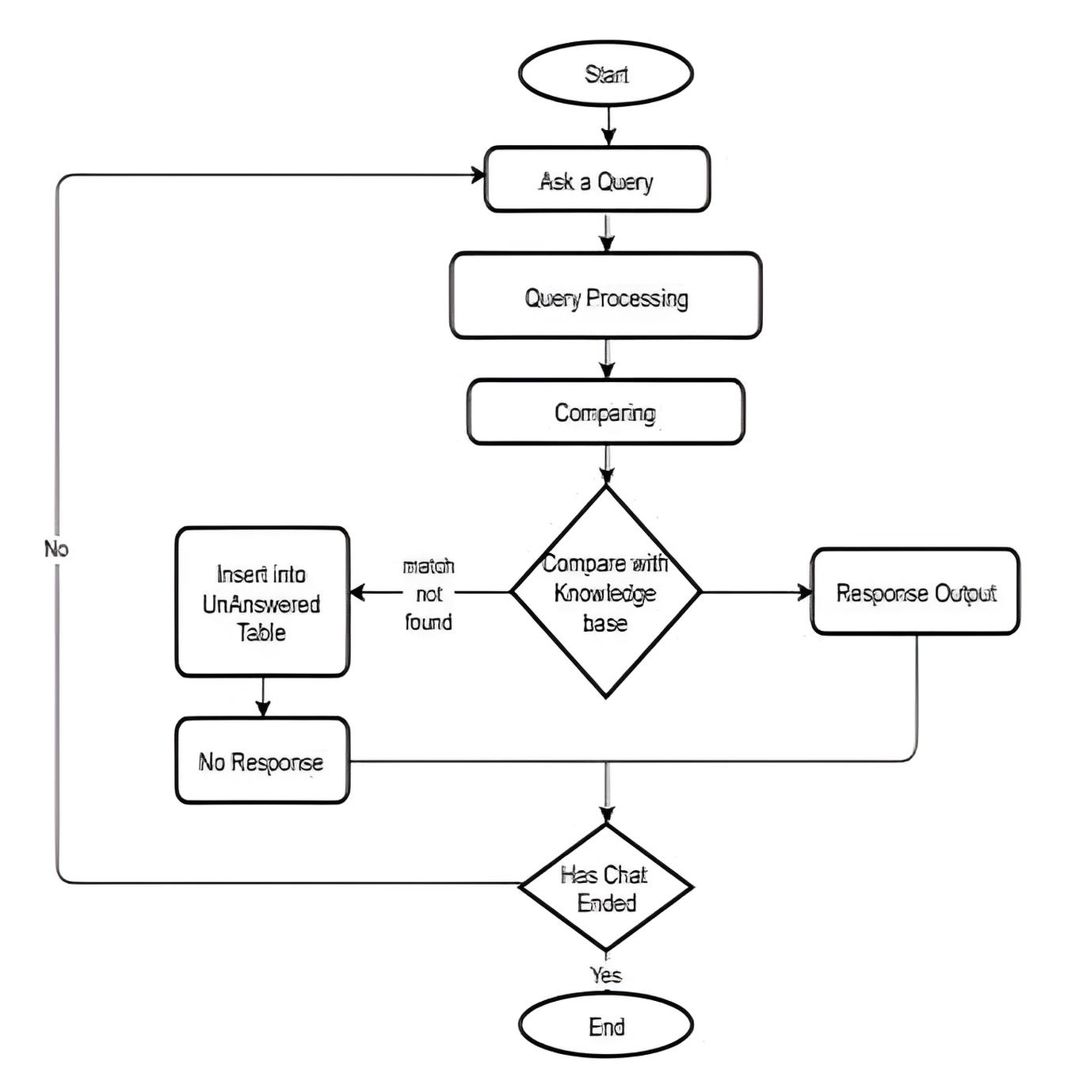
FLOWCHART
The flowchart explains the step-by-step NIETM chatbot process.

Slide 8
Technology Used
System Requirements
Hardware Requirements
Minimum:
CPU: Intel Core i5 / AMD Ryzen 5
RAM: 8 GB
Storage: 50 GB HDD/SSD
GPU: Integrated or entry-level GPU (limited performance)
Software Requirements
Programming Language: Python 3.7+
Libraries:
NLP&AI models– For extracting details
NumPy / Pandas – For data handling
Matplotlib / Seaborn – For visualization
Development Environment: Jupyter Notebook, VS Code, or PyCharm
Package Manager: pip / conda
FRONTEND
HTML
CSS
JavaScript
BACKEND
Python
DATABASE
SQL & SQLITE 3

Slide 9
Features
Admission Enquiry
Cource Details
Fees Information
Placement details
Scholarship
Hostel
Campus

Slide 10
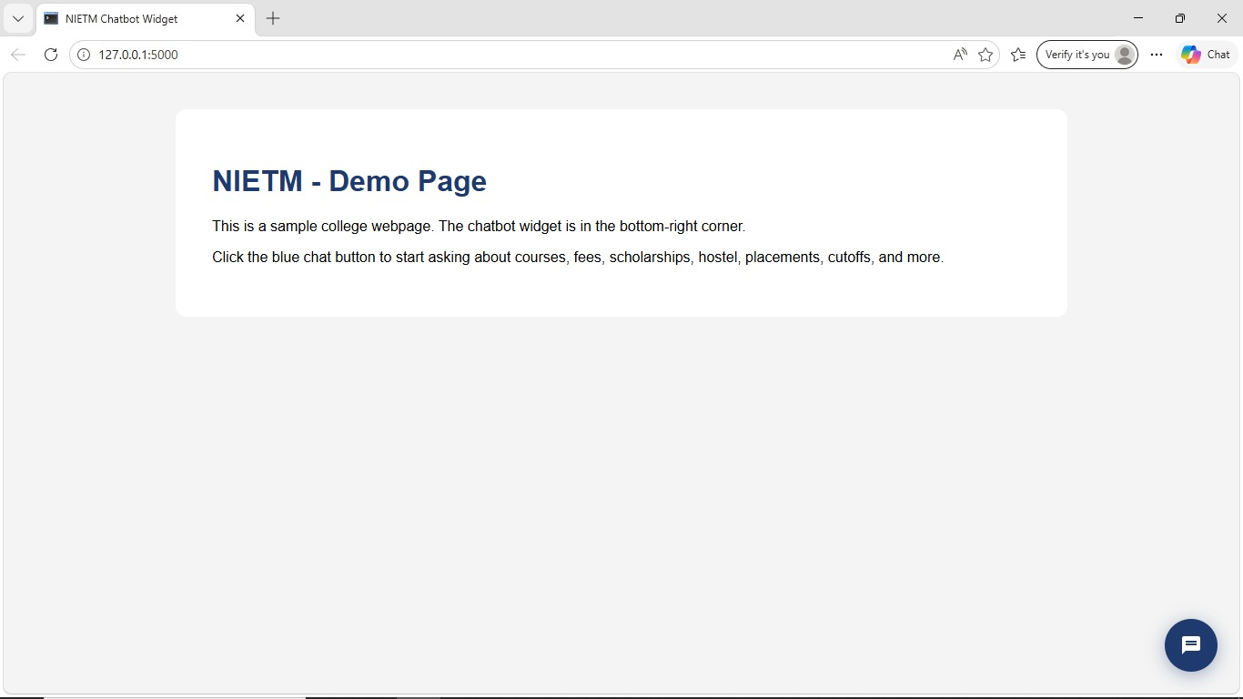
Result

Slide 11
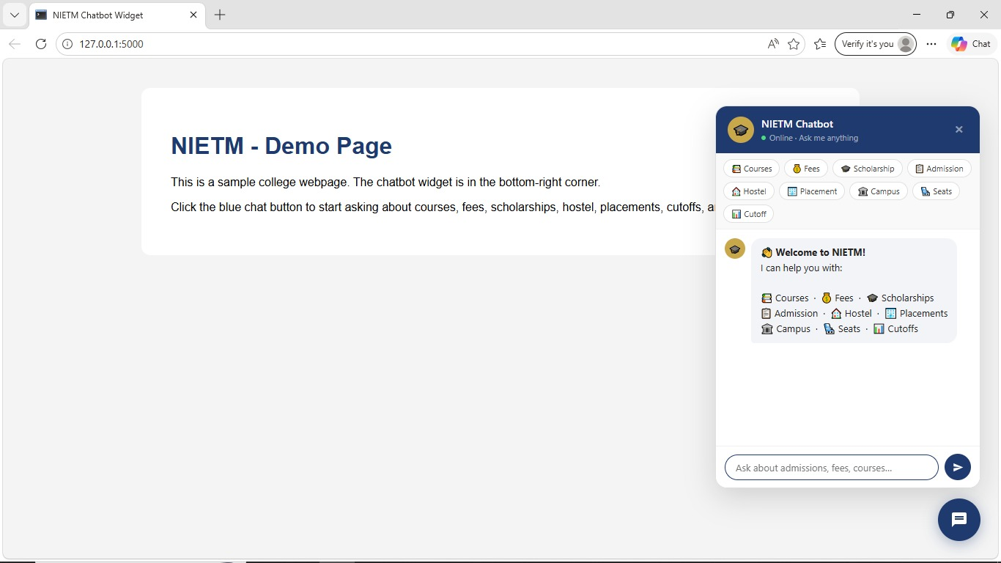
Result

Slide 12
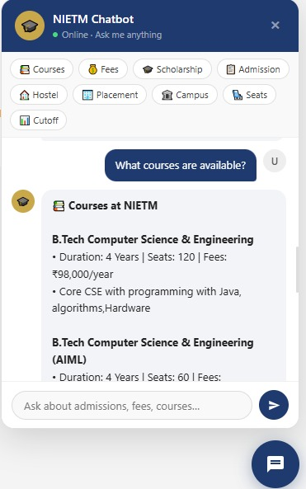
Result

Slide 13
Conclusion
Chatbots improve communication between college and student.
It reduces the manual workload and provides 24/7 accessible platform.
Provides quick and reliable information.
Useful for modern digital campuses.

Slide 14
THANK YOU

