Slide 1

Carbon Reporting & CO₂ Reduction Strategies
Python Project Part II
Vamshi Varaganti(110090)
Uday Maduri(110310)
Course: Python Programming - Fundamentals
Professor: Mr. Brunno Vanelli

Slide 2
Project idea
Electricity use creates CO₂ emissions
CO₂ depends on when electricity is used (grid is clean/dirty at different times)
We calculated:
  Baseline CO₂ emissions
  Sampling accuracy (hourly vs 15-min)
  Reduction strategies

Slide 3
Data used
Electricity consumption (University) → hourly
Carbon intensity (German grid) → 15-minute
We combined both to calculate CO₂ emissions

Slide 4
Key challenge: different time resolution
Consumption is hourly
Carbon intensity is 15-minute
So we created a high-resolution reference dataset
We used interpolation to align timings

Slide 5
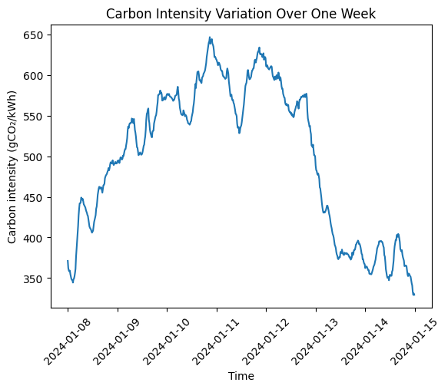
High-resolution reference dataset (Plot)
The plot shows 15-minute carbon intensity data over one representative week
It highlights strong temporal fluctuations within and across days
These variations would be missed with hourly or daily averages
This justifies the use of a high-resolution reference dataset for emissions analysis

Slide 6
Task 1: Is hourly sampling accurate enough?
Many buildings only have hourly meters
We compared:
  CO₂ using 15-min baseline
  CO₂ using hourly data

Slide 7
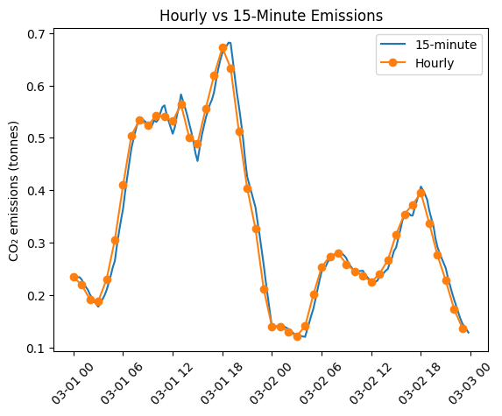
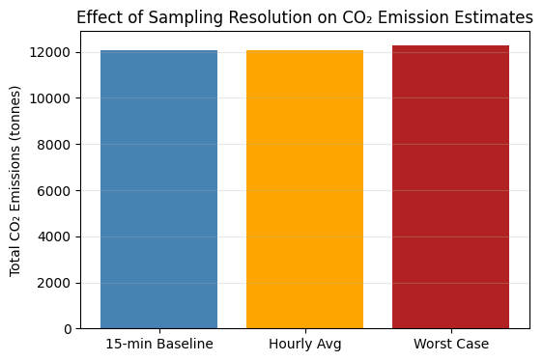
Hourly vs 15-min CO₂ (Plot)
Worst-case error scenario (Plot)
Still error is not very high
The estimated CO₂ emissions increase by approximately 1.9%.
Conclusion: hourly is reliable in real use
Result: Hourly and 15-min emissions are almost same
So hourly data is good enough for reporting

Slide 8
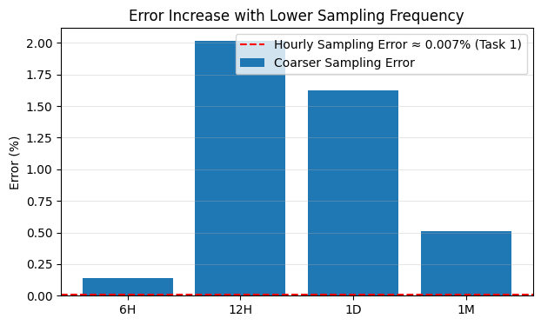
Task 2: What if data is not hourly (example: 6H / 12H / daily)?
Lower resolution → higher error
Best is hourly

Slide 9
Task 3: On-site solar generation
PVGIS provides solar power, we converted it to energy (kWh)
Then we calculated CO₂ savings
PV installation avoids approximately 20.6 tonnes of CO₂ emissions per year

Slide 10
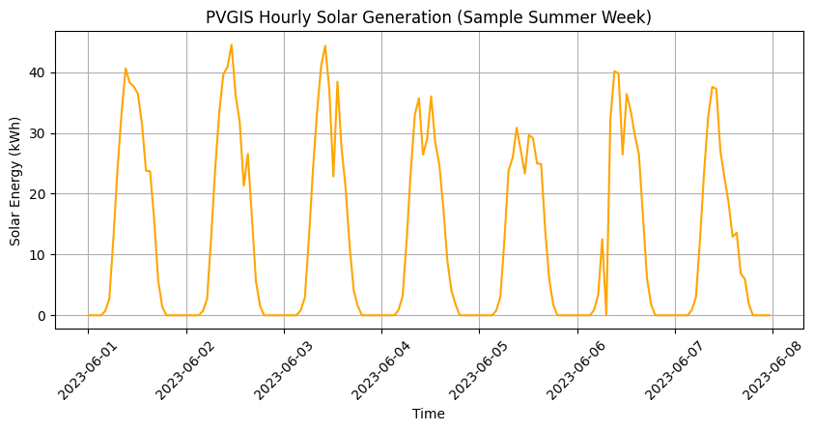
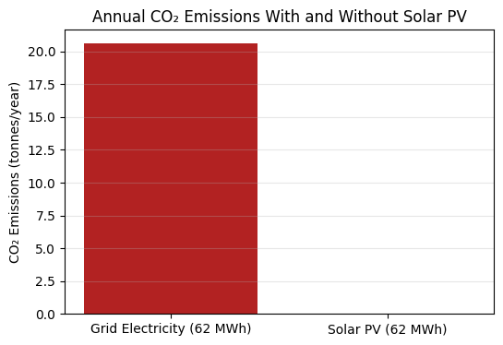
Solar week visualization
CO₂ savings interpretation
Using solar reduces grid usage
That reduces total CO₂ emissions
Saving 20.6 tonnes of CO₂ emissions per year
Solar production is high in day, low at night
This helps replace grid electricity during day

Slide 11
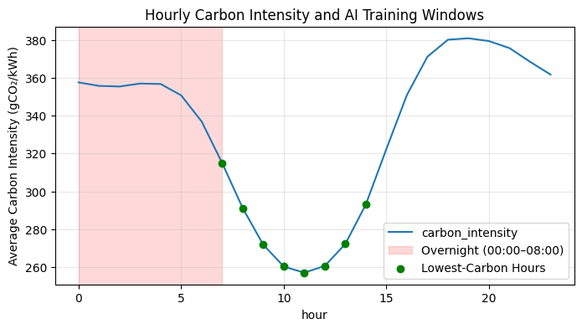
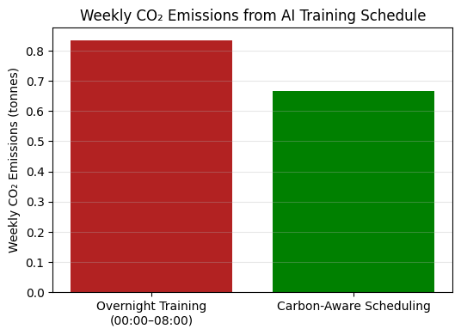
TASK 4 Carbon-Aware Operation of an AI Server Rack
Carbon intensity follows a daily pattern
Some hours are cleaner, some hours are dirtier
This pattern is used later in Task-6 strategies

Slide 12
Task 5 Relationship Between Electricity Price and Carbon Intensity
We did not use direct CO₂ here
We used:
  Electricity price
  Renewable generation
  Goal: check relationship between renewables and market price

Slide 13
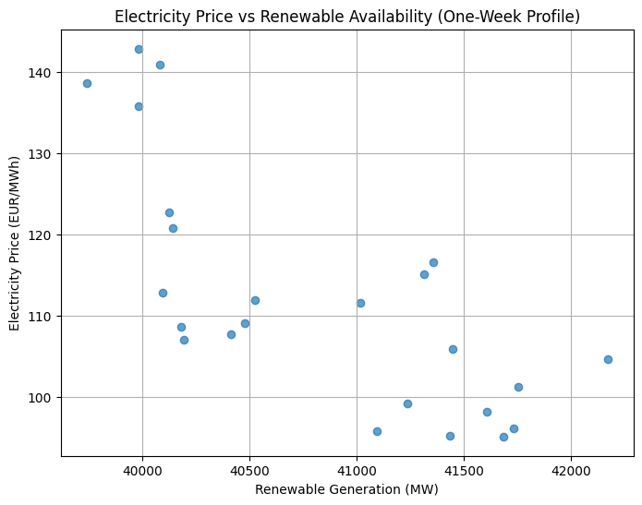
Price vs Renewable generation
Scatter plot shows a clear downward trend between renewable generation and electricity price
Low renewable generation is associated with higher electricity prices
Higher renewable availability corresponds to significantly lower prices
Pearson correlation coefficient: −0.74 (strong negative correlation)
p-value < 0.01, indicating the relationship is statistically significant

Slide 14
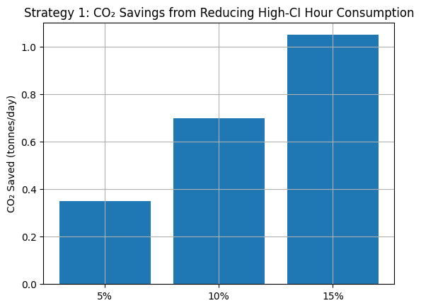
TASK 6: Data-Driven Strategies to Reduce CO₂ Emissions
Strategy 1 - Reduce electricity usage in high-carbon hours
Example high-carbon window: 02:00–06:00
Even small reduction gives good CO₂ savings

Slide 15
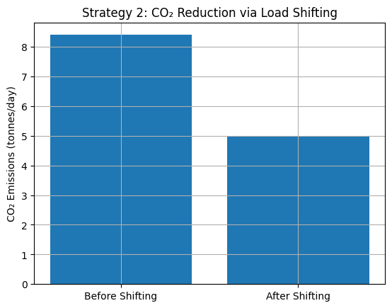
Strategy 2: Shift flexible usage to low-carbon hours
Total energy stays same
CO₂ becomes lower because electricity is cleaner

Slide 16
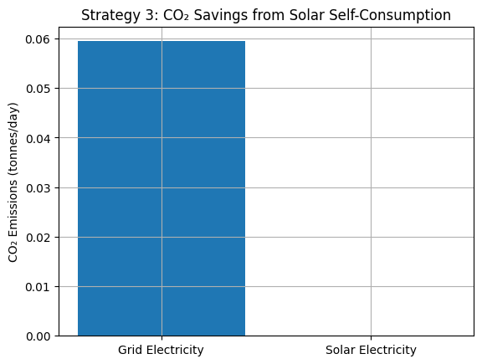
Strategy 3: Use more electricity when solar is available
Solar replaces grid electricity
Best result is combining Strategy 1 + 2 + 3

Slide 17
Thank You

