Slide 1
Apache NiFi
From beginner to advanced in no time!

Slide 2
Course objectives
Getting Started
Downloading and Installing NiFi
Create first data flow – basic concepts
NiFi in details
Concept of Processors / Connections / Flow Files
NiFi templates, data provenance, monitoring and other NiFi features
Advanced NiFi
Tuning of Processors and Connections
Writing custom processors
NiFi architecture
Notes:
Intro class

Slide 3
Introduction to Apache NiFi
Apache NiFi supports powerful and scalable directed graphs of data routing, transformation, and system mediation logic.”
Automate the flow of data between systems
E.g. : JSON -> Database, FTP-> Hadoop, Kafka -> ElasticSearch, etc…
Drag and drop interface
Focus on configuration of processors (i.e. what matters only to the user)
Scalable across a cluster of machines
Guaranteed Delivery / No Data Loss
Data Buffering / Back Pressure / Prioritization Queuing / Latency vs Throughput
Notes:
Lecture 1

Slide 4
Apache NiFi use cases:
What Apache NiFi is good at:
Reliable and secure transfer of data between systems
Delivery of data from sources to analytic platforms
Enrichment and preparation of data:
Conversion between formats
Extraction/Parsing
Routing decisions
What Apache NiFi shouldn’t be used for:
Distributed Computation
Complex Event processing
Joins, rolling windows, aggregates operations
Notes:
Lecture 1

Slide 5
Download Instructions for NiFi
Follow the link
https://nifi.apache.org/docs/nifi-docs/html/getting-started.html#downloading-and-installing-nifi

Slide 6
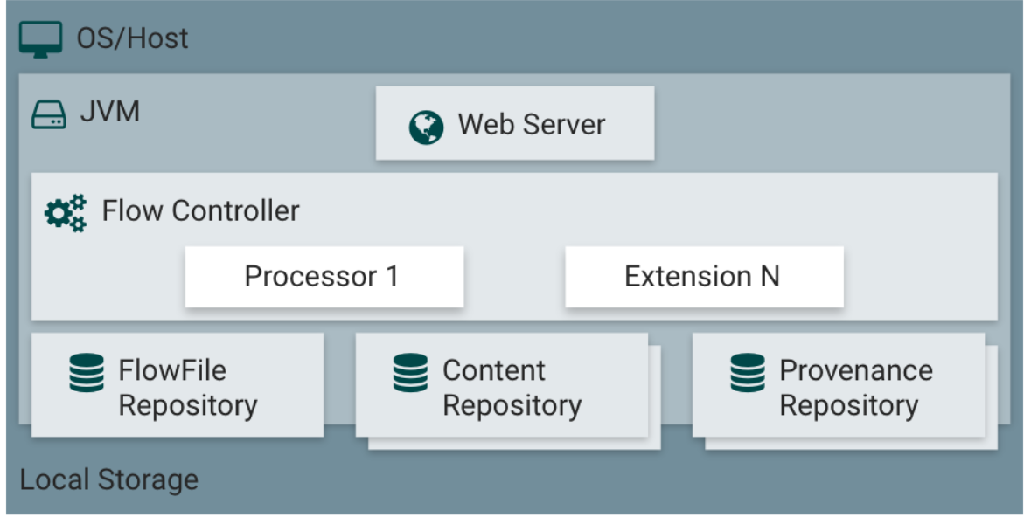
NiFi Architecture

Slide 7
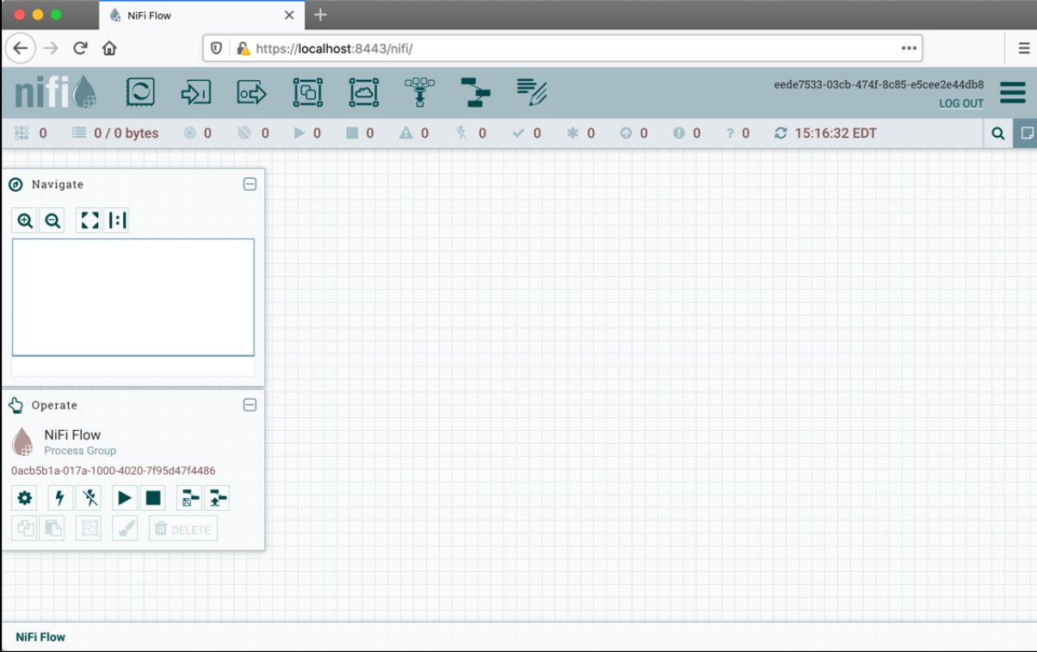
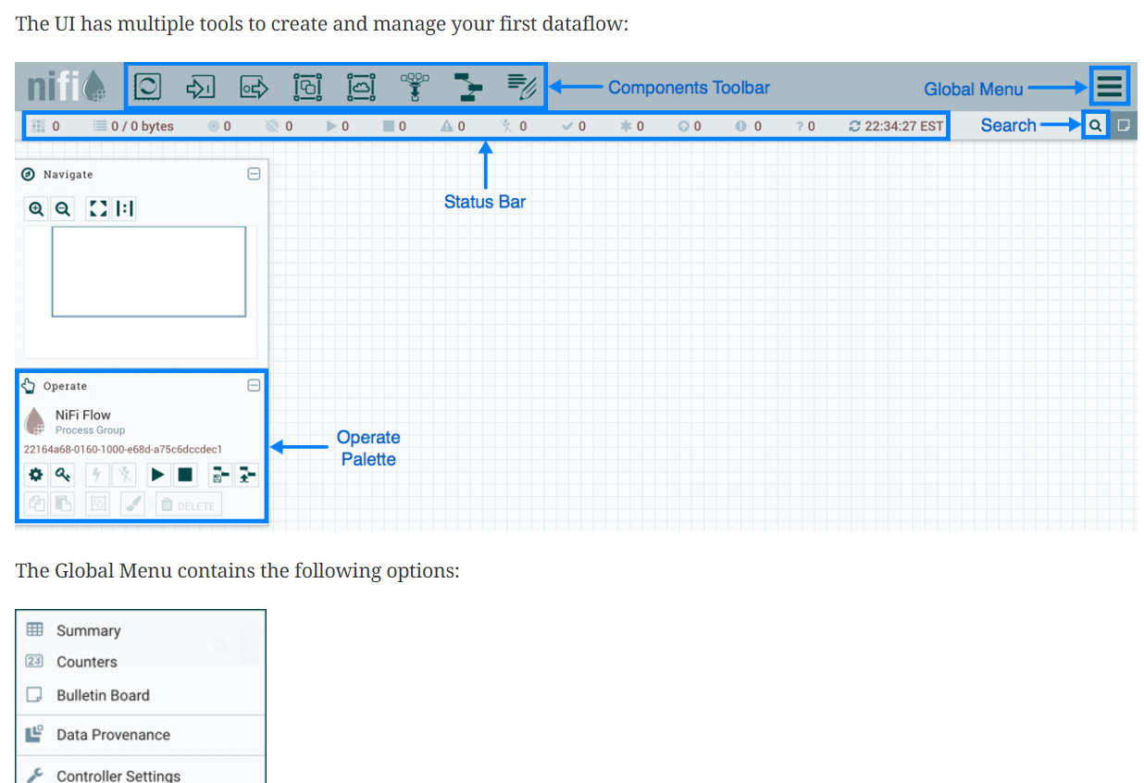
GUI Understanding

Slide 8
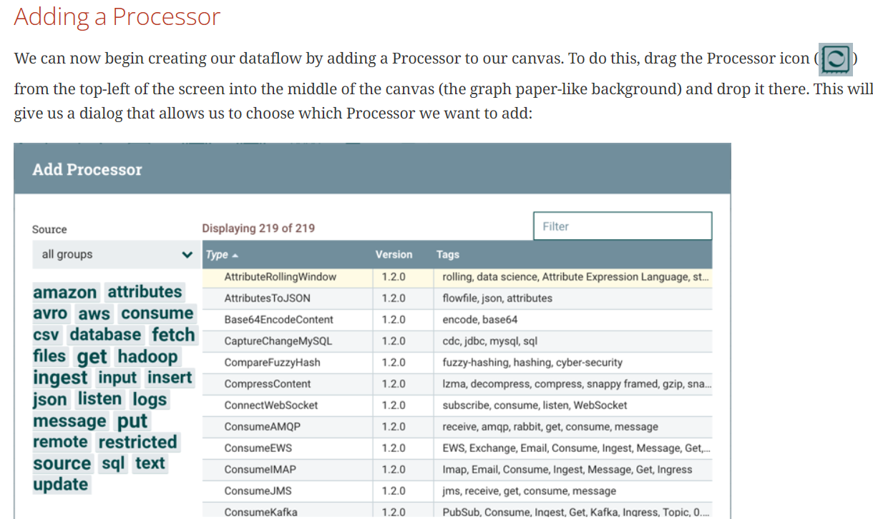
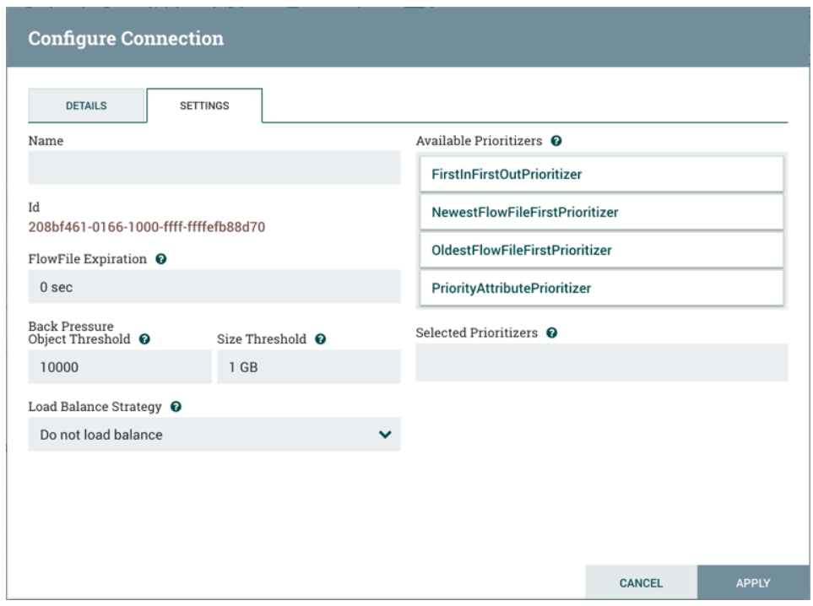
GUI Understanding Continued

Slide 9
Concept: FlowFile
It’s basically the data
Comprised of two elements:
Content: the data itself
Attributes: Key value pairs associated with the data (creation date, etc.…)
Gets persisted to disk after creation
Notes:
Lecture 2

Slide 10
Concept: Processor
Applies a set of transformations and rules to FlowFiles, to generate new FlowFiles
Any processor can process any FlowFile
Processors are passing FlowFile references to each other to advance the data processing
They are all running in parallel (different threads)
Data
Processor 1
FlowFile 1
Processor 2
FlowFile 2
…Processor N
Notes:
Lecture 2

Slide 11
Concept: Connector
It’s basically a queue of all the FlowFiles that are yet to be processed by Processor 2
Defines rules about how FlowFiles are prioritized (which ones first, which ones not at all)
Can define backpressure to avoid overflow in the system
Processor 1
Connector
Processor 2
FlowFile 1
FlowFile 2
FlowFile N
Notes:
Lecture 2

Slide 12
Few More Controllers
Queues: Queues act as buffers to temporarily store data between processors, ensuring efficient data transfer and minimizing the risk of data loss during processing.
FlowFile Repository: FlowFiles are the fundamental unit of data in NiFi. The FlowFile Repository stores metadata and information about the data flow, including attributes and content.
Provenance Repository: The Provenance Repository records all actions taken on data within NiFi, providing a detailed audit trail for data governance and troubleshooting.

Slide 13
NiFi basics: FlowFile, Processor, Connector
Processor
Connector
FlowFile
Data
Processor
Connector
Processor
Connector
Processor
FlowFile
FlowFile
FlowFile
FlowFile
Connector
FlowFile
FlowFile
Processor
Notes:
Lecture 2

Slide 14
Examples of File reading , transfering and loading
1. Copy the file and move file to different location
https://www.youtube.com/watch?v=v2ZLu_ykBr0
2. Reading and Writing to PostgreSQL Database
https://www.youtube.com/watch?v=jJnPD2qCU3U

Slide 15
NiFi: Categorization of processors
Over 188 bundled processors
Data Transformation: ReplaceText, JoltTransformJSON…
Routing and Mediation: RouteOnAttribute, RouteOnContent, ControlRate…
Database Access: ExecuteSQL, ConvertJSONToSQL, PutSQL...
Attribute Extraction: EvaluateJsonPath, ExtractText, UpdateAttribute…
System Interaction: ExecuteProcess …
Data Ingestion: GetFile, GetFTP, GetHTTP, GetHDFS, ListenUDP, GetKafka…
Sending Data: PutFile, PutFTP, PutKafka, PutEmail…
Splitting and Aggregation: SplitText, SplitJson, SplitXml, MergeContent…
HTTP: GetHTTP, ListenHTTP, PostHTTP…
AWS: FetchS3Object, PutS3Object, PutSNS, GetSQS
Notes:
Lecture 2

Slide 16
NiFi: FlowFile Topology
A FlowFile has two components
Attributes:
These are the metadata from the FlowFile
Contain information about the content: e.g. when was it created, where is it from, what data does it represent?
Content:
That’s the actual content of the FlowFile. e.g. it’s the actual content of a file you would read using GetFile
A processor can (either or both):
Update, add, or remove attributes
Change content
Notes:
Lecture 11

