Slide 1

Gender Recognition By Voice
(EDA & Model Prediction)
By Uday Pratap Yati

Slide 2
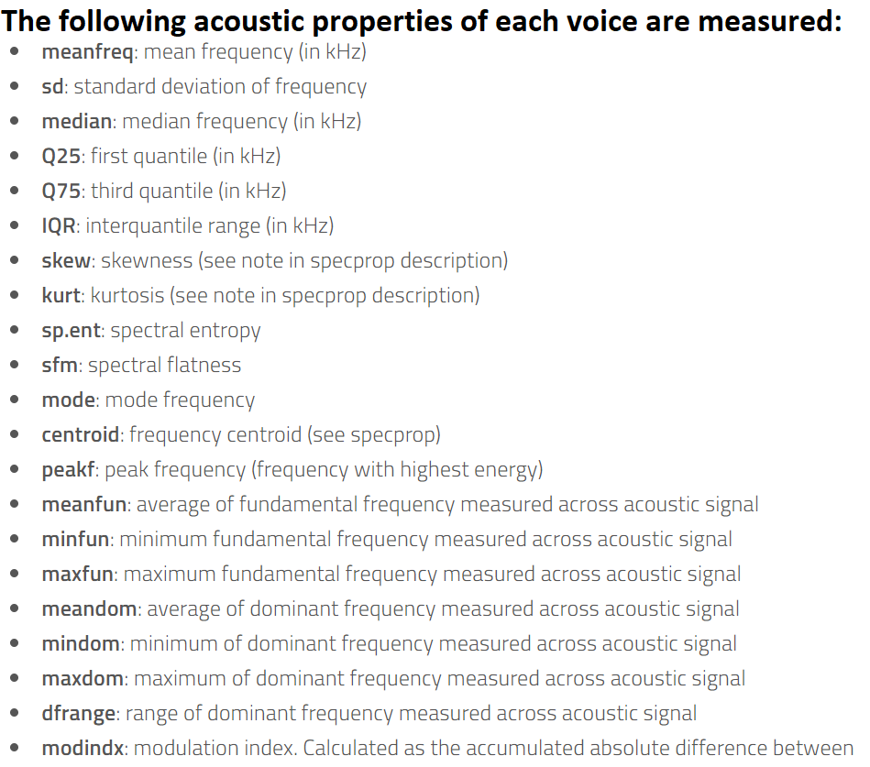
Introduction
Data set :
The dataset consists of voice sample of thousands
of male and female volunteers.
Goal :
Predict the gender of the voice sample(Male/Female).
Maximize the accuracy (classification problem)
Records :
Number of records:3168
Number of features : 20
Target variable : label (male/female)
Notes:
Determining a person’s gender as male or female, based upon a sample of their voice seems to initially be an easy task.
Often, the human ear can easily detect the difference between a male or female voice within the first few spoken words.
However, designing a computer program to do this turns out to be a bit trickier.

Slide 3
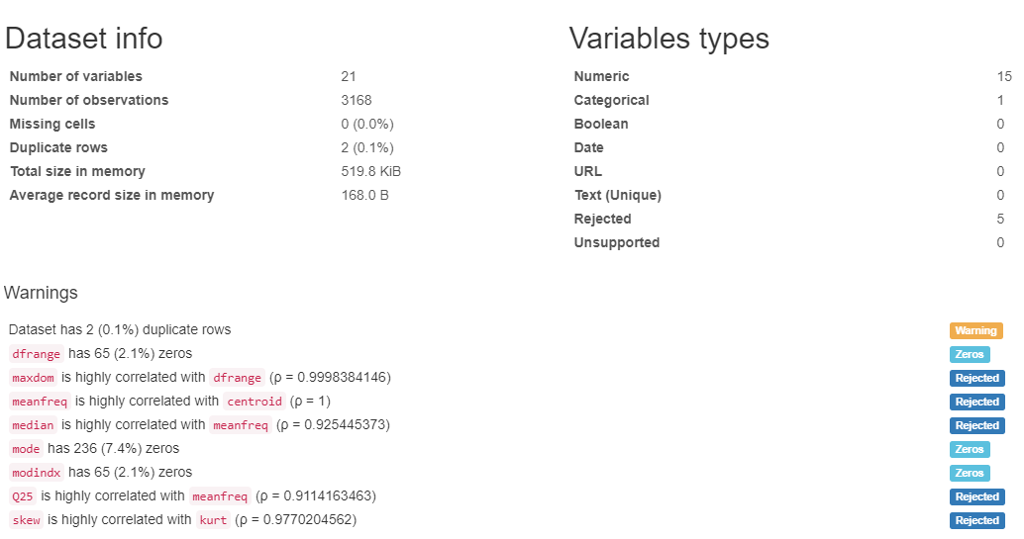
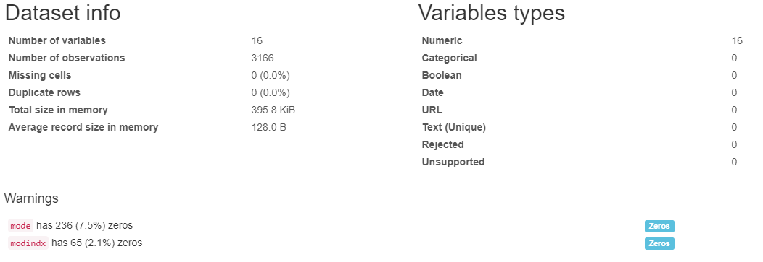
Data cleaning
Pre-Profiling
Post-Profiling
Notes:
5 features dropped
2 duplicate rows dropped

Slide 4
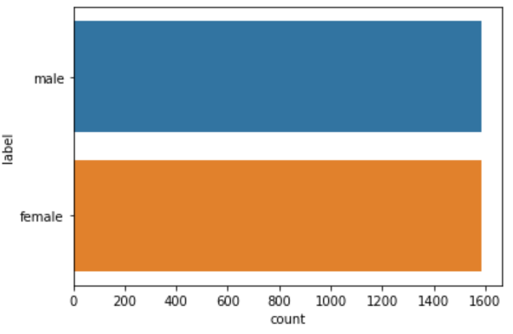
Assumption and Hypothesis:
An adult male has pitch within a range of 85 to 180 Hz
An adult female has pitch between 165 to 255 Hz
Assumptions :
Pitch, combined with intonation (the rise and fall of the voice in speech), are important factors in classifying male versus female.
Male classified voices tend to be low and within a narrow range of pitch (i.e. relatively monotone).
Female classified voices tend to be higher in pitch and fluctuate frequency to a much greater degree.
Female classified voices often rise in frequency at the end of a sentence, as if asking a question.
Hypothesis:
Setting a threshold for frequency, sounds like a reasonable way to detect gender from voice or speech.
A frequency of 200 Hz could be used as a dividing line.
Base-line Model:
Always Predict Male
Accuracy : 50%
Distribution of Target Variable
[1] Milan Sigmund 2008 Gender Distinction using Short Segments of Speech Signal. Int. J. of Computer Science and Network Security, Vol.8, No.10.

Slide 5
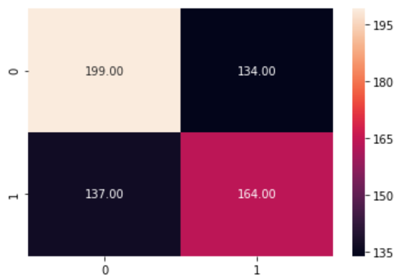
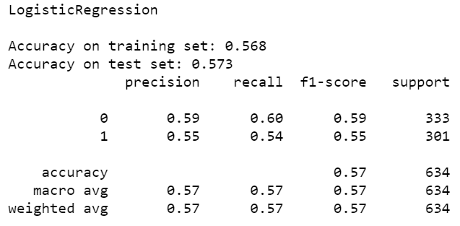
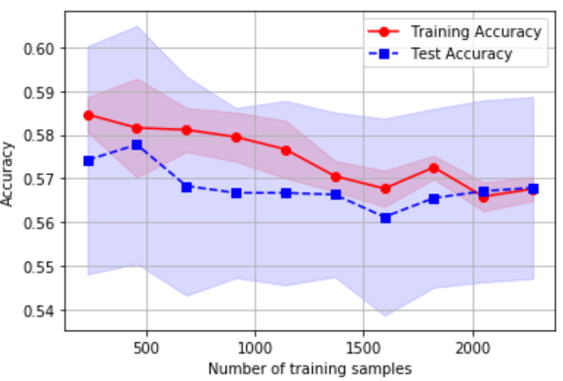
Hypothesis Testing
0 = Male, 1 = Female
Logistic regression model, using the average dominant frequency
Average dominant frequency (meandom) is, indeed significant
Change in frequency is helping in classification
Train Accuracy : ~ 57%
Test Accuracy : ~ 57%
This suggests there is more to detecting a voice’s gender than simply applying a threshold on how low or high a voice sounds.
Notes:
Trained a basic Log Reg model with only the mean dominant freq and evaluation, the accuracy of the model was 57%

Slide 6
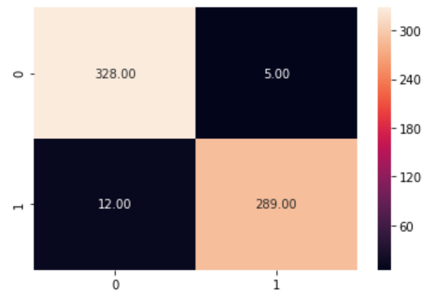
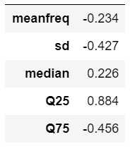
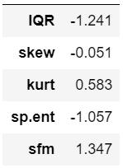
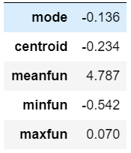
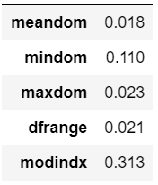
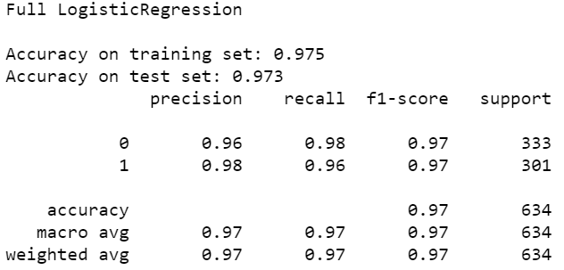
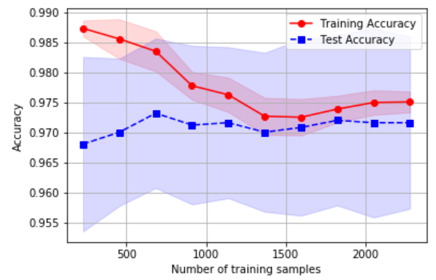
Full Regression
0 = Male, 1 = Female
Regression analysis of all measured acoustic properties
Accuracy : ~ 97%
How many features required ?

Slide 7
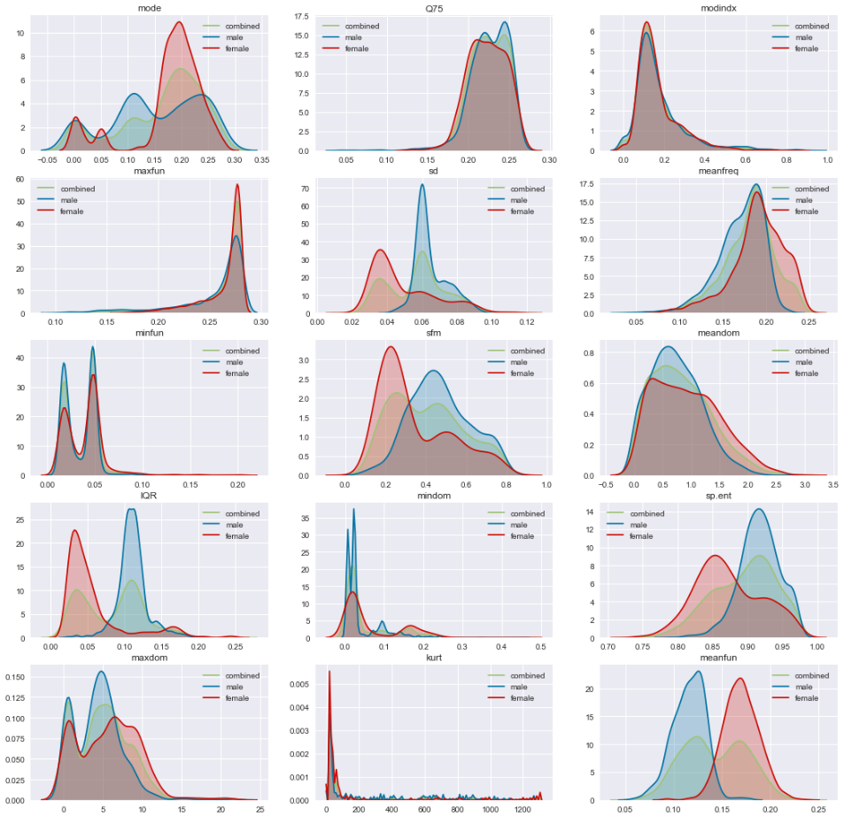
Data Visualization : Distribution:
Clear Separation of target var.
Sd
IQR
sfm
Sp.int
meanfun

Slide 8
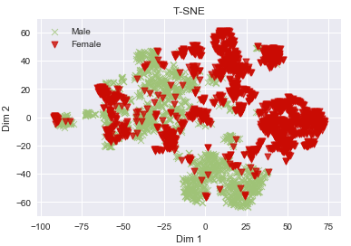
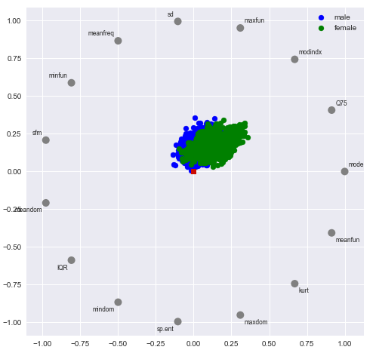
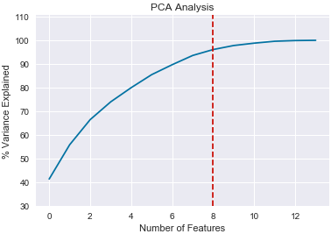
Visualization in 2-Dimension

Slide 9
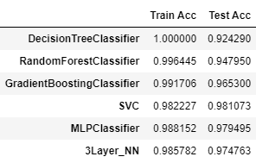
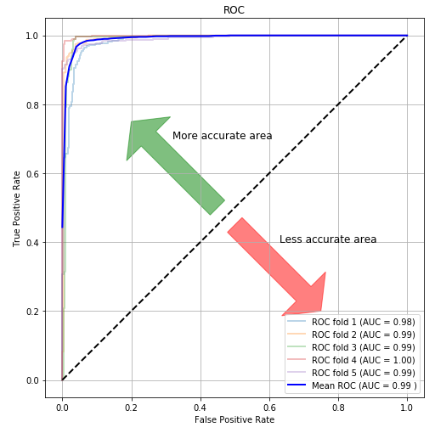
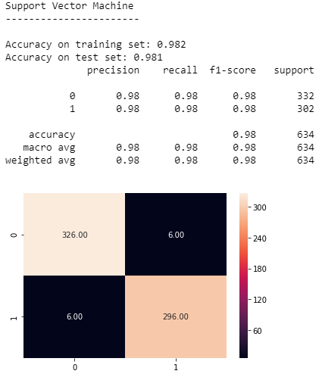
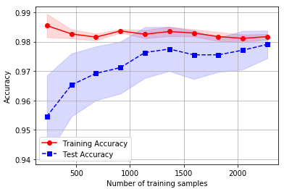
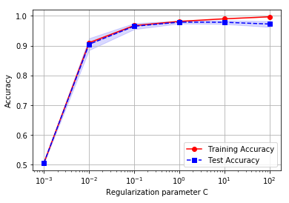
Model :Support vector classifier
Validation Curve
Learning Curve
0 = Male, 1 = Female

Slide 10
Conclusion:
Despite being trained on a publicly available training set, the model performs very well when guessing the gender of actual recordings of speech.
I tested the performance of the model on few genuine recordings of the utterance "hello" by two different speakers (1 male, 1 female).
The model correctly identified the gender in all 8 tests.
Where the model begins to show faults is when gender is impersonated.
On recordings where a female might pretend to sound like a male, the model consistently recognized the correct gender.
However, when males pretended to sound like females, the SVM was not as consistent.
Likewise, the SVM also fails to detect the gender of a child.
This is most likely since the training data set only contained points from adults.
A more diverse data set could solve this problem.

Slide 11
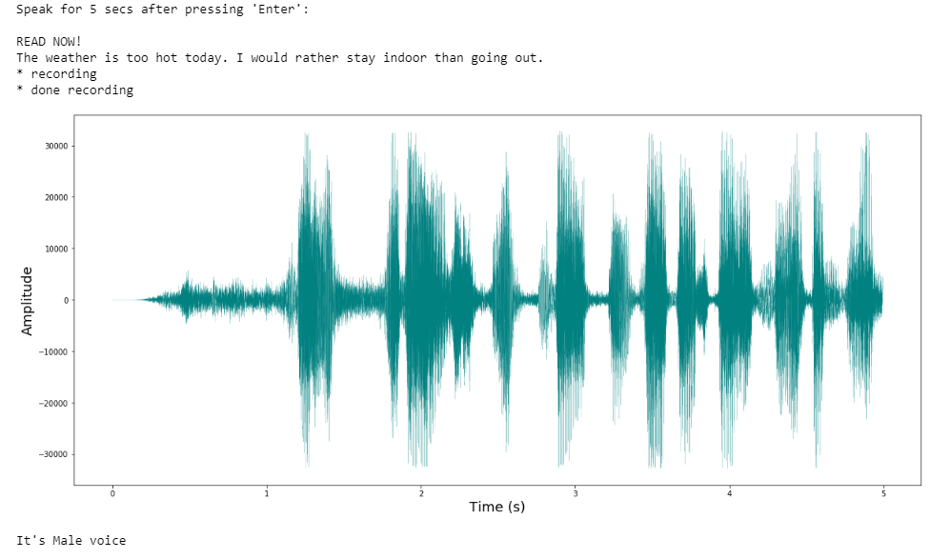
Demo:

Slide 12
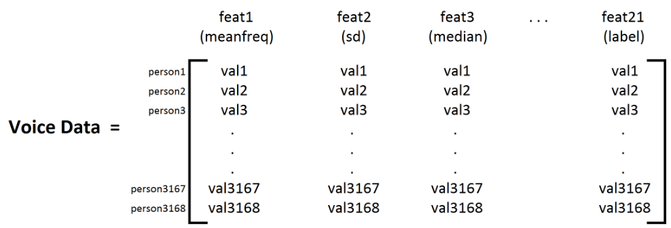
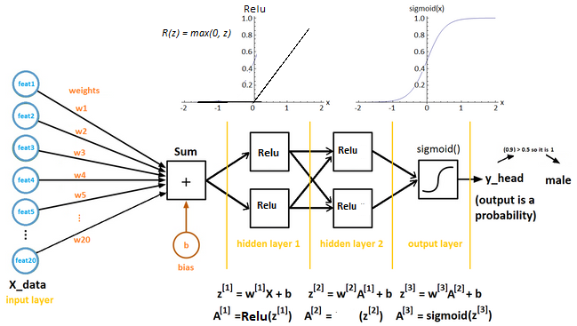
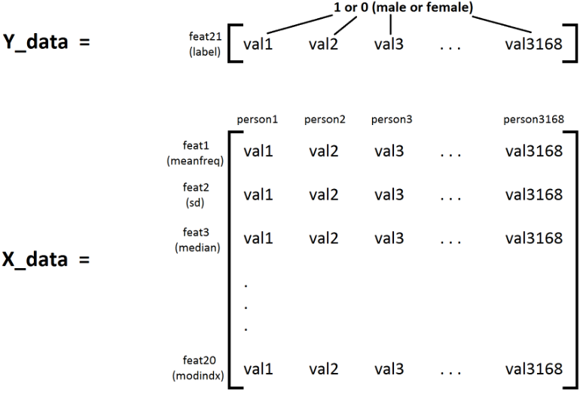
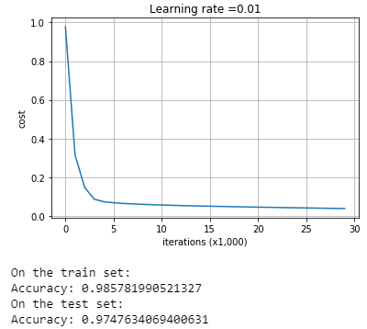
3-Layer Neural Network:

Slide 13
Thank You

