Slide 1
Anatomy of an Attack on Person Re-Identification
(+ An EOT Universal Invisibility Torso Patch & Adversarial Defense)
Deep Learning Project • Empirical Benchmark on Market-1501
Architectures: ResNet-50 (BoT), DenseNet-121, ViT-Small/16 | 100% Empirically Measured

Slide 2
RE-ID ADVERSARIAL ANATOMY
Why Re-ID Security Differs from Standard Classification
Open-Set Ranking vs Fixed Labels
• Closed-Set Classification: Predicts 1 of N known training classes using softmax logits.
• Person Re-ID: Queries and gallery belong to unseen identities across non-overlapping surveillance cameras.
• Scoring Metric: Evaluated on gallery distance ranking (Rank-1, Rank-5, mAP), not class accuracy.
• Silent Retrieval Failure: An attacker doesn't need to force a label—simply degrading Rank-1 displaces true matches out of the top-k results.
Core Research Questions We Answer
1. Embedding vs Logit Attacks: Does directly pushing embeddings in metric space outperform classical classification-head attacks?
2. Cross-Architecture Transfer: Do adversarial directions crafted on CNNs transfer to other CNNs and Vision Transformers?
3. Universal Physical Feasibility: Can a single fixed torso patch fool multiple architectures without per-image optimization?
4. Adversarial Training Cost: What is the exact clean accuracy trade-off when hardening Re-ID with PGD adversarial training?

Slide 3
RE-ID ADVERSARIAL ANATOMY
Victim Models: Architecture & Clean Performance (Market-1501)
Architecture | Parameters | Rank-1 (%) | Rank-5 (%) | Rank-10 (%) | mAP (%)
ResNet-50 (BoT / BNNeck) | 25.1 M | 86.97 % | 95.40 % | 97.36 % | 70.64 %
DenseNet-121 | 7.7 M | 77.35 % | 91.95 % | 95.07 % | 56.63 %
ViT-Small / 16 (DeiT) | 21.9 M | 91.75 % | 96.67 % | 98.01 % | 79.69 %
Standard Training Recipe & Protocol Constraints
• Initialization: All backbones use ImageNet-1K pretrained weights fine-tuned on Market-1501 (12,936 training images, 751 identities).
• Loss Formulation: Joint ID cross-entropy loss + Batch-Hard Triplet loss with margin m = 0.3 (PK sampler: P=16 identities, K=4 instances).
• BNNeck Head: Batch normalization layer separates metric embedding f (normalized for cosine ranking) from classification logits.
• Market-1501 Protocol: Evaluated on 3,368 queries vs 15,913 gallery targets across 6 cameras. Junk rule strictly enforced (same PID + camera ignored).

Slide 4
RE-ID ADVERSARIAL ANATOMY
Threat Model & Objective Formulations in Metric Space
Evasion Objective
L_evade = - ( f(x_adv) · f(x) )
Pushes the adversarial embedding as far away from its clean representation as possible.
Minimizes cosine similarity between perturbed and clean feature vectors. Forces true matches out of the top gallery ranks.
Impersonation Objective
L_impersonate = + ( f(x_adv) · e_target )
Pulls the query embedding towards the centroid embedding of an unauthorized identity.
Maximizes cosine similarity to target centroid. Measured by Hit@1: target identity returned as Rank-1 match.
Classification Logit Baseline
L_logit = CrossEntropy( W · f(x_adv), y_true )
Standard adversarial classification attack on the training ID-classifier head.
Maximizes cross-entropy loss on training classes. Used to test whether classification attacks suffice for open-set Re-ID.

Slide 5
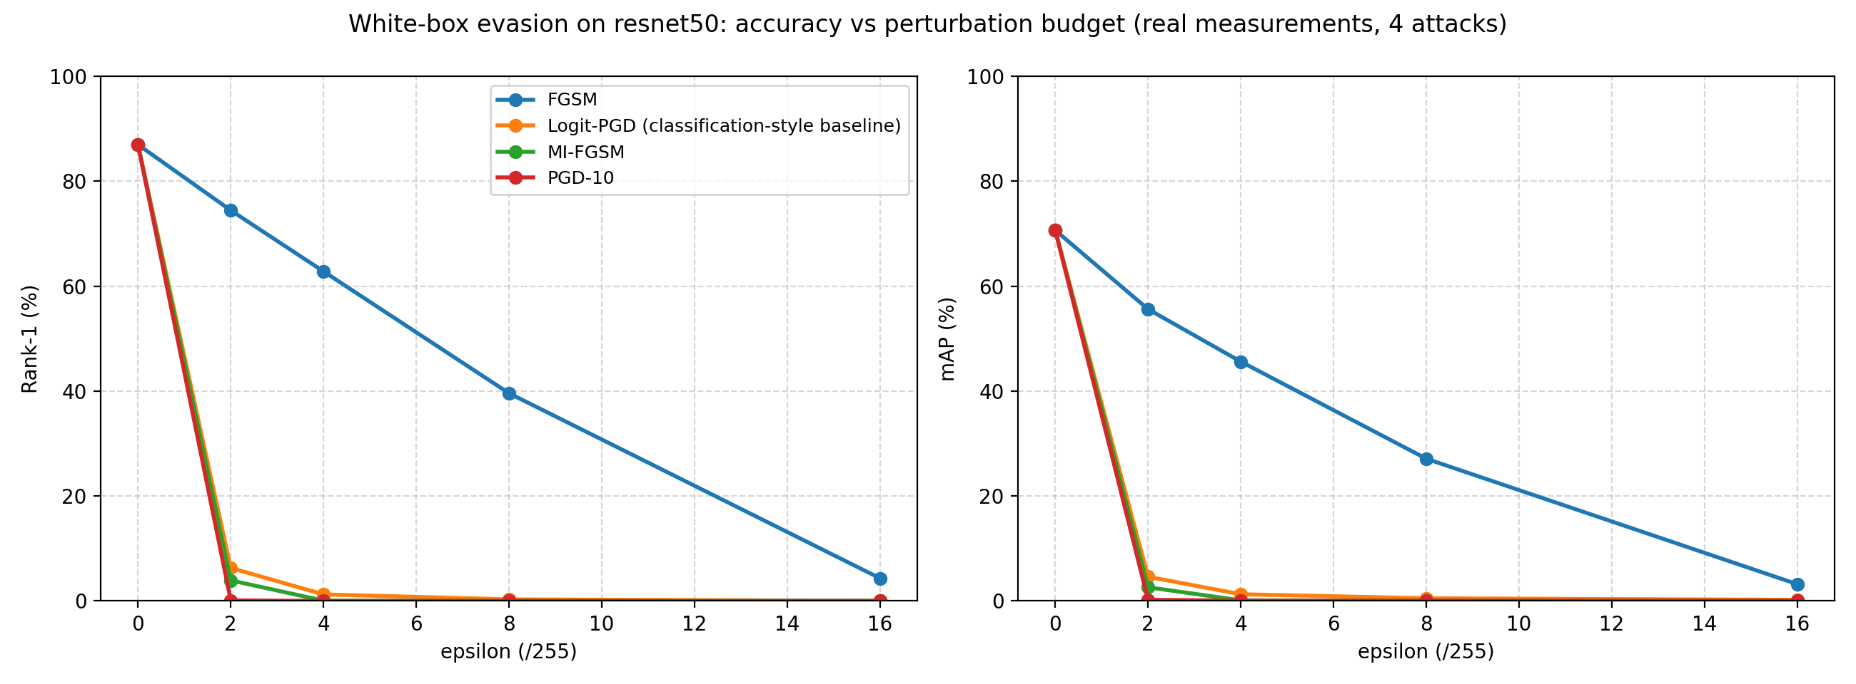
RE-ID ADVERSARIAL ANATOMY
White-Box Evasion: Rank-1 Collapses to 0.0% at eps = 8/255
Epsilon Degradation (ResNet-50)
• Clean Baseline: 86.97 % Rank-1 | 70.64 % mAP
• FGSM (1-step eps=8): Drops to 39.58 % Rank-1
• PGD-10 (eps=8): Complete collapse to 0.00 % Rank-1 (0.05 % mAP)
• MI-FGSM (eps=8): Complete collapse to 0.00 % Rank-1 (0.05 % mAP)
• Logit-PGD (eps=8): 0.30 % Rank-1 (Embedding PGD is strictly stronger)
• Even at eps = 2/255 (barely perceptible): PGD drives Rank-1 to 0.12 %!

Slide 6
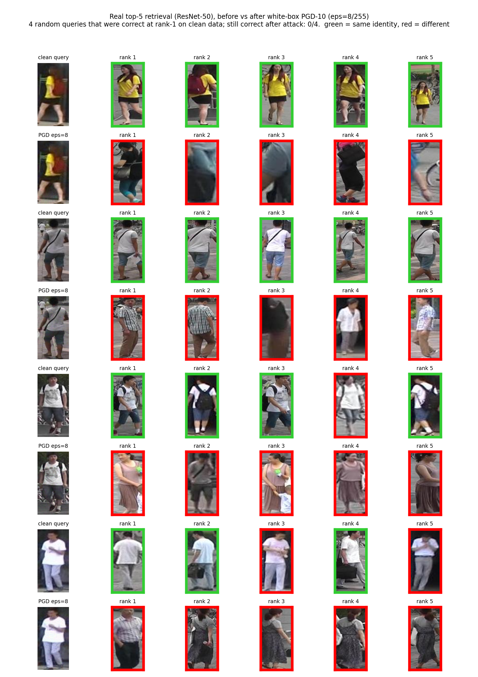
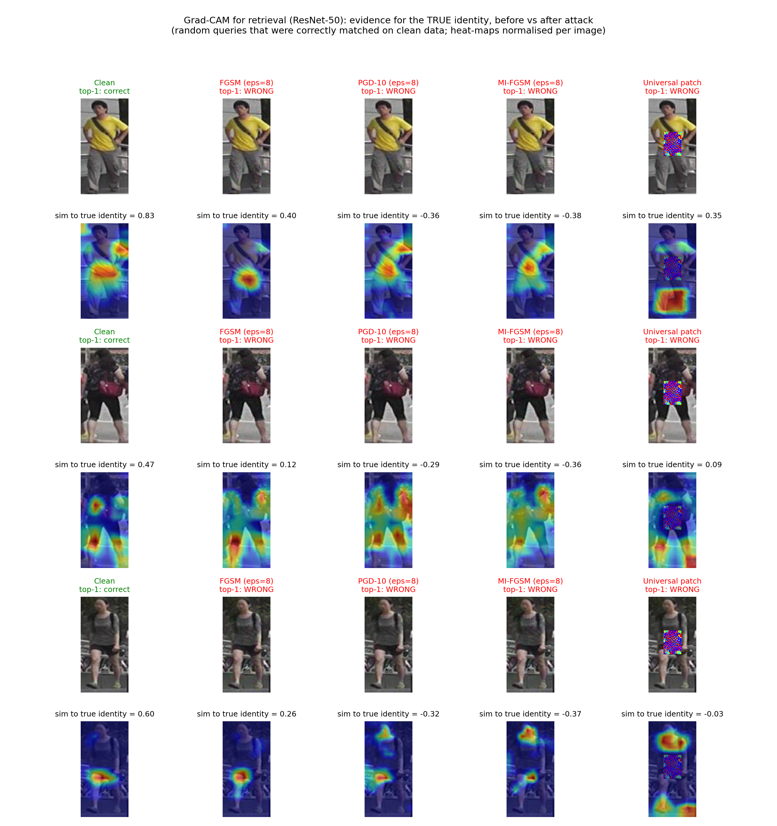
RE-ID ADVERSARIAL ANATOMY
Visualizing Failure: Retrieval Before/After & Attention Drift
Query Retrieval Ranking: Clean top-5 matches true ID; under PGD, true match drops entirely from top results.
Grad-CAM Feature Saliency: Gradient perturbations shift network focus away from person torso to background clutter.

Slide 7
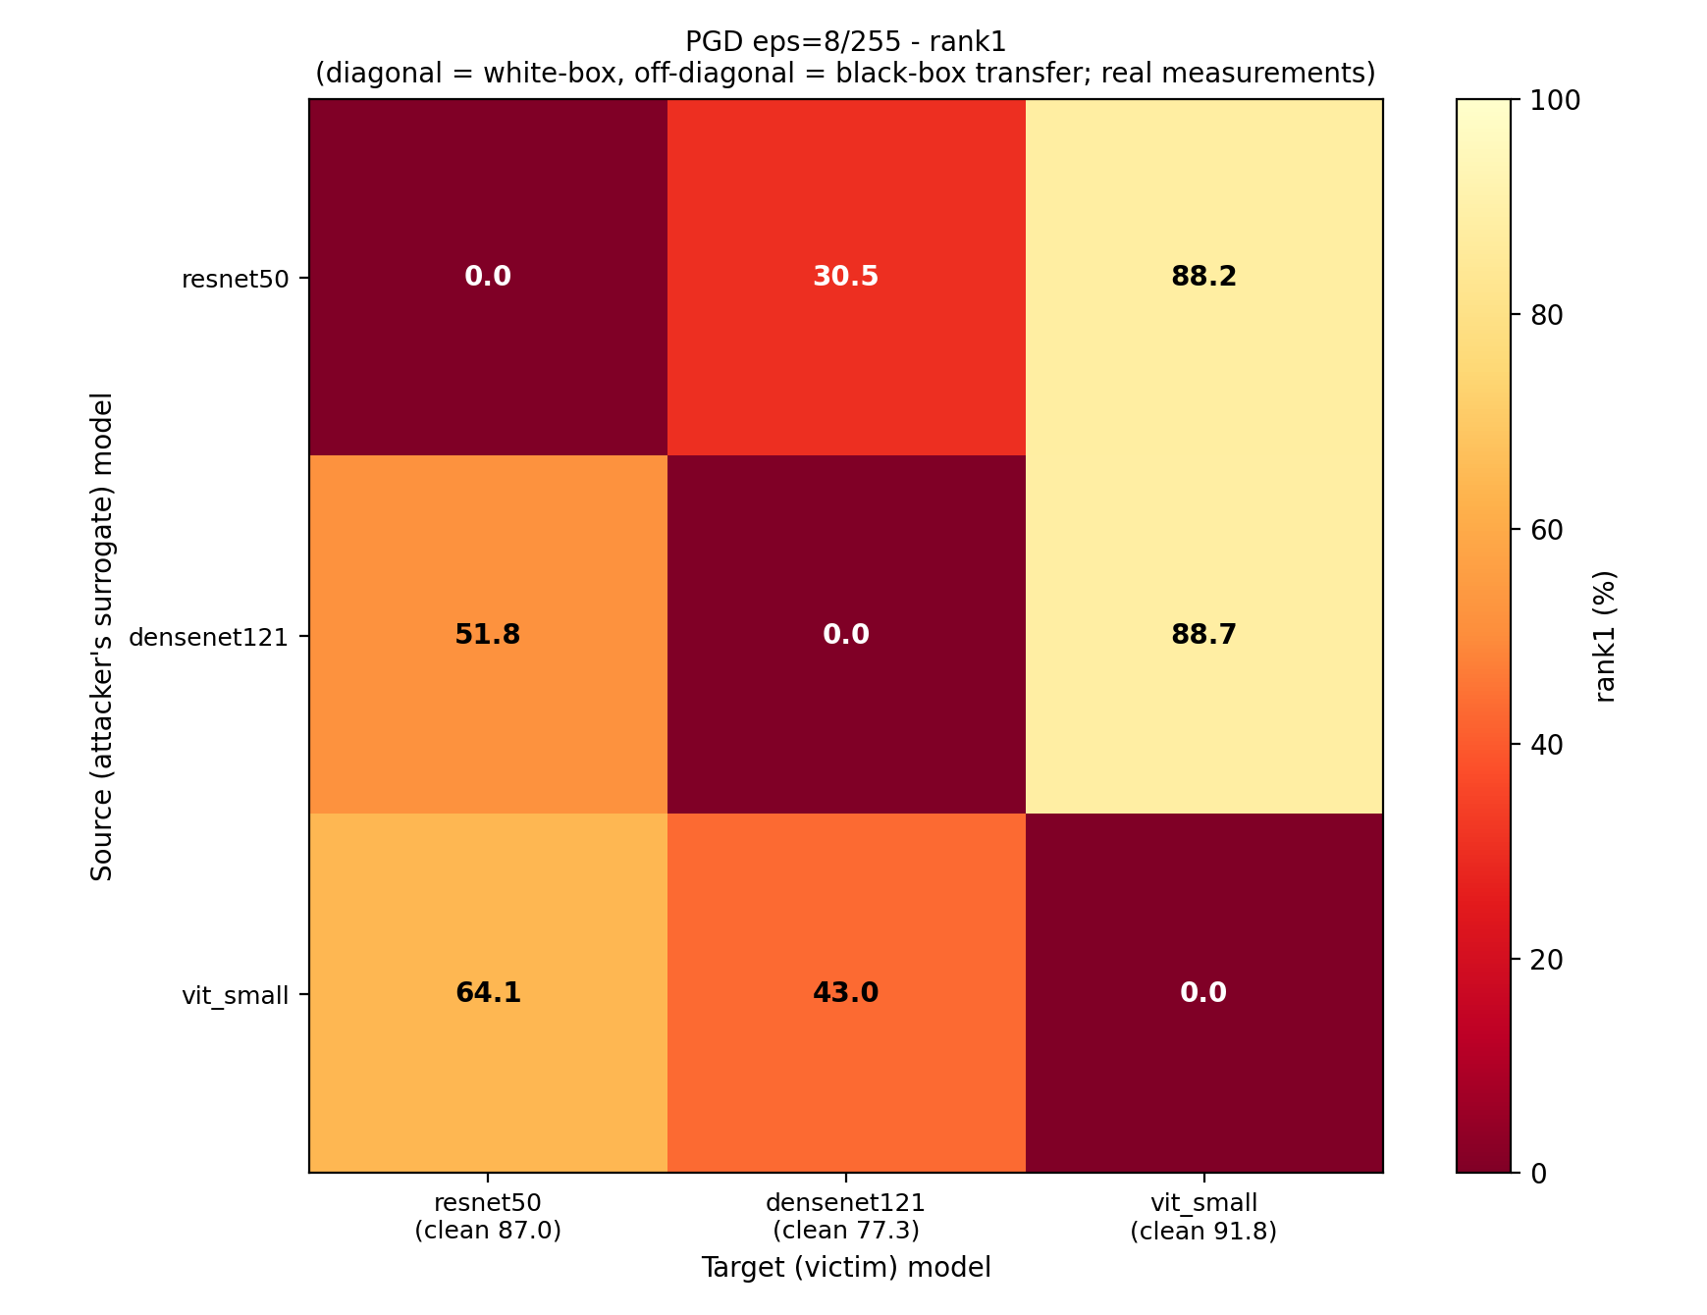
RE-ID ADVERSARIAL ANATOMY
Cross-Architecture Transfer Matrix: Asymmetry Between CNNs & ViT
Key Empirical Transfer Observations
• White-Box vs Black-Box: Mean Rank-1 is 0.0 % white-box vs 61.04 % under black-box PGD transfer.
• CNN-to-CNN Transfer: Attacks transfer moderately between CNN architectures: ResNet-50 PGD drops DenseNet-121 from 77.35 % to 30.46 % (MI-FGSM to 17.81 %).
• CNN-to-ViT Resistance: Perturbations crafted on ResNet-50 or DenseNet-121 barely hurt ViT-Small (Rank-1 remains 88.15 % and 88.66 % vs 91.75 % clean).
• Hypothesis: Local convolutional receptive fields share inductive bias, whereas ViT's global self-attention produces divergent gradient landscapes.
• MI-FGSM Advantage: Momentum smooths gradient oscillations and reduces mean black-box Rank-1 from 61.04 % (PGD) to 50.64 %.

Slide 8
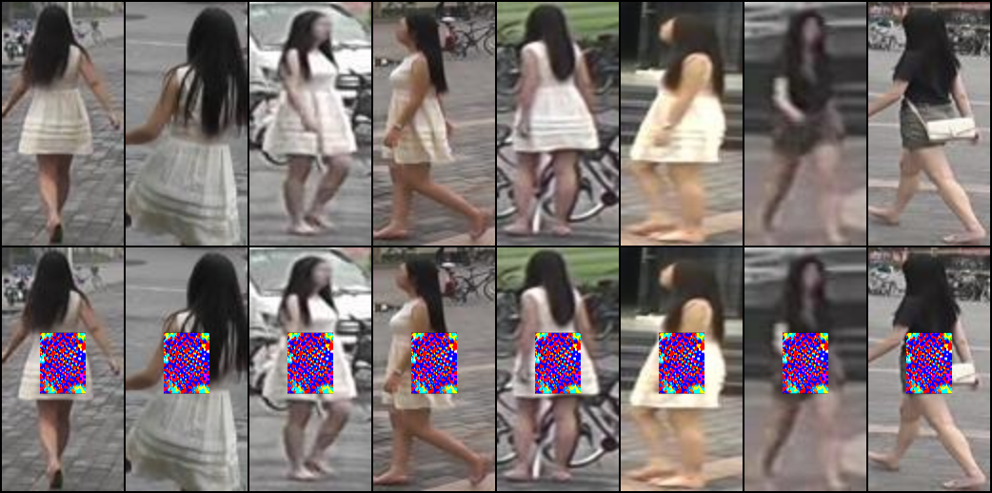
RE-ID ADVERSARIAL ANATOMY
Universal Torso Patch: One Printable Pattern Evades Retrieval
Torso Patch Performance on ResNet-50
• Control Experiment (Random Noise Patch): Leaves Rank-1 at 73.19 % (Rank-1 drop is only 13.78 % due to occlusion).
• Trained Universal Patch (64x48): Collapses Rank-1 to 2.67 % (mAP 3.29 %) — an 84.30 % absolute drop!
• EOT Robustness: Under random testing scale, rotation, translation, and noise, Rank-1 remains crushed at 2.73 %.
• Cross-Model Transfer: The patch trained only on ResNet-50 drops DenseNet-121 Rank-1 to 13.63 % without retraining.
• EOT Training Objective: Minimizes cosine similarity to clean features over 40 epochs with TV smoothness regularization.
Trained on 40 epochs with Total Variation (TV) loss to prevent high-frequency noise and ensure physical printability.

Slide 9
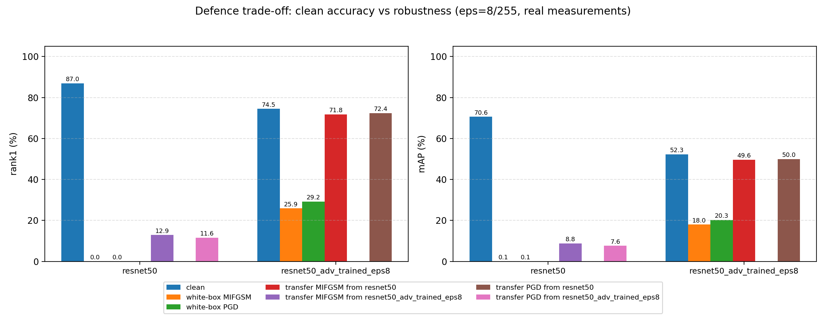
RE-ID ADVERSARIAL ANATOMY
Defense Benchmark: Adversarial Training Trade-Off
Empirical Defense Evaluation (ResNet-50)
• White-Box Robustness Gain: Robust Rank-1 rises from 0.00 % (standard model) to 29.19 % (robust model) under white-box PGD-10.
• Clean Accuracy Trade-off: Clean Rank-1 drops from 86.97 % to 74.52 % (a 12.45 % penalty), consistent with classical robust classification trade-offs.
• Black-Box Protection: When attacked by perturbations from the standard ResNet-50, the adversarially trained model retains 72.39 % Rank-1 (mAP 49.96 %).
• Caveat on Evaluation: The defense was trained against PGD-5 and evaluated against PGD-10; adaptive attacks (e.g. PGD-50) would likely erode robustness further.

Slide 10
RE-ID ADVERSARIAL ANATOMY
Summary, Limitations & Future Directions
Core Takeaways
✔ Re-ID is uniquely vulnerable: Gradient evasion attacks drive Rank-1 retrieval to 0.00 % without requiring classification label access.
✔ Architecture Matters: ViTs exhibit substantial intrinsic resistance to CNN-crafted transfer attacks (maintaining >88 % Rank-1).
✔ Physical Feasibility: A single 64x48 torso patch trained with EOT effectively blinds surveillance models (Rank-1 86.97 % -> 2.67 %).
✔ Defense Reality: Adversarial training restores robust Rank-1 to 29.19 % but incurs a 12.45 % clean retrieval penalty.
Scientific Transparency & Limitations
• Backbones Pretrained: Backbones use ImageNet-1K pretrained weights fine-tuned on Market-1501, not trained from scratch.
• Epoch Definition: One 'epoch' represents one pass over 751 identities (4 images each), approximately 23 % of total dataset images.
• Digital-Only Patch: Torso patch was evaluated via digital transformation overlay; physical printing on clothing was not experimentally validated.
• Single Seed Evaluation: Experiments conducted with fixed seed (seed=0); multi-seed confidence intervals remain future work.
• Adaptive Attacks: Defense evaluated on PGD-10; advanced AutoAttack/PGD-50 evaluations are needed for definitive robustness bounds.

