Slide 1
🧠
HireMind AI
Multi-Agent Resume Screening & Job Matching Platform
Problem Statement PS03 · NLP + LLM + Agentic AI
LLM extracts · Deterministic engine decides · Fully explainable
[YOUR TEAM NAME] · [HACKATHON NAME] · 11 Sept 2026

Slide 2
01 The Problem: Hiring Screening Doesn't Scale
▸ 7 seconds — average first-pass time a recruiter spends on a resume; hundreds of applications per opening
▸ Inconsistent screens — different screeners, different outcomes; strong candidates get missed
▸ Vocabulary mismatch — 'React.js' vs 'React' vs 'ReactJS' breaks keyword ATS systems
▸ Opaque black boxes — pure-LLM or embedding scores can't justify a ranking to a candidate or auditor
▸ No feedback loop — bare scores don't tell recruiters what's missing or how close a candidate is
We need automated matching that is fast, consistent, AND explainable.
HireMind AI · PS03 Multi-Agent Resume Screening & Job Matching
2

Slide 3
02 Our Solution: Five Cooperating AI Agents
① Resume Agent — parses resumes (txt/pdf/docx) into structured candidate profiles
② Job Agent — extracts must-have vs nice-to-have skills, experience & education
③ Matching Agent — deterministic weighted 0–100 fit score — explainable & reproducible
④ Skill Gap Agent — critical vs stretch gaps + adjacent strengths + upskilling plan
⑤ Recruiter Agent — human-style summary with interview / hold / pass recommendation
Core principle: "LLM extracts, never decides" — language models parse & write; a transparent engine ranks.
HireMind AI · PS03 Multi-Agent Resume Screening & Job Matching
3

Slide 4
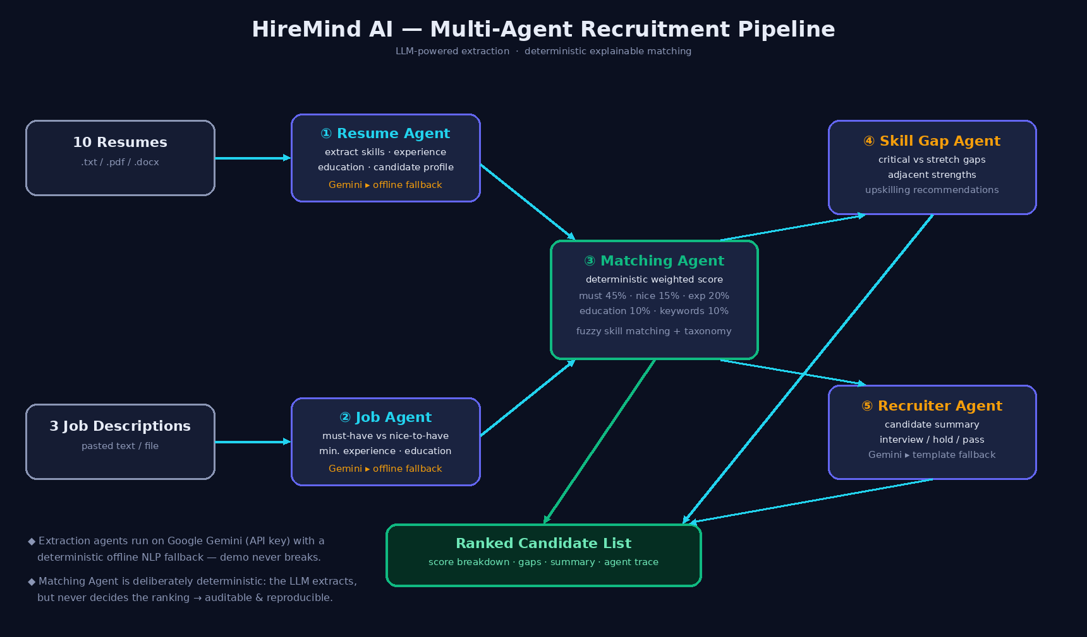
03 Architecture & Technical Flow
Every agent's input/output is exposed in the UI via an Agent Trace panel — full auditability per decision.
HireMind AI · PS03 Multi-Agent Resume Screening & Job Matching
4

Slide 5
04 Explainable Scoring Model (Matching Agent)
Dimension | Weight | How it's computed
Must-have skills | 45% | fraction matched (fuzzy + taxonomy)
Nice-to-have skills | 15% | fraction matched
Experience | 20% | 1.0 if ≥ required yrs, scaled below
Education | 10% | degree-rank comparison
Keyword affinity | 10% | JD keywords found in resume text
▸ Fuzzy matching — 'React.js' = 'React' (difflib + 130-skill alias taxonomy)
▸ Verdicts — ≥80 Strong · 60–79 Good · 40–59 Partial · <40 Weak
▸ Reproducible — same input ⇒ identical ranking, every run
▸ No demographics — only skills / experience / education enter scoring
Pipeline: Upload → Extraction (Gemini / offline NLP) → Weighted Scoring → Gap Analysis → Recruiter Summary → Ranked List + Agent Trace
Dual mode: works with a Gemini API key OR fully offline — the demo never breaks on stage.
HireMind AI · PS03 Multi-Agent Resume Screening & Job Matching
5

Slide 6
05 Technology Stack
Layer | Technology | Why
Frontend | React 18 + Vite | agent cards, ranked lists, explainable detail panels, hot-reload dev
Backend | Python 3 + FastAPI (Uvicorn) | async REST API, auto OpenAPI docs, serves the React build
LLM | Google Gemini 2.5 Flash | JSON-mode extraction & summarisation; user-supplied key, never hard-coded
Offline NLP | Regex + skill taxonomy + difflib | deterministic fallback & alias normalisation ('k8s' → Kubernetes)
Parsing | pypdf · python-docx | real-world resume formats
Concurrency | ThreadPoolExecutor | parallel recruiter summaries for speed
Repo: backend/ (agents) · frontend/ (React) · data/ (demo set) · docs/ (this deck + report) · test_pipeline.py
HireMind AI · PS03 Multi-Agent Resume Screening & Job Matching
6

Slide 7
06 Live Demo: 10 Resumes × 3 Jobs → Ranked Lists
Job Description | #1 Ranked | #2 | #3
Senior ML Engineer | Aarav Sharma · 95 Strong | Priya Nair · 69 Good | Divya Reddy · 59 Partial
Full-Stack Developer | Sneha Kulkarni · 100 Strong | Rohan Mehta · 81 Strong | Vikram Singh · 66 Good
Data Analyst | Karan Patel · 80.7 Strong | Priya Nair · 78 Good | Aarav Sharma · 46.7 Partial
▸ Domain specialists top their own role — exactly what a recruiter would expect
▸ Fresh M.Tech ML grad ranks #3 on senior ML role (experience dimension at work)
▸ Every card opens an explainable report: score bars, ✓/✗ skills, gaps, recruiter note
▸ Agent Trace panel shows each agent's raw JSON — audit any decision live
HireMind AI · PS03 Multi-Agent Resume Screening & Job Matching
7

Slide 8
07 Innovation, Explainability & Fairness
What makes us different
Trust & fairness by design
▸ Hybrid LLM + deterministic design
▸ Dual-engine resilience (keyless demo)
▸ Adjacency-aware gap analysis
▸ Shared 130-skill taxonomy contract
▸ Recruiter-grade output, not a bare number
▸ One-click PS03-required demo
▸ Published weights, plain-language notes
▸ Agent Trace = end-to-end audit
▸ No names / photos / ages in scoring
▸ Identical input ⇒ identical output
▸ Alias matching removes terminology bias
▸ Weights tunable per organisation
HireMind AI · PS03 Multi-Agent Resume Screening & Job Matching
8

Slide 9
08 Limitations & Roadmap
▸ Today — heuristic offline extraction on very unstructured resumes; in-memory storage
▸ Next — SQLite/Postgres persistence, saved match history, recruiter accounts
▸ Next — semantic embeddings as a 6th scoring signal; layout-aware PDF parsing
▸ Next — multi-job comparison board; CSV/PDF export of ranked lists
▸ Next — scheduled fairness audits of weights & gap recommendations
Honest scope: we ship a complete, judge-proof vertical slice today — persistence & semantics are planned, not promised.
HireMind AI · PS03 Multi-Agent Resume Screening & Job Matching
9

Slide 10
Thank You
[YOUR TEAM NAME] — questions welcome
AI & external resource disclosure: Google Gemini 2.5 Flash powers optional extraction & summaries; AI coding assistant used for scaffolding (all design decisions team-verified); demo data 100% synthetic; open datasets surveyed with license checks per PS03.
Stack: React 18 · Vite · FastAPI · Gemini · python-docx/pypdf
Live demo: load dataset → run pipeline → open any ranked candidate → inspect the Agent Trace
HireMind AI · PS03 Multi-Agent Resume Screening & Job Matching
10

