Slide 1
Youp Credit Card Presentation
Features
Application Process
Our credit card offers a variety of features to meet your needs.
Applying for a Youp credit card is easy and straightforward.

Slide 2
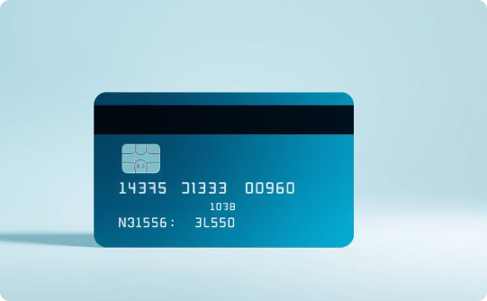
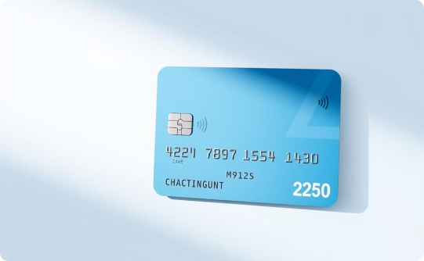
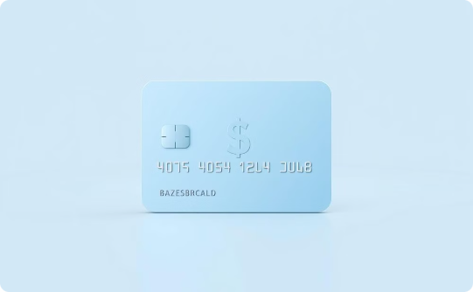
Introduction
High Interest Rates on Fixed Deposits
Zero Annual Fees
Cashback Rewards
Enjoy the convenience of zero annual fees, making the Youp Credit Card a cost-effective financial solution.
Earn cashback rewards on your purchases, adding value to your everyday spending.
The Youp Credit Card offers high interest rates on fixed deposits, giving you a chance to grow your savings efficiently.

Slide 3






Key Features
8% Interest on Fixed Deposits
Up to 90% Credit Limit
Zero Annual Fees
Up to 5% Cashback on Purchases
Grow your savings with our high interest rates.
Enjoy a generous credit limit for your needs.
No hidden charges, just pure value.
Earn rewards for your everyday spending.
Exclusive Lounge Access
Contactless Payments
Enjoy exclusive benefits and services.
Make quick and secure payments with ease.

Slide 4

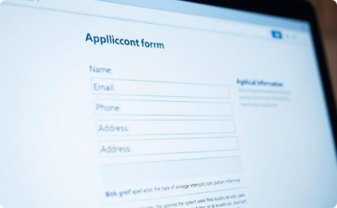


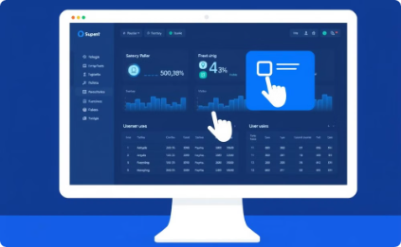
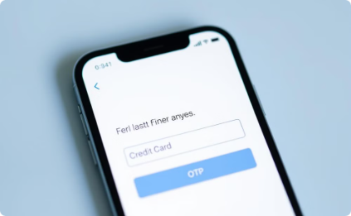
How the Website Works
Click 'Apply Now'
Enter Personal Details
Online KYC Call
Show Documents
Start your application process by clicking the 'Apply Now' button on our homepage.
Enter your personal details in the application form, providing accurate information for a smooth process.
You will receive a link for an online KYC video call. This is a quick and convenient way to verify your identity.
During the video call, you will need to show your PAN card, Aadhaar card, and provide your signature.
Admin Input
Login After 24 Hours
Our admin team will then manually generate and enter your details into our system.
After 24 hours, you can log in using the last 6 digits of your credit card and an email-based OTP. You will then have access to your new Youp Credit Card.

Slide 5

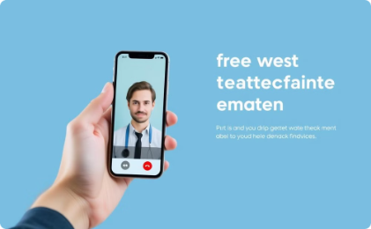





The Youp Credit Card Journey
User Clicks 'Apply Now'
Show ID During Call
Fill Personal Details
Admin Generates Credit Card
Start the application process by clicking 'Apply Now' on our homepage.
You will receive a link for an online KYC video call. Show your ID card during the call.
Enter your personal details in the application form, providing accurate information for a smooth process.
Our admin team will manually generate and enter your details into our system, and generate your credit card.
Receive KYC Call Link
User Logs In
Enjoy Credit Card
Receive a link for an online KYC video call.
After 24 hours, log in using the last 6 digits of your credit card and an email-based OTP.
You will then have access to your new Youp Credit Card.

Slide 6
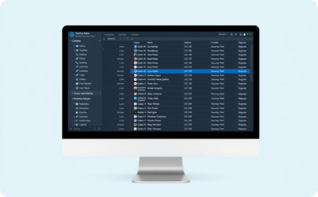
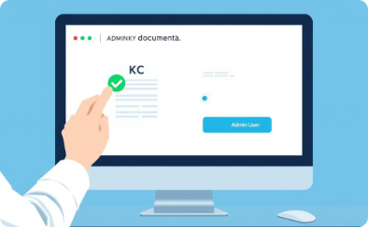
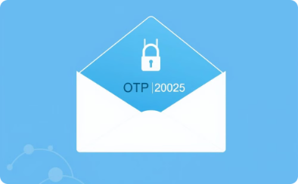
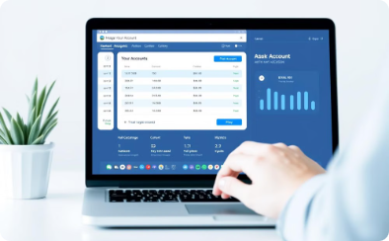
Backend Process
Secure Data Storage
KYC Verification & Card Generation
Secure Login via Email-Based OTP
Online Account Management
User data is securely stored in the database.
Admin verifies KYC details and generates the credit card.
Email-based OTP system ensures secure login.
Users can manage their account online.

Slide 7

Conclusion
The Youp Credit Card website offers a streamlined application process, incorporating robust security measures and enticing features, making it a valuable financial resource for users.

