Slide 1

Evolution of Spark SQL and an Exploration into its Performance Evaluation
GROUP - 12
Team Members:-
Uday Surya Deveswar Reddy K – M15791036
Naveengandhi Ch – M15802874
Selvaharshini Easwaran – M15791351
Shivananda Reddy M – M15803260

Slide 2

Introduction
Apache spark SQL - where complex queries meet seamless optimization, transforming data into actionable insights.
The reference that we considered to work on Spark SQL mainly includes how and why Spark SQL was introduced and its functionalities.
It presents various benefits that are offered by spark SQL such as automatic optimization, complex analytics and so on.
Run time analysis between Spark SQL, Shark (Oldest Version), Impala.

Slide 3

OVERVIEW
In this project, we've explored how Spark SQL handles both structured and unstructured data.
Through two practical scenarios, we'll walk you through the journey of query processing, highlighting the brilliance of the Catalyst Optimizer.
In addition, we performed query runtime analysis by comparing spark SQL with HQL

Slide 4
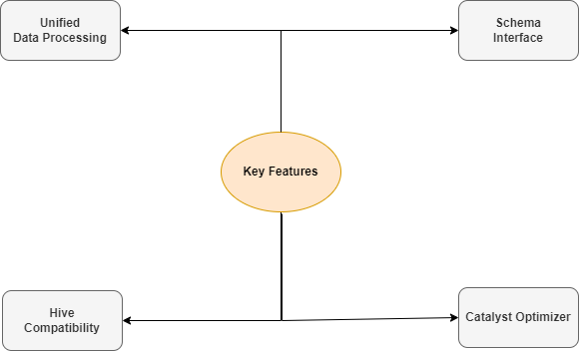
SPARK SQL
Spark SQL provides a programming interface for working with structured and semi-structured data, enabling users to query data using SQL syntax, DataFrame API, and Datasets API.
Spark SQL streamlines the data analysis process by providing a SQL interface on top of the powerful Apache Spark engine.
Its versatility and compatibility with existing tools make it a valuable choice for various data processing tasks, from batch processing to real-time analytics.
Spark SQL Features

Slide 5
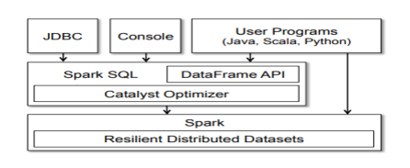
Architecture
Spark SQL includes four key libraries in its architecture for processing relational and procedural data.
The Data Source API supports universally structured data insertion and storage, as well as a variety of formats and third-party interactions.
The DataFrame API represents distributed data sets in the form of named columns, similar to SQL tables.
The SQL Interpreter and Catalyst optimizer which was built based on Scala.
Finally, the Spark SQL serves as the entry point for structured data operations, allowing the construction of data frames and the execution of SQL queries.

Slide 6

Advantages
Simplified Data Processing Provides a familiar SQL interface for data processing, making it accessible to data analysts and developers with SQL expertise.
Integration Capabilities Integrates with various data sources, such as Parquet, Avro, ORC, JSON, and external databases, enabling unified data analysis.
Real-time Analytics Supports real-time stream processing through Structured Streaming, allowing SQL queries on live data streams.

Slide 7
Installation requirements
Prerequisites | Details
Java Version | Minimum version 8 is required to run Spark SQL.
Scala Support | Scala is necessary as Spark is written in Scala.
Spark Version | Spark 3.2.4 version used in the setup.
Scala Version | Scala 2.12.15 used for programming in Spark.
Storage System | Meta storage used as the default storage system.
Environment Setup | Local mode chosen for easy access and flexibility in testing.

Slide 8

DATASET DESCRIPTION AND SQL QUERIES
In the age of big data, the ecommerce industry relies on data analysis for valuable insights.
This study utilizes a Kaggle-sourced ecommerce dataset to perform Spark SQL query processing.
Utilizing data, four SQL queries are formulated to perform run time analysis and explore query processing and its optimization.

Slide 9
Scenario 1
In this module, we will mainly focus on demonstrating two use cases:- 1. Creation of schema in spark SQL and insertion of data from CSV file format to their respective SQL table. 2. An introduction to phases involved in spark SQL query processing.
In the proposed work, there are three tables, created in the spark SQL which are utilized to explore the system.

Slide 10
Data storage in spark
Spark SQL does not have its own storage system; instead, on it using its built-in metadata storage as its data storage backend.
The warehouse directory is a location on HDFS where spark stores table data and managed tables metadata.
The support of procedural language is necessary in spark to create schema in the spark SQL.
In this work, we utilized Scala programming language as a support to the SQL for creation of tables.

Slide 11
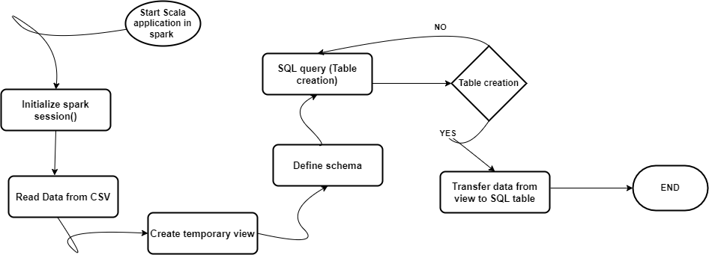
Database schema
There are certain steps need to be follow when one wants to create schema in spark SQL from various other file formats. The process has been represented in the below figure:-

Slide 12
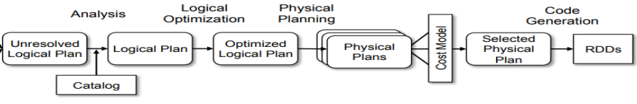
QUERY PROCESSING IN SPARK SQL
In spark SQL, when an employee or analyst wants to retrieve data with specific conditions, the query goes through various phases.
For example, analyst wants to count number of orders received from each state.
SELECT State, COUNT(*) as TotalOrders FROM ListofOrders GROUP BY State

Slide 13
Query processing (contd..)
SQL query is analyzed for its components: SELECT, FROM, and GROUP BY clauses. It selects 'state' column and counts orders, grouping by 'state.’
High-level plan is formed, specifying 'state' selection and count operation, followed by grouping based on 'state.’ Then it undergoes optimization.
Optimized plan is converted into physical execution plan, detailing distributed operations for aggregating order counts per state.
The query is executed in parallel across cluster nodes, calculating counts for each state individually. Intermediate counts are then combined, resulting in the final total order counts per state.

Slide 14
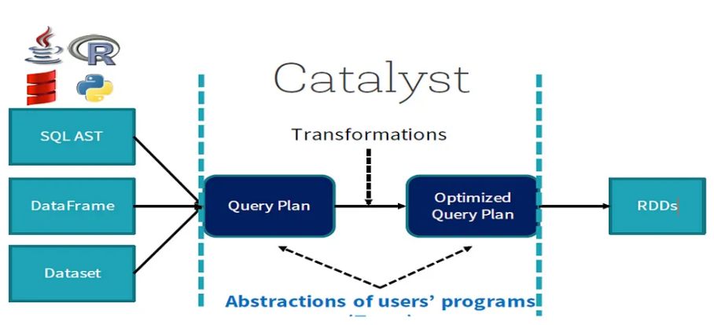
SCENARIO 2
We examine into the important role of the Spark SQL Catalyst Optimizer in enhancing query performance.
Explored how this optimizer works at the logical plan level, employing techniques to improve execution efficiency.
Highlight how Catalyst Optimizer leverages techniques like filter pushdown and join reordering to boost query performance.
Showcase the impact of these optimizations within the context of a specific query.

Slide 15
CATALYST OPTIMIZER
Add
The optimizer aims to enhance the logical query plan by applying predetermined rule-based optimizations.
The optimizer creates multiple optimized physical plans from the initial logical plan.
The chosen plan is transformed into bytecode using Scala's quasiquotes, with cost-based optimization for efficiency.
Attribute(x)
Add
Literal 1
Literal 2

Slide 16
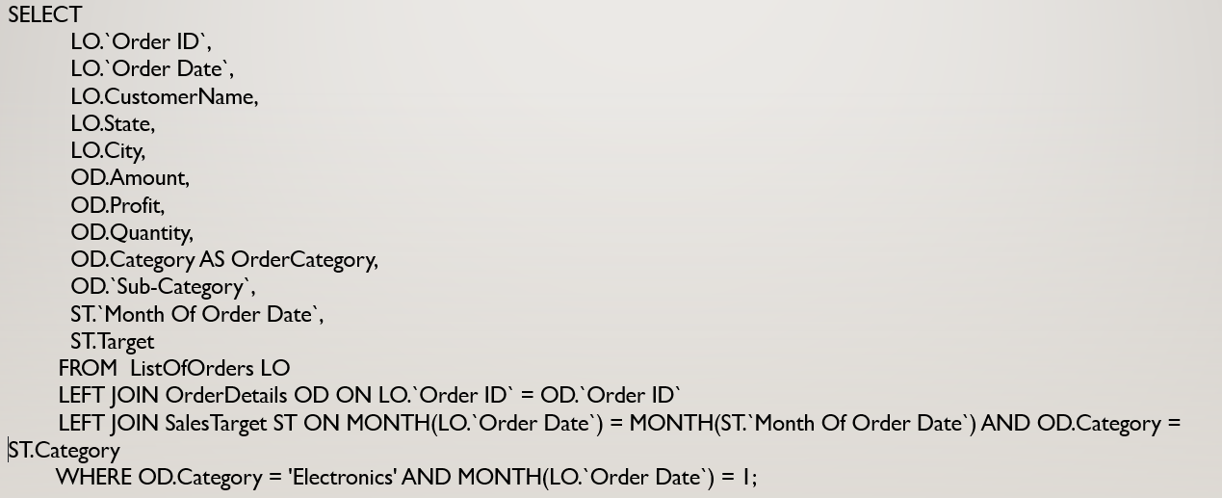
Query OPTIMIZATION - 1
Objective Retrieve data on Electronics orders, details, and sales targets for a specific month.
Query Breakdown (Joins)
1. ListOfOrders (LO) with OrderDetails (OD) on Order ID. 2. Result joined with SalesTarget (ST) based on matching month and category.
Filtering Criteria I. Category:- Electronics II. Month:- January
Query Logic Matches orders with details and aligns them with sales targets for the specified category and month.

Slide 17
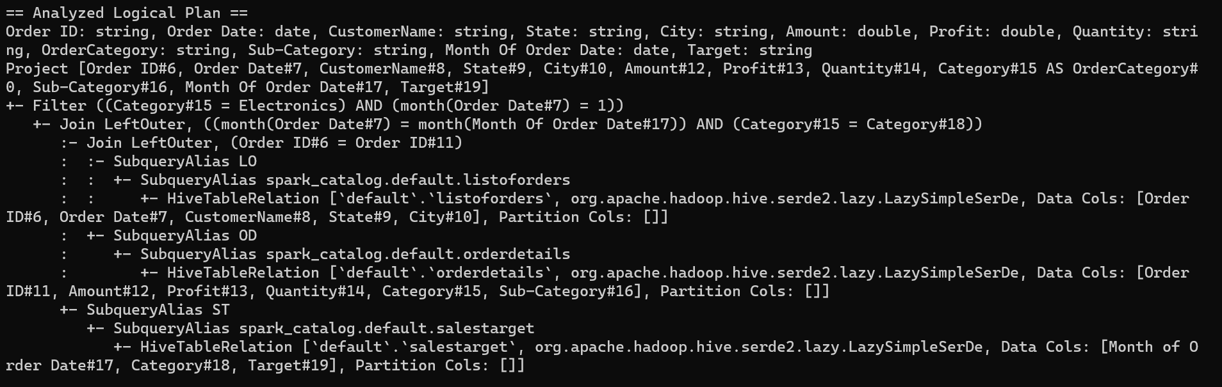
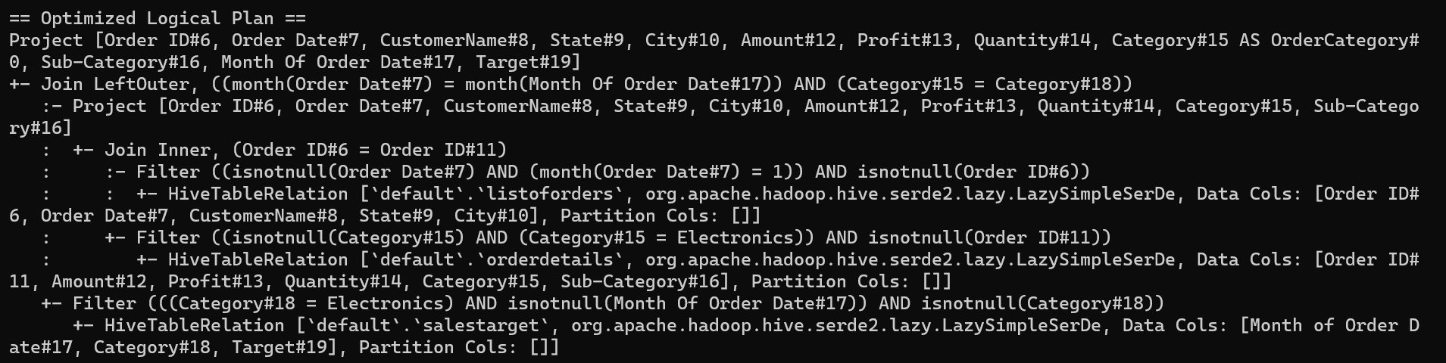






Query -1 (Optimization)
Unoptimized logical plan
Optimized logical plan

Slide 18
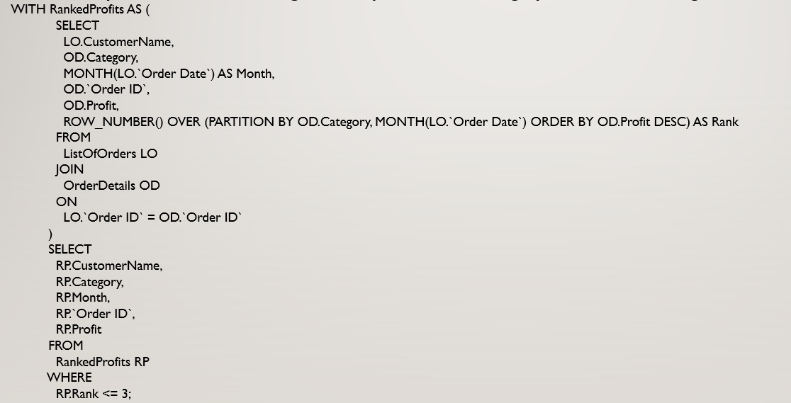
QUERY OPTIMIZATION - 2
Objective Identify the top 3 customers with the highest total profit for each category and month, including order details.
Query Breakdown 1. Utilizes a Common Table Expression (CTE) named "RankedProfits" for ranking profits within each category and month. 2. Employs a JOIN operation between ListOfOrders (LO) and OrderDetails (OD) on the "Order ID" to retrieve relevant information.
Query Logic The ROW_NUMBER() function is used within the CTE, and it is partitioned by both the category and the month of the order date.

Slide 19
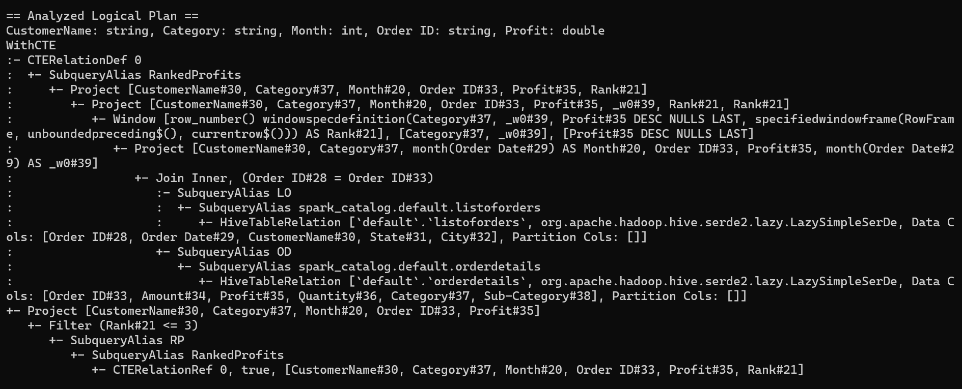
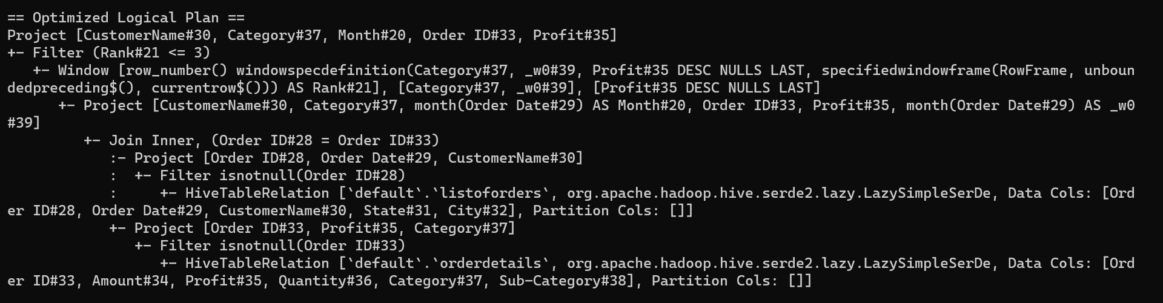










Query -2 (Optimization)
Unoptimized logical plan
Optimized logical plan

Slide 20
OPTIMIZATION TECHNIQUES
Join Type Optimization: As it recognized that the left outer join was not necessary for the query's purpose, thus reducing data and improving performance.
Filter Optimization: In the optimized plan, the filtering condition for the rank (top 3) has been pushed down to the final step of the plan (Query 2).
Column Pruning:- The optimizer has pruned unnecessary columns from the CTE, selecting only the columns needed for the final result.
Redundancy Reduction: Redundant checks for non-null values (e.g., "isnotnull") have been eliminated in the optimized plan, streamlining the execution and making it more efficient (Query 1 and 2).

Slide 21
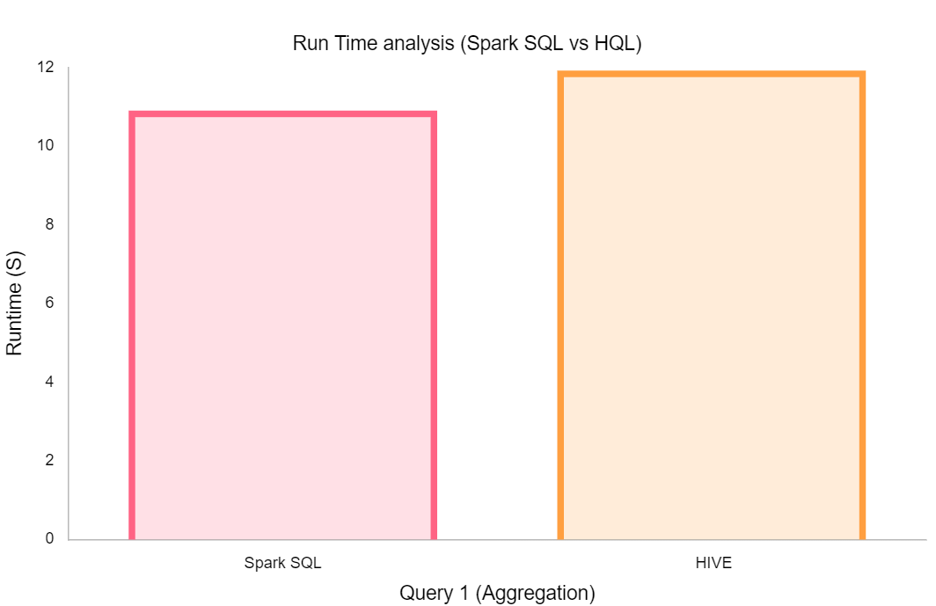
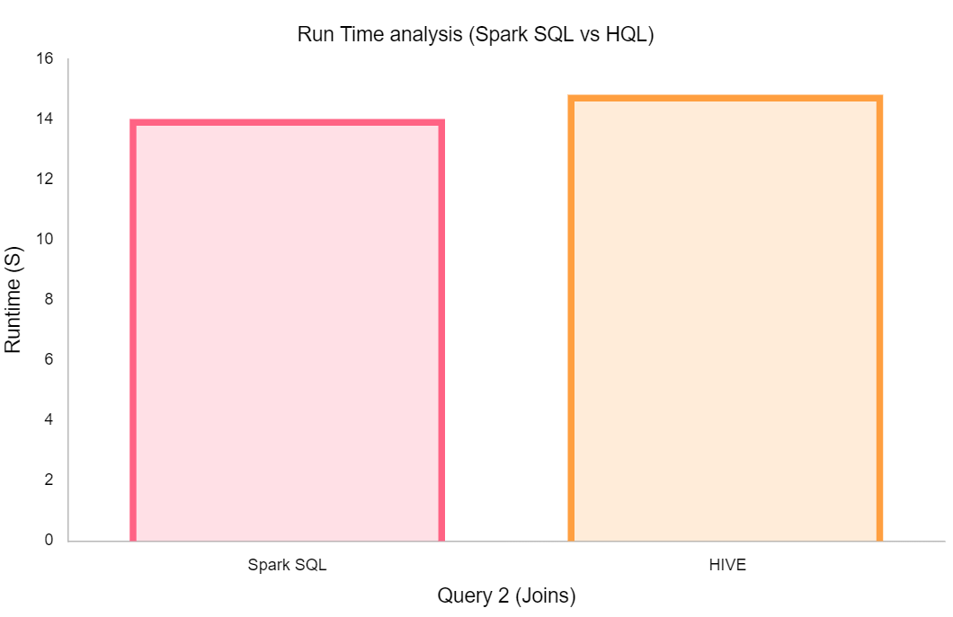
EXPERIMENTAL ANALYSIS
11.92
14.82
10.90
14.01

Slide 22
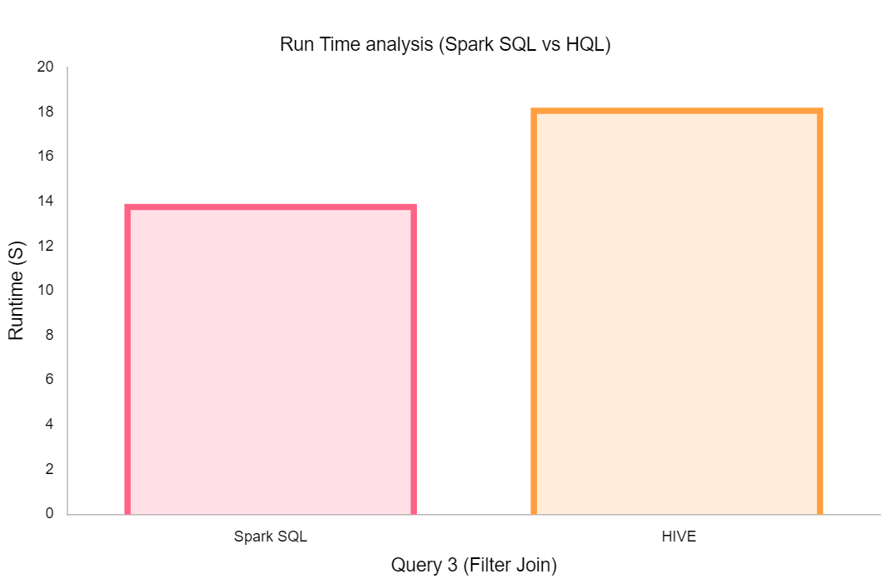
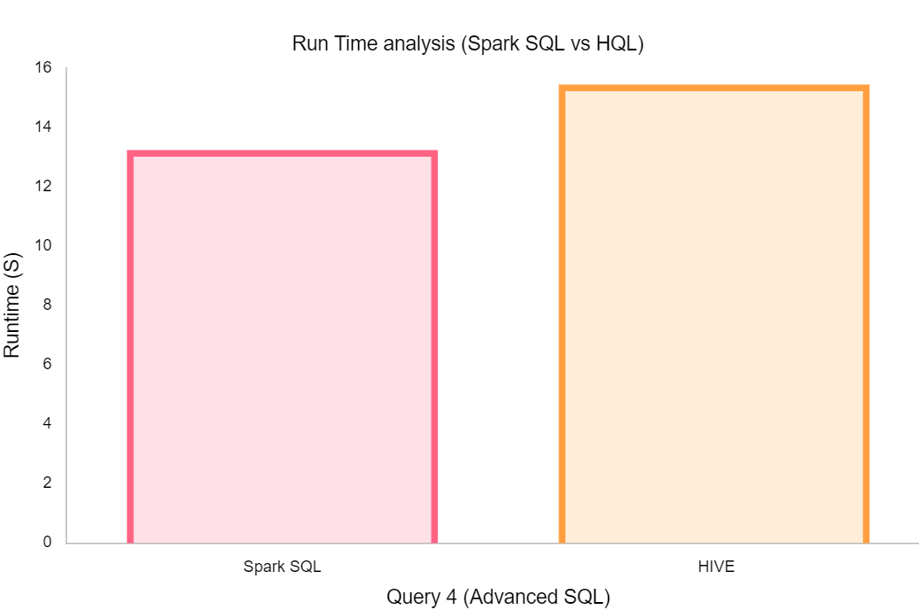
EXPERIMENTAL ANALYSIS (CONTD..)
15.44
18.20
13.24
13.89

Slide 23
Benefits of catalyst
Catalyst optimizer in Apache Spark's SQL engine is unique in several ways:
Logical and Physical Optimization:- It generates optimized logical plans and explores multiple physical execution plans to find the most efficient one.
Cost-Based Optimization: Catalyst incorporates cost-based optimization, which means it considers the estimated cost of execution for various plans.
Cross-Language Support: Catalyst is designed to work seamlessly with multiple programming languages.
Adaptive Query Optimization: Catalyst can adapt to runtime statistics through the Adaptive Spark Plan feature.

Slide 24

THANK YOU!!
ANY QUESTIONS?

Slide 25
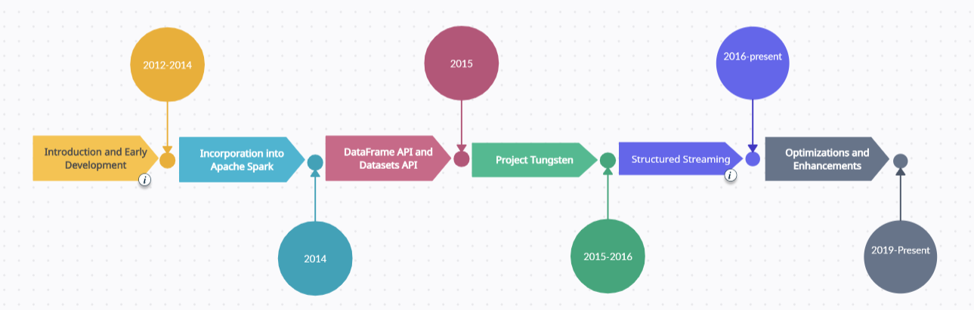
SPARK SQL HISTORY

Slide 26
SUMMARY OF RESEARCH PAPER
Spark SQL makes data processing easy by addressing the problem of connecting big data frameworks with relational databases.
Predicate pushdown and constant folding are two of the optimizations used by Catalyst Optimizer, which cleverly rearranges SQL query operations to reduce disc I/O and data shifting.
Across addition to guaranteeing quick query execution, this optimisation process enables Spark SQL to adjust to changing workloads and data patterns.
Spark SQL is a key analytics tool because of its capacity to analyse relational and structured data effectively, as demonstrated by the integration of Catalyst Optimizer.

Slide 27
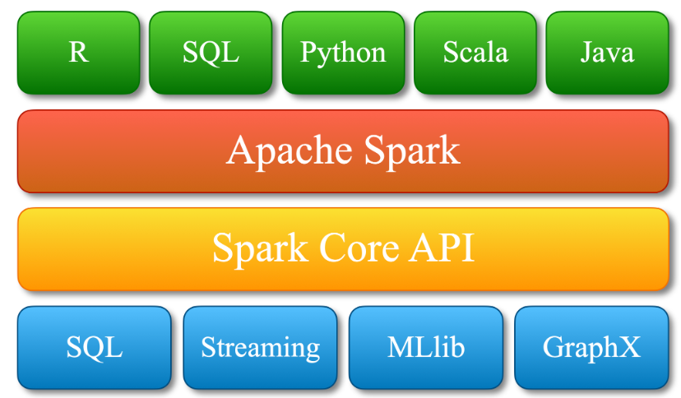
APACHE SPARK
Apache Spark is an open-source, distributed computing system that provides a fast and general-purpose cluster-computing framework for big data processing and analytics.
It offers in-memory processing and can process large datasets in a distributed and parallel fashion, making it highly efficient.
Spark Components

Slide 28
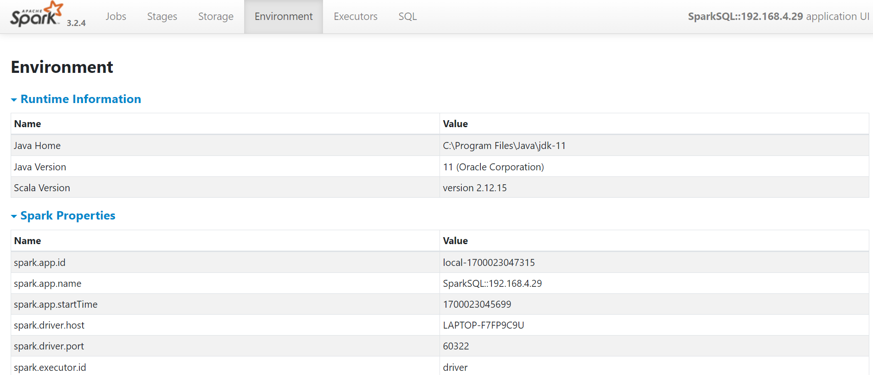
Scenario 1 (contd..)
In the context of Spark SQL, the Spark Web UI remains a valuable tool for monitoring and optimizing Spark SQL queries and jobs.
For Spark SQL queries, the Spark Web UI includes statistics related to the SQL execution. This is valuable for understanding the performance characteristics of your SQL queries.
The Directed Acyclic Graph (DAG) visualization in the Web UI provides a graphical representation of the execution plan for Spark SQL queries.
Spark SQL queries are executed by Spark executors on worker nodes.
The Spark Web UI provides information about the resource usage of these executors, helping you optimize the configuration for better performance.
Web UI Environment

Slide 29
OPTIMIZED QUERY EXECUTION (SCENARIO 2 CONTD..)
A number of basic actions that are essential for effective query execution are included in the execution plan of query.
After, optimizing the logical plan, the optimizer generates multiple physical plans, and finally elects the most optimized plan based on cost model.
Catalyst optimizer goes through a series of rule-based transformations, to convert logical plan into physical plan, that is more efficient to execute on a distributed cluster
The optimizer takes into account statistics about the data and the cluster's characteristics to make informed decisions about the most efficient way to execute the query.
Optimizations related to data partitioning and shuffling are crucial for performance. In some cases, the optimizer may employ code generation techniques to dynamically generate bytecode for specific tasks.
The optimizer may decide to cache intermediate results or broadcast small datasets to optimize subsequent stages of the query.

Slide 30
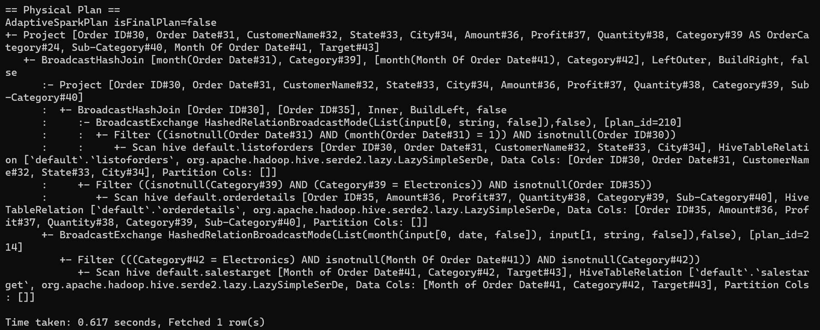
PHYSICAL PLAN FOR FILTER JOIN QUERY
The physical plan aims to minimize the amount of data movement during the execution of operations like joins and aggregations.
The "Filter" procedure starts by reading the "listoforders" table and selecting entries where the "Order Date" is January and not null.
Broadcasting this filtered data improves data distribution across worker nodes for parallel processing; this is known as "BroadcastExchange."
In order to reduce data shuffling and enhance efficiency, the next phases use "BroadcastHashJoin" procedures, in which records with matching keys are effectively connected using hash algorithms.

Slide 31
OPTIMIZED PHYSICAL PLAN (CONTD…)
Furthermore, there are 'Project' procedures that designate particular columns for the output.
The plan consists of many 'Filter' operations that refine datasets according to predetermined criteria.
An 'AdaptiveSparkPlan' is employed, indicating adaptability to optimize the plan further based on runtime statistics, ensuring efficient execution.
After adapting an optimized plan, the plan will forwarded to the RDD’s (Resilient Distributed Datasets) for execution of data retrieving process.

Slide 32
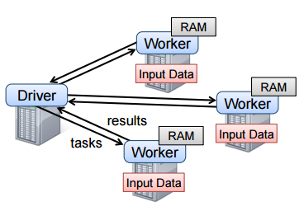
RESILIENT DISTRIBUTED DATASTRUCTERS (RDD’s)
(RDDs) are the fundamental data abstraction representing distributed collections of objects across a cluster.
The results of individual tasks from physical plan are aggregated to produce the final result. This may involve shuffling data across the network, especially in operations like groupBy, join, or reduceByKey.
At this point, the final result is materialized as one or more RDDs, which can be stored in memory or persisted for later use.
If any of the tasks fail during execution, Spark uses lineage information stored in the RDDs to recompute only the necessary partitions, ensuring fault tolerance.

Slide 33
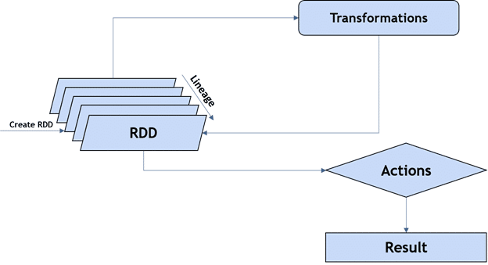
RDD’s (Contd..)
RDDs in Spark support two types of operations: transformations and actions.
Transformations are operations on RDDs that create a new RDD from an existing one.
Actions are operations on RDDs that trigger computation and return values to the driver program or write data to an external storage system.
However, transformations are lazy in Spark, meaning they don't immediately compute the result.
Unlike transformations, actions force the execution of the transformations specified in the RDD lineage.

Slide 34

EXPERIMENT ANALYSIS
Dataproc, a managed cloud service provided by Google Cloud Platform, is a platform extensively employed for conducting experiment analysis.
Offering managed clusters for Apache Spark and Apache Hadoop, Dataproc provides an ideal environment for executing large-scale data processing tasks and intricate analytical experiments.
In this study, to perform run time analysis between spark SQL and HIVE QL, Dataproc has been utilized.

Slide 35
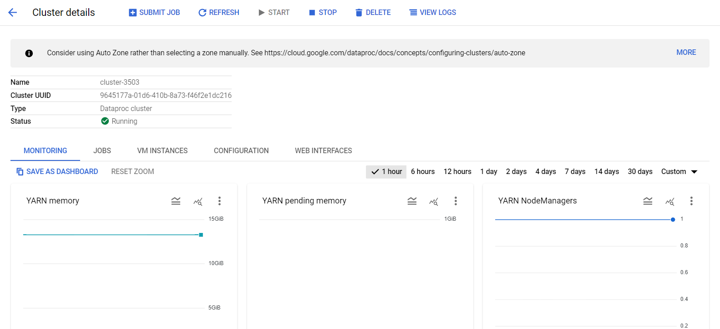
EXPERIMENT ANALYSIS (Contd..)
In the research work, comparison between spark SQL, shark, and impala has been employed.
As shark services are terminated by Apache, the run time analysis between spark and hive has been performed.
To implement the work, cluster with 2 worker nodes has been created in the cloud and a data bucket has been created for the purpose of data storing and retrieving.
By examining the results, it was clear that Apache spark SQL is faster then the HIVE.
Cluster Information

Slide 36
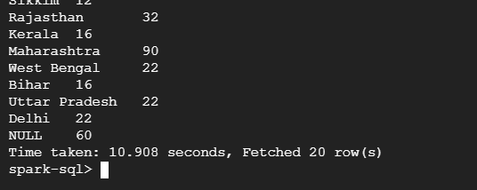
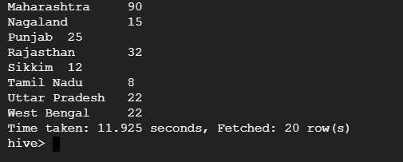
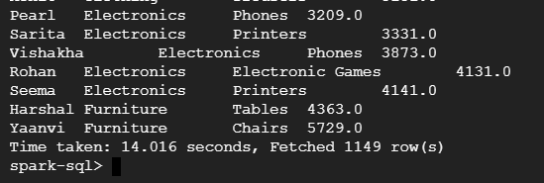
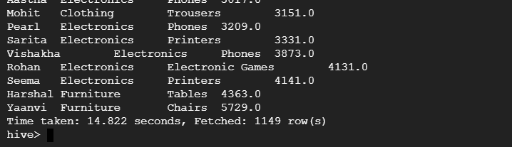
EXPERIMENT ANALYSIS (Contd..)
Query 1 (Spark SQL)
Query 1 (Hive)
Query 2 (Spark SQL)
Query 2 (Hive)

Slide 37
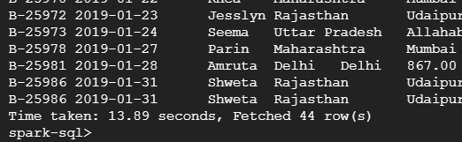
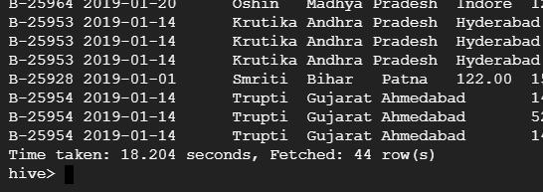
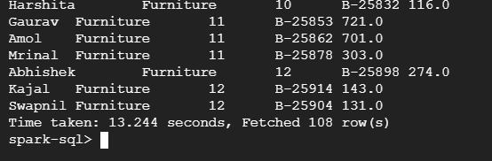
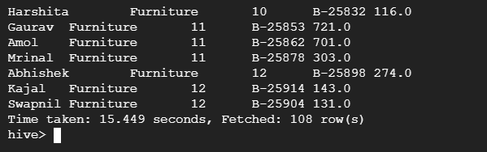
EXPERIMENT ANALYSIS (Contd..)
Query 3 (Spark SQL)
Query 3 (Hive)
Query 4 (Spark SQL)
Query 4 (Hive)

Slide 38
REFERENCES
Demo Video (Implementation)
https://drive.google.com/file/d/1sy-DuWq3n5519SgodCDY04F6lkMyoUET/view?usp=drive_link
Armbrust, M., Xin, R. S., Lian, C., Huai, Y., Liu, D., Bradley, J. K., ... & Zaharia, M. (2015, May). Spark sql: Relational data processing in spark. In Proceedings of the 2015 ACM SIGMOD international conference on management of data (pp. 1383-1394).
SQL Queries:- https://drive.google.com/file/d/19RKHoXxJZ1xyQulxOmOdBq9oS8ZLwuno/view?usp=drive_link
Data set:- https://www.kaggle.com/datasets/benroshan/ecommerce-data

