Slide 1

FinShield AI Assistant
Where Machine Learning Meets Financial Intelligence - Your Real-Time Risk, Fraud & Market Copilot.
👨‍💻 Project made & designed by Uday Sahu
FINTECH AI
MACHINE LEARNING
EXPLAINABLE AI

Slide 2
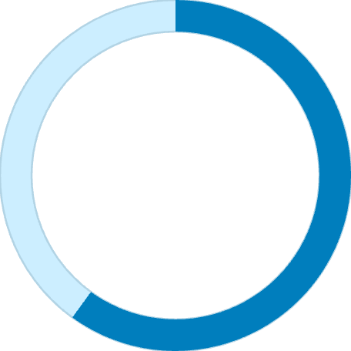

FinShield AI Assistant Overview
An end-to-end ML + Explainable AI platform for financial risk assessment. Turning customer, credit, market,
and sentiment data into a unified 0–1000 FinShield Score.
Core Tech Stack
Platform Scale
Python
Core ML & data pipeline
60K
SQL
Structured data queries
Customers Analyzed
ML Models
Classification & detection
1000
SHAP
Explainable AI layer
Streamlit
Max FinShield Score
Interactive UI & chatbot

Slide 3
Problem & Objective
⚠️ The Challenge
✅ Our Objective
1
Build a transparent, data-driven platform combining six integrated capabilities into one unified intelligence layer:
Manual & Slow
Credit-Risk Classification
Traditional credit-risk assessment relies on slow, human-driven processes that cannot scale to modern data volumes.
Segment customers into risk tiers with ML precision.
Fraud Detection
2
Anomaly-based flagging of suspicious profiles.
Biased Decisions
Market Forecasting
Legacy models embed systemic bias, producing unfair outcomes for underrepresented customer segments.
Time-series prediction of economic conditions.
Sentiment Analysis
3
News & media signal scoring via TF-IDF.
Black Box ML
Explainable AI (SHAP)
Existing ML models lack transparency - regulators and analysts cannot interpret or trust their outputs.
Every decision backed by interpretable feature attribution.
Conversational Chatbot
Natural language decision-support for analysts.

Slide 4
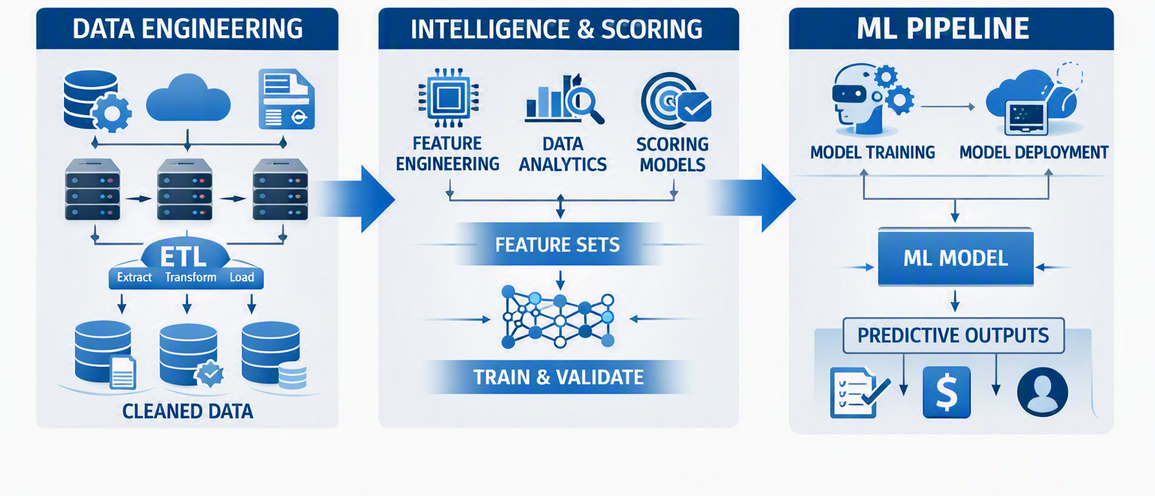
Pipeline & Methodology
Part 1 : Data Engineering
Part 2 : ML Engine
Part 3 : Intelligence & Scoring
Customer profiles & credit history
Logistic Regression & Random Forest : risk classification
Composite FinShield Score (0–1000)
Market & economic data feeds
Isolation Forest : fraud detection
SHAP explainability layer
News sentiment streams
ARIMA : market forecasting
Risk monitoring & AI recommendation engine
TF-IDF : sentiment scoring

Slide 5
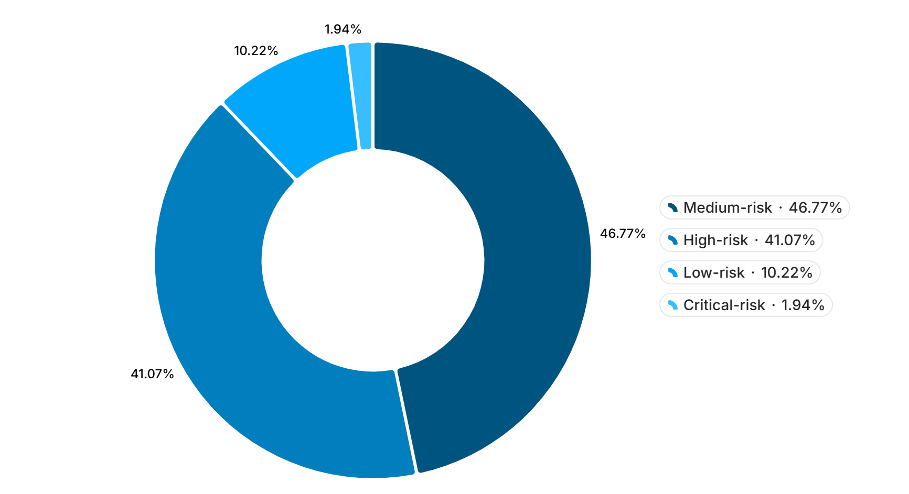

Key Results & Insights
Risk Distribution — 60,000 Customers
Model Performance Metrics
73.4%
Model Accuracy
0.93
ROC-AUC Score
8.03%
Loan Default Rate
4,817 customers
2.0%
Fraud Flagged
1,200 customers
Medium and high-risk customers together represent over 88% of the portfolio, underscoring the platform's critical role in continuous monitoring.
~66.5% of model importance is driven by credit score — the single most predictive feature across all risk tiers.

Slide 6

Chatbot Demo & Conclusion
Interactive Intelligence - Streamlit Chatbot
The Path Forward
The FinShield chatbot enables analysts to query any customer's FinShield Score, alert level, and recommended actions in plain natural language running fully offline on saved model outputs. No live API dependency required.
FinShield demonstrates a production-ready foundation for transparent, AI-driven financial risk management. Clear future scope includes:
Real-Time Data Integration
1
Live streaming pipelines replacing batch inference for instant risk updates.
💬 "What is Customer #4821's risk level?"
→ High-risk. FinShield Score: 312. Recommend credit limit reduction.
Generative AI Integration
LLM-powered narrative explanations and proactive risk advisory generation.
2
💬 "Flag any fraud alerts today?"
FinShield is built to scale — from 60K customers today to enterprise-grade deployment tomorrow.
→ 3 anomalies detected. Isolation Forest confidence: 94%. Review recommended.

