Slide 1
Water Management system -
through (IOT)

Slide 2
WATER MANAGEMENT THROUGH -(IOT)
PROBLEMS:
Using dual connections through one connection.
Lack of finding pipe breakage in any locality.
No approximate metering in water supplied .
Huge wastage of manpower and time.
TEAM MEMBERS
V Naveen Kumar(II CSE)
V Uday Sai(II ECE)
T Lohit Kumar(II ECE)

Slide 3
DETAILED PROBLEMS :
The water supply board faces many problems in solving the menances of common people.
And inadequate supply of water to some areas,without finding the actual problem of where it arises.(breakage of pipes,leakage of pipes).
And not responding effectively to the people who lodge a complaint.
And the water quality delivered to the people can not be calculated.
And the water resource sent to them is not approximate due to worn out meters.

Slide 4
Solution:
Hyderabad water supply board is the 3rd largest board in supplying the water .
So the solution to all these problems is connecting the meters to internet through (Iot).
We use flow sensors,pressure sensors,metering program,time stamp algorithm and dc 5v battery, to transmit data gsm module is used.
So by this we can reduce the risks of malpractising of water resources.

Slide 5
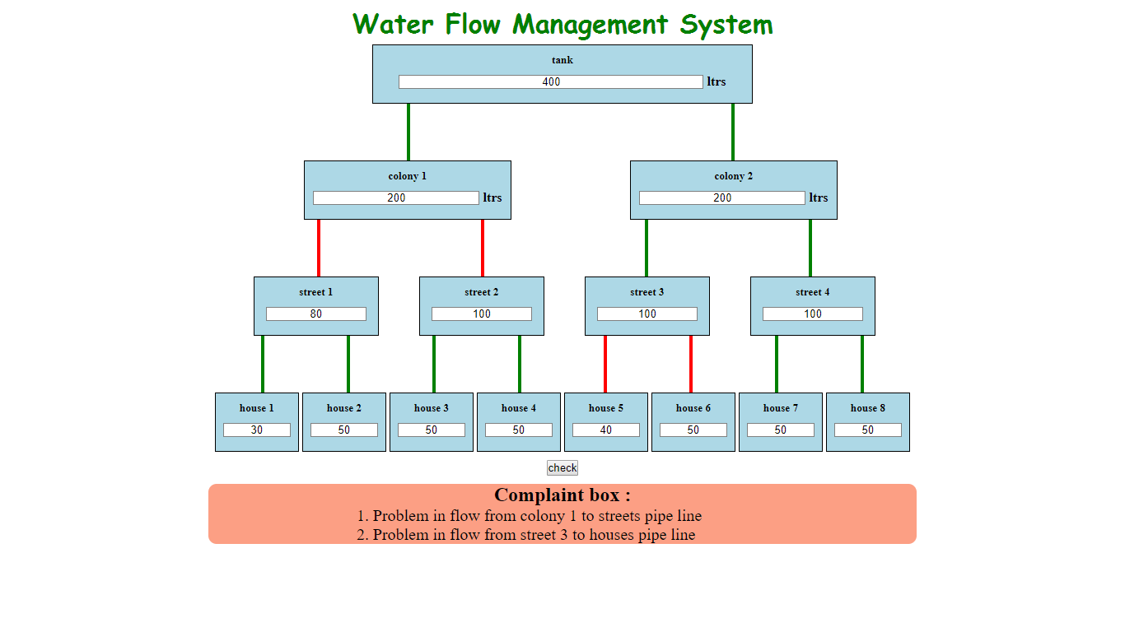
demo model-of management system.

Slide 6
About Demo Model:
The above shown image is a working demo model which is written in JavaScript and a framework called vue.js
Since we cant use sensors and IOT in demo model we use manual input Textfields to interpret the errors that occur in flow of water.
If there is any discrepancy in flow of water it automatically detects the problem in that particular area and it stacks in the complaint box.
In the practical world if implemented perfectly the board receives the message of where the problem occurred and it can be resolved.

Slide 7
Uses
Malpractices can be easily detected and avoided.
If any pipe lines are break in between the flow can be easily and precisely detected with this method.
The volume of water used by the individual as well as a community can be detected.
The billing system can be made auto generate.
There is no need of any man power to detection or prediction of usage of water.
Auto generation of complaints can be achieved and solved efficiently.
Quality of water can be improved by the keeping the pH sensor .which sends the quality report to the board.
Water level sensor indicates the water level at any places in hilly areas etc and the pressure sensor senses the pressure of water .

Slide 8
WORKING:
This system can be implemented on water storage tanks for safe and waste less consumption.
Water when supplied from reservoir checks the pH .
And the water is then supplied to the storage tank.
This water when filled with water completely then the gates are opened up and as the meter is attached to the valve the flow makes it to increase the count of the water flowed and at every check point it is checked.
The whole data is sent via gsm module to the webpage of the board and they will monitor the data of which colony used the most and which colony used the least.
water board can even predict the future water use in a specified colony from previous data in a specific season.

Slide 9
Hardware used:
Wi-fi/GSM module to send the data to web page.(ESP8266)
Water flow sensor(YF-S201)
Water level sensor(HC-SR04)
pH meter(ETP306)
Arduino board(microcontroller).
5v battery (power supply)
These all are connected into a single component forming a digital water meter.
This checks the water flow and the leakage at certain point .

Slide 10
conclusion
If this is included in our Hyderabad city then water problem will be drastically reduced.
And the water board gets an apt profit for an apt volume they deliver.
And the problems can be identified easily and effectively.
And auto billing system can increase the software employability and the maintenance costs are very low.

