Slide 1
Report Automation

Slide 2
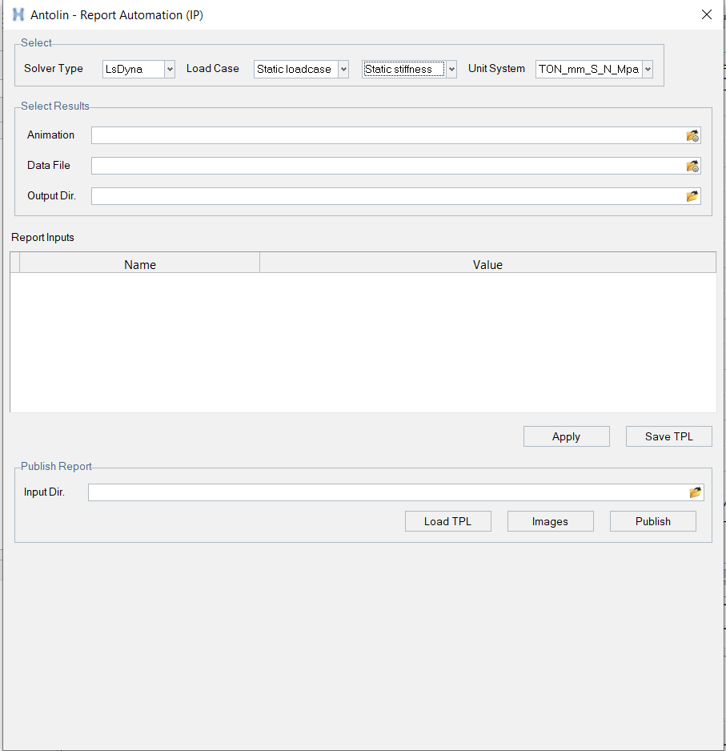
Automation Framework
Solver Type
Load case
Unit system
Single Animation result
Single TH result
Output directory
Report parameters
Apply report
Save TPL
Input directory
Load TPL
Images
Publish

Slide 3
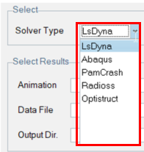
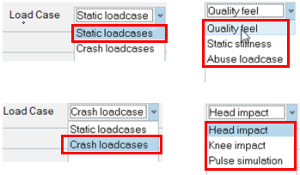
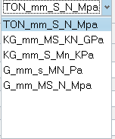
Solver type → User to select solver type
Load case → User to select proper load case. Based on this selection required reporting parameters and ppt template can be used
Unit system → User to select correct unit system
Single Animation result → Provision to select single animation file. It will be used for contours, sections ..etc

Slide 4
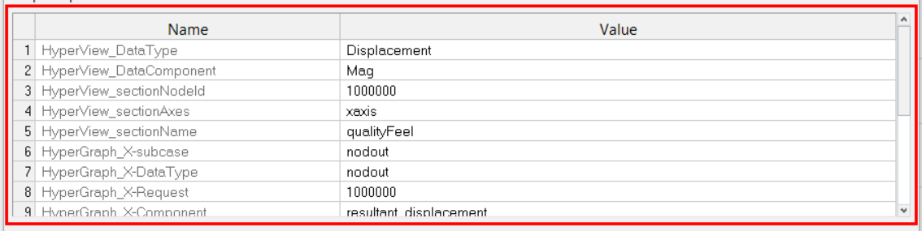
Single data file → Provision to select single TH file. It will be used for plotting graphs
Output Directory → Provision to select output directory. Result will be generated here, including images, tpl file and report ppt
Report parameters → Table will display the default parameters for a load case. These parameters are necessary to generate contours and plots in HV and HG. Table default values are governed by csv files stored in script directory. The Value column can be edited whenever required.
Apply report → Tool will read the animation result, TH result and table parameters to generate the contours and plots. It will be applicable for single result. Once done, user can set the views as required.
Save TPL → Provision to save the TPL file. This TPL will be used for other results in input directory
Input directory → Provision to select the input directory, where all point results are placed. Tool will search for such results in subdirectory and plot using saved TPL

Slide 5
Load TPL → It will apply TPL on all the results in selected input directory.
Images → Tool go through each page, window and capture the images. These images will be used in ppt report
Publish → It will launch python executable in backend and generate ppt report

Slide 6
Framework Advantages

Slide 7
Mimic the manual process
Standard gui widgets, APIs and UX
Only relevant options in GUI
Proper error handling
Scalable GUI
Standard coding practices
No hardcoding
No dependencies
Build python executable to generate ppt
Even if tool crash, no need to start new HW session from scratch. User can resume from same location
User can use existing TPL
No hard stop. If few parameters does not available in result, tool popup message upfront and continue processing

