Slide 1
Pamcrash Thickness Assignment

Slide 2
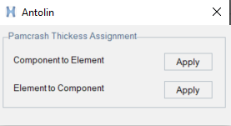
Introduction
Process automation tool has been developed to assign component thickness to element thickness and vice-versa
Support two thickness conversions
Component to Element
Element to Component

Slide 3
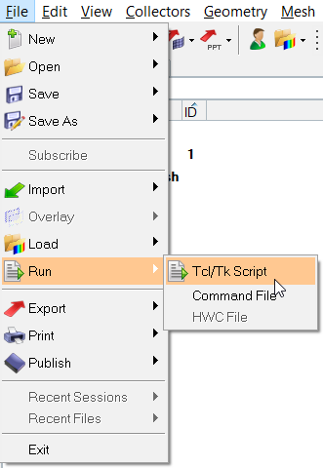
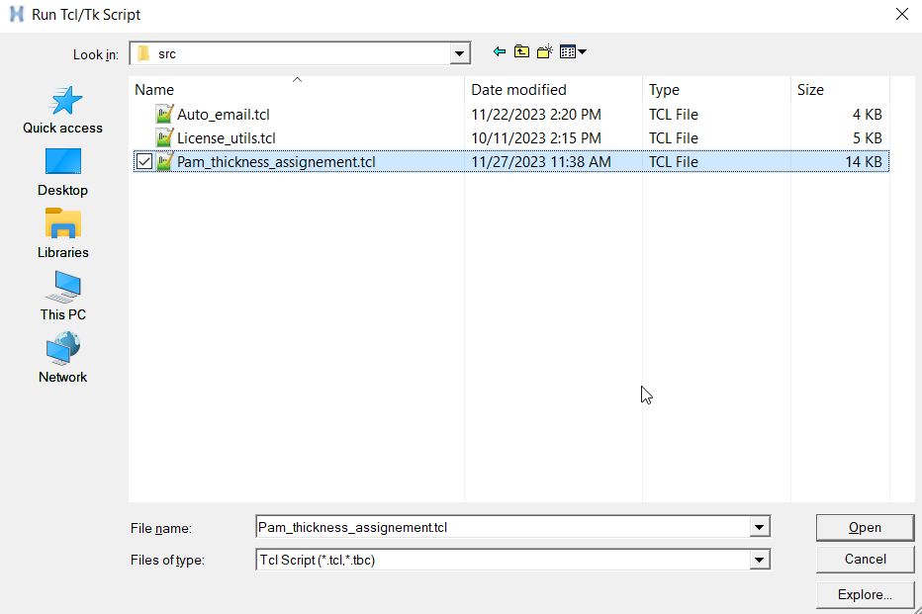
Launching
Select File > Run > Tcl/Tk Script > Pam_thickness_assignement.tbc

Slide 4
User Guide
Load the model in HM database
Case – 1 : Component to Element
Component thickness (H – value) will be assigned to all the elements in a component
Case – 2 : Element to Component
Tool collect same thickness elements in a component
Create new component for each thickness value with thickness included in name
Move same thickness elements to newly created component
Update element thickness (H-value) to 0.00

Slide 5

Pre-requisites
Internet connection : Laptop/Desktop should be connected to internet
Python installation : Python should be installed on your system
Install python library : Execute “pip install pywin32” in windows command prompt. It is one time activity which install necessary python libraries

