Slide 1
Result Converter

Slide 2
Introduction
Process automation tool has been developed to convert d3plot format results into h3d results while allowing flexibility in data types
Tool has capability to look into nested sub-directories and get results for conversions

Slide 3
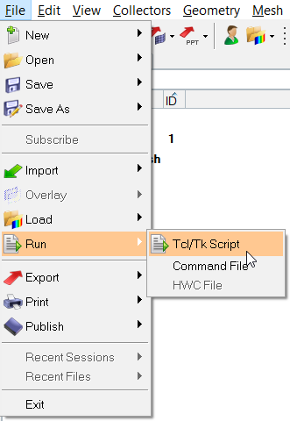
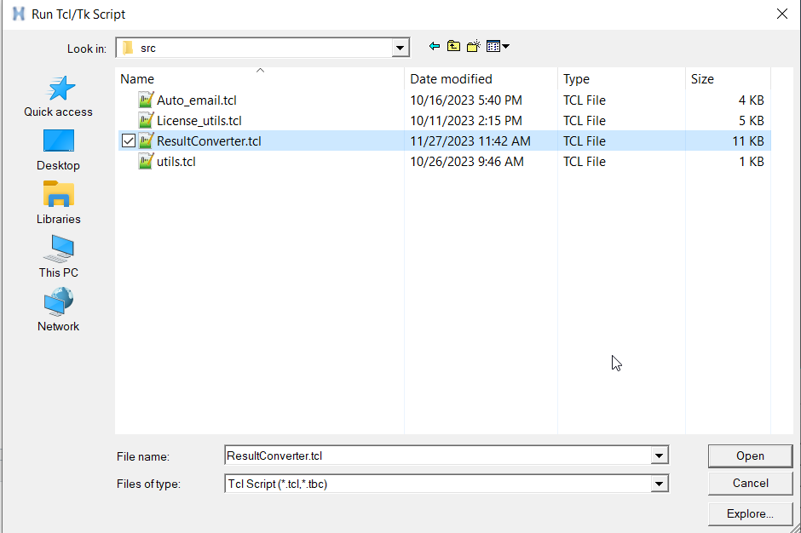
Launching
Select File > Run > Tcl/Tk Script > ResultConverter.tbc

Slide 4
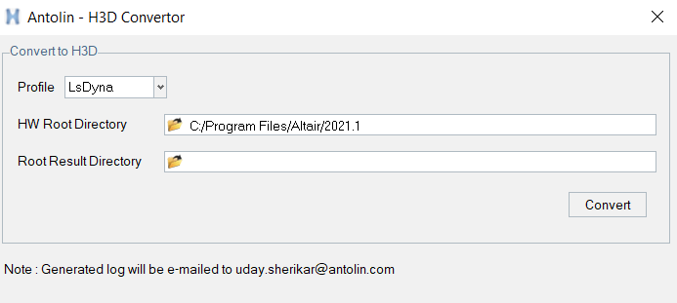
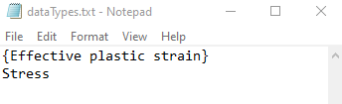
User Guide
Profile : Select parent result type. Default profile is LsDyna
HW Root Directory : Select HyperWorks installation root directory. The tool utilizes HvTrans.exe from the chosen HW directory
Root Result Directory : Select directory containing all results
Manage results : User can control the result types to be written in h3d file using dataTypes.txt

Slide 5
Key features
Batch Processing with HvTrans: H3DResultConvertor PA invokes HvTrans.exe in batch mode, streamlining the result conversion process
Customizable Data Types: The tool utilizes a 'dataTypes.txt' file to store a list of data types that need to be included in the H3D file. You can edit the 'dataTypes.txt' file as per the requirements. Default data types are “{Effective plastic strain}” and “Stress”
Efficient Result Search: PA will efficiently identify d3plot results within nested sub-directories, automatically converting them into H3D files
Simplified Result Output: Tool writes the H3D result in the same directory with the name 'main.h3d’
Auto Email Logs: The tool generate and auto email logs to me. While this feature is still in beta phase, once stabilized, it can be implemented into other process automation tools, enhancing overall functionality

Slide 6

Pre-requisites
Internet connection : Laptop/Desktop should be connected to internet
Python installation : Python should be installed on your system
Install python library : Execute “pip install pywin32” in windows command prompt. It is one time activity which install necessary python libraries

Slide 7
Future Scope
Support on HPC
Support other solver types

