Slide 1
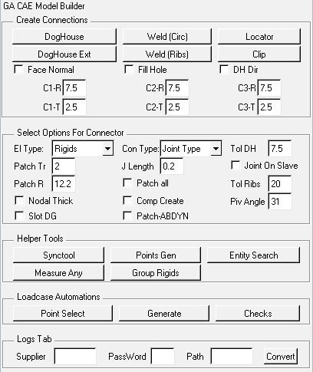
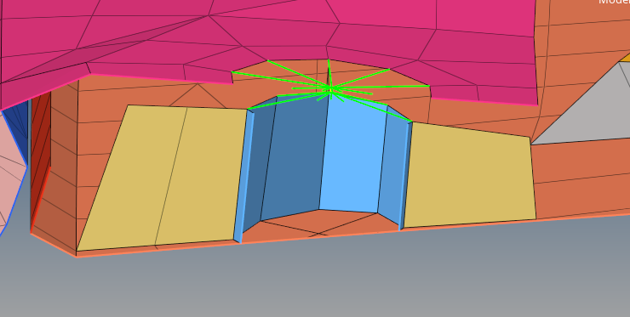
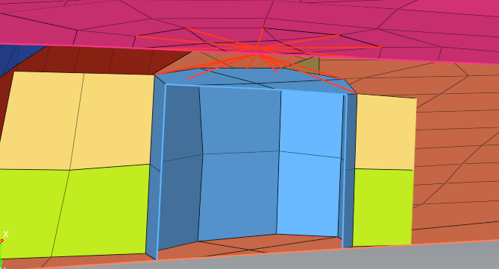
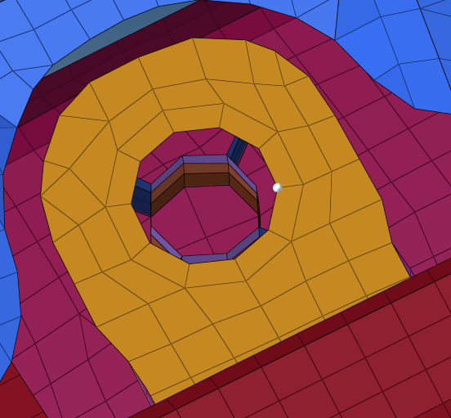
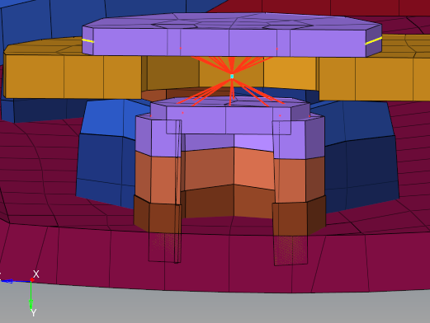
Weld Circular
Without fill hole
Select fill hole to fill the holes.
Shown on the left is a dyna model with and without Fill hole option.
With fill hole
Selection Mechanism
Enter a component name for joint .
Enter a component ID for joint component leave an interval of 10 from previous ID(interval 10)
Always select one node from the curvature of the top surface of the weld.
A patch is default for Pamcrash solver profile.
If Patches are required for Abaqus and Dyna profiles , Please select Patch-ABDYN tickbox.

Slide 2
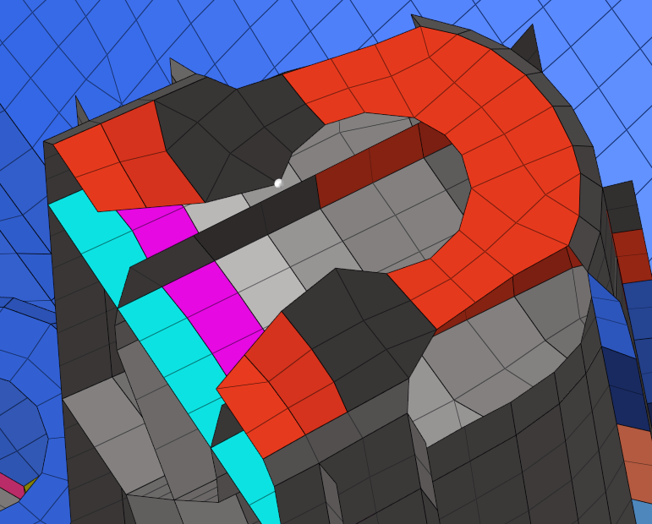
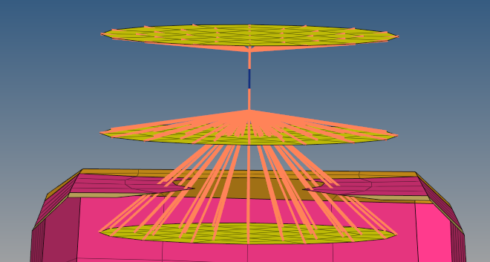
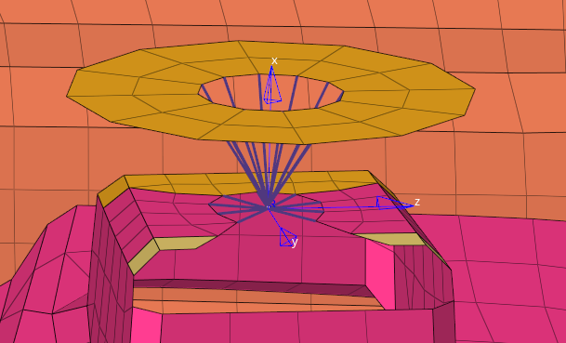
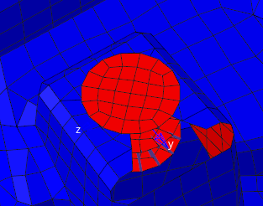

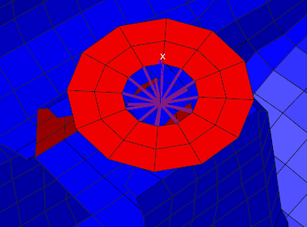

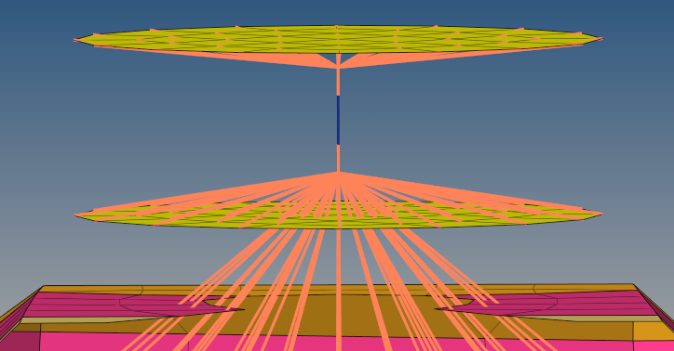
Doghouse
Doghouse Ext
Doghouse
Selection Mechanism
Always select one node from the inner curvature at the top surface of the Doghouse.
Without face normal on blue face
Select fill hole to fill the holes.
Shown on the left is a dyna model with and without Fill hole option.
With face normal on blue face
The patches will be along the normal of The elements for Doghouses .Tick the Face normal check box to take control
Of the direction.
Select joint on slave to create special type of rigid connection. An extended slave branch that connects with joint.
Type in the final joint length required to override the default values.
1.4mm

Slide 3
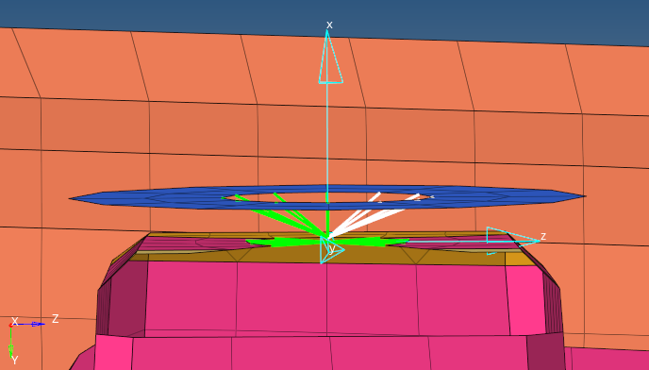

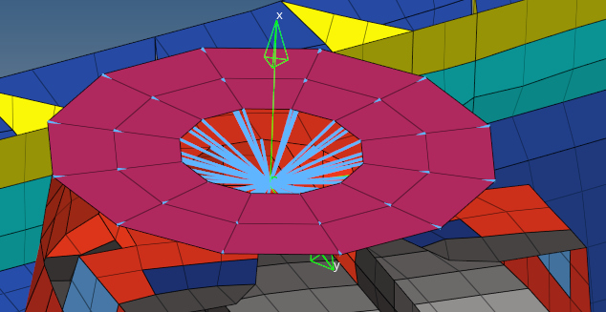
Doghouse (Continued)
Change El Types from rigids to beams to change type of connection. Default is rigids for all solvers.
Patch Radius 14mm
Patch Translate 8mm
With face normal on blue face
Input the Patch radius and Patch translate values for defining the patch translation values and Patch radius values.
Tick patch all to connect all nodes of the patch to rigid body .
By default , only the inner edge nodes of the patch are connected to rigid body.

Slide 4
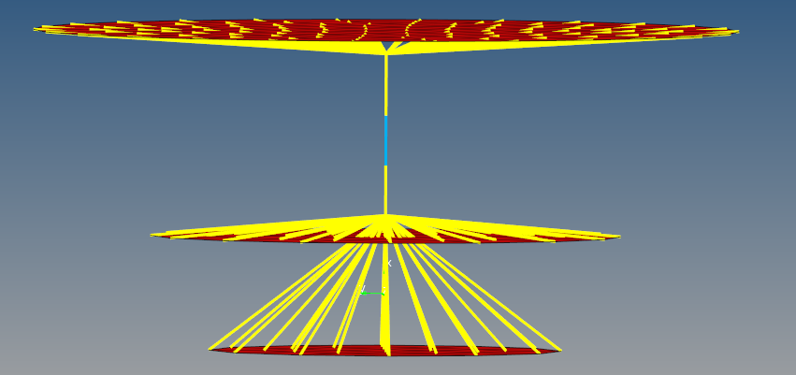
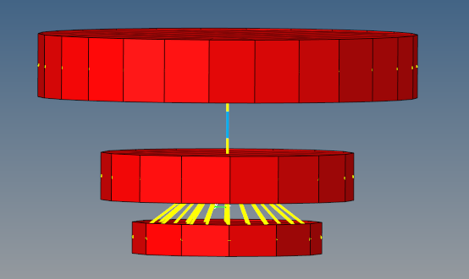
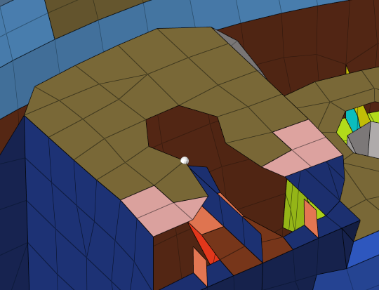
Doghouse (Continued)
C3-R Radius - 12
C2-R Radius - 8
C1-R Radius - 6
Option to specify Dia and Thickness for the patch.
For Pamcrash nodal thickness is defined.
For other solvers- at the moment 1mm constant thickness
C3-T Thickness - 4
C2-T Thickness - 3
C1-T Thickness - 2
Input the Patch radius and Patch translate values for defining the patch translation values and Patch radius values.
Selection Mechanism
Enter a component name for joint .
Enter a component ID for joint component leave an interval of 10 from previous ID(interval 10)

Slide 5
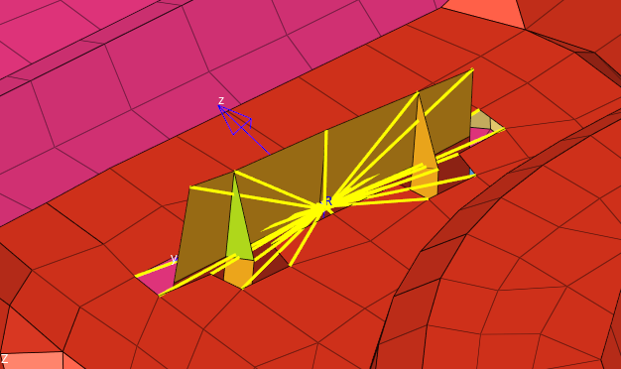
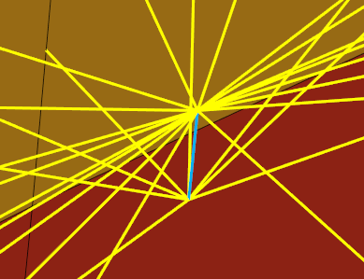
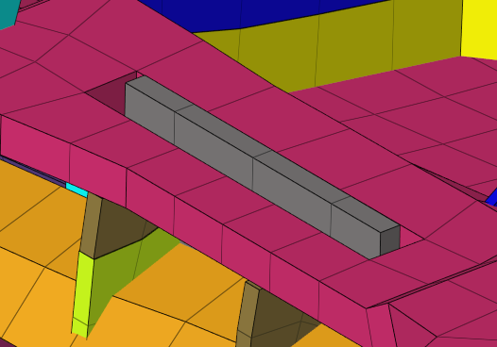
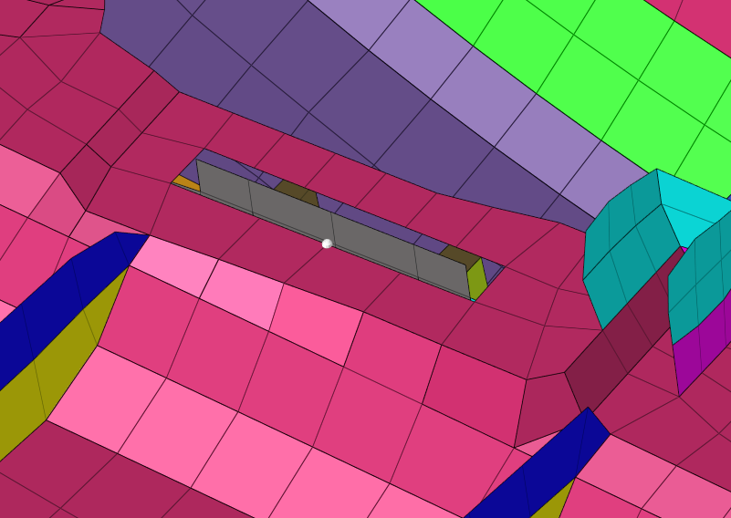
Weld Ribs
Select Weld ribs to create weld rib modelling.
Use Face normal and Tolerance input boxes to control the direction and distance of nodes that needs to be added to the rigids or beams group.
Selection Mechanism
Enter a component name for joint .
Enter a component ID for joint component leave an interval of 10 from previous ID(interval 10)

Slide 6
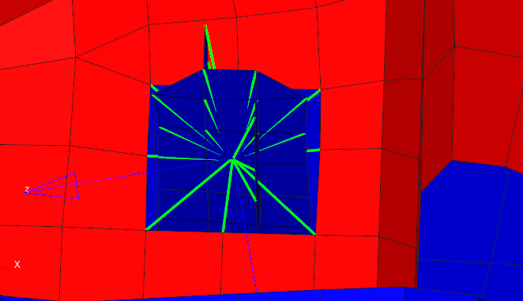
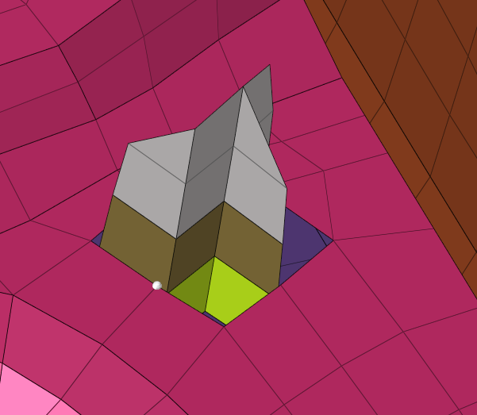
Locator
Select locator create locator connections.
Tick the face normal if the normal of
element of node selected is positive (Red) .
Use Face normal and Tolerance input boxes to control the direction and distance of nodes that needs to be added to the rigids or beams group.
Selection Mechanism
Enter a component name for joint .
Enter a component ID for joint component leave an interval of 10 from previous ID(interval 10)

