Slide 1

Uday Vikram Singh
MACHINE LEARNING INTERNSHIP ASSIGNMENT

Slide 2

Machine Learning Internship Assignment
EXPLORATORY DATA ANALYSIS (EDA)
INTRODUCTION
Exploratory Data Analysis (EDA) is an approach for analyzing and visualizing dataset to summarize main characteristics and get important valuable insights from the dataset.
It is a crucial step in the data analysis process. It involves systematically examining and summarizing
the main characteristics of a dataset to gain a deeper understanding of its underlying patterns, structures and potential relationship between variables.

Slide 3
Machine Learning Internship Assignment
Methods for EDA:
Python’s Plotly library is used for visualizing the plots to observe the relationship
between different features in a dataset.
It also helps in visualizing different performance metrics and creative attributes
performance over the time in Digital Marketing Campaign.
A thorough analysis of relationship between different performance metrics and
creative attributes has been done through Plotly.

Slide 4
Machine Learning Internship Assignment
Different features for EDA:
Spend
Conversion
Engagement
Videourl
Comment Counts
Repost
Likes Count
and many more….

Slide 5
Machine Learning Internship Assignment
Key Results from Exploratory Data Analysis (EDA):
Spend: 1 September 2023 has highest spending on digital marketing campaign.
Impression: 24 August 2023 has highest number of impression of digital ad.
Like Count: 24 August 2023 has highest number of likes
Comment Counts: 21 August 2023 has highest number of comments.
Repost: 23 August 2023 has highest number of Digital ads.
Engagement: 24 August 2023 has highest engagements (likes, comments, repost)
Conversion: 24 August 2023 has highest Digital Campaign ad conversion like sign up, etc.
Dominant Color: Blue is the most dominant color in digital marketing campaign.
Logo Presence: Sdenider Electric Motor has higher conversion rate due to logo presence.

Slide 6
MACHINE LEARNING INTERNSHIP ASSIGNMENT
MACHINE LEARNING MODEL
INTRODUCTION
Assignment: Predictive Modeling for Digital Marketing Campaign Performance
I have developed a predictive Machine Learning model which can estimate the performance of new digital marketing campaign based on its creative attributes.
In the next few slides, I will mention the key points about machine learning model and its results .

Slide 7
Machine Learning Internship Assignment
Model: Supervised Model
Data Preprocessing:
Numerical missing values is handled by SimpleImputer with median strategy.
Categorical missing values is handled by SimpleImputer with constant strategy.
Numerical values is scaled using StandardScaler.
Categorical values are encoded using OneHotEncoder.
All data preprocessing is performed using Pipeline and ColumnTransformer

Slide 8
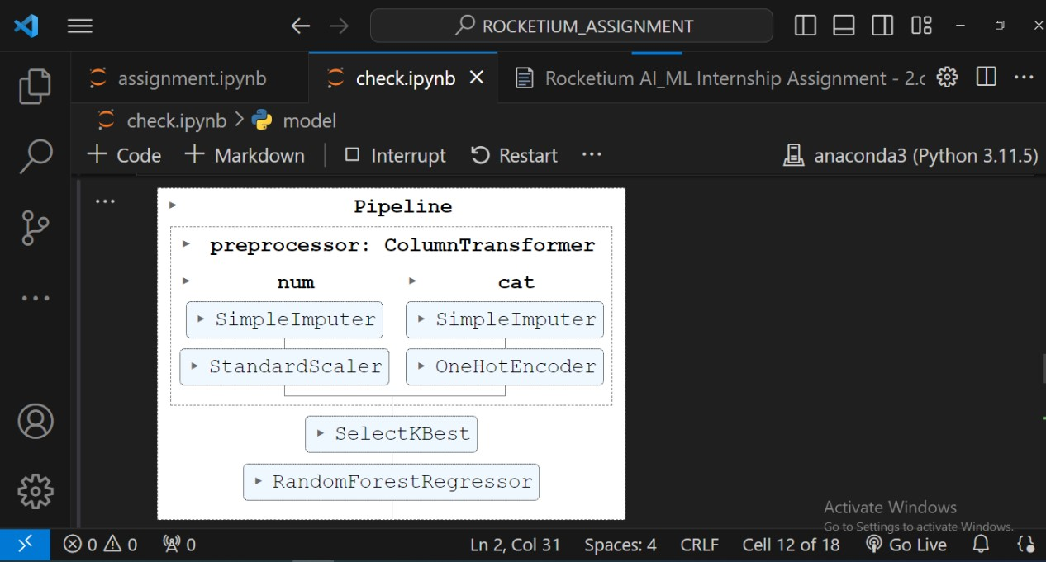
Machine Learning Internship Assignment
Algorithms:
Linear Regression
Decision Tress Regression
Random Forest Regression
Model:

Slide 9
Machine Learning Internship Assignment
Metrics: On Training Data On Testing Data
Models | MSE | R2 Score
Linear Regression | 1.85 | 0.99
Decision Tree Regressor | 0.0 | 1.0
Random Forest Regressor | 258 | 0.929
Random Forest with SelectKBest | 259 | 0.929
Models | MSE | R2 Score
Linear Regression | 2855 | 0.29
Decision Tree Regressor | 2017.95 | 0.50
Random Forest Regressor | 1139.93 | 0.72
Random Forest with SelectKBest | 939 | 0.77

Slide 10
THANK YOU

