Slide 1
WINE QUALITY PREDICTION
CSE3505 FOUNDATIONS OF DATA ANALYTICS
PROJECT REVIEW - III
Uday Singh Shergill 20BCE1806
Sai Tharun V 20BRS1066
Nehaal Reddy A 20BPS1151
Guided By:
DR. TRILOK NATH PANDEY,
SCOPE, VIT CHENNAI

Slide 2
INTRODUCTION
Drinking wine may not be something we Indians do.
But worldwide wine drinking is culture followed by many countries
Wine’s are costly but important in their lifestyle.
People expect goods to be worth its price.
But there are people cheat people for some profit.
There are health risks since drinking bad quality wine.
Wine industry is large and widespread.
But it follows traditional methods without modern intervention.

Slide 3
PROBLEM STATEMENT
Drinking wine may not be something we Indians may look up to but when we consider the broader world, wine drinking is a culture followed by many countries and people regard it essential for their living, and such wine is not cheap either. So, people expect to get quality goods for the money they pay. But there always are a set of people who aim to cheat people out of their money and earn some profit. It also involves health risks since drinking bad wine may cause altitude of problems for both those who drink it and are around them in various ways.

Slide 4
Research objectives
Predict the quality of a wine sample based on its physicochemical factors
To provide a quality product for the price customers pay
Make sure that customers are not badly affected by the product both economically and health based.

Slide 5
PROPOSED SYSTEM
Define the Problem:
Show the contribution of each factor to the wine quality in your model
Show which features are more important in determining the wine quality
Show which features are less important in determining the wine quality
2. Data Gathering and understanding:
Our analysis will use Wine Quality Data Set, available on the UCI machine learning repository (https://archive.ics.uci.edu/ml/machine-learning-databases/wine-quality/winequality.csv).
The dataset contains a total of 12 variables, which were recorded for 4,898 observations. This data will allow us to create different regression models to determine how different independent variables help predict our dependent variable, quality. Knowing how each variable will impact the wine quality will help producers, distributors, and businesses in the red wine industry better assess their production, distribution, and pricing strategy.

Slide 6
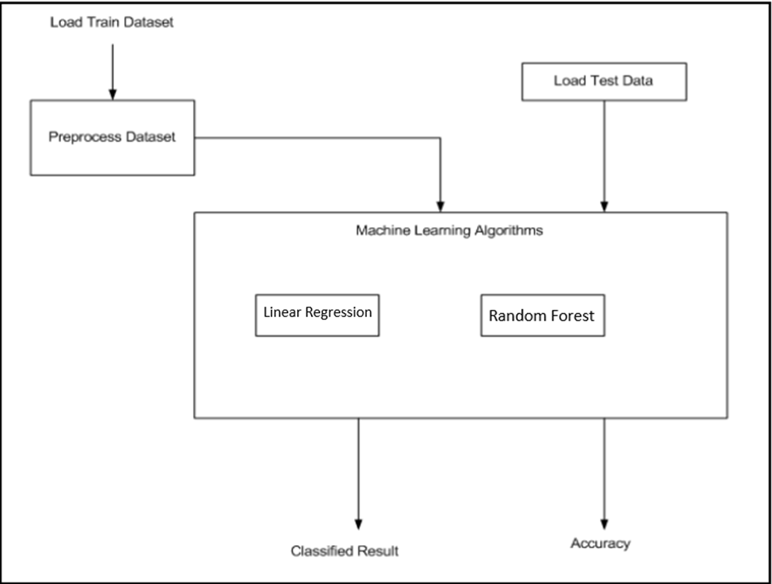

Slide 7
The aim of our project is to analyze wine dataset to predict the quality of a wine sample based on its physicochemical factors which will involve the creation of training sets using the data collected from the vineyards and testing based on new wine to test the quality.
In our project the training and testing sets are created from the dataset we acquired and they will be used during the model building to provide a sample for the real world solution.
3. Data Preparation and Exploration:
Data Preparation:
First step to clean and prepare the data for analysis
First, we check the data types focusing on numerical and categorical.
Then, identifying missing values existing in our data set.
Lastly, checking for problems like outliers and abnormal distributions.
Data Exploration:
Helps in interpreting each feature of wine data.
To know which variables are likely to affect the quality of wine the most.

Slide 8
4. Modelling with algorithms:
Multivariable Regression
To build an optimal prediction model for wine quality.
Random Forest
Helps to create a random sample of multiple regression decision trees.
Merges them to obtain a more stable and accurate prediction through cross-validation.
5. Performance Metrics:
In the end we will evaluate our model (Regression and Classification) using a few metrics:
Skew: a normal distribution close to zero is a perfect distribution
MSE (Mean Squared Error): is an absolute measure of fit. Note that an MSE of 0 indicates a perfect fit
RMSE (Root Mean Squared Error): is a good measure of how accurate the model predicts the target
R-Squared: is a relative measure of fit
Also, the use of BIC (Bayesian Information Criterion) for model selection in measuring complexity
The model with the lower BIC Value is preferred.

Slide 9
Dataset understanding
The main aim of the red wine quality dataset is to predict which of the physiochemical features make good wine. With 11 variables and 1 output variable (quality) given, let us examine the role of each of these features:
Fixed Acidity: are non-volatile acids that do not evaporate readily
Volatile Acidity: are high acetic acid in wine which leads to an unpleasant vinegar taste
Citric Acid: acts as a preservative to increase acidity. When in small quantities, adds freshness and flavor to wines
Residual Sugar: is the amount of sugar remaining after fermentation stops. The key is to have a perfect balance between sweetness and sourness. It is important to note that wines > 45g/ltrs are sweet
Chlorides: the amount of salt in the wine
Free Sulfur Dioxide: it prevents microbial growth and the oxidation of wine

Slide 10
Total Sulfur Dioxide: is the amount of free + bound forms of SO2
Density: sweeter wines have a higher density
pH: describes the level of acidity on a scale of 0–14. Most wines are always between 3–4 on the pH scale
Alcohol: available in small quantities in wines makes the drinkers sociable
Sulphates: a wine additive that contributes to SO2 levels and acts as an antimicrobial and antioxidant
Quality: which is the output variable/predictor
Now we have a basic knowledge of various factors that influence the quality of good wine, shall we drink to that?

Slide 11
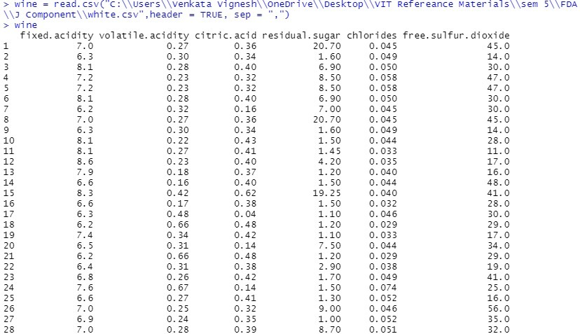
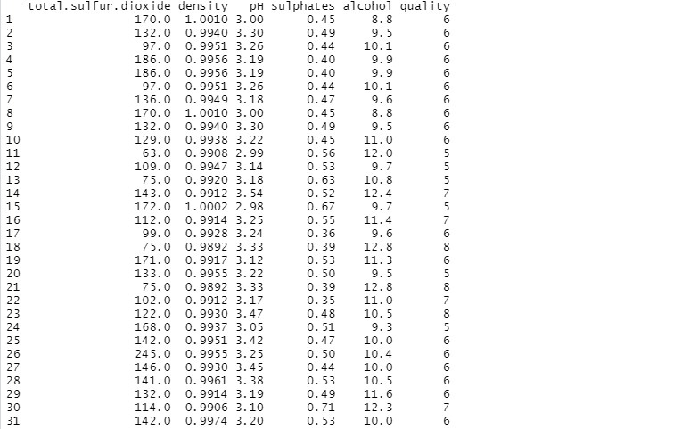
Data Preprocessing
wine = read.csv("C:\\Users\\lalli\\Downloads\\whiteWine.csv",header = TRUE, sep = ",")
wine

Slide 12

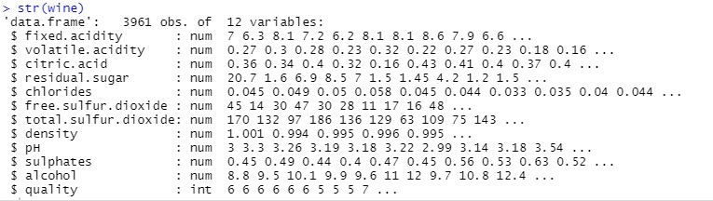
Data Preprocessing
library("dplyr")
distinct(wine)
wine<-dim(wine)
View(wine)
str(wine)
dim(wine)

Slide 13
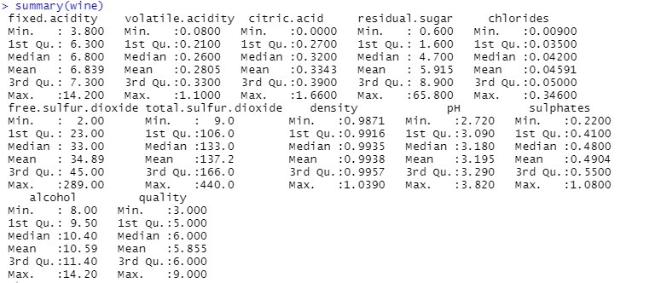
Data Preprocessing
summary(wine)

Slide 14
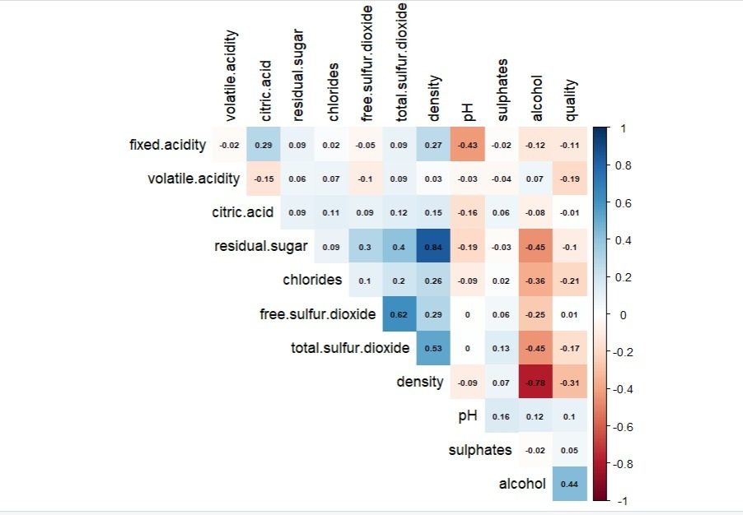
Data preparation and exploration
wine = read.csv("C:\\Users\\lalli\\Downloads\\whiteWine.csv",header = TRUE)
corrplot(cor(wine), method = "color", ,type="upper",addCoef.col = "black",number.cex = .6, tl.col = "black", tl.srt = 90, diag = FALSE)

Slide 15
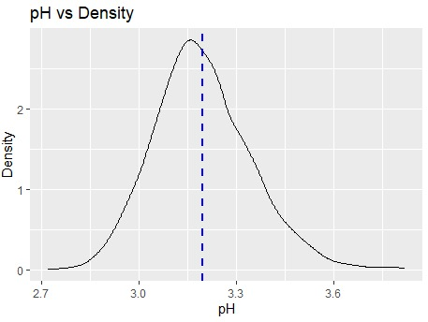
Data preparation and exploration
Plotting the marginal distributions of key numerical quantities of interest
p9 <- ggplot(wine, aes(x=pH)) + geom_density()
> p9 + geom_vline(aes(xintercept=mean(pH)),color="blue", linetype="dashed", size=1)+ggtitle("pH vs Density")+labs(x="pH",y="Density")

Slide 16
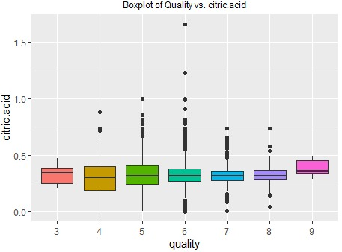
Inspecting quality against numerical variables of interest
g3 <- ggplot(wine, aes(factor(quality), citric.acid, fill=factor(quality))) + geom_boxplot() +labs(x = "quality", y = "citric.acid", title = "Boxplot of Quality vs. citric.acid") + theme(legend.position = 'none', plot.title = element_text(size = 9, hjust=0.5))

Slide 17
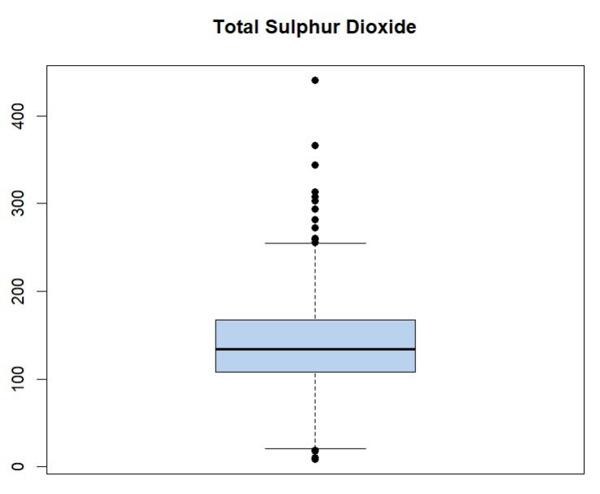
b7 <- boxplot(wine$total.sulfur.dioxide, col="slategray2", pch=19,main="Total Sulphur Dioxide")

Slide 18
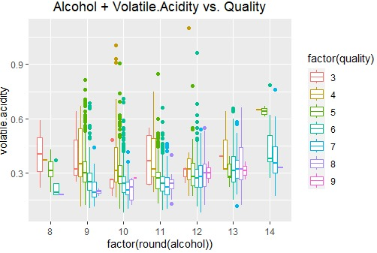
i2 <- ggplot(wine, aes(x=factor(round(alcohol)), y=volatile.acidity)) + geom_boxplot(aes(colour = factor(quality))) +labs(title="Alcohol + Volatile.Acidity vs. Quality") + theme(plot.title=element_text(hjust=0.5))

Slide 19
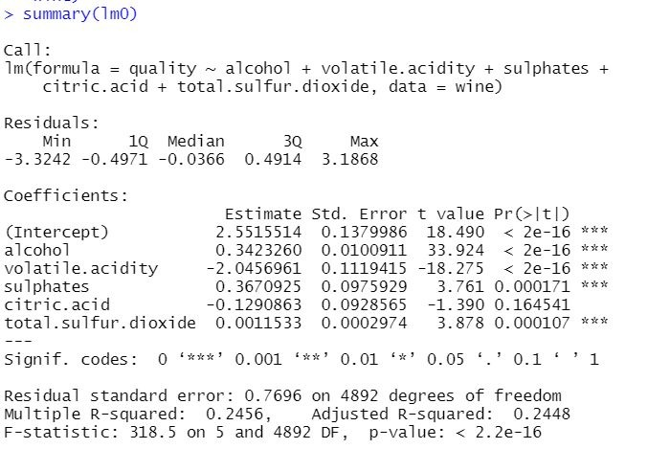
MODELLING
Modeling with top 5 variables
Model 1 with top 5 highest correlation with Total Incidents
lm0 <- lm(quality ~ alcohol + volatile.acidity + sulphates + citric.acid + total.sulfur.dioxide, data = wine)summary(lm0)

Slide 20
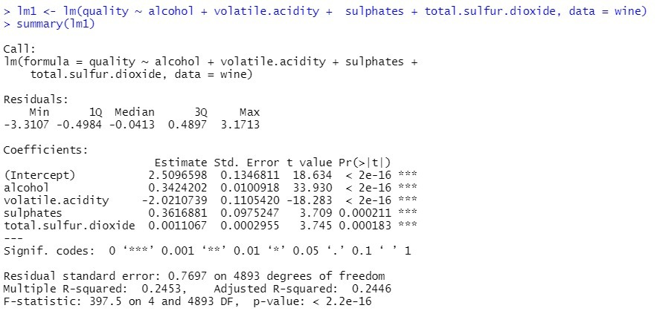
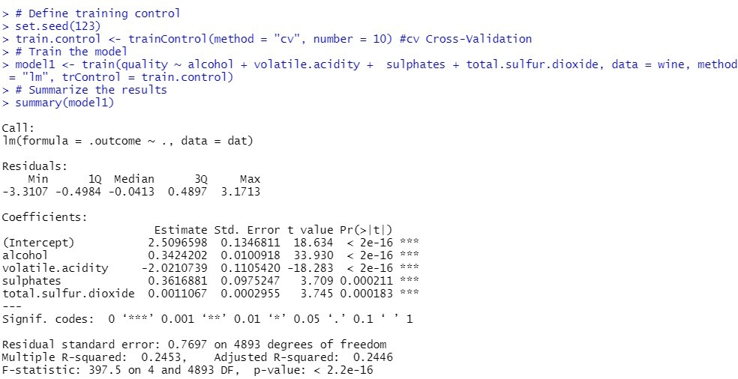
MODELLING

Slide 21
modelling

Slide 22
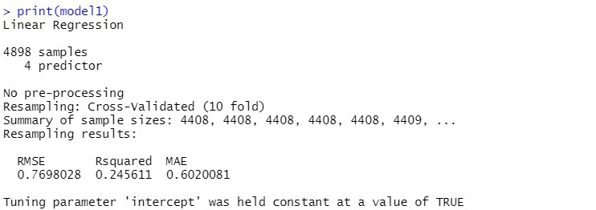
modelling

Slide 23
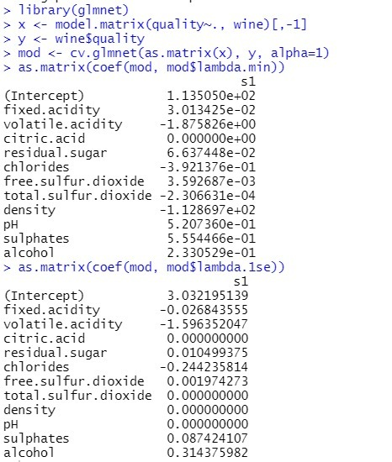
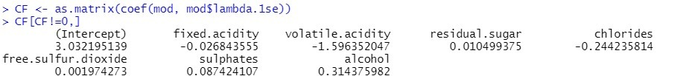
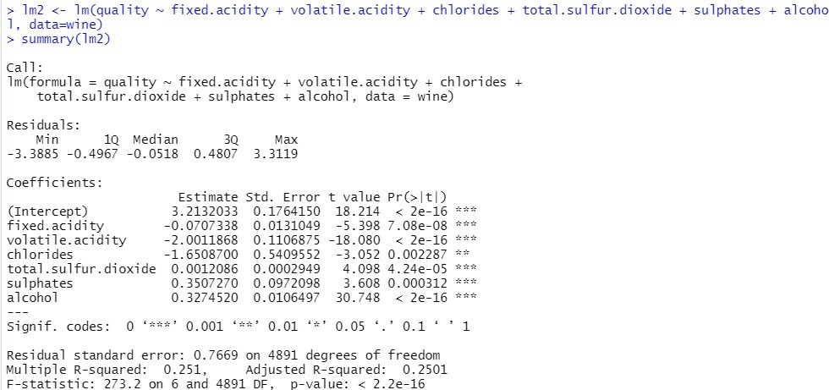
modelling

Slide 24
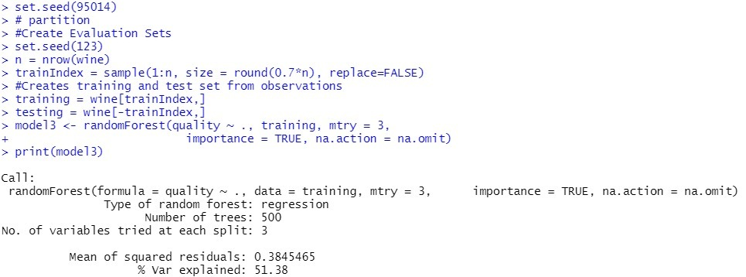
modelling

Slide 25
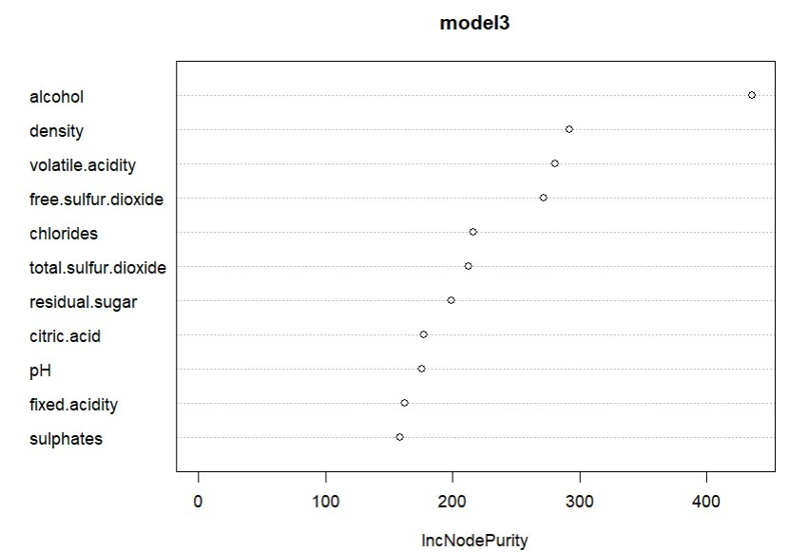
modelling
varImpPlot(model3,type=2)

Slide 26
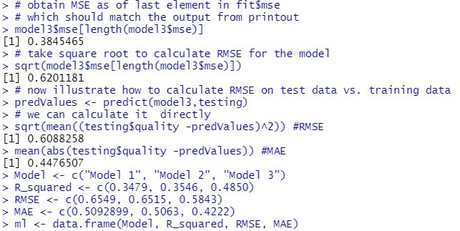
PERFORMANCE METRICS

Slide 27
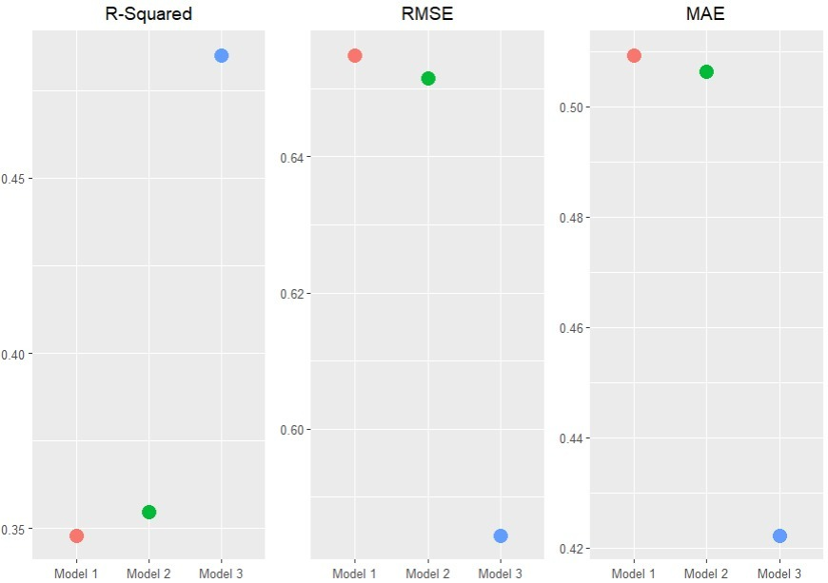
PERFORMANCE METRICS
p1 <- ggplot(ml, aes(Model, RMSE)) + geom_point(aes(colour = factor(Model), size = 4)) + labs(title="RMSE") + theme(plot.title=element_text(hjust=0.5), axis.title.y = element_blank(),axis.title.x = element_blank(), legend.position="none")
p2 <- ggplot(ml, aes(Model, R_squared)) + geom_point(aes(colour = factor(Model), size = 4)) + labs(title="R-Squared") + theme(plot.title=element_text(hjust=0.5), axis.title.y = element_blank(),axis.title.x = element_blank(), legend.position="none")
> p3 <- ggplot(ml, aes(Model, MAE)) + geom_point(aes(colour = factor(Model), size = 4)) + labs(title="MAE") + theme(plot.title=element_text(hjust=0.5), axis.title.y = element_blank(),axis.title.x = element_blank(), legend.position="none")
> grid.arrange(p2,p1,p3, ncol=3)

Slide 28
Final Review
What are we claiming?
To predict the best quality of wine using given dataset by analysing the factors effecting the taste and quality of wine.
2. How much have we achieved?
We have achieved a completion of around 92% and would wish to further study and research on this topic in areas of deep learning and AI. After analysing the dataset, we generated 3 models to calculate the quality of wine, from the result we interpret that model-3 is most efficient in predicting the quality wine.
3. PPT and Report Submission in Moodle?
Yes, we have submitted the PPT and Report on Moodle
Contribution of Team Members:
Lallith Prasath: Partial Implementation and Review-2 PPT
Venkata Vignesh Reddy: Review-1 PPT and Final Report
Rokithkumar: Partial Implementation and Review-3 PPT
GitHub link:
https://github.com/Lallith-Prasath/Wine-Quality-Analysis.git

Slide 29
Conclusion
In the aim of analyzing the Red Wine Quality, we have performed Data preparation under which we have performed data cleaning, data exploration and transformation where we removed duplicate records, checked for NA values and derived each feature’s statistical summary to detect any problem like outliers and abnormal distributions.
We tried to find which variables are likely to affect the quality of the red wine the most. We have performed a correlation analysis of the independent variables against variable, quality. The analysis gave us a list of variables of interest that had highest correlations with quality.
Then we created density plot visualizing the spread of the data, in order to analyze the relationship with the dependent variable.
After analyzing the density plots, we plot the interaction between the numeric variables of interest and the dependent variable of quantity.
We built 3 dimensional plots to deep dive into relationships within independent variables and with quality.
We performed modelling to estimate the relations between the factors effecting the quality of wine. And finally Evaluation, where we evaluate the relations and factors to predict the best quality of wine.

Slide 30
REFERENCES
Multivariate Methods Based Soft Measurement for Wine Quality Evaluation
https://www.hindawi.com/journals/aaa/2014/740754/
Improving Wine Data, Meredith Galante, Jan 28, 2020, Dimensional Insight:
https://www.dimins.com/blog/2020/01/28/improving-wine-data/
Multivariate Statistical Analysis Applied in Wine Quality Evaluation:
https://www.researchgate.net/publication/282982301_Multivariate_Statistical_Analysis_Applied_in_Wine_Quality_Evaluation
Random Forest Classification in prediction of best quality wine, Sailaja Konda, Apr 13 2020, Medium
https://medium.com/@sailajakonda2012/random-forest-classification-in-prediction-of-best-quality-wine-d0d7591a7c17
Analysis of Wine Quality Data
https://online.stat.psu.edu/stat508/book/export/html/804

Slide 31
Thank You

