Slide 1







Department of Electronics and Communication Engineering
Khulna University of Engineering & Technology
Recognition of Two Hand English Manual Sign Alphabets of BdSL with Transfer Learning and CNN
ECE-4000:
Project & Thesis
Supervised By:
Dr. Md. Foisal Hossain
Professor
Department of Electronics and Communications Engineering
Khulna University of Engineering & Technology, Khulna
12th February,2023
Presented By:
Uday Syed
Department of Electronics and Communication Engineering
1709036

Slide 2
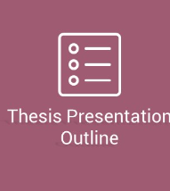

Overview
Contents
Challenges
Objectives
Methodology
Result Analysis and Evaluation
Conclusion

Slide 3




1
Overview
Convolutional Neural Networks (CNN) has been demonstrated to be accurate to traditional Machine Learning models
ML vs DL
Overview
The recognition of Bangla Sign Language (BSL) is an area that has received relatively less attention
Understudied
Endeavors to create a new and innovative architecture for the detection of two-handed manual sign alphabets in Bangla Sign Language (BSL).
Novel Model

Slide 4
2
Challenges
No publicly available validated dataset
Developed models
suffer from lack of reproducibility
Understudied field of research
Low samples to label ratio

Slide 5
3
Objectives
To create a comprehensive dataset
To develop a novel architecture
To propose a hybrid model comprised of a pretrained model and novel architecture

Slide 6


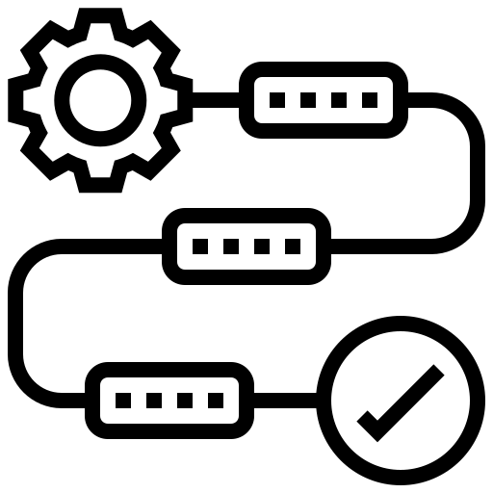

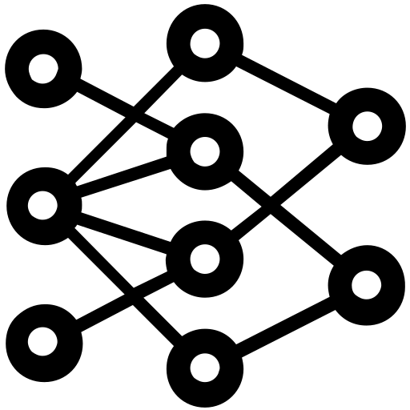
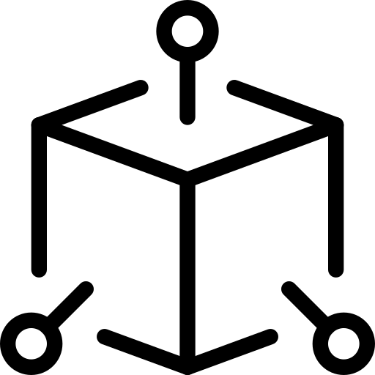

5
Methodology
Selection a well researched validated dataset
Determining best CNN architecture
Developing a novel architecture
Creating own Dataset
Preprocessing
Fine-Tuning
Determining optimum dense layers

Slide 7
Developing proprietary dataset

Slide 8




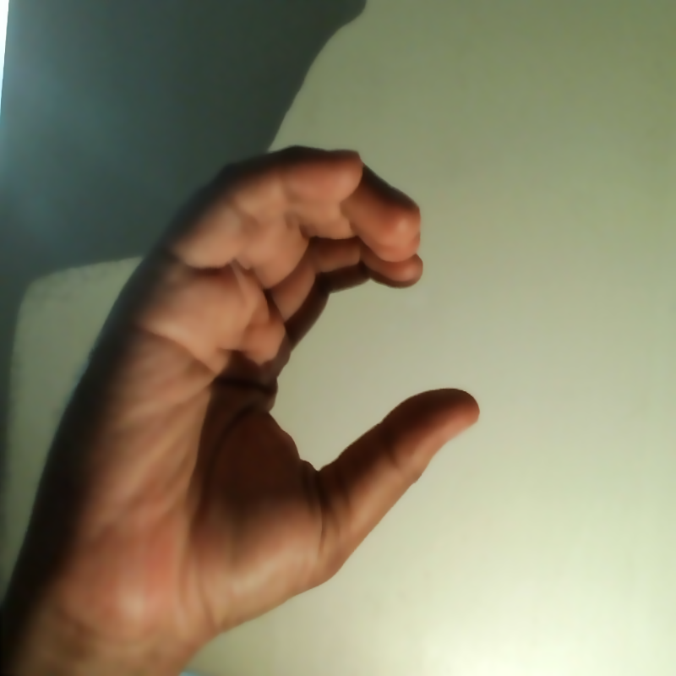

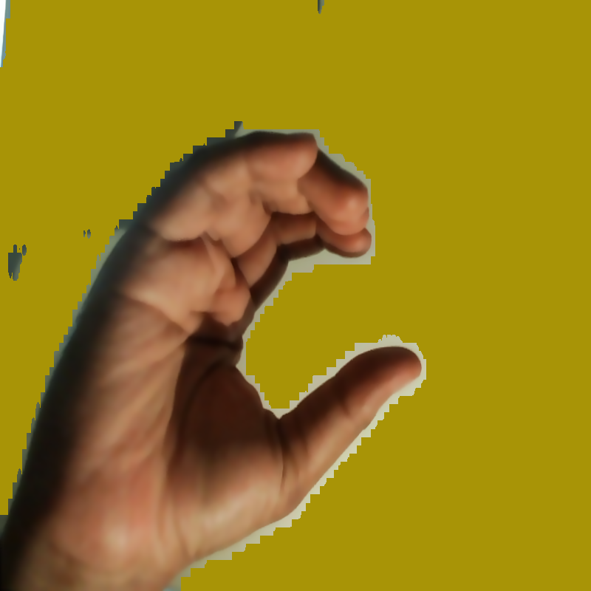
6
Generating a proprietary dataset
01
Patterned dataset - 01
Plain dataset - 02
Minimum samples/label= 124
Total Dataset size= 3100
Minimum samples/label= 138
Translation variation= 3
Total Dataset size= 3450
03
02
Colored dataset - 03
Minimum samples/label= 121
Total Dataset size= 3025

Slide 9







7
Splitting proprietary dataset
(415 samples/label)
Patterned dataset
Colored dataset
Plain dataset
Patterned dataset
Colored dataset (Test)
(123 samples/label)
Plain dataset
Training Dataset
(292 samples/label)
ValidationDataset

Slide 10
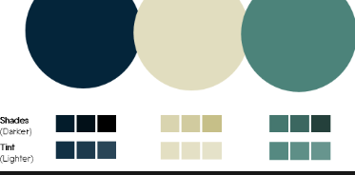
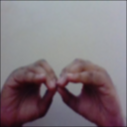





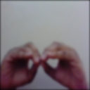
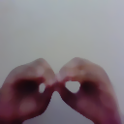




8
Filtering proprietary dataset
Gaussian
Median
Bilateral
Kernel size 3x3
$σ_{COLOR}$=50
Kernel size 5x5
$σ_{COLOR}$=100
Kernel size 7x7
$σ_{COLOR}$=200
Fig 1: Output of different denoising filters for label “B”

Slide 11





9
Edge Detection of proprietary dataset
Upper Threshold=int(max(0,(1-0.5)*median of intensities))
Lower Threshold=int(min(255,(1-0.5)*median of intensities))
Raw Image
Gaussian
Median
Bilateral
Fig 2: Detected edges for different denoising filters by Canny edge detector

Slide 12
Selecting a validated dataset

Slide 13



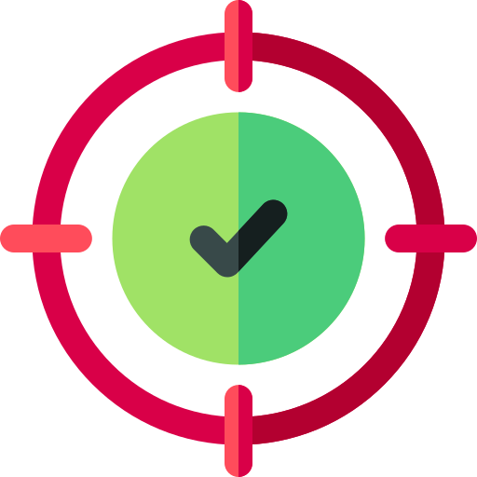
10
Selecting a validated dataset
Dataset/Authors | Labels | Samples/Label | Accuracy
D1500 [1] | 87 | 1517 | 99.99
Rafi_BdSL [2] | 38 | 320 | 91.51*
IsharaLipi [3] | 36 | 50 | 94.74
Md. S. Islalm et al.[4] | 45 | 688 | 99.80
Rahman et al. [5] | 36 | 100 | 96.46
BdSLImset [6] | 36 | 1111 | 98.20
BdSL 49 [7] | 49 | 600 | 93
Table 1: Previously validated datasets of BdSL

Slide 14
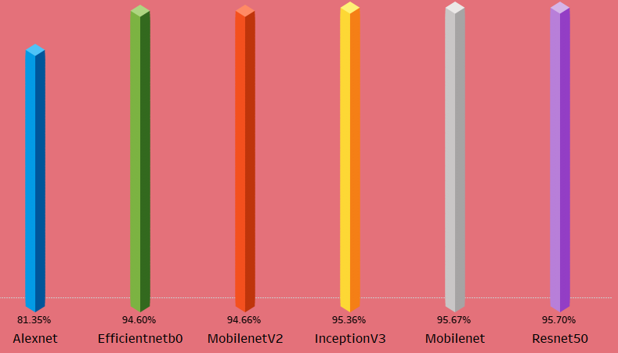
11
Determining CNN architecture
Test Accuracy
Model
Fig 3: Test accuracy of various pretrained CNN architecture

Slide 15
12
Dense Layer Configuration | Model Architecture | Test Accuracy (%)
1000_512_256_128 | MobileNet | 96.06
 | ResNet50 | 95.06
512_256_128 | MobileNet | 94.2
 | ResNet50 | 95.05
512_256 | MobileNet | 94.5
 | ResNet50 | 95.36
256_128 | MobileNet | 93.8
 | ResNet50 | 95.74
Table 2: Test accuracy of different dense layers of Mobilenet and Resnet

Slide 16
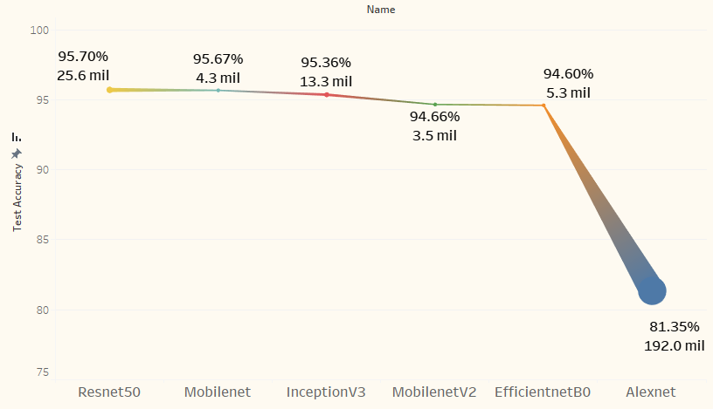
13
Determining Parameters for novel architecture
Fig 4: Test accuracy for different values of trainable parameters

Slide 17
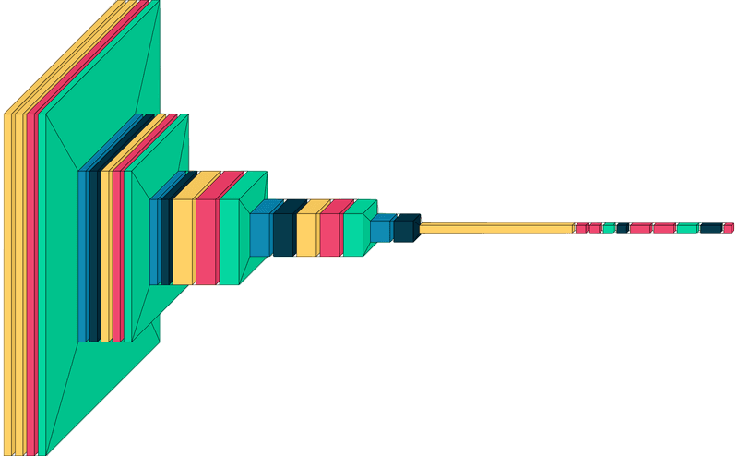
14
Proposed base CNN architecture
Trainable Parameters: 29 million
Activation: ‘ReLU’ and ‘Softmax’
Stride=(1,1)
Kernel Size= (3,3)
Conv2D
BatchNormalization
Activation
MaxPooling2D
Dropout
Fig 5: Proposed CNN architecture

Slide 18
Performance evaluations

Slide 19
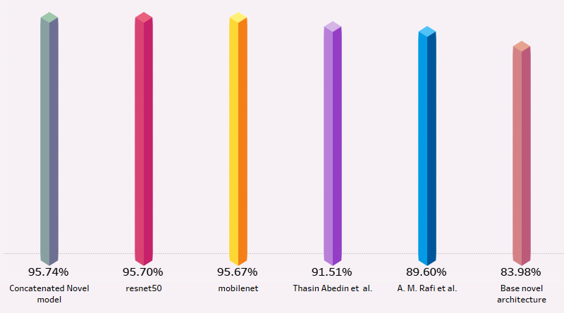
15
Performance of different models
Test Accuracy
Model
Fig 6: Test accuracy for different models on Rafi_BdSL dataset

Slide 20
16
Performance of base model
Datasets | Training Acc. (%) | Validation Acc. (%) | Test Acc. (%) | Loss | Precision | Recall | AUC | F1 Score
Rafi_BdSL | 98.31 | 84.21 | 83.98 | .766 | .892 | .8313 | .98 | .8605
Two Hand English Manual Sign Alphabets of BdSL | 99.95 | 99.59 | 99.11 | .4793 | .9983 | .9456 | 1.00 | .9712
Table 3: Performance of base CNN architecture on two datasets

Slide 21
16
Performance of proposed Hybrid model
Datasets | Training Acc. (%) | Validation Acc. (%) | Test Acc. (%) | Loss | Precision | Recall | AUC | F1 Score
Rafi_BdSL | 99.77 | 95.36 | 95.74 | 0.2663 | 0.9596 | 0.9551 | 0.9899 | .9573
Two Hand English Manual Sign Alphabets of BdSL | 95.45 | 99.52 | 99.54 | .2890 | .9954 | .9954 | 1.00 | .9954
Table 4:Accuracy of proposed hybrid model on two different datasets

Slide 22
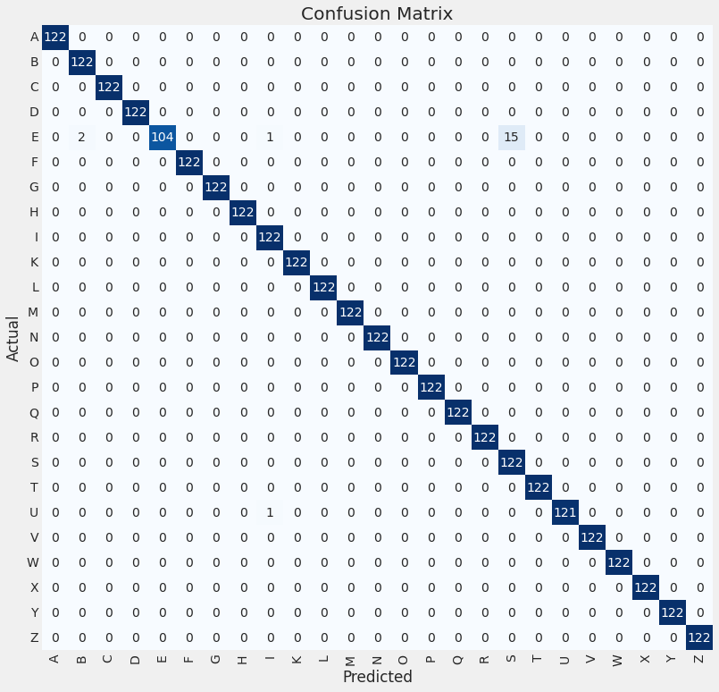


Confusion Matrix
18

Slide 23



19
Conclusion
Developed a proprietary dataset containing "Two Hand English Manual Sign Alphabets"
Proposed CNN architecture to recognize Bengali sign alphabets of BdSL
Observed a high level of accuracy in developed model, which showcases the effectiveness of proposed architecture

