Slide 1

Analysis Of Olympic Data
Guided by,
Deepak Rao
Assistant Professor
SOIS, MAHE
Presented by,
Srinivas K 181046001
Uday T 181046016

Slide 2
Introduction:
Olympics : One of the largest and oldest games event !
206 countries, 300 events under 28 sports.
Huge data is generated through the years
Upholds factors like:
Country's Progress
Gender Distribution

Slide 3
Introduction:

Slide 4
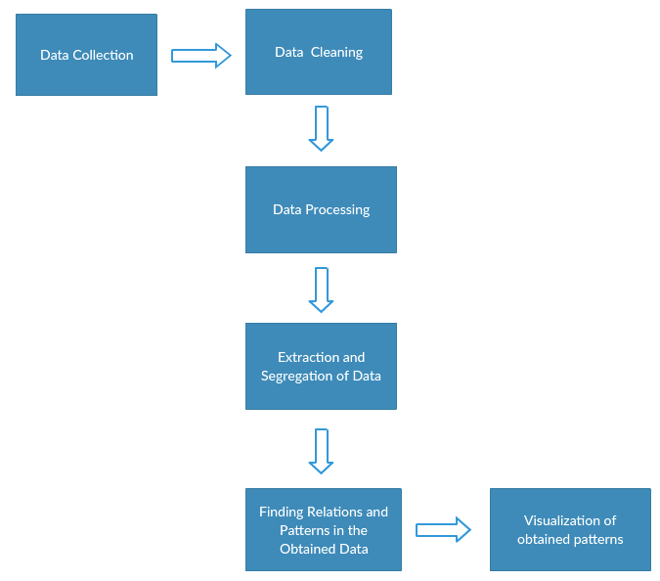
Project Design

Slide 5
Data Collection
Data Cleaning
Data Pre-Processing
Finding Relations and Patterns
Data Visualization of Patterns

Slide 6
Relations and Patterns with Visualization and Analysis

Slide 7
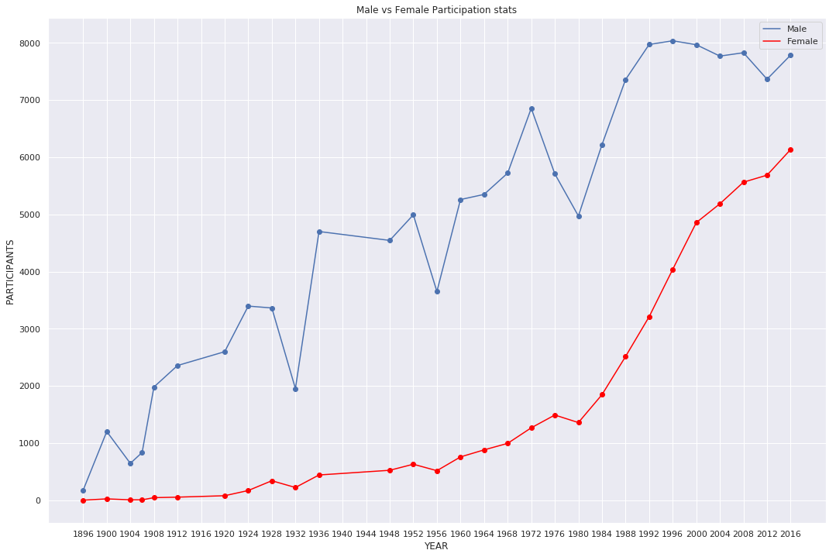
Gender Participation

Slide 8
Gender Participation Analysis
1932:
Attendance dipped because these Games occurred in the midst of the Great Depression, such that many athletes were unable to afford the trip to the Olympics.
1956:
Attendance dipped due to boycotts by : Iraq, Egypt, Lebanon, Netherlands, Spain, Switzerland, and Cambodia

Slide 9
Continued…
1976:
Attendance dipped because 25 nations, mostly African, boycotted the Games in response to apartheid policies in South Africa.
1980:
Attendance dipped because 66 nations, including the U.S., boycotted the Games in response to the Soviet invasion of Afghanistan.

Slide 10
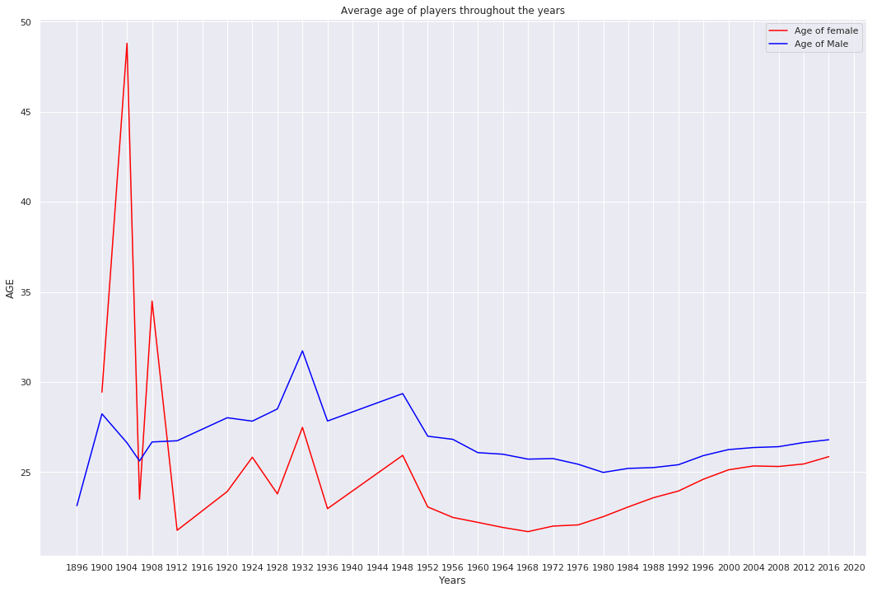
Average Age

Slide 11
Average Age Analysis
1904
Only 6 participants, from one country (USA), and one sport (Archery) whose age was greater than 44
1932
Many Nations didn’t participate, hence USA had lot of female participation in Art – Competitions
1908
Archers age > 40 is more
Missing values, filled with mean!

Slide 12
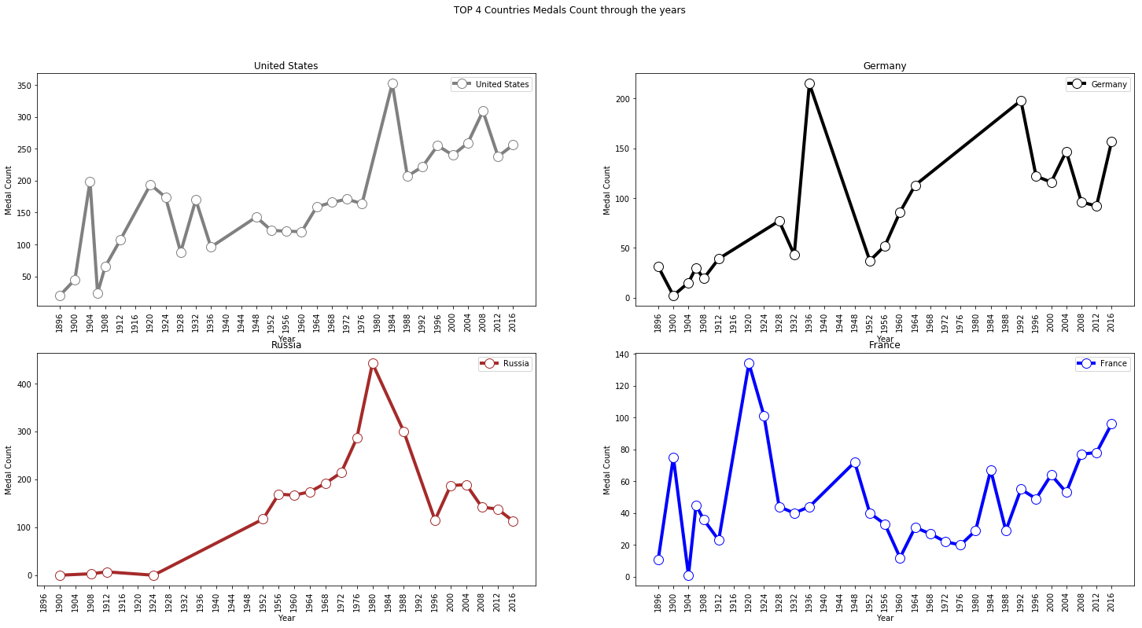
Participation and medal count [Top 4 Countries]

Slide 13
Analysis - Top 4 Countries
1980
The reason Russia won many medals in 1980 is because around 65 countries including USA didn’t participate in Olympics held at Moscow
1984
Similarly Russia boycotted 1984 Olympics which was held at USA, which led to USA winning lot of Medals
1920[France] & 1936[Germany]
Germany and Belgium won maximum medals when they hosted the Olympics

Slide 14
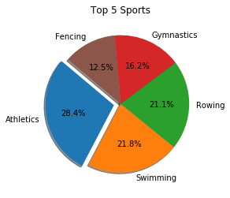
Top 5 Sports with highest no of medals

Slide 15
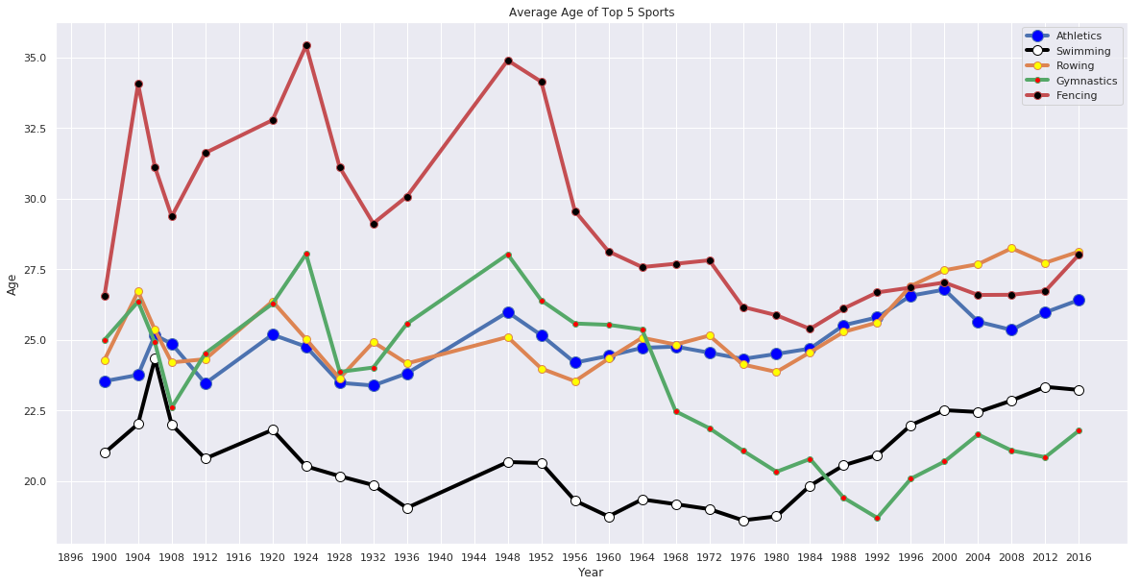
Average age of medal winners in top 5 sports

Slide 16
Top 5 players in top 5 Sports

Slide 17
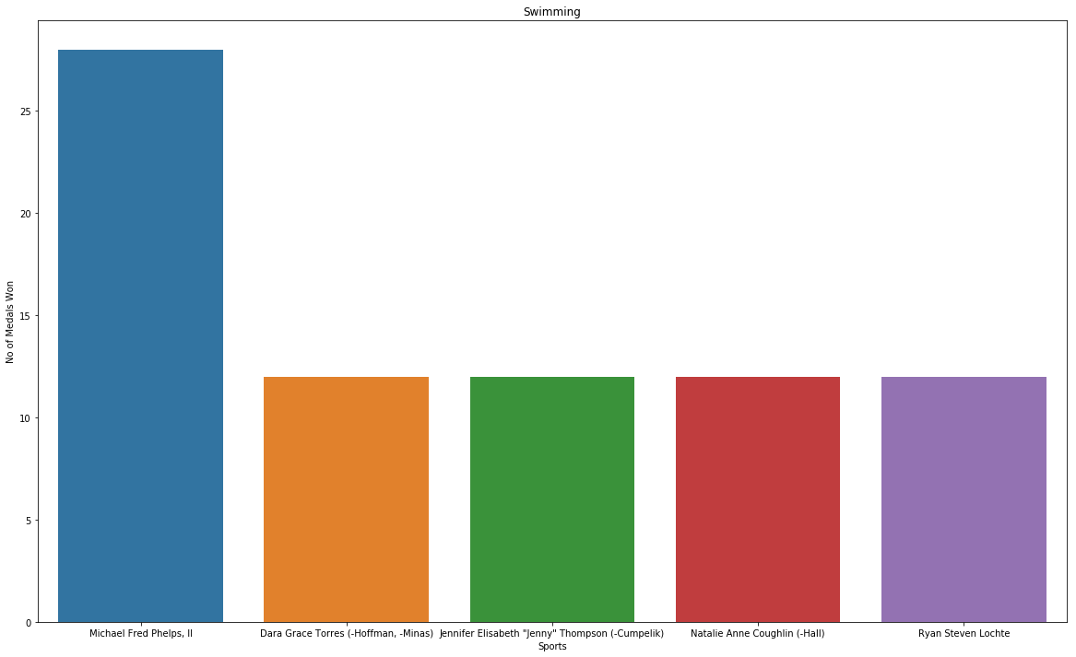
Swimming

Slide 18
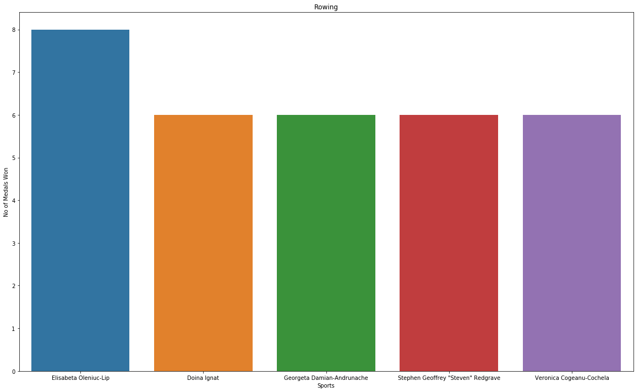
Rowing

Slide 19
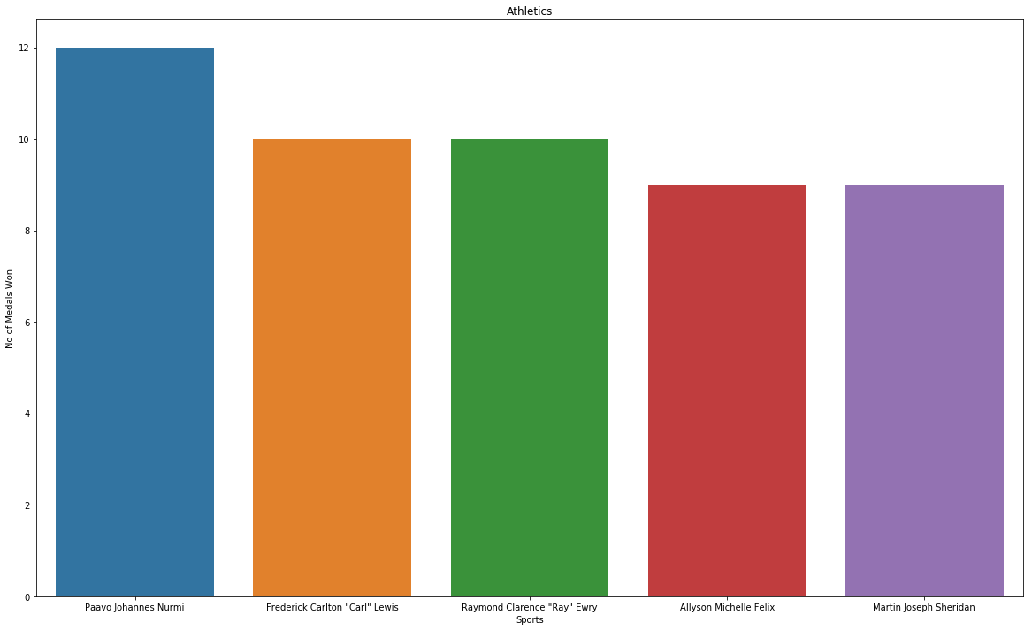
Athletics

Slide 20
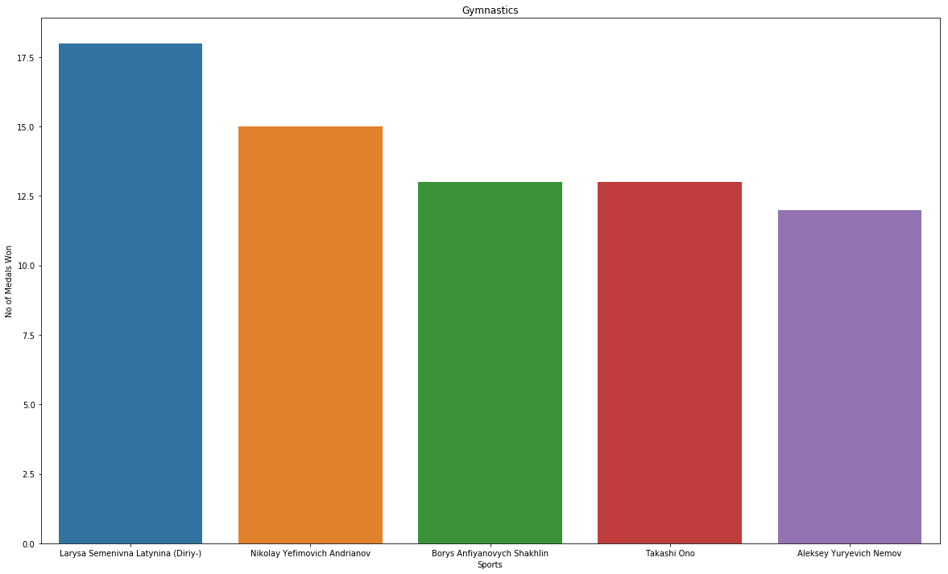
Gymnastics

Slide 21
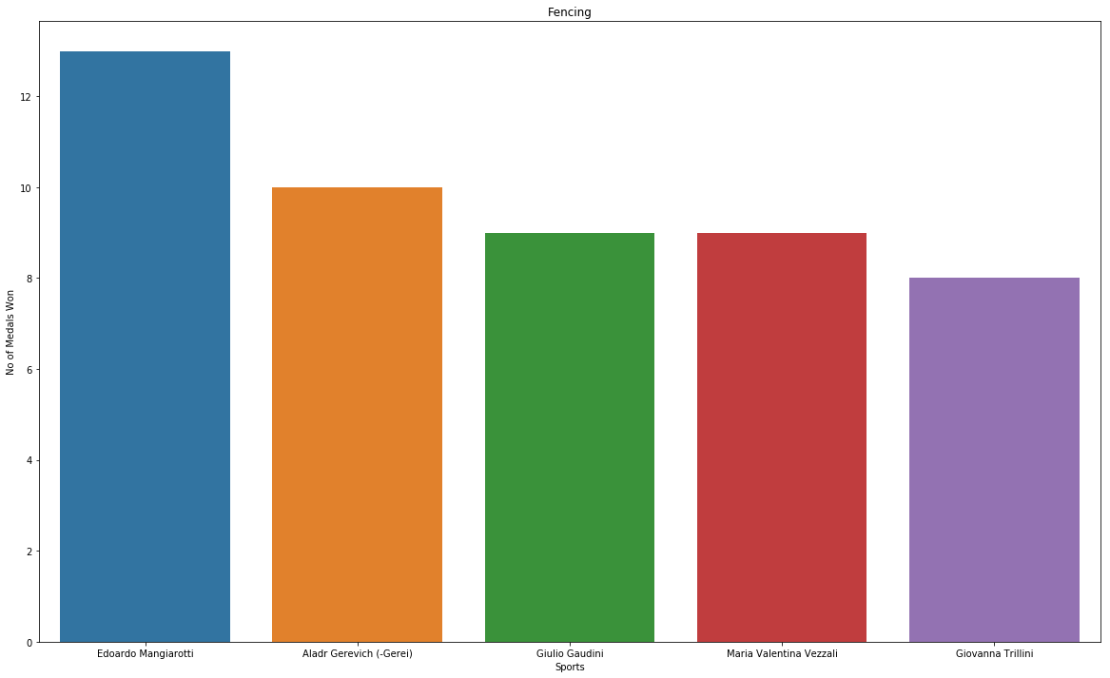
Fencing

Slide 22
Country performance with respect to GDP and Population-per-medal for the last 5 Olympics

Slide 23
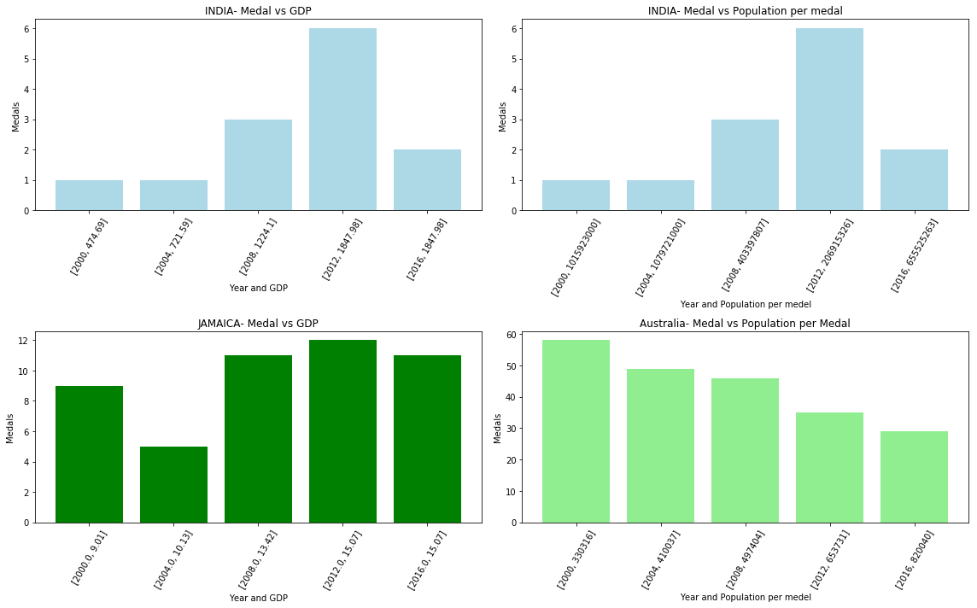

Slide 24
DEMONSTRATIONS

Slide 25
DEMONSTRATION - 1
1. For a Given Year

Slide 26
DEMONSTRATION - 2
2. For a Given Country

Slide 27
DEMONSTRATION - 3
3. For a Given Sport

Slide 28
Major Inferences
USA, Russia, Germany and France are medal tally leaders in the Olympics most number of times.
The number of athletes have grown dramatically since 1896, but growth levelled off around 2000 for the Summer Games.
Women, who were not a very large part of the Olympics contingents earlier, now enjoy equal representation in the Olympics teams.

Slide 29
Continued…
The height, weight and average age of a Olympic medal winner depends on sport they participate!
China isn’t in the list of top most medal winning countries.
It is not always necessary that the GDP and Population impacts the number of medals won by a team.

Slide 30
Challenges Faced
Handling Null values
Duplication of key attributes
Getting GDP, Population data and mapping to Olympic data
Wrong values in dataset
Team vs Individual Event…

Slide 31
Conclusion

Slide 32
References and Bibliography
[1] Python for Data Analysis: Wrangling with Pandas, Numpy and IPython by Wes Mckinney
[2] Designing Data Visualizations by Noab Illinky and Julie Steele
[3] https://www.kaggle.com/
[4] https://python-graph-gallery.com/
[5] https://seaborn.pydata.org
[6]https://github.com/chrisalbon/notes/tree/master/content/python

Slide 33
THANK YOU

