Slide 1
INVESTMATE

Slide 2
AGENDA
TEAM MEMBERS
PROJECT OVERVIEW
PERSONAS
TECH STACK
SPRINT SCHEDULE
TEAM AGREEMENT
RETROSPECTIVE
WIKI LINK

Slide 3
1.Venkatesh Nidumukkala - Project Manager
2.Ankit mhatre - Machine learning engineer
3.Uma Maheshwari Bichinepally - Developer
4.Tejaswi Koppula - Developer
5.Charan Raju M - Developer
6.kilaru Mani Chandana - Developer
TEAM MEMBERS

Slide 4
In a modern world of finance, numerous young people aged from 18 to 25 years old are confused looking at the situation when, on one hand, they aspire to get involved in this global trend but, on the other hand, they experience numerous difficulties trying to search for a source of practical experience and knowledge. Even as you understand the principles from the course rooms academically, you struggle to apply them in the real life scenarios. This results in proficiency gap between your educational knowledge and investment strategies. This gap is a result of overwhelming complications in the structure as well as the FEAR of monetary loss, which is a key factor education platform which should be easy to understand and also a learner-based approach should be discovered.
PROBLEM STATEMENT

Slide 5
An AI-Powered Investment Portfolio Assistant is a web-based tutorial tool aimed at giving hands-on exposure on investing for college students and young adults to fill the knowledge gap between classroom and real investing. Listening to historical market data, the platform is a place for users to test different investment strategies, looking for market dynamics, but managing virtual portfolios as well. The platform has designed to be an interactive learning sheet; through personalized investment recommendations based on machine learning algorithms and a user-friendly interface, the platform rans all of that while educating the users to be well informed when it comes to making decisions concerning their finances.
PROJECT DESCRIPTION

Slide 6
The online investment platform market is aggressively rising at a CAGR of 14.4% till $4.4 billion by the year 2028 due AI introducing and popularity of digital investment rising. The main variables are the incorporation and application of AI algorithms for data analysis and risk management together with increasing investments that are a direct result of economic growth, and the increase of High Net Worth Individuals (HNWIs) on digital assets. Disadvantages such as hard regulatory requirements may stop penetration into new markets. In the process of development, the market is subject to the influence of the blockchain technology spread and to a great extent influenced by effect of the COVID-19 pandemic which was considered as the catalyst for the increased volume of investments via digital platforms.
MARKET ANALYSIS

Slide 7

PERSONAS
Name: Priya
Age: 23
Occupation: College student in the final year, aspiring to start her own business.
Investment Experience: Minimal experience.
Goals: To acquire investment management skills for better financial management.
Challenges: Unable to balance academic responsibilities, entrepreneurial planning and investment learning.

Slide 8
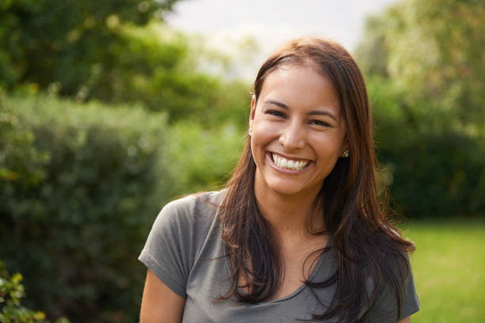
PERSONAS
Name: Sara
Age: 20
Occupation: College student majoring in English Literature.
Investment Experience: None.
Goals: Interested in learning about personal finance and investing to start saving for the better future
Challenges: Unable to understand the financial terms

Slide 9
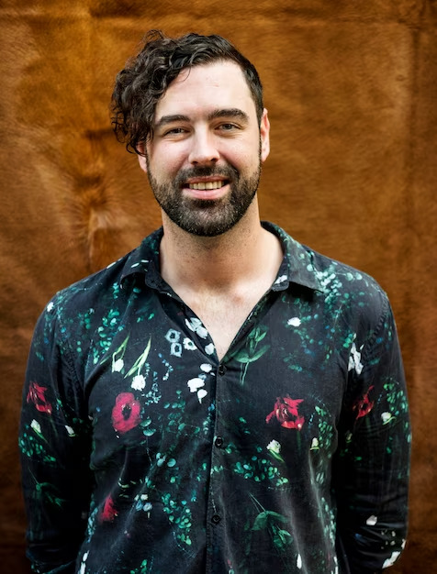
PERSONAS
Name: Michael
Age: 25
Occupation: College student majoring in finance.
Investment Experience: No practical experience.
Goals: To gain hands-on experience in the stock market using his classroom knowledge.
Challenges: Finds it difficult to apply his theoretical knowledge in real-world

Slide 10







TECH STACK

Slide 11
Sprint Table
Task | Duration | Assigned to
Idea Finalization | 2 Days | Entire team
Roles & Responsibilities | 1 Day | Entire team
Research on investment theories | 2 Days | Machine learning team
Tech stack finalization | 3 Days | Entire team
Team agreement | 1 day | Entire team
Sprint 1 documentation | 2 Days | Entire team

Slide 12
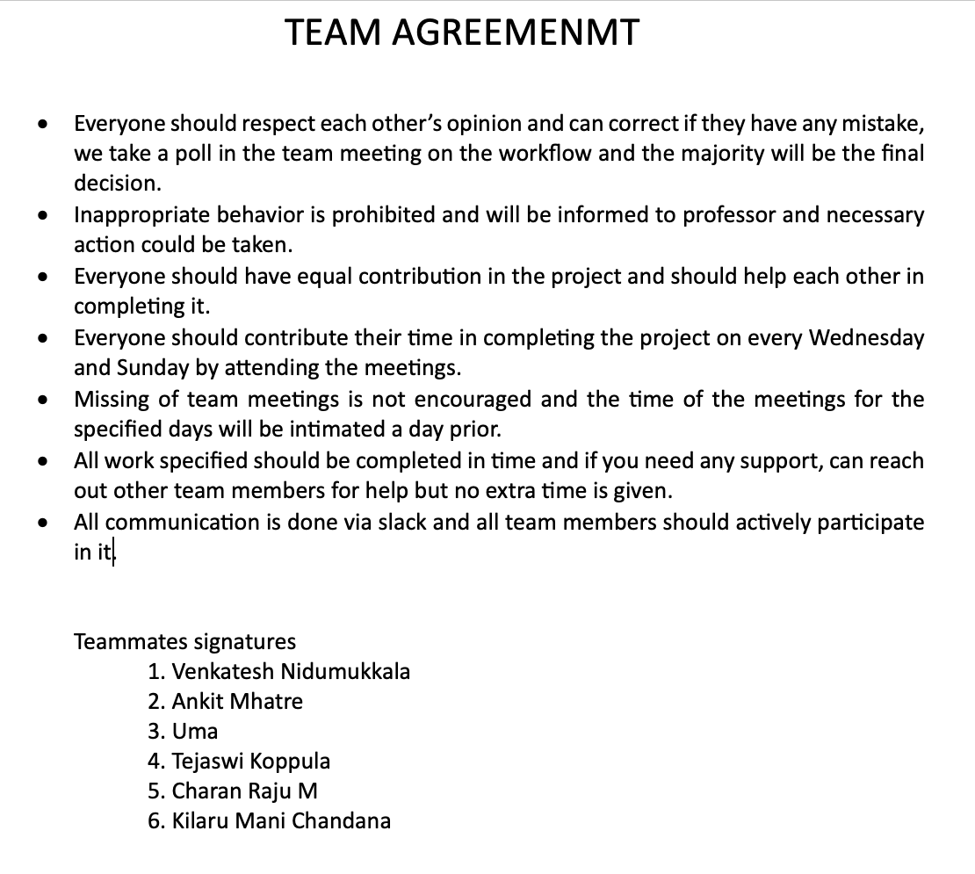
TEAM AGREEMENT

Slide 13
RETROSPECTIVE
WHAT WENT WELL
Active communication
Quick decision making
WHAT WE CAN IMPROVE
Improve research
Reduce overlapping of time
ACTION ITEMS
Have recurring meetings
Keep realistic goals

Slide 14
Sprint 2
Design UI and implement Machine Learning.
Start of backend.

Slide 15
WIKI LINK
https://github.com/htmw/2024S-pace-super-kings/wiki

Slide 16

THANK YOU

