Slide 1

CISC 372: Advanced Data Analytics Project Report
Udbhav Balaji
20179467

Slide 2
Problem Introduction
The ‘Spotify Hit Predictor’ is a tool that uses Machine Learning models to assess and predict whether a particular Spotify track has the potential to become a ‘Hit’ song or not.
The tool takes in a song URL, extracts the song ID and interacts with Spotify’s API endpoint to retrieve the features that our model needs to predict the result.
Notes:
For my project, I decided to create a spotify hit predictor.

Slide 3
Problem Background
An average human nowadays has access to thousands of tracks in each of their favourite genres.
Artists around the world can share their work through the internet, making it available to everyone.
Music artists find it difficult to get peoples’ attention without the necessary promotions of the track.
Artists starting their careers will want a tool that will help them in identifying tracks that have the potential to become popular.
By using the tool, they will be able to increase their spending on marketing and promotion of each of these ‘potential hit’ tracks and thus, reach more people with their best music.
Notes:
Let’s go over the problem a bit! The internet today has so much content, making it pretty much impossible for anyone to consume all of it. Most people, when listening to music, know exactly the style of music they like to listen to, as well as the artists who make that style of music. This makes it incredibly difficult for a new artist to enter the field, as catching the attention of people not really looking for new artists is very hard. It can be done, however, with the right marketing and promotion of the tracks. This is where this tool comes handy for them, as it helps the artists reach more people with their best music, thus increasing their chances of making it big.

Slide 4
Scenario 1
David is 24 years old and has a job at a multi-national corporation. He is also an aspiring music artist who wants to do music full time. He has made a few songs and uploaded them to YouTube, where he has around 500 subscribers.
His compensation package from his job isn’t very glamorous, and he has enough to live comfortably. He, however, chooses to live in a shared space so that he can save on rent and put that money towards his music promotion. He has about 10 songs out and has another 5 ready to be released, and wants to spend the money equally for each song.
This leaves him with a measly amount for the promotion of each song. He would like to know which of these 15 songs has the potential to be a popular song among the masses.
Notes:
Let’s walk through a scenario. David, 24 years, has a job at a big company. He is an aspiring music artist, wanting to work in music full-time. He has some following, with just over 500 subscribers on YouTube. The salary he gets from his company isn’t a lot, but enough to live comfortably. Wanting to make it big in music, he is foregoing comfort, so that he can promote his tracks. He has released a few songs, with a few more coming soon. He wants to spend the saved money equally promoting all the songs, as he believes that they are all amazing. However, this reduces the money and effort he can spend on each song, which isn’t effective and could result in no traction being gained after all the effort.

Slide 5
Scenario 2
After gaining a little more traction, David has found his style, which is rap music. He approaches a record-label company so that he can quit his job and focus on music full-time. He submits his work to a talent acquisition team member, Phil, at the company.
Phil, who isn’t a fan of rap music, doesn’t really give it too much attention once he finds out that most of the demos that were given by David are rap songs. He breaks the news to David, that he can’t be signed as the standard of music isn’t good enough. When asked for some objective reasoning, however, Phil wasn’t able to provide a good enough reason.
The record-label company needs a way to make this choice objectively, so that they don’t miss out on genuine talent due to the biases held by their employees.
Notes:
Another scenario! David uses the ‘Spotify Hit Predictor’ to effectively promote his songs and gains a bit of traction in the field, finding that his style is mainly rap music. He approaches a record-label company, in hopes of quitting his current job to do music full-time, which is his dream. Phil, a talent acquisition team member at the company, is the person deciding David’s fate. Phil isn’t a fan of rap music and quickly dismisses David’s work as not good enough. However, since this decision is heavily biased, he is unable to give a reason for this decision. This company needs an objective process to make sure that they don’t miss out on genuine talent during the demo process, due to employees’ biases.

Slide 6
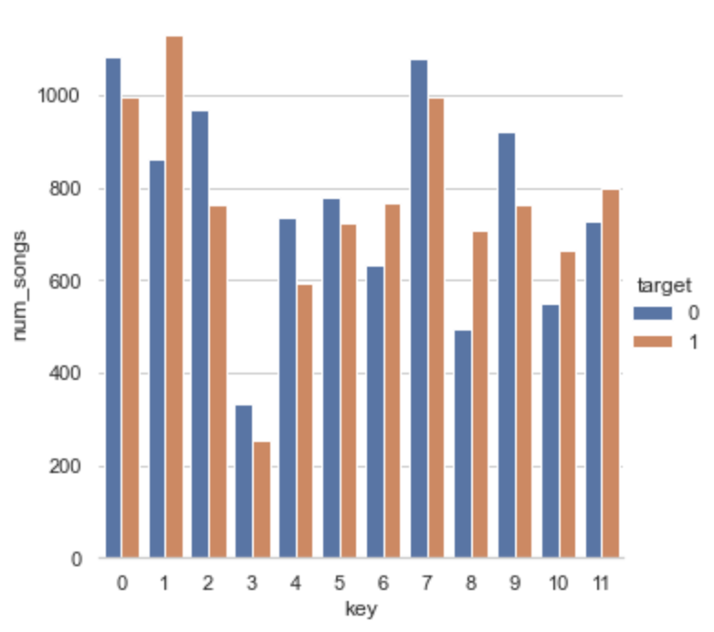
What Features Do Good Songs Have?
When we look at the distribution to the left, we see that a lot of the keys have more songs that are flops rather than hits.
It is considerable to note that there are very few songs in the key of D# compared to the other keys, with just over 500 tracks.
The most popular keys are C, C# and G.
Songs in the key of C#, F#, G#, A# and B are more likely to be popular.
Notes:
Let us quickly look at a common characteristic that most good songs have. On the left, we see a diagram, showing the distribution of hit and flop songs for each possible key. We see that we have tracks in all the keys. However, the keys of C#, F#, G#, A# and B are the keys where there are more hit songs than flop songs. We also see that the most popular keys are C, C# and G. It is also interesting to note that D# is the least popular key, with just over 500 tracks. It is however, important to note that these are observations given the dataset, and might not hold true for all music.

Slide 7
Average Values of Numeric Features
Feature | Average Value
 | Hit Songs | Flop Songs
Danceability | 0.643784 | 0.491776
Energy | 0.674886 | 0.621141
Loudness | -6.67345 | -10.100611
Speechiness | 0.098672 | 0.082885
Acousticness | 0.164384 | 0.314252
Instrumentalness | 0.013217 | 0.314110
Liveness | 0.184205 | 0.209497
Valence | 0.520275 | 0.423823
Tempo | 121.8014 | 120.788648
Duration (in ms) | 233535.845490 | 251630.322123
Timestamp of Chorus | 39.55417 | 42.485120
Number of sections | 10.32245 | 10.799847
We see that most of the mean values for Hit and Flop songs are quite close to each other.
The features that have a significant difference are Danceability, Loudness, Acousticness, Valence, Duration and Chorus Timestamp.
Making a track that aligns more with the ‘Hit’ values could result in a potential ‘Hit’ song.
Notes:
Here, we see a table on the left with the numeric features that we have in our dataset. This table contains the mean values of all these features for hit and flop songs. Most of the features don’t have a significant difference in the mean values for hit and flop songs. Danceability, loudness, acousticness, valence, duration and chorus timestamp are the features that have a very significant difference between these 2 values. Making a track with values closer to the hit mean value would result in a higher chance of making a hit song.

Slide 8
Models I Used and Their Optimal Results
Logistic Regression
Random Forest Classifier
After doing Randomized Search, the best accuracy score I got was around 82.17%.
On the testing data, I got an accuracy of 83.16%.
After doing Randomized Search, the best accuracy score I got was around 82.23%.
On the testing data, I got an accuracy of 83.41%.
XGBClassifier
After doing Randomized Search, the best accuracy score I got was around 86.6%.
On the testing data, I got an accuracy of 88.16%.
Notes:
For the model building process, I mainly used 3 models, which are Logistic Regression, Random Forest and XG Boost. There were numerous trials done for each of the models, but I have summarized the results to only the best of each model. For logistic regression, the best CV score I got was an accuracy of 82.17%. The accuracy on the testing data was slightly higher, getting an accuracy of 83.16%. With the random forest model, the best CV score I got was an accuracy of 82.23% and a testing set accuracy of 83.41%. Finally, with the XGBoost model, the best CV score I got was an accuracy of 86.6% and a testing accuracy of 88.16%. Overall, we can certainly say that the Xgboost model was the best performing model and hence, that is the model I used to build the tool.

Slide 9
Future Improvements
Improving the Visual Appeal of the tool so that potential customers don’t get driven away by lack-lustre visuals.
Expanding the domain to include markets other than the US as well. This will improve the reach of the tool, allowing more artists to benefit from the service.
Automating the OAuth token retrieval process. Once the service is deployed, we will need to generate new tokens every hour to keep the service online and running.
Creating a mini-dashboard to help the artist understand the technical aspects of their music, as well as understand the reason behind the decision given by the model.
Notes:
While all of the model-building process is done, the tool is still in the production stage, with a lot of improvement needed before it can be deployed. The 4 main improvements we intend ot make are: 1. Improving the visual appeal of the tool, mainly to not discourage new users with a very unworthy visual setting. 2. I want to include tracks from all over the world, as every country has its own taste in music and its own style of music. 3. Automating the OAuth token retrieval process so that the tool can be up and running without need for any manual re-configuration. And finally 4. Creating a mini- dashboard to help the artist understand where the song lies compared to the industry standard, as well as help them understand the reason for the prediction given by the model.

Slide 10
Conclusion
The ‘Spotify Hit Detector’ is a very important tool for up-and-coming artists to assess their talent, as well as make use of the technology to identify strengths and weaknesses in their talent .
It also gives them the chance to get opportunities to sign with record-label companies, who now have an objective process to sign new talent.
With the implementation of the future improvements, this will be a great tool available to artists around the world.
Notes:
In conclusion, the spotify hit detector can be a very important tool for up and coming artists to assess their skills, as well as make use of the technology to analyze their strengths and weaknesses. It also gives them the opportunity to sign with record-labels, to push their careers forward. With the implementation of the future improvements, this will be a great tool available to artists around the world.

Slide 11
Thank You!

