Slide 1
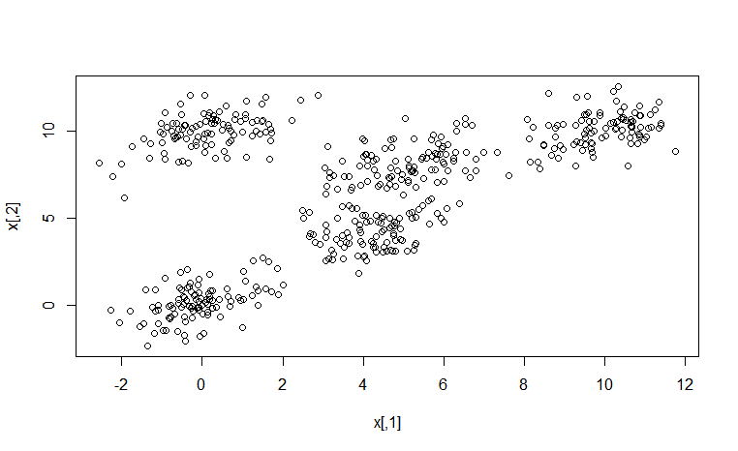
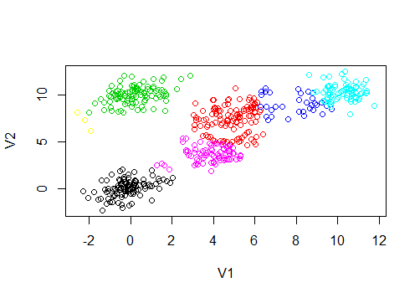
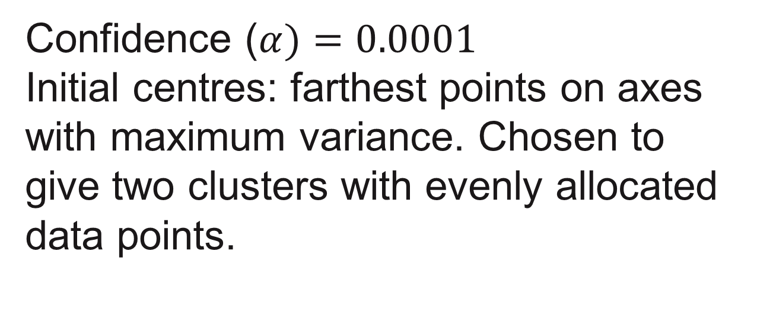
G-means Clustering
Department of Computer Science
Uddhav Bhosle(1), Deepak Patil(2), Satish Gurav(3), Rasika Pande(4), Atefeh Morasali(5), Nielarshi Kumar(6)
North Carolina State University
1. Introduction
3. Implemention
5. Parameter choices
Learning the K in K-means using Gaussian distribution based clustering and Bisecting K-means.
(The data in the cluster is divided into small clusters that have gaussian distribution or are small enough to not be divided further.)
Each cluster is bisected based on K-means clustering.
The two centroids are chosen based on the farthest points along the maximum variance axes.
The data is converted to 1 dimensional form and Anderon Darling test is applied to the data for checking if it is Gaussian or not.
If cluster is Gaussian or smaller than a particular size, it is added to the final set of clusters.
Else it is broken down further into two clusters.
Confidence ($α)=0.0001$
Initial centres: farthest points on axes with maximum variance. Chosen to give two clusters with evenly allocated data points.
2. Data description
4. Results
6. Conclusions
The data used in the implementation was in numeric form.
String input must be converted to numeric form.
G-means clustering performs well in finding the optimal value of k, in k-means clustering algorithm and divides data into clusters such that they each cluster has a normal distribution.
7. References
- Learning the k in k-means - Greg Hamerly, Charles Elkan
Github: https://github.ncsu.edu/sjgurav/G-Means

