Slide 1
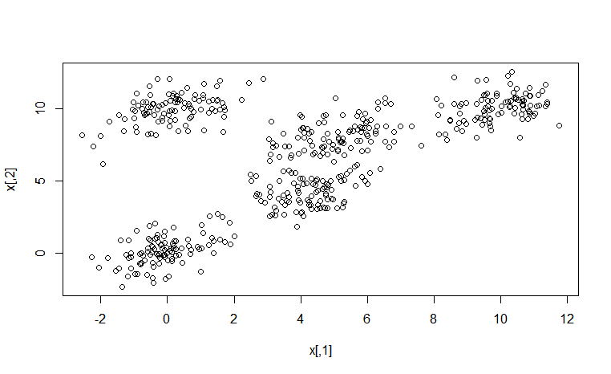
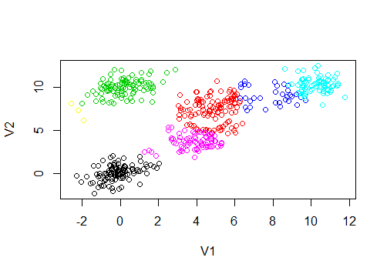
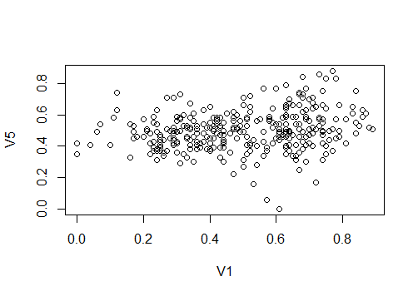
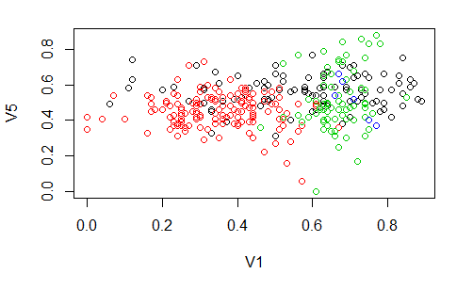
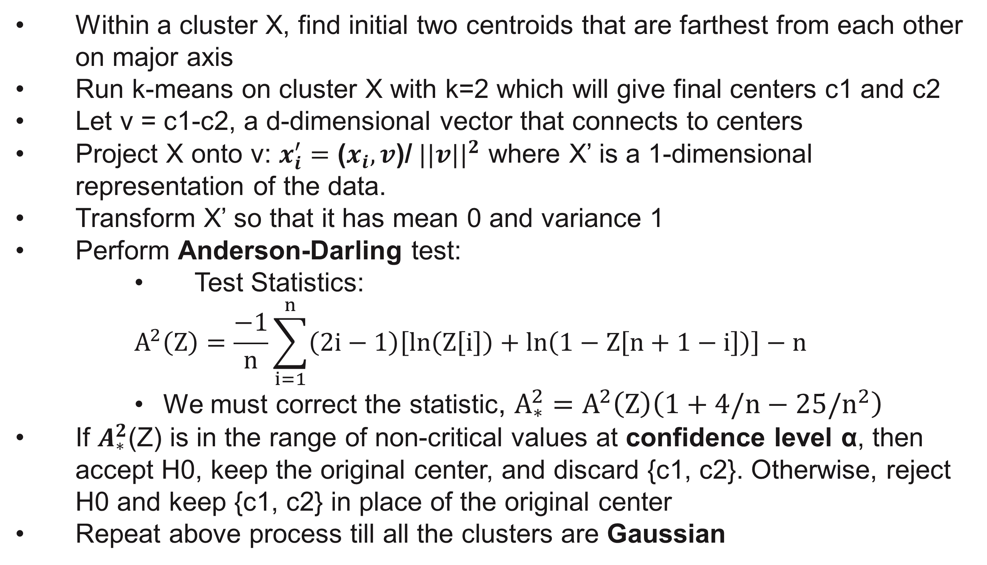
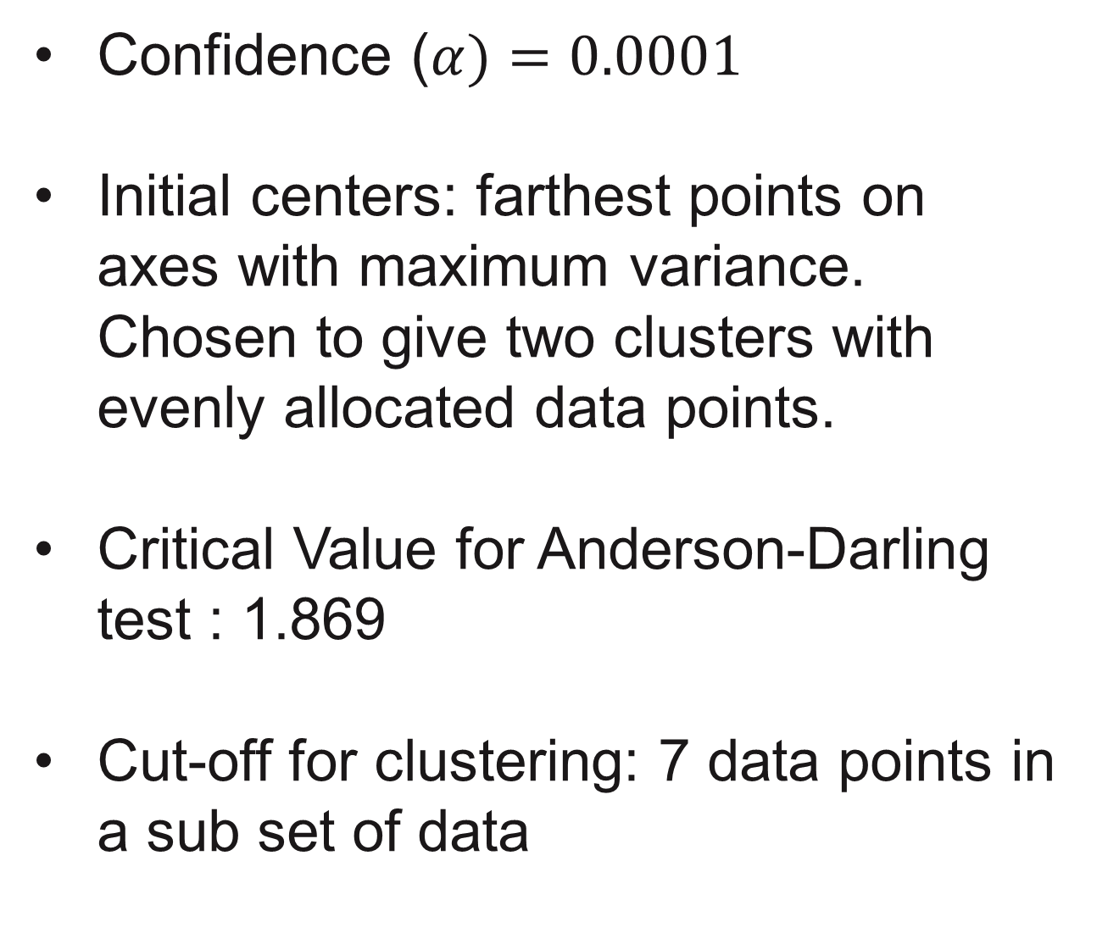
G-means Clustering
Department of Computer Science
Uddhav Bhosle(1), Deepak Patil(2), Satish Gurav(3), Rasika Pande(4), Atefeh Morasali(5), Kumar Nielarshi(6)
North Carolina State University
1. Introduction
3. Implementation
5. Parameter choices
One of the primary difficulties in cluster analysis is determining whether the obtained solution actually represents the underlying structure in the data or is merely an artifact of the procedure used to obtain that solution.
Here, we explore an improved algorithm, called G-means, for learning the value of k while clustering
It is based on a statistical test for the hypothesis that a subset of data follows Gaussian Distribution.
Within a cluster X, find initial two centroids that are farthest from each other on major axis
Run k-means on cluster X with k=2 which will give final centers c1 and c2
Let v = c1-c2, a d-dimensional vector that connects to centers
Project X onto v: $x_{i}^{′}=$ ($x_{i}, v$)/${||v||}^{2}$ where X’ is a 1-dimensional representation of the data.
Transform X’ so that it has mean 0 and variance 1
Perform Anderson-Darling test:
Test Statistics:
$$A^{2}\left(Z\right)=\frac{−1}{n}\sum_{i=1}^{n}{\left(2i−1\right)\left[\ln\left(Z\left[i\right]\right)+\ln\left(1−Z\left[n+1−i\right]\right)\right]}−n$$
We must correct the statistic, $A_{∗}^{2}=A^{2}\left(Z\right)\left(1+4/n−25/n^{2}\right)$
If $A_{∗}^{2}$(Z) is in the range of non-critical values at confidence level α, then accept H0, keep the original center, and discard {c1, c2}. Otherwise, reject H0 and keep {c1, c2} in place of the original center
Repeat above process till all the clusters are Gaussian
Confidence ($α)=0.0001$
Initial centers: farthest points on axes with maximum variance. Chosen to give two clusters with evenly allocated data points.
Critical Value for Anderson-Darling test : 1.869
Cut-off for clustering: 7 data points in a sub set of data
2. Data description
4. Results
6. Conclusions
The data used in the implementation was in numeric form.
String input must be converted to numeric form.
We have made use of two datasets, 1. Synthetic dataset - 300 data points with 2 attributes 2. ecoli dataset - 336 data points with 8 attributes obtained from UCI machine learning repository
Synthetic dataset
Actual Cluster: 5 Predicted value of k = 6
G-means clustering performs well in finding the optimal value of k, in k-means clustering algorithm and divides data into clusters such that they each cluster has a normal distribution.
7. References
2. Ecoli dataset
Actual Clusters = 8 with 2 clusters of 2 instance Predicted k = 4
Greg Hamerly, Charles Elkan, Learning the k in k-means, p.281-288
Dataset: https://archive.ics.uci.edu/ml/datasets/ecoli
Github: https://github.ncsu.edu/sjgurav/G-Means

