Slide 1
Team Name SoloHack Team member Ayaz Uddin

Slide 2

Switching to Remote working because of the COVID-19
Cybersecurity experts warn that the ongoing situation has made cybercriminals more active as they are increasingly targeting both the bank employees with malware attacks, and the unwitting customers using digital channels with scam messages, to defraud them and gain remote access to secure networks
While most banks have business continuity plans in place, such protocols have never been tested at this scale in India or globally,
Cyber criminals are exploiting the COVID-19 outbreak as an opportunity to send phishing emails claiming to have important updates or encouraging donations, impersonating trustworthy organization
Precaution is better than prevention. We need to follow some rules to prevent from hacking personal information

Slide 3

COVID-19 CYBER CRIME
XSS ATTACKS (Identify Theft)
PHISHING
SOCIAL ENGINEERING
SPAM
MALWARE
HACKING
RANSOMEWARE
SCAMMING
DDoS ATTACKS
BOTNETS

Slide 4

Cross Site Scripting (XSS)
Enabling organizations to conceive, develop, acquire, operate, and maintain applications that can be trusted

Slide 5

Hacker Attack Steal Info
Cross-Site Scripting (XSS) attacks are a type of injection, in which malicious scripts are injected into otherwise benign and trusted websites. XSS attacks occur when an attacker uses a web application to send malicious code, generally in the form of a browser side script, to a different end user. Flaws that allow these attacks to succeed are quite widespread and occur anywhere a web application uses input from a user within the output it generates without validating or encoding it.
An attacker can use XSS to send a malicious script to an unsuspecting user. The end user’s browser has no way to know that the script should not be trusted, and will execute the script. Because it thinks the script came from a trusted source, the malicious script can access any cookies, session tokens, or other sensitive information retained by the browser and used with that site. These scripts can even rewrite the content of the HTML page. For more details on the different types of XSS flaws

Slide 6
Technology
Servlet
Jsp
Css

Slide 7
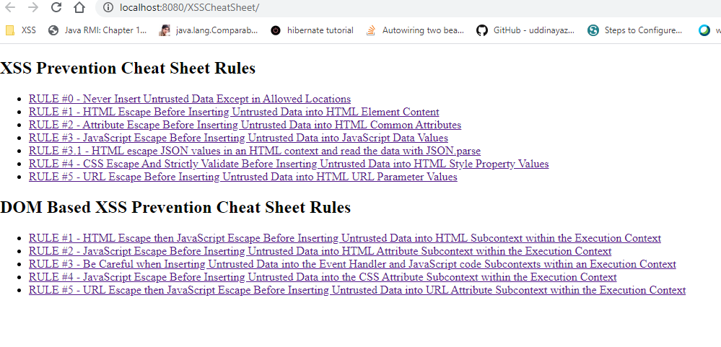
Home Page with Rules
The following rules are intended to prevent all XSS in your application. While these rules do not allow absolute freedom in putting untrusted data into an HTML document, they should cover the vast majority of common use cases. You do not have to allow all the rules in your organization. Many organizations may find that allowing only Rule #1 and Rule #2 are sufficient for their needs. Please add a note to the discussion page if there is an additional context that is often required and can be secured with escaping.
Do NOT simply escape the list of example characters provided in the various rules. It is NOT sufficient to escape only that list. Blacklist approaches are quite fragile. The whitelist rules here have been carefully designed to provide protection even against future vulnerabilities introduced by browser changes.

Slide 8
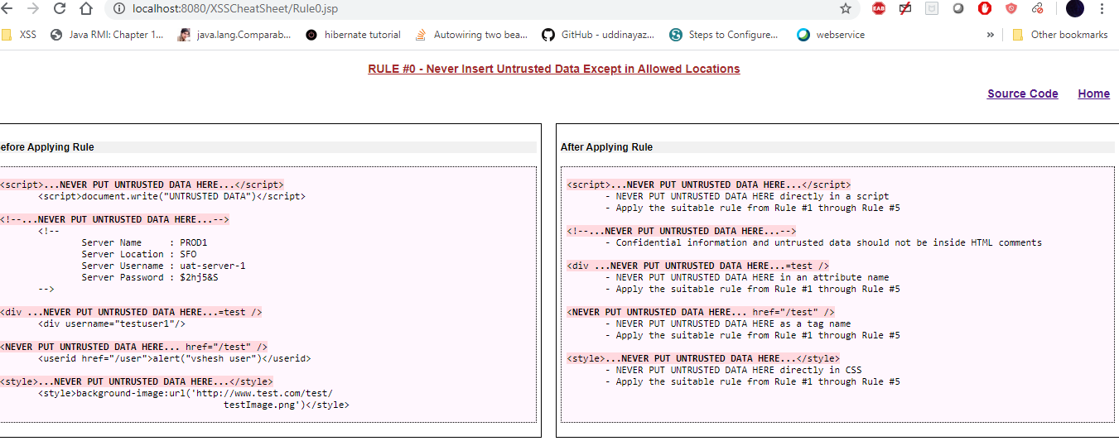
RULE #0 - Never Insert Untrusted Data Except in Allowed Locations
The first rule is to deny all - don't put untrusted data into your HTML document unless it is within one of the slots defined in Rule #1 through Rule #5. The reason for Rule #0 is that there are so many strange contexts within HTML that the list of escaping rules gets very complicated. We can't think of any good reason to put untrusted data in these contexts. This includes "nested contexts" like a URL inside a javascript -- the encoding rules for those locations are tricky and dangerous.

Slide 9
If you insist on putting untrusted data into nested contexts, please do a lot of cross-browser testing and let us know what you find out.
Directly in a script:
<script>...NEVER PUT UNTRUSTED DATA HERE...</script>
Inside an HTML comment:
<!--...NEVER PUT UNTRUSTED DATA HERE...-->
In an attribute name:
<div ...NEVER PUT UNTRUSTED DATA HERE...=test />
In a tag name:
<NEVER PUT UNTRUSTED DATA HERE... href="/test" />
Directly in CSS:
<style>
...NEVER PUT UNTRUSTED DATA HERE...
</style>
Most importantly, never accept actual JavaScript code from an untrusted source and then run it. For example, a parameter named "callback" that contains a JavaScript code snippet. No amount of escaping can fix that.

Slide 10
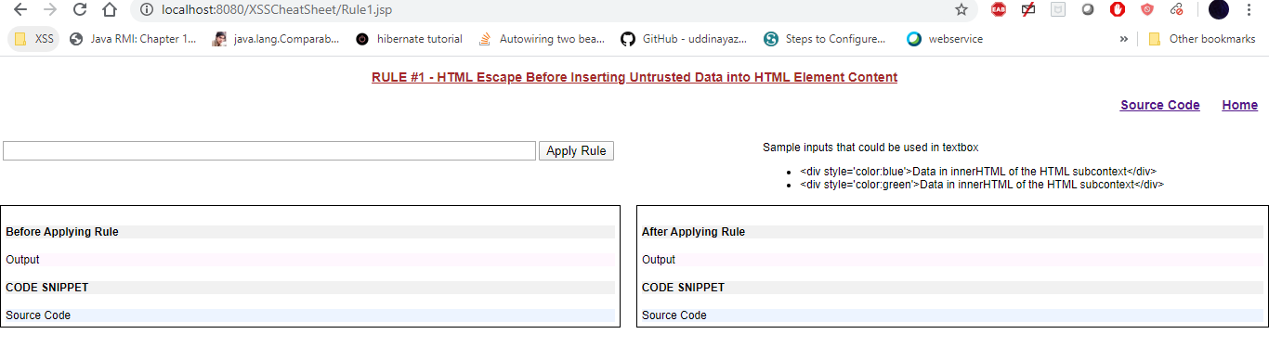
RULE #1 - HTML Escape Before Inserting Untrusted Data into HTML Element Content
Rule #1 is for when you want to put untrusted data directly into the HTML body somewhere. This includes inside normal tags like div, p, b, td, etc. Most web frameworks have a method for HTML escaping for the characters detailed below. However, this is absolutely not sufficient for other HTML contexts. You need to implement the other rules detailed here as well.

Slide 11
<body>
...ESCAPE UNTRUSTED DATA BEFORE PUTTING HERE...
</body>
<div>
...ESCAPE UNTRUSTED DATA BEFORE PUTTING HERE...
</div>
Escape the following characters with HTML entity encoding to prevent switching into any execution context, such as script, style, or event handlers. Using hex entities is recommended in the spec. In addition to the 5 characters significant in XML (&, <, >, ", '), the forward slash is included as it helps to end an HTML entity.
& --> &amp;
< --> &lt;
> --> &gt;
" --> &quot;
' --> &#x27;
/ --> &#x2F;
&apos; not recommended because its not in the HTML spec (See: section 24.4.1) &apos; is in the XML and XHTML specs.
Forward slash is included as it helps end an HTML entity

Slide 12
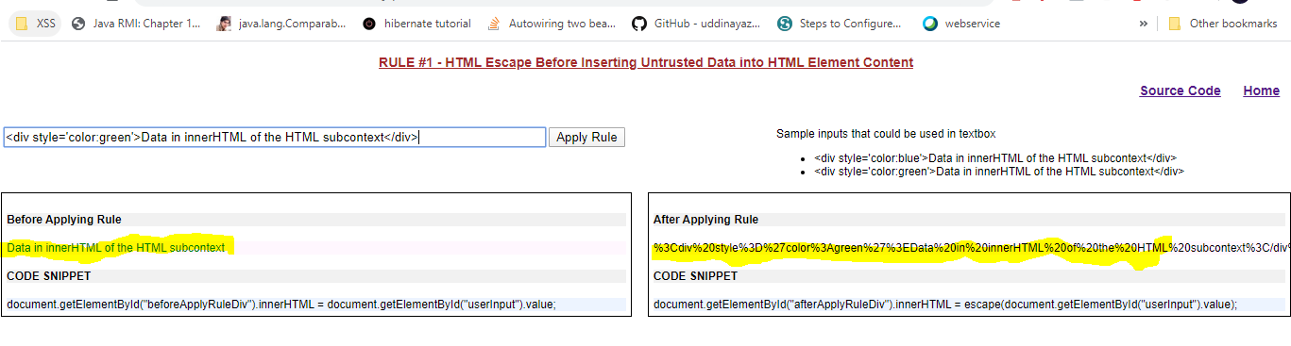
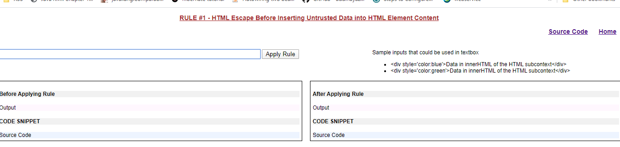
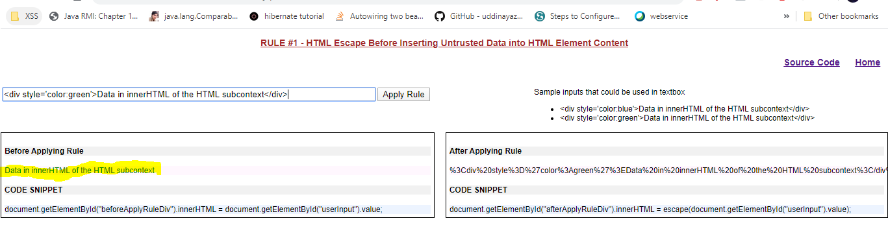
RULE #1 - HTML Escape Before Inserting Untrusted Data into HTML Element Content
Paste sample text to see effect
Before and after applying rule appears to Hacker

Slide 13
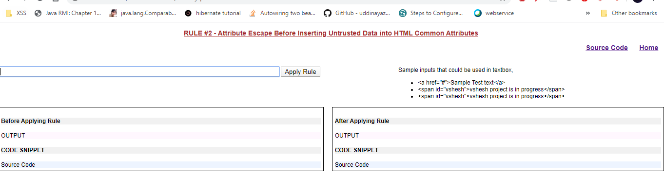
RULE #2 - Attribute Escape Before Inserting Untrusted Data into HTML Common Attributes
Rule #2 is for putting untrusted data into typical attribute values like width, name, value, etc. This should not be used for complex attributes like href, src, style, or any of the event handlers like onmouseover. It is extremely important that event handler attributes should follow Rule #3 for HTML JavaScript Data Values.

Slide 14
Inside UNquoted attribute:
<div attr=...ESCAPE UNTRUSTED DATA BEFORE PUTTING HERE...>content
Inside single quoted attribute:
<div attr='...ESCAPE UNTRUSTED DATA BEFORE PUTTING HERE...'>content
Inside double quoted attribute :
<div attr="...ESCAPE UNTRUSTED DATA BEFORE PUTTING HERE...">content
Except for alphanumeric characters, escape all characters with ASCII values less than 256 with the &#xHH; format (or a named entity if available) to prevent switching out of the attribute.
The reason this rule is so broad is that developers frequently leave attributes unquoted. Properly quoted attributes can only be escaped with the corresponding quote.
Unquoted attributes can be broken out of with many characters, including [space] % * + , - / ; < = > ^ and |.

Slide 15
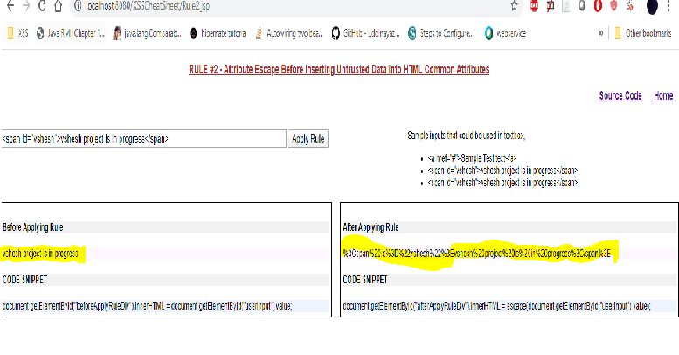
Paste sample text, apply rules Hacker will be baffled
Inside UNquoted attribute:
<div attr=...ESCAPE UNTRUSTED DATA BEFORE PUTTING HERE...>content
Inside single quoted attribute:
<div attr='...ESCAPE UNTRUSTED DATA BEFORE PUTTING HERE...'>content
Inside double quoted attribute :
<div attr="...ESCAPE UNTRUSTED DATA BEFORE PUTTING HERE...">content
Except for alphanumeric characters, escape all characters with ASCII values less than 256 with the &#xHH; format (or a named entity if available) to prevent switching out of the attribute.
The reason this rule is so broad is that developers frequently leave attributes unquoted. Properly quoted attributes can only be escaped with the corresponding quote.
Unquoted attributes can be broken out of with many characters, including [space] % * + , - / ; < = > ^ and |.

Slide 16
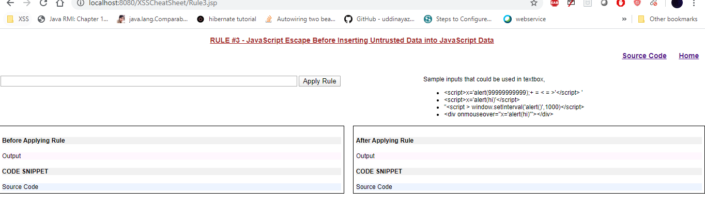
RULE #3 - JavaScript Escape Before Inserting Untrusted Data into JavaScript Data Values
Rule #3 concerns dynamically generated JavaScript code - both script blocks and event-handler attributes. The only safe place to put untrusted data into this code is inside a quoted "data value." Including untrusted data inside any other JavaScript context is quite dangerous, as it is extremely easy to switch into an execution context with characters including (but not limited to) semi-colon, equals, space, plus, and many more, so use with caution.

Slide 17
Inside a quoted string:
<script>alert('...ESCAPE UNTRUSTED DATA BEFORE PUTTING HERE...')</script>
One side of a quoted expression:
<script>x='...ESCAPE UNTRUSTED DATA BEFORE PUTTING HERE...'</script>
Inside quoted event handler:
<div onmouseover="x='...ESCAPE UNTRUSTED DATA BEFORE PUTTING HERE...'"</div>
Please note there are some JavaScript functions that can never safely use untrusted data as input - EVEN IF JAVASCRIPT ESCAPED!
For example:
<script>
window.setInterval('...EVEN IF YOU ESCAPE UNTRUSTED DATA YOU ARE XSSED HERE...');
</script>

Slide 18
Except for alphanumeric characters, escape all characters less than 256 with the \xHH format to prevent switching out of the data value into the script context or into another attribute. DO NOT use any escaping shortcuts like \" because the quote character may be matched by the HTML attribute parser which runs first. These escaping shortcuts are also susceptible to escape-the-escape attacks where the attacker sends \" and the vulnerable code turns that into \\" which enables the quote.
If an event handler is properly quoted, breaking out requires the corresponding quote. However, we have intentionally made this rule quite broad because event handler attributes are often left unquoted. Unquoted attributes can be broken out of with many characters including [space] % * + , - / ; < = > ^ and |.
Also, a </script> closing tag will close a script block even though it is inside a quoted string because the HTML parser runs before the JavaScript parser. Please note this is an aggressive escaping policy that over-encodes. If there is a guarantee that proper quoting is accomplished then a much smaller character set is needed. Please look at the OWASP Java Encoder JavaScript escaping examples for examples of proper JavaScript use that requires minimal escaping.

Slide 19
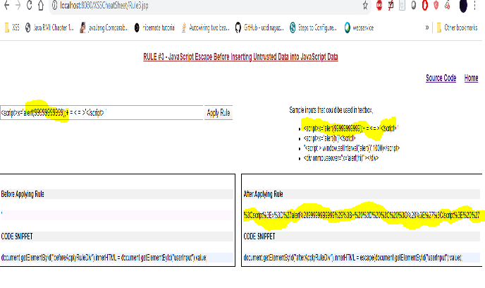
Alert appears in encrypted format

Slide 20
RULE #3.1 - HTML escape JSON values in an HTML context and read the data with JSON.parse
In a Web 2.0 world, the need for having data dynamically generated by an application in a javascript context is common. One strategy is to make an AJAX call to get the values, but this isn't always performant. Often, an initial block of JSON is loaded into the page to act as a single place to store multiple values. This data is tricky, though not impossible, to escape correctly without breaking the format and content of the values.

Slide 21
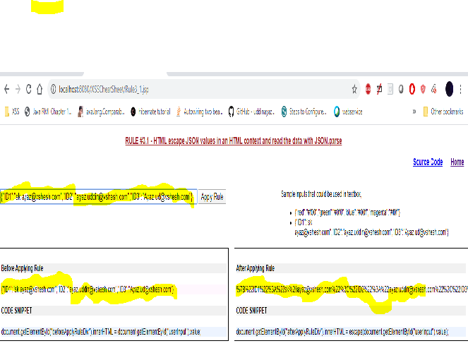
RULE #3.1 - HTML escape JSON values in an HTML context and read the data with JSON.parse
In a Web 2.0 world, the need for having data dynamically generated by an application in a javascript context is common. One strategy is to make an AJAX call to get the values, but this isn't always performant. Often, an initial block of JSON is loaded into the page to act as a single place to store multiple values. This data is tricky, though not impossible, to escape correctly without breaking the format and content of the values.

Slide 22
Ensure returned Content-Type header is application/json and not text/html. This shall instruct the browser not misunderstand the context and execute injected script
Bad HTTP response:
HTTP/1.1 200
Date: Wed, 06 Feb 2013 10:28:54 GMT
Server: Microsoft-IIS/7.5....
Content-Type: text/html; charset=utf-8 <-- bad
....
Content-Length: 373
Keep-Alive: timeout=5, max=100
Connection: Keep-Alive
{"Message":"No HTTP resource was found that matches the request URI 'dev.net.ie/api/pay/.html?HouseNumber=9&AddressLine
=The+Gardens<script>alert(1)</script>&AddressLine2=foxlodge+woods&TownName=Meath'.","MessageDetail":"No type was found
that matches the controller named 'pay'."} <-- this script will pop!!

Slide 23
Good HTTP response:
HTTP/1.1 200
Date: Wed, 06 Feb 2013 10:28:54 GMT
Server: Microsoft-IIS/7.5....
Content-Type: application/json; charset=utf-8 <--good
.....
A common anti-pattern one would see:
<script>
// Do NOT do this without encoding the data with one of the techniques listed below.
var initData = <%= data.to_json %>;
</script>

Slide 24

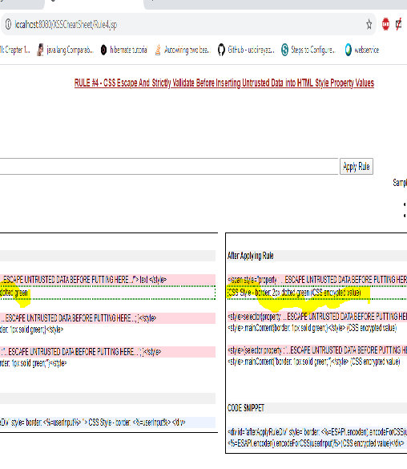
RULE #4 - CSS Escape And Strictly Validate Before Inserting Untrusted Data into HTML Style Property Values
Rule #4 is for when you want to put untrusted data into a stylesheet or a style tag. CSS is surprisingly powerful, and can be used for numerous attacks. Therefore, it's important that you only use untrusted data in a property value and not into other places in style data. You should stay away from putting untrusted data into complex properties like url, behavior, and custom (-moz-binding).
You should also not put untrusted data into IE's expression property value which allows JavaScript.

Slide 25
Property value:
<style>
selector { property : ...ESCAPE UNTRUSTED DATA BEFORE PUTTING HERE...; }
</style>
<style>
selector { property : "...ESCAPE UNTRUSTED DATA BEFORE PUTTING HERE..."; }
</style>
<span style="property : ...ESCAPE UNTRUSTED DATA BEFORE PUTTING HERE...">text</span>
Please note there are some CSS contexts that can never safely use untrusted data as input - EVEN IF PROPERLY CSS ESCAPED! You will have to ensure that URLs only start with http not javascript and that properties never start with "expression".
For example:
{ background-url : "javascript:alert(1)"; } // and all other URLs
{ text-size: "expression(alert('XSS'))"; } // only in IE
Except for alphanumeric characters, escape all characters with ASCII values less than 256 with the \HH escaping format. DO NOT use any escaping shortcuts like \" because the quote character may be matched by the HTML attribute parser which runs first. These escaping shortcuts are also susceptible to escape-the-escape attacks where the attacker sends \" and the vulnerable code turns that into \\" which enables the quote.

Slide 26
If attribute is quoted, breaking out requires the corresponding quote. All attributes should be quoted but your encoding should be strong enough to prevent XSS when untrusted data is placed in unquoted contexts.
Unquoted attributes can be broken out of with many characters including [space] % * + , - / ; < = > ^ and |.
Also, the </style> tag will close the style block even though it is inside a quoted string because the HTML parser runs before the JavaScript parser. Please note that we recommend aggressive CSS encoding and validation to prevent XSS attacks for both quoted and unquoted attributes.
RU

Slide 27
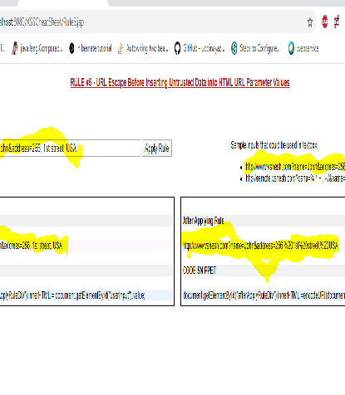
RULE #5 - URL Escape Before Inserting Untrusted Data into HTML URL Parameter Values
Rule #5 is for when you want to put untrusted data into HTTP GET parameter value.
<a href="http://www.somesite.com?test=...ESCAPE UNTRUSTED DATA BEFORE PUTTING HERE...">link</a >
Except for alphanumeric characters, escape all characters with ASCII values less than 256 with the %HH escaping format. Including untrusted data in data: URLs should not be allowed as there is no good way to disable attacks with escaping to prevent switching out of the URL.

Slide 28
All attributes should be quoted. Unquoted attributes can be broken out of with many characters including [space] % * + , - / ; < = > ^ and |. Note that entity encoding is useless in this context.
WARNING: Do not encode complete or relative URL's with URL encoding! If untrusted input is meant to be placed into href, src or other URL-based attributes, it should be validated to make sure it does not point to an unexpected protocol, especially javascript links. URL's should then be encoded based on the context of display like any other piece of data. For example, user driven URL's in HREF links should be attribute encoded.
For example:
String userURL = request.getParameter( "userURL" )
boolean isValidURL = Validator.IsValidURL(userURL, 255);
if (isValidURL) {
<a href="<%=encoder.encodeForHTMLAttribute(userURL)%>">link</a>
}

Slide 29
DOM Based XSS Prevention Cheat Sheet Rules
RULE #1 - HTML Escape then JavaScript Escape Before Inserting Untrusted Data into HTML Subcontext within the Execution Context
RULE #2 - JavaScript Escape Before Inserting Untrusted Data into HTML Attribute Subcontext within the Execution Context
RULE #3 - Be Careful when Inserting Untrusted Data into the Event Handler and JavaScript code Subcontexts within an Execution Context
RULE #4 - JavaScript Escape Before Inserting Untrusted Data into the CSS Attribute Subcontext within the Execution Context
RULE #5 - URL Escape then JavaScript Escape Before Inserting Untrusted Data into URL Attribute Subcontext within the Execution Context

Slide 30
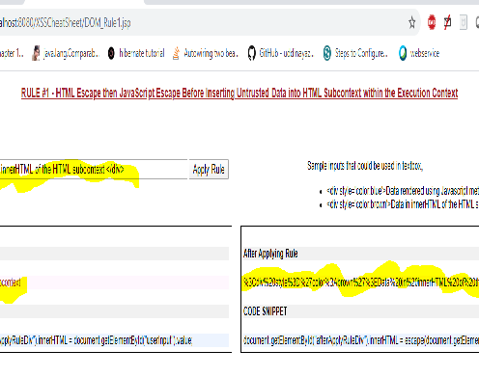
RULE #1 - HTML Escape then JavaScript Escape Before Inserting Untrusted Data into HTML Subcontext within the Execution Context
There are several methods and attributes which can be used to directly render HTML content within JavaScript. These methods constitute the HTML Subcontext within the Execution Context. If these methods are provided with untrusted input, then an XSS vulnerability could result. For example:

Slide 31
Example Dangerous HTML Methods
Attributes
element.innerHTML = "<HTML> Tags and markup";
element.outerHTML = "<HTML> Tags and markup";
Methods
document.write("<HTML> Tags and markup");
document.writeln("<HTML> Tags and markup");
Guideline
To make dynamic updates to HTML in the DOM safe, we recommend:
HTML encoding, and then
JavaScript encoding all untrusted input, as shown in these examples:
element.innerHTML = "<%=Encoder.encodeForJS(Encoder.encodeForHTML(untrustedData))%>";
element.outerHTML = "<%=Encoder.encodeForJS(Encoder.encodeForHTML(untrustedData))%>";
document.write("<%=Encoder.encodeForJS(Encoder.encodeForHTML(untrustedData))%>");
document.writeln("<%=Encoder.encodeForJS(Encoder.encodeForHTML(untrustedData))%>");
Note: The Encoder.encodeForHTML() and Encoder.encodeForJS() are just notional encoders. Various options for actual encoders are listed later in this document.

Slide 32
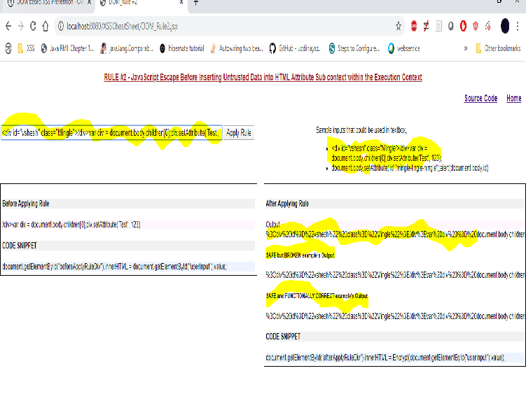
RULE #2 - JavaScript Escape Before Inserting Untrusted Data into HTML Attribute Subcontext within the Execution Context
The HTML attribute subcontext within the execution context is divergent from the standard encoding rules. This is because the rule to HTML attribute encode in an HTML attribute rendering context is necessary in order to mitigate attacks which try to exit out of an HTML attributes or try to add additional attributes which could lead to XSS.
When you are in a DOM execution context you only need to JavaScript encode HTML attributes which do not execute code (attributes other than event handler, CSS, and URL attributes).

Slide 33
For example, the general rule is to HTML Attribute encode untrusted data (data from the database, HTTP request, user, back-end system, etc.) placed in an HTML Attribute. This is the appropriate step to take when outputting data in a rendering context, however using HTML Attribute encoding in an execution context will break the application display of data.
SAFE but BROKEN example
var x = document.createElement("input");
x.setAttribute("name", "company_name");
// In the following line of code, companyName represents untrusted user input
// The Encoder.encodeForHTMLAttr() is unnecessary and causes double-encoding
x.setAttribute("value", '<%=Encoder.encodeForJS(Encoder.encodeForHTMLAttr(companyName))%>');
var form1 = document.forms[0];
form1.appendChild(x);

Slide 34
The problem is that if companyName had the value "Johnson & Johnson". What would be displayed in the input text field would be "Johnson & Johnson". The appropriate encoding to use in the above case would be only JavaScript encoding to disallow an attacker from closing out the single quotes and in-lining code, or escaping to HTML and opening a new script tag.
SAFE and FUNCTIONALLY CORRECT example
var x = document.createElement("input");
x.setAttribute("name", "company_name");
x.setAttribute("value", '<%=Encoder.encodeForJS(companyName)%>');
var form1 = document.forms[0];
form1.appendChild(x);
It is important to note that when setting an HTML attribute which does not execute code, the value is set directly within the object attribute of the HTML element so there is no concerns with injecting up.

Slide 35
RULE #3 - Be Careful when Inserting Untrusted Data into the Event Handler and JavaScript code Subcontexts within an Execution Context

Slide 36
Putting dynamic data within JavaScript code is especially dangerous because JavaScript encoding has different semantics for JavaScript encoded data when compared to other encodings. In many cases, JavaScript encoding does not stop attacks within an execution context. For example, a JavaScript encoded string will execute even though it is JavaScript encoded.
Therefore, the primary recommendation is to avoid including untrusted data in this context. If you must, the following examples describe some approaches that do and do not work.
var x = document.createElement("a");
x.href="#";
// In the line of code below, the encoded data on the right (the second argument to setAttribute)
// is an example of untrusted data that was properly JavaScript encoded but still executes.
x.setAttribute("onclick", "\u0061\u006c\u0065\u0072\u0074\u0028\u0032\u0032\u0029");
var y = document.createTextNode("Click To Test");
x.appendChild(y);
document.body.appendChild(x);

Slide 37
The setAttribute(name_string,value_string) method is dangerous because it implicitly coerces the value_string into the DOM attribute datatype of name_string.
In the case above, the attribute name is an JavaScript event handler, so the attribute value is implicitly converted to JavaScript code and evaluated. In the case above, JavaScript encoding does not mitigate against DOM based XSS.
Other JavaScript methods which take code as a string types will have a similar problem as outline above (setTimeout, setInterval, new Function, etc.). This is in stark contrast to JavaScript encoding in the event handler attribute of a HTML tag (HTML parser) where JavaScript encoding mitigates against XSS.
<!-- Does NOT work -->
<a id="bb" href="#" onclick="\u0061\u006c\u0065\u0072\u0074\u0028\u0031\u0029"> Test Me</a>

Slide 38
An alternative to using Element.setAttribute(...) to set DOM attributes is to set the attribute directly. Directly setting event handler attributes will allow JavaScript encoding to mitigate against DOM based XSS. Please note, it is always dangerous design to put untrusted data directly into a command execution context.
<a id="bb" href="#"> Test Me</a>
//The following does NOT work because the event handler is being set to a string.
//"alert(7)" is JavaScript encoded.
document.getElementById("bb").onclick = "\u0061\u006c\u0065\u0072\u0074\u0028\u0037\u0029";

Slide 39
//The following does NOT work because the event handler is being set to a string.
document.getElementById("bb").onmouseover = "testIt";
//The following does NOT work because of the encoded "(" and ")".
//"alert(77)" is JavaScript encoded.
document.getElementById("bb").onmouseover = \u0061\u006c\u0065\u0072\u0074\u0028\u0037\u0037\u0029;
//The following does NOT work because of the encoded ";".
//"testIt;testIt" is JavaScript encoded.
document.getElementById("bb").onmouseover = \u0074\u0065\u0073\u0074\u0049\u0074\u003b\u0074\u0065\u0073
\u0074\u0049\u0074;

Slide 40
RULE #4 - JavaScript Escape Before Inserting Untrusted Data into the CSS Attribute Subcontext within the Execution Context
Normally executing JavaScript from a CSS context required either passing javascript:attackCode() to the CSS url() method or invoking the CSS expression() method passing JavaScript code to be directly executed.
From my experience, calling the expression() function from an execution context (JavaScript) has been disabled. In order to mitigate against the CSS url() method, ensure that you are URL encoding the data passed to the CSS url() method.
document.body.style.backgroundImage = "url(<%=Encoder.encodeForJS(Encoder.encodeForURL(companyName))

Slide 41
RULE #5 - URL Escape then JavaScript Escape Before Inserting Untrusted Data into URL Attribute Subcontext within the Execution Context
The logic which parses URLs in both execution and rendering contexts looks to be the same. Therefore there is little change in the encoding rules for URL attributes in an execution (DOM) context.
var x = document.createElement("a"); x.setAttribute("href", '<%=Encoder.encodeForJS(Encoder.encodeForURL(userRelativePath))%>'); var y = document.createTextElement("Click Me To Test"); x.appendChild(y); document.body.appendChild(x);
If you utilize fully qualified URLs then this will break the links as the colon in the protocol identifier (http: or javascript:) will be URL encoded preventing the http and javascript protocols from being invoked.

Slide 42
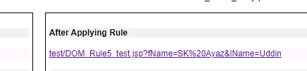
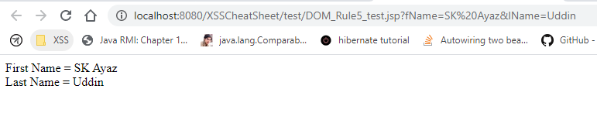
RULE #5 - URL Escape then JavaScript Escape Before Inserting Untrusted Data into URL Attribute Subcontext within the Execution Context
On clicking
The result appears

Slide 43
This project implements & explains owasp.org

