Slide 1
Final Project Presentation DATA 698 Md. Jalal Uddin
Project Title:
Preventing Chronic Disease of South Asian Community through Engagement with Community and Faith-Based Organizations in New York City.

Slide 2
Data Collection
CSAAH (Center for the Study of Asian American Health):
I have collected all my data from CSAAH. It is a non profit research organization at NYU School of Medicine under department of Population Health.
IMPACT (Implementing Million Hearts for Provider and Community Transformation): IMPACT is a research project for manage and control High blood pressure for South Asian Community in fifteen different primary care provider clinic throughout New York City.
CSP (Community Service Planning): CSP is a blood pressure and diabetes management program working with four faith-base organization, two in Brooklyn and two in Manhattan.

Slide 3
Data Collection (IMPACT)
All IMPACT participants were divided into Treatment and Control group by randomization. Treatment participant received monthly basis five educational classes, education material, phone/in-person follow up, exercise DVD, tools and so on to manage and control their high blood pressure. Educational classes and phone and in-person follow-up were conducted by experienced Community Health Worker, CHW. But Control participant did not receive any of the following. The intervention were as follows:
Round1: Total 8 primary care provider clinic.
Round2: Total 7 primary care provider clinic.
Treatment: Total 86 participant in round1, 73 participant in round2.
Control: Total 81 participant in round1, 64 participant in round2.
Baseline and Endpoint: Both treatment and control participant completed baseline Survey (Beginning of the intervention) and six month/endpoint survey (at the end of the intervention)

Slide 4
Data Collection (CSP)
CSP providing free monthly blood pressure screenings and basic hypertension reduction and management strategies to the mosque congregants. Every Friday prayer approximately 3000 people come to pray to the four different mosque. The data collection from CSP was as follows:
community health workers trained 24 volunteers from these 4 mosques. These 24 volunteers conduct the screenings.
Close to 400 mosque congregants received free blood pressure.
From all four mosques, a total of 207 KOT baseline surveys were collected.

Slide 5
Data Cleaning and organizing
All the data for project IMPACT and project CSP were saved in REDCap. I have created report in the REDCap to export all the Baseline, End point data into SQL 2012. Data cleaning and organizing procedure was as follows:
I created table under two instances named Data_698 and Data_698R2 and imported those REDCap data into SQL instances.
Then I cleaned the data, created table based on my research needs and finally exported the cleaned data into excel files.
Then, I used RStudio to research those final data. I have attached all the imported excel tables, SQL coding, R coding, and RStudio files (.Rmd files) attached with this final research paper.

Slide 6
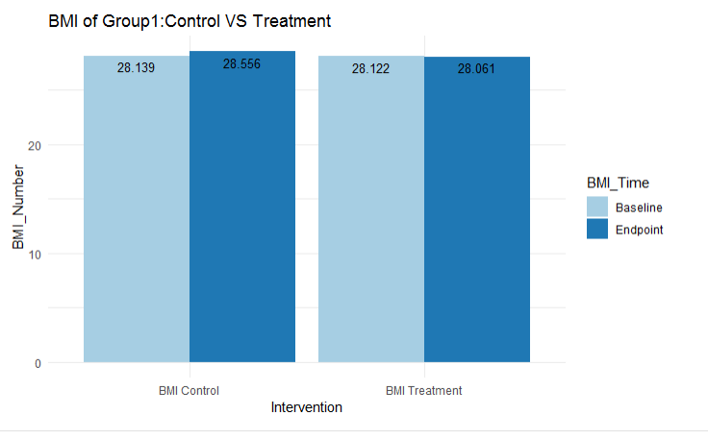
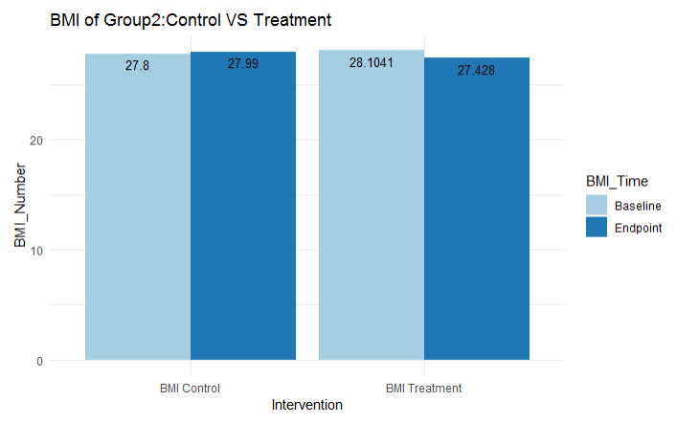
Research Method and Results
Analysis on BMI Comparison between Control and Treatment participant of Round 1 and Round 2:
In Round 1, average BMI of Control participants increases Basement to Treatment from 28.139 to 28.556. On the other hand, average BMI of Treatment participants decreases Basement to Treatment from 28.122 to 28.061.
Similarly, In Round 2, average BMI of Control participants increases Basement to Treatment from 27.8 to 27.99. On the other hand, average BMI of Treatment participants decreases Basement to Treatment from 28.1041 to 27.428.

Slide 7
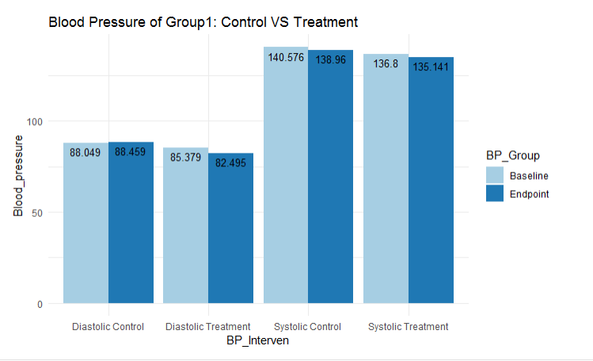
Research Method and Results
Analysis on Blood Pressure Comparison between Control and Treatment participant of Round 1:
In Round1, average diastolic blood pressure of Control participants increases Basement to Treatment from 88.049 to 88.459. On the other hand, average diastolic blood pressure of Treatment participants decreases Basement to Treatment from 85.379 to 82.495.
Average systolic blood pressure of Control participant decreases from 140.576 to 138.96 which is 1.61. And average systolic blood pressure of Treatment participant decreases from 136.8 to 135.141 which is 1.66. The decrease rate of Treatment participant is more than the control participant for systolic blood pressure.

Slide 8
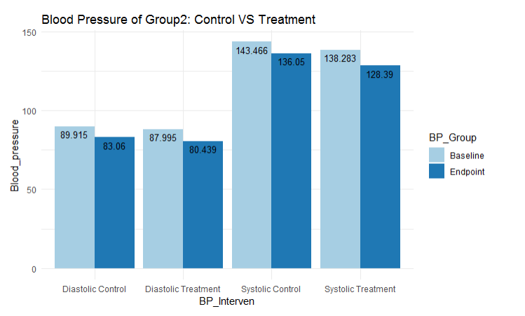
Research Method and Results
Analysis on Blood Pressure Comparison between Control and Treatment participant of Round 2:
In Round 2, average diastolic blood pressure of Control participants decreases Basement to Treatment from 89.915 to 83.06. On the other hand, average diastolic blood pressure of Treatment participants decreases Basement to Treatment from 87.995 to 80.439.
Average systolic blood pressure of Control participants decreases Basement to Treatment from 143.466 to 136.05. On the other hand, average systolic blood pressure of Treatment participants decreases Basement to Treatment from 138.283 to 128.39.

Slide 9
Research Method and Results
Preliminary results from baseline and 12-month KOT data at Assafa and Madina (n=25) show as follows:
mean systolic blood pressure (SBP) decreased from 128.8 at baseline to 120.2 at 12 months (p=0.027).
Mean diastolic blood pressure (DBP) decreased from 79.0 at baseline to 77.3 at 12-months (p=0.415).
BP control (using cutoff of 140 for SBP and 90 for DBP) was 72% at baseline and 80% at 12-months (p=0.508).
Health related self-efficacy (range of 1-4, 4=highest self-efficacy) also increased between baseline and 12-month follow-up; the mean score increased from 3.46 to 3.74 (p=0.002).

Slide 10
Conclusion
The analysis suggests that culturally tailored-education classes, education materials, one on one phone follow up and one on one in person visits helps hypertensive patients to lower their BMI, High blood pressure, maintain healthy food and physical exercise regularly. And in the long run, culturally and linguistically tailored clinic-based resources help participant to lower the Cardiovascular disease, CVD risk reduction.

Slide 11
Sources
https://github.com/uddinjalal1983/DATA_698_Final_Research_Paper

