Slide 1



Deforestation Detection(Fire Classification)
Presented By
Student Name:- UDDIP BISHT
College Name:- Panipat Institute of Enginnering & Technology
Department:- B.Tech (CsE)
Email ID:- uddipbisht2004@gmail.com
AICTE Internship Student Registration ID:- STU668e4423c86ed1720599587
AICTE Internship ID:- INTERNSHIP_1748923002683e727a876ea

Slide 2

Learning Objectives
Learning Objectives:-
Understand and analyze MODIS satellite fire data specific to India.
Learn preprocessing techniques for handling real-world geospatial datasets.
Apply feature scaling and encoding for machine learning readiness.
Build and evaluate a classification model to predict fire types.
Deploy a machine learning model using Streamlit for real-time predictions.
Tackle challenges related to large file handling and model integration in web applications.
GOAL
Source :
www.freepik.com/

Slide 3
Tools and Technology used
Tools and Technology Used:-
Python – Core language for data processing, modeling, and deployment.
Pandas & NumPy – For data cleaning, manipulation, and numerical computations.
Scikit-learn – To build and train machine learning classification models.
Joblib – For saving and loading large model and scaler files efficiently.
Streamlit – To create an interactive web application for fire type prediction.
Matplotlib & Seaborn – For data visualization and exploratory data analysis.
Google Drive – Used for sharing large model files exceeding GitHub's size limit.
Jupyter Notebook – For exploratory analysis and model development.

Slide 4
Methodology
Methodology:-
Data Collection
Acquired MODIS satellite fire data for India from the years 2021, 2022, and 2023 in CSV format.
Data Preprocessing
Merged datasets and cleaned missing or invalid values.
Converted categorical variables (e.g., confidence level) into numerical format.
Scaled numerical features using standard scaling for uniformity.
Exploratory Data Analysis (EDA)
Visualized data distributions and correlations to understand feature relevance.
Identified patterns and anomalies using histograms, heatmaps, and pair plots.
Model Building
Built a classification model using machine learning algorithms (e.g., Random Forest or XGBoost).
Split data into training and testing sets for model evaluation.
Optimized hyperparameters for best performance.
Model Evaluation
Assessed the model using accuracy, precision, recall, and F1-score.
Selected the best-performing model for deployment.
Model Deployment
Integrated the trained model and scaler into a Streamlit app.
Developed a user-friendly web interface for inputting fire data and predicting fire types.
Handling Deployment Constraints
Managed model file size limitations by sharing large files via Google Drive.
Ensured portability and usability across different platforms.

Slide 5
Problem Statement:
Problem Statement:-
India experiences numerous fire incidents annually, affecting forests, agriculture, and offshore areas. Accurately identifying the type of fire based on satellite data is crucial for timely response and effective disaster management.
However, raw satellite data such as from MODIS (Moderate Resolution Imaging Spectroradiometer) can be complex and requires processing and classification to determine the nature of the fire. Manual analysis is not feasible at scale due to the volume and complexity of data.
The objective of this project is to develop a machine learning-based system that can classify different types of fires in India (e.g., vegetation fire, offshore fire, and other land sources) using MODIS satellite data, and deploy it via a user-friendly web application for real-time prediction.

Slide 6
Solution:
Solution
To address the problem of identifying fire types from complex satellite data, the following solution was implemented:-
Data Integration and Cleaning
Collected MODIS satellite fire data for India (2021–2023).
Cleaned and merged datasets to form a unified dataset for modeling.
Feature Engineering
Selected key features such as brightness, brightness_T31, FRP, scan, track, and confidence.
Encoded categorical features and applied feature scaling for model compatibility.
Model Development
Trained a supervised classification model (e.g., Random Forest) to categorize fire incidents into vegetation fires, offshore fires, and other land-based sources.
Evaluated model performance and fine-tuned it for accuracy and robustness.
Deployment with Streamlit
Built a web application using Streamlit to make predictions based on user inputs.
Integrated the trained model and scaler to enable real-time fire type classification.
Scalable Access
Hosted large model files via Google Drive due to GitHub file size limitations.
Designed the app to be lightweight, fast, and accessible from any device with internet access.
GITHUB REPO:- https://github.com/uddipbisht/Classification_of_Fire_Types_in_India_Using_MODIS_Satellite_Data_week1.git

Slide 7
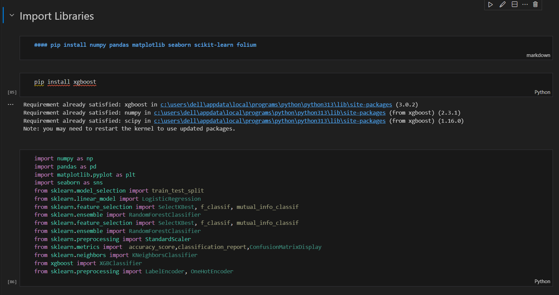
Screenshot of Output:
IMPORT LIBRARIES

Slide 8
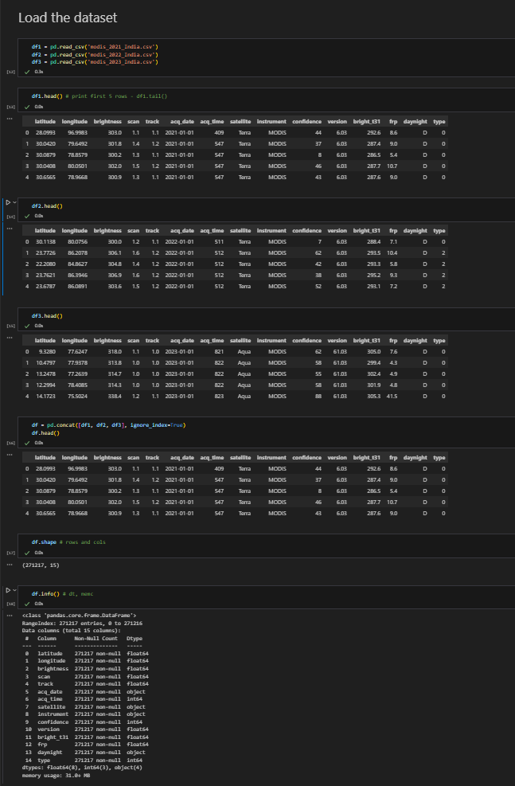
Screenshot of Output:
Load the Dataset

Slide 9
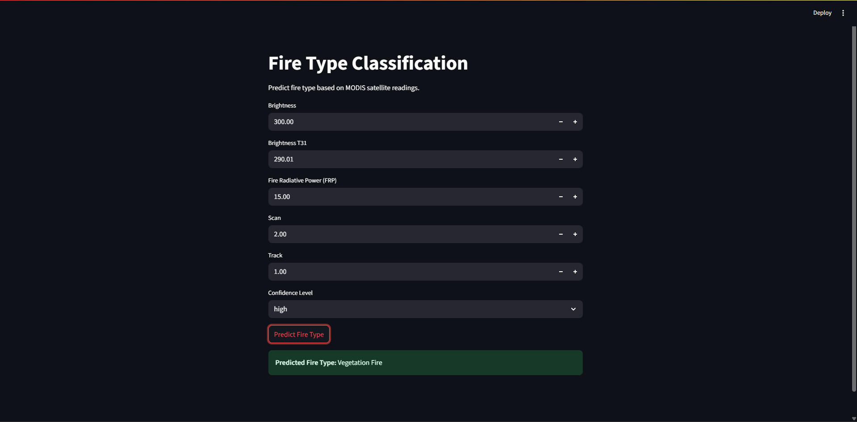
Screenshot of Output:
The screenshot from deployed Streamlit app, showing the following:
User inputs filled (Brightness, Brightness T31, FRP, Scan, Track, Confidence level)
A clicked “Predict Fire Type” button
The resulting output such as: ✅ Predicted Fire Type: Vegetation Fire

Slide 10
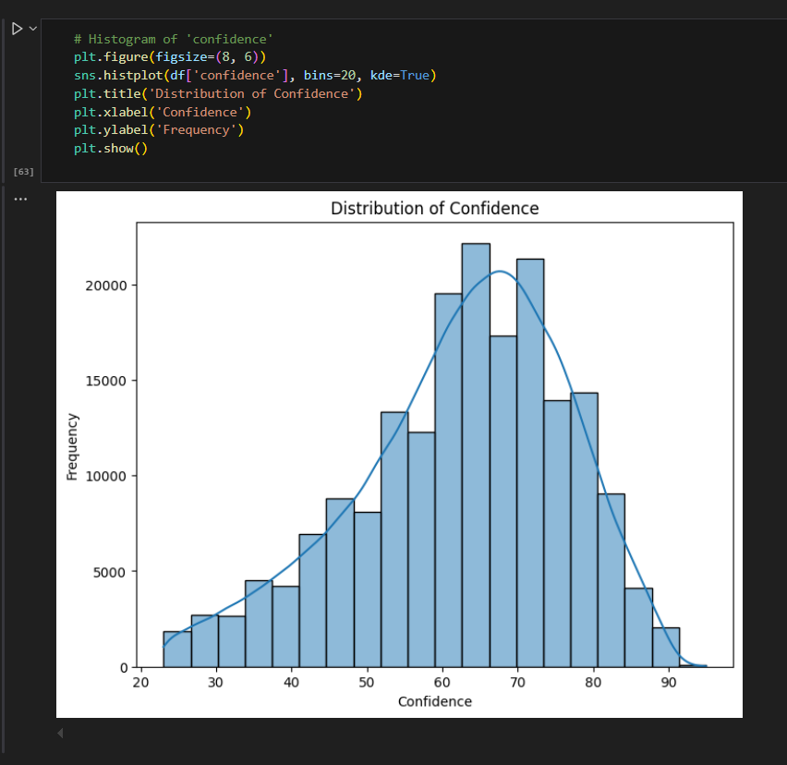
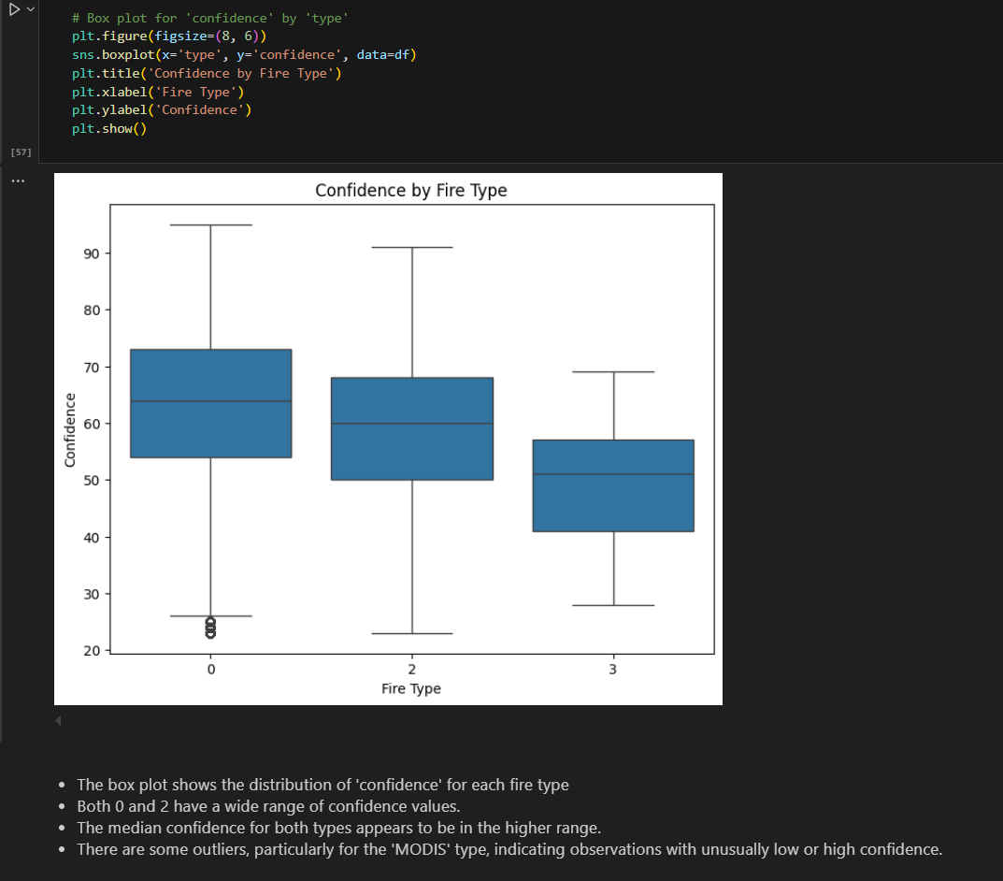
Screenshot of Output:
Exploratory Data Analysis (EDA):-

Slide 11
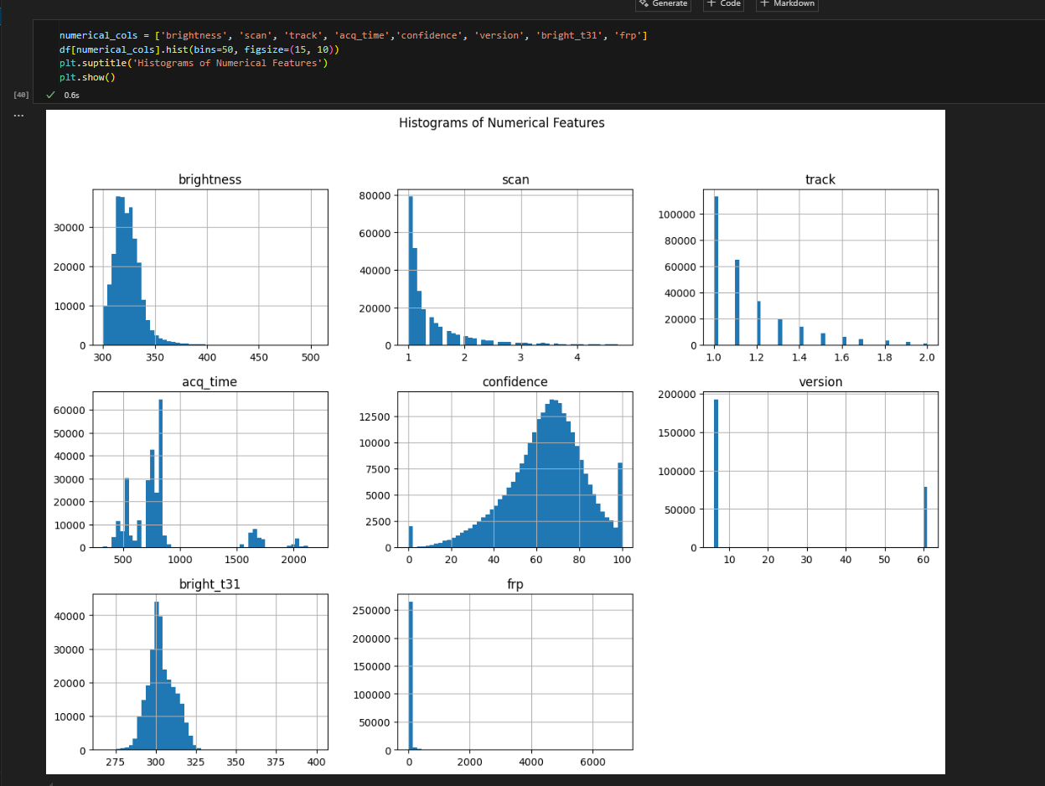
Screenshot of Output:
Histograms of Numerical Features

Slide 12
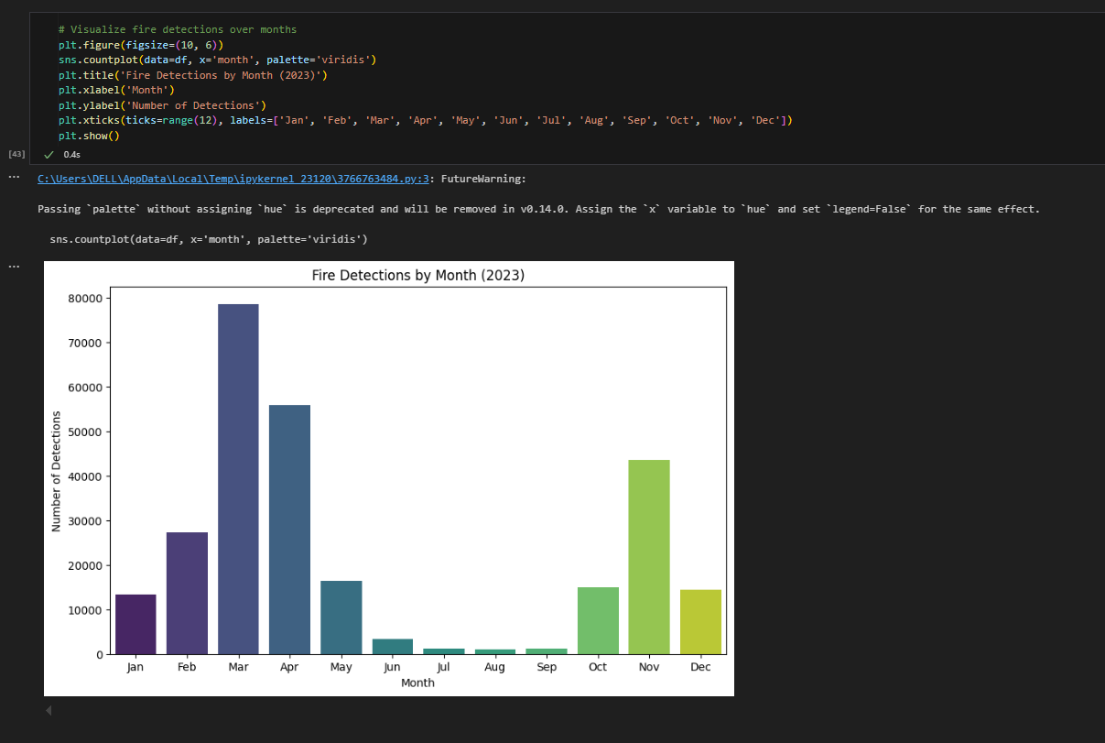
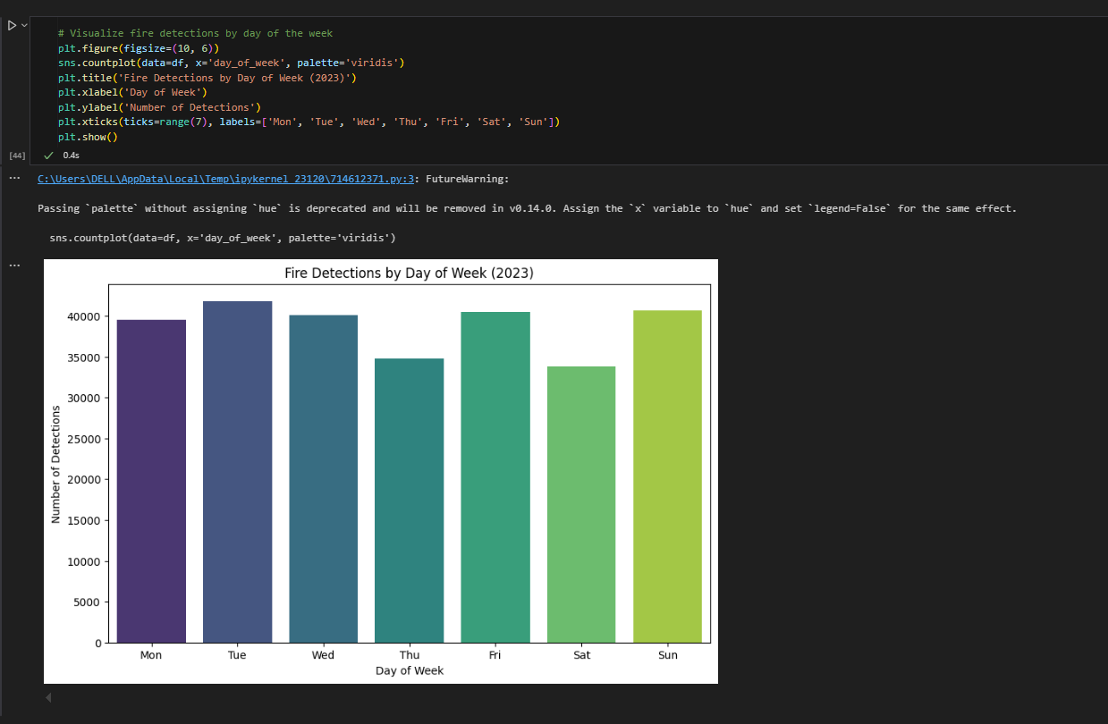
Screenshot of Output:
Visualize fire detections over months
Visualize fire detections by day of the week

Slide 13
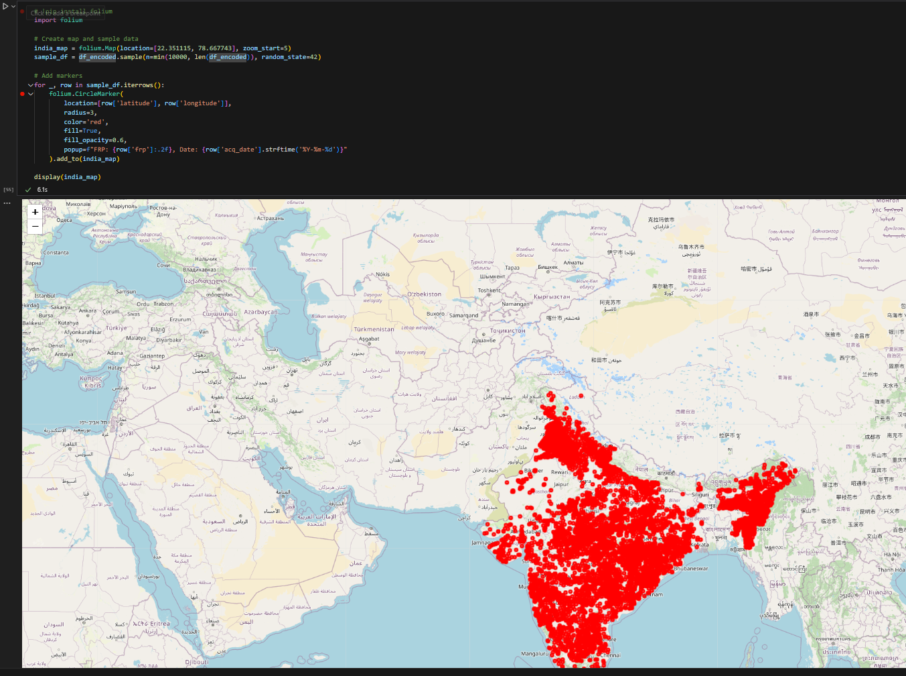
Screenshot of Output:
Folium map of India with red circle markers indicating fire locations based on the 'latitude' and 'longitude' columns of the dataset. Each marker represents a detected fire incident.

Slide 14
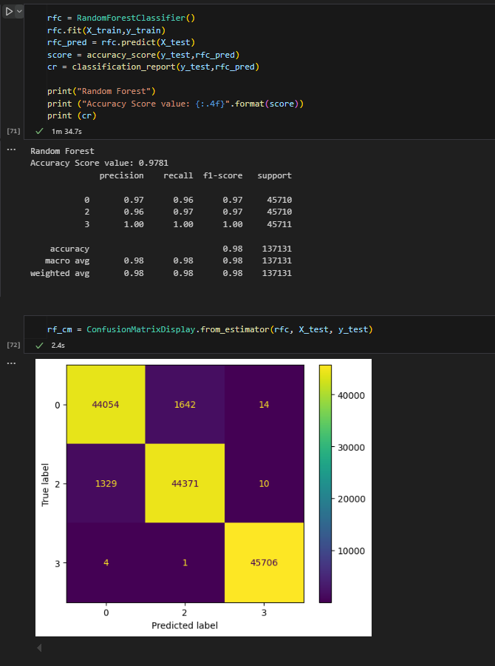
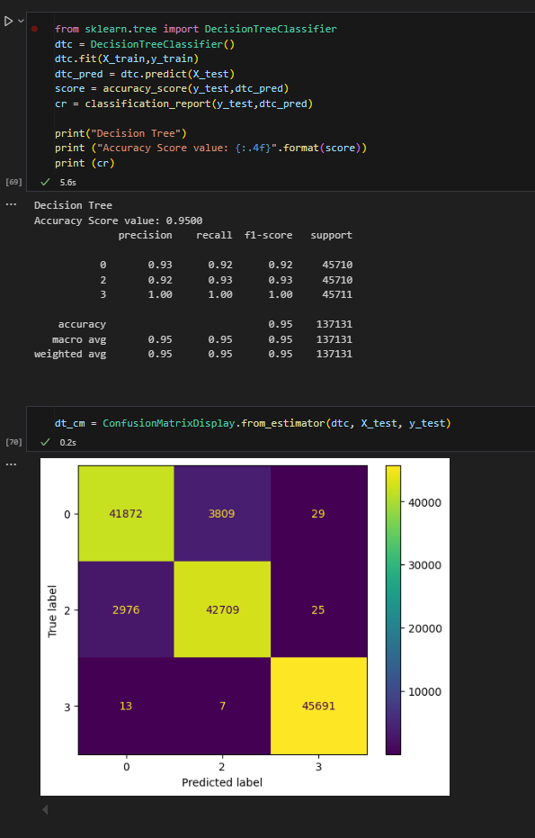
Screenshot of Output:
Random Forest
Decision Tree

Slide 15
Conclusion:
Conclusion:-
This project successfully demonstrates the application of machine learning for classifying fire types in India using MODIS satellite data. By leveraging key features such as brightness, fire radiative power (FRP), and confidence levels, we trained a reliable classification model capable of predicting fire categories with good accuracy.
The deployment of this model using Streamlit ensures ease of use and real-time predictions through an interactive web interface. Additionally, practical issues such as large model file size were effectively managed using external file hosting.
Overall, the project highlights the potential of combining remote sensing data with AI to support faster and more informed decision-making in fire monitoring and disaster response efforts.
Future Scope:-
Incorporate More Features: Include additional environmental variables such as wind speed, humidity, and vegetation index to improve model accuracy.
Use Deep Learning Models: Experiment with deep learning techniques (e.g., CNNs or LSTMs) for better pattern recognition in complex satellite data.
Real-Time Data Integration: Connect the model with real-time MODIS or VIIRS satellite feeds for live fire detection and classification.
Mobile App Development: Extend the application to mobile platforms for quick access by field officers and disaster response teams.
Alert System Integration: Develop automated alert systems to notify concerned authorities when a specific fire type is detected.
Global Applicability: Adapt and scale the model for fire detection in other countries or regions beyond India.

