Slide 1


ASANSOL ENGINEERING COLLEGE
INNOVATIVE MODEL MAKING COMPETITION
WIRELESS NOTICEBOARD
Using Arduino
BY
CORE FOUR

Slide 2
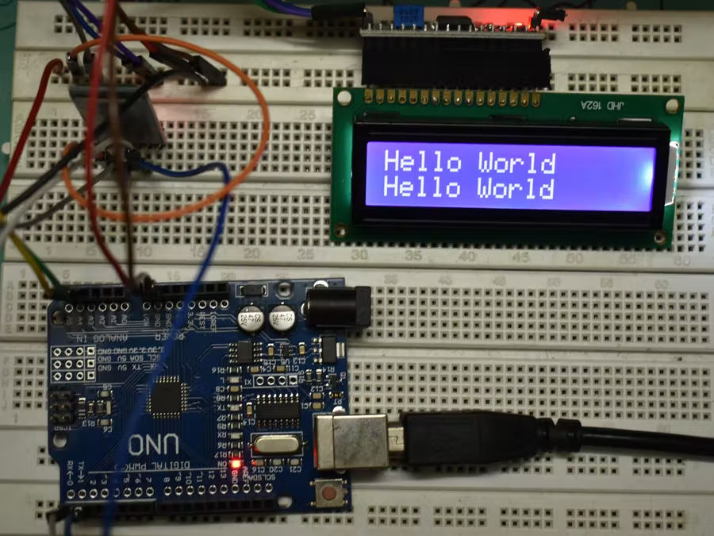
Introduction
In earlier days people used the paper as the medium to convey any message and printed paper is used to display on a notice board. These conventional notice boards are not so connected for the changes in the message which is to be displayed. Also needs huge amount of time, resources and manpower. Notice boards are one amongst the mainly used ones, which are ranging from primary schools to major organizations to convey information. Individuals using these notice boards through wireless communication can
interconnect with people easily and it requires less amount of time. Wi-Fi network has been used to give a wide area network that permits to transfer the information into text
message through LED display that acts as a notice board.

Slide 3

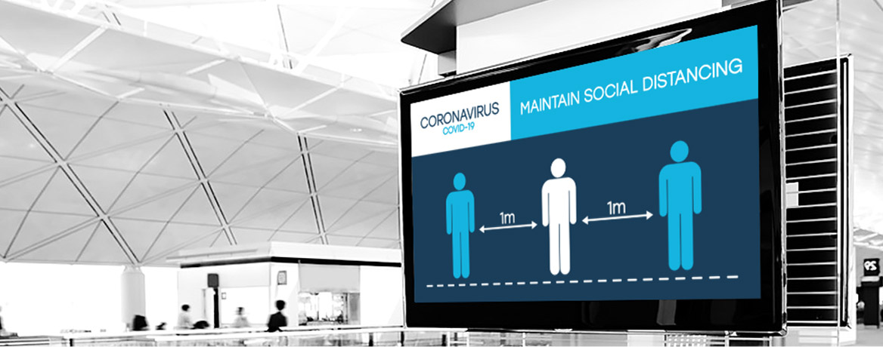
PROPOSED SYSTEM
AIM-The aim of our project is to develop a wireless notice board that display message or the information sent
from the user through a simple interface and which displays it on LED screen. To originate a Wi-Fi driven automatic display Board which can replace the presently used paper based notice board and conventional notice boards. So this document gives us clear idea of how to change the contents of Digital display using Wi-Fi. So for that we use some Embedded as well as communication idea and using Arduino board we try to implement our system.

Slide 4

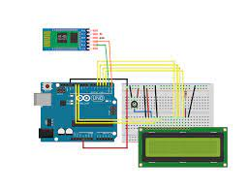
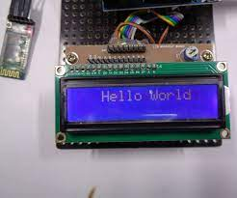
THE MODEL
What is an wireless digital board ?
WirelessNotice digital Board is the most uniform and primary apparatus in any university,schools or public places like bus stations, railway stations and parks. But fixing and changing various notices of instruction on a day-today is a difficult process.

Slide 5
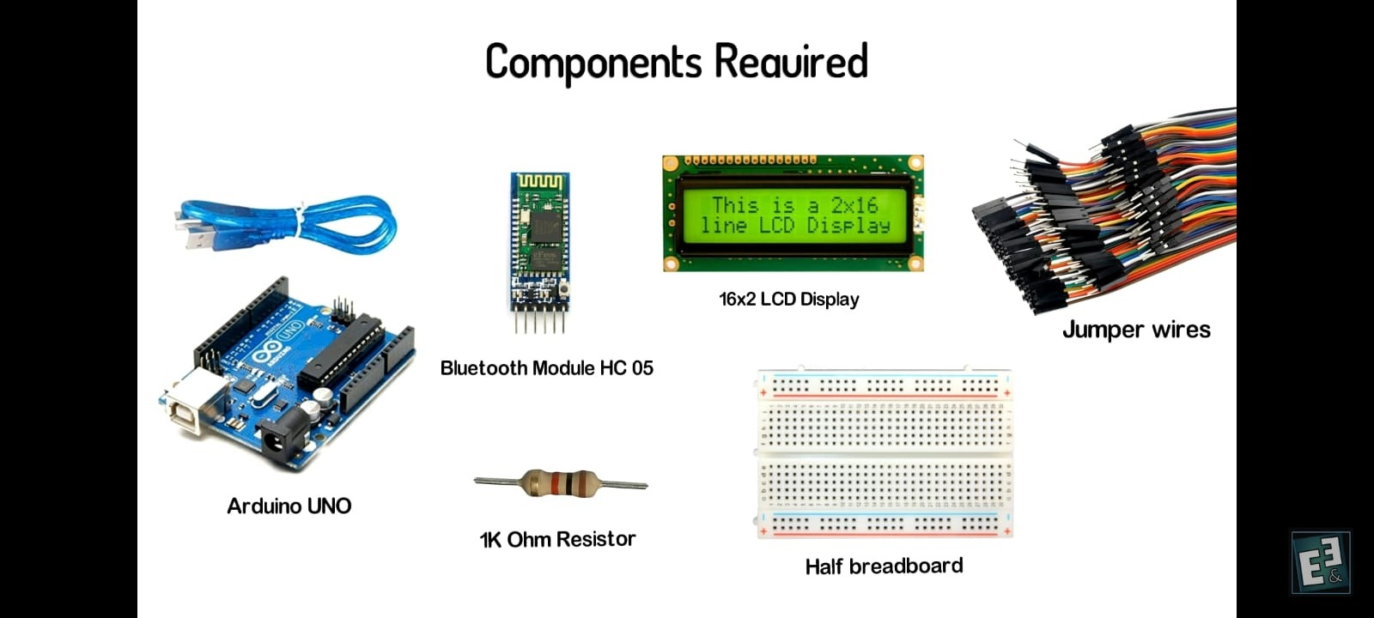
COMPONENTS

Slide 6

CIRCUIT DIAGRAM

Slide 7

APPLICATION
The applications of wireless notice board mainly include public places like bus stands, railway stations, airports, shopping malls, and parks to display the information wirelessly.
This project is also used in organizations, schools, and colleges

Slide 8
Advantages
Disadvantages
The electronic notice board is wireless and no need for wires for displaying the information on the LCD display.
It is very easy to operate and consumes less power
The circuit of the wireless notice board is portable.
Sometime electronic notice board is not able to provide the information in time, due to far range and bad whether issue we have to face very heavy loss also.

Slide 9
TEAM CORE FOUR
Team details
UDDIPTA DAS (10800320040)
PRABHAT KUMAR ( 10800320041)
RANJAN KUMAR (10800320044 )
SURAJ CHOWHAN ( 10800320058 )
Student of ECE 2nd Year
ASANSOL ENGINEERING COLLEGE
THANK YOU

