Slide 1

Practical AI/ML for Computational Biology and Chemistry
(Day 5)
Chuming Chen
chenc@udel.edu
Research Associate Professor
Computer and Information Sciences
Center for Bioinformatics and Computational Biology
Data Science Institute
Slides and notebooks: https://github.com/udel-cbcb/al_ml_workshop
June 17, 2022

Slide 2

Lecture Outline
Review of Day 4
Introduction to Deep Learning
Course summary

Slide 3
Review of Day 4
Model Selection, Training and Evaluation
Models: Linear regression, Polynomial regression, Logistic regression, Support vector machine, Decision trees, Random forest, Hierarchical clustering, Density based clustering
Metrics: Confusion matrix, Accuracy, Precision, Recall, F1-score, ROC, AUC, R2, MSE
Model Tuning, Interpretation and Deployment
Live Demo
Model building and evaluation (Wisconsin Breast Cancer Dataset)
Model tuning, interpretation and deployment (Wisconsin Breast Cancer Dataset)
Predict Drug Activity for Androgen Receptor
Exercise

Slide 4
Lecture Outline
Review of Day 4
Introduction to Deep Learning
Course summary

Slide 5
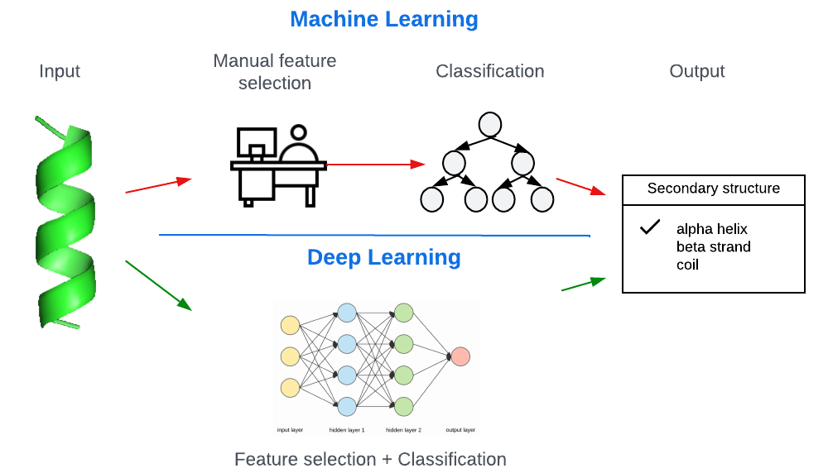
What is Deep Learning (DL)?
Sub-field of Machine Learning, often termed as a rebranded fancy name for neural networks.
Builds machine intelligence by representing data as a layered hierarchy of concepts, where each layer of concepts is built from other simpler layers.
DL tries to understand the representation in the data itself by learning mapping from inputs to outputs instead of relying on expert knowledge to do feature extraction and engineering.
Created in LucidChart by C. Arighi

Slide 6
Noticeable trends and characteristics of DL
Based on distributed representational learning. Performs better with more data over time.
Robust software frameworks (e.g., tensorflow) allow building extremely complex, multi-layered DL models easily and quickly.
Hierarchical layered representation of concepts.More complex and high-level features and concepts are derived from simpler, low-level features.
Deep architectures have a multi-layered architecture where each layer consists of multiple non-linear processing units. Each layer’s output is feed into the next layer as the input.
Can perform automated feature extraction, classification, anomaly detection and many other ML tasks.

Slide 7
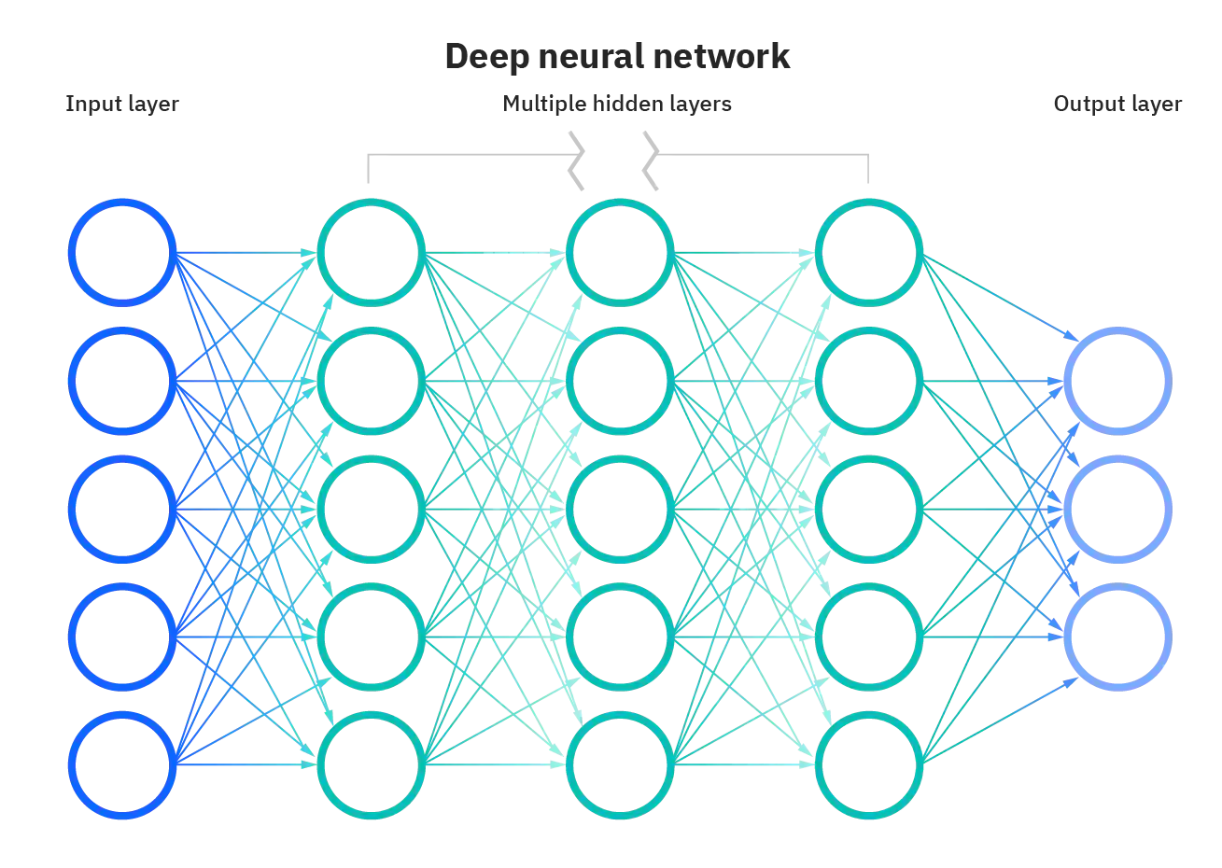
Artificial Neural Networks
A computational model and architecture that simulates biological neurons and the way they function in our brain.
Multiple layers of nodes, specific connection patterns and links between the layers.
Connection weights and activation functions for the nodes that convert weighted inputs to outputs.
The objective of learning for the network is to optimize the cost function or reduce errors.
The weights are also updated in the learning process
(source: https://www.ibm.com/cloud/learn/neural-networks)

Slide 8
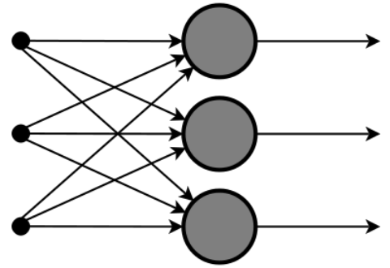
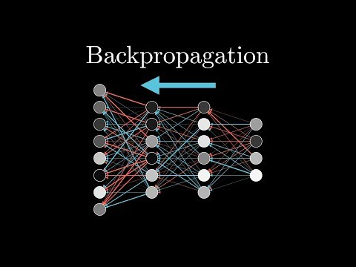
Two flows in neural network
Forward Flow: The input data sample vectors are propagated forward through the neural network to generate the output values from the output layer.
Data passes through the neural network, and weights are assigned randomly.
(source: analyticsindiamag.com)
Backward flow or backpropagation: the Weights are updated to minimize the error.
Compute weight gradients by multiplying the output delta (error) and input activation.
Use learning rate to determine percentage of the gradient to be subtracted from original weight and update the weight accordingly.
Notes:
https://youtu.be/Ilg3gGewQ5U
Propagation:
The input data sample vectors are propagated forward through the neural network to generate the output values from the output layer.
Compare the generated output vector with the actual/desired output vector for that input data vector to compute difference in error at the output units.
Error values are back propagated to generate deltas at each node.
Weight update:
Compute weight gradients by multiplying the output delta (error) and input activation.
Use learning rate to determine percentage of the gradient to be subtracted from original weight and update the weight of the nodes.

Slide 9
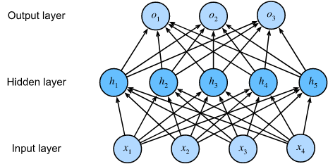
Multi-Layer Perceptrons (MLP)
A fully connected, feed-forward artificial neural network with at least three layers (input, output, and at least one hidden layer) where each layer is fully connected to the adjacent layer.
Each neuron is a non-linear functional processing unit.
Deep neural networks are MLPs when they have multiple hidden layers.
(source: d2l.ai)

Slide 10
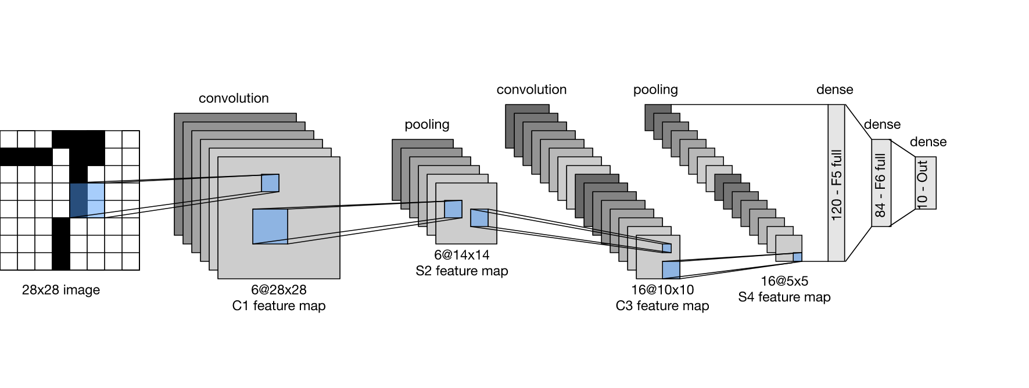
Convolutional Neural Networks (CNN)
A class of artificial neural network (ANN), most commonly applied to analyze visual imagery.
Multiple convolutional layers
Pooling layers
Fully connected MLPs.
(source: analyticsindiamag.com)
(source: d2l.ai)
Notes:
Multiple convolutional layers
Consists of multiple filters that are convolved across the height and width of the input data by basically computing a dot product to give a two-dimensional activation map.
By stacking all the maps across all the filters, we get the final output from a convolutional layer.
Pooling layers
Perform non-linear downsampling to reduce the input size and number of parameters from the convolutional layer output to generalize the model more and prevent overfitting and reduce computation time.
Filters go through the heights and width of the input and reduce it by taking an aggregate like sum, average, or max.
Fully connected MLPs.
Perform tasks such as image classification and object recognition

Slide 11
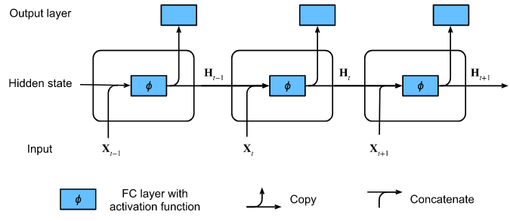
Recurrent Neural Networks (RNN)
Allows persisting information based on past knowledge by using a special type of looped architecture. Often used in areas related to data with sequences.
These looped networks are called recurrent because they perform the same operations and computation for each and every element in a sequence of input data.
RNNs have memory to capture information from past sequences.
(source: d2l.ai)
(source: towardsdatascience.com)

Slide 12
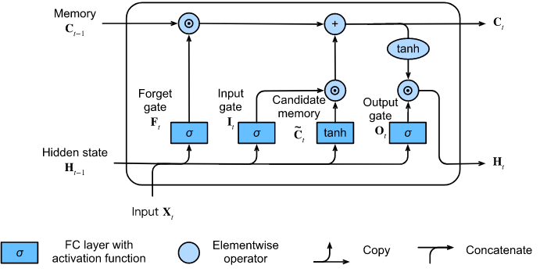
Long Short-Term Memory Networks (LSTMs)
As the sequences increasing, RNNs lose historical context over time.
LSTMs can remember information from really long sequence based data and prevent issues like the vanishing gradient problem in training with backpropagation.
Consists of three or four gates such as input gate, forget gate, output gate etc.
(source: d2l.ai)
(source: analyticsindiamag.com)

Slide 13

Encoder-Decoder Architecture
The first component is an encoder: it takes a variable-length sequence as the input and transforms it into a state with a fixed shape.
The second component is a decoder: it maps the encoded state of a fixed shape to a variable-length sequence.
The objective is to learn data representation approximations, and encodings.
It can be used for building generative models, performing dimensionality reduction, and detecting anomalies.
(source: d2l.ai)

Slide 14
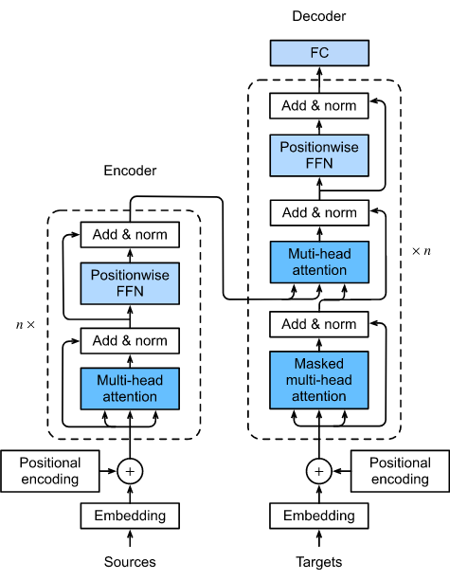
Transformer Architecture
An instance of the encoder-decoder architecture.
The input (source) and output (target) sequence embeddings are added with positional encoding before being fed into the encoder and the decoder that stack modules based on self-attention mechanism.
Self Attention, also called intra Attention, is an attention mechanism relating different positions of a single sequence in order to compute a representation of the same sequence.
(source: d2l.ai)

Slide 15
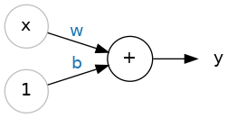
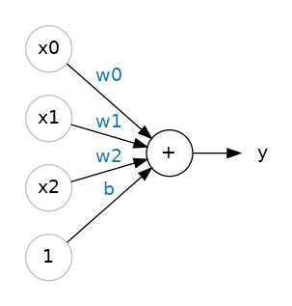
The linear unit
The input is x, its connection to the neuron has a weight w. b is a special kind of weight called bias. Y is the value the neuron ultimately outputs.
The neuron sums up all the values it receives through its connections.This neuron’s activation is y = wx + b.
If we have multiple input features, we can add more input connections to the neuron, multiply each input to its connection weight and sum up them.
y = w₀x₀ + w₁x₁ + w₂x₂ + b
A linear unit with two inputs will fit a plane, a unit with multiple inputs will fit a hyperplane.
(source: kaggle.com)

Slide 16
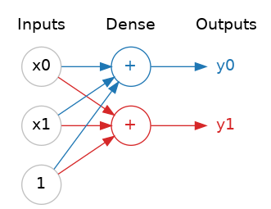
Layers
Neural networks typically organize their neurons into layers.
Linear units having a common set of inputs forms a dense layer.
Each layer in a neural network performs some kind of relatively simple transformation.
A neural network can transform its inputs in more and more complex ways (also a little bit closer to a solution) through a stack of layers.
(source: kaggle.com)

Slide 17
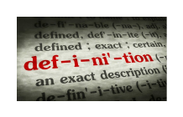
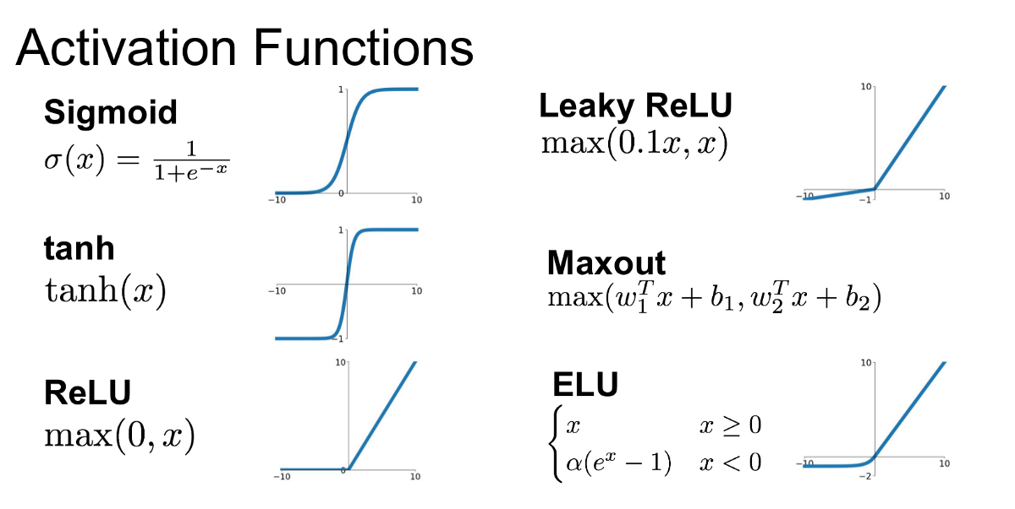
The activation function
An activation function is simply some function we apply to each of a layer's outputs (its activations) to introduce some non-linearity.
(source: Jadon, 2018)

Slide 18
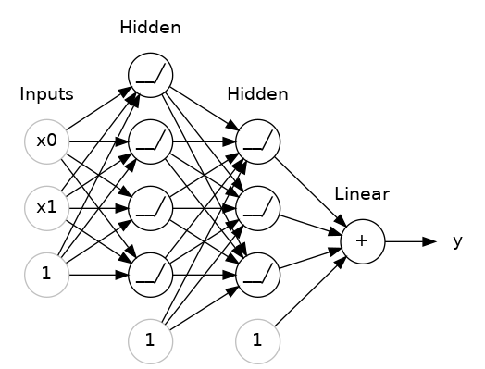
Stacking dense layers together
With some non-linearity, we can stack layers to get complex data transformations.
The final (output) layer is a linear unit (meaning, no activation function). That makes this network appropriate to a regression task, where we are trying to predict some arbitrary numeric value.
Other tasks (like classification) might require an activation function on the output.
(source: kaggle.com)

Slide 19
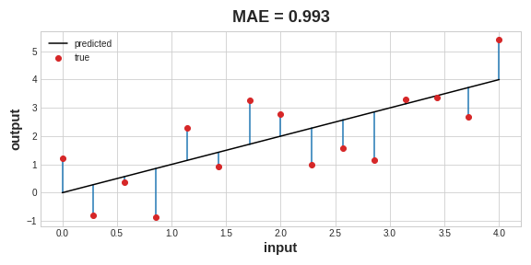
The loss function
Measures the disparity between the target's true value and the predicted value. A common loss function for regression problems is the mean absolute error (MAE).
MAE measures an absolute difference between true target value and predicted value. The total MAE loss on a dataset is the mean of all these absolute differences.
During training, the model will use the loss function as a guide for finding the correct values for its weights (lower loss is better).
(source: kaggle.com)

Slide 20
The optimizer - Stochastic Gradient Descent
The optimizer is an algorithm that adjusts the weights to minimize the loss.
Virtually all of the optimization algorithms used in deep learning belong to a family called stochastic gradient descent (SGD). They are iterative algorithms that train a network in steps:
Sample some training data and run it through the network to make predictions.
Measure the loss between the predictions and the true values.
Finally, adjust the weights in a direction that makes the loss smaller.
For each iteration, the sample of training data is called a mini-batch (or often just "batch"), while a complete round of going through the training data is called an epoch.
The number of epochs you train for is how many times the network will see each training example.

Slide 21
Learning Rate and Batch Size
Every time SGD sees a new minibatch, it will shift the weights (w the slope and b the y-intercept) toward their correct values on that batch.
The size of these shifts is determined by the learning rate. A smaller learning rate means the network needs to see more mini-batches before its weights converge to their best values.
The learning rate and the size of the mini-batches are the two parameters that have the largest effect on how the SGD training proceeds. Their interaction is often subtle and the right choice for these parameters isn't always obvious.
Adam is an SGD algorithm that has an adaptive learning rate that makes it suitable for most problems without any hyperparameter tuning.

Slide 22
The information in the training data
Signal:
The signal is the part that generalizes, the part that can help our model make predictions from new data.
Noise:
The noise is that part that is only true of the training data; the noise is all of the random fluctuation that comes from data in the real-world or all of the incidental, non-informative patterns that can't actually help the model make predictions. The noise is the part might look useful but really isn't.

Slide 23
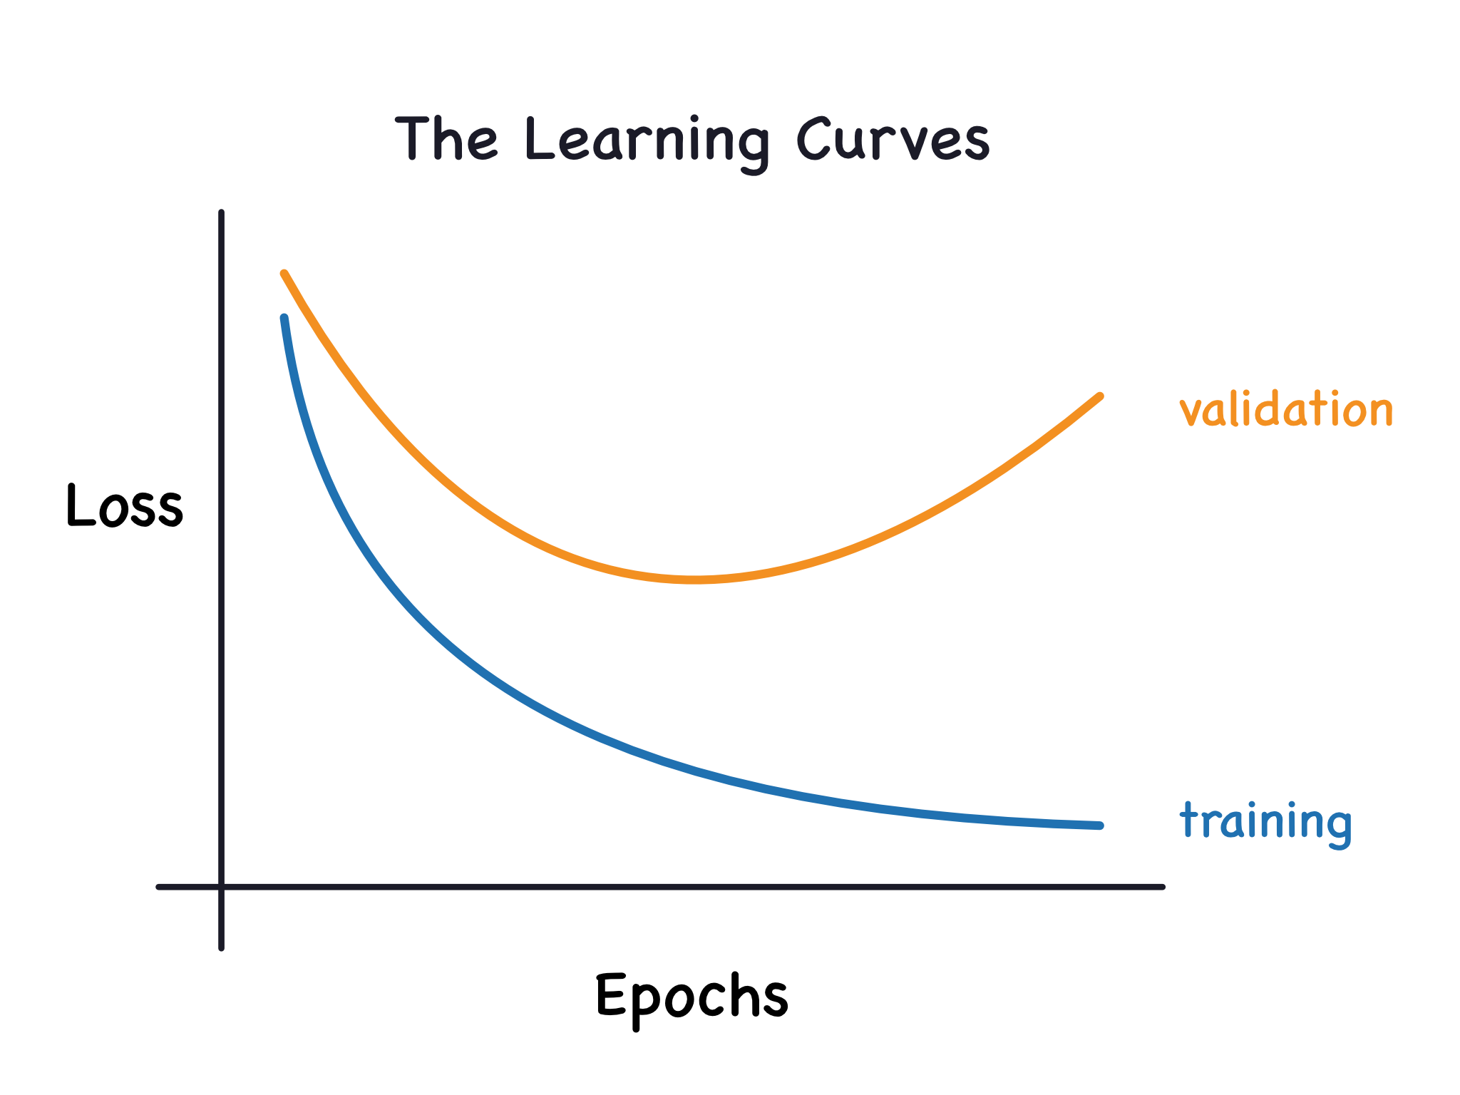
The learning curves
We train a model by choosing weights or parameters that minimize the loss on a training set. However, to accurately assess a model's performance, we also need to evaluate it on a new set of data, the validation data.
We can keep a history of the training and validation loss over the epochs during the model training process. That can be used to plot the learning curves.
The training loss will go down either when the model learns signal or when it learns noise. But the validation loss will go down only when the model learns signal.
When a model learns signal both curves go down, but when it learns noise a gap is created in the curves. The size of the gap tells you how much noise the model has learned.
(source: kaggle.com)

Slide 24
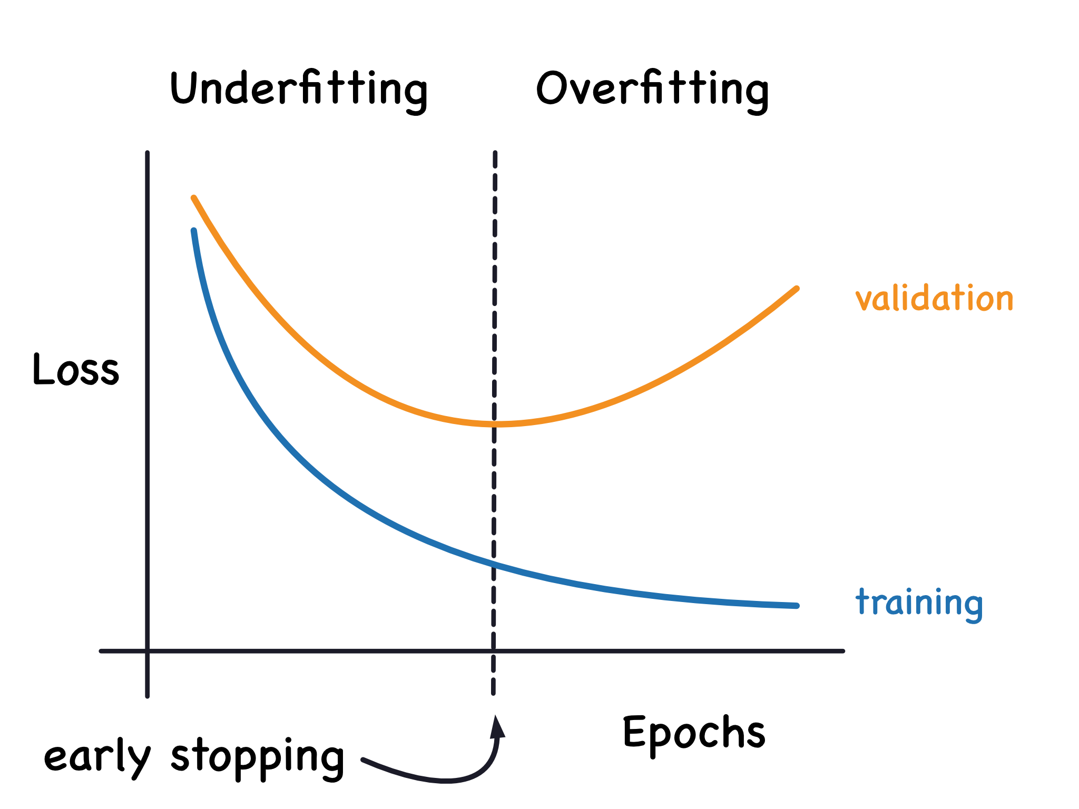
Early stopping
It is when we stop the training whenever it seems the validation loss isn't decreasing anymore.
Once we detect that the validation loss is starting to rise again, we can reset the weights back to where the minimum occured. This ensures that the model won't continue to learn noise and overfit the data.
Besides preventing overfitting from training too long, early stopping can also prevent underfitting from not training long enough. Just set your training epochs to some large number (more than you'll need), and early stopping will take care of the rest.
(source: kaggle.com)

Slide 25
Dropout Layer
Overfitting is often caused by the network learning spurious patterns in the training data.
To break up these conspiracies, we can randomly drop out some fraction of a layer's input units every step of training, making it much harder for the network to learn those spurious patterns.
It forces the neural network to search for broad, general patterns, whose weight patterns tend to be more robust.
The predictions will no longer be made by one big network, but instead by a committee of smaller networks, making decision by the committee as a whole better than any individual.
(source: kaggle.com)

Slide 26
Batch Normalization Layer
It is generally a good idea to put all of your data on a common scale.
A batch normalization layer looks at each batch as it comes in, first normalizing the batch with its own mean and standard deviation, and then putting the data on a new scale.
Batchnorm, in effect, performs a kind of coordinated rescaling of its inputs.

Slide 27
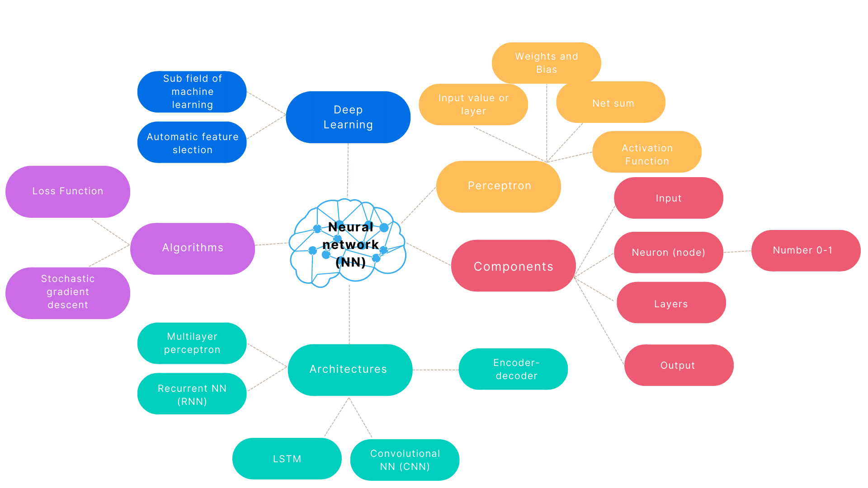
Deep Learning Mind Map
Created in Canva by C. Arighi

Slide 28

DeepChem
The DeepChem (deepchem.io) project aims to create high quality, open source tools for drug discovery, materials science, quantum chemistry, and biology.
The origin of DeepChem focused on applications of deep learning to chemistry, but the project has slowly evolved past its roots to broader applications of deep learning to the sciences in general
DeepChem is a machine learning library, so it gives you the tools to solve your applications. For example:
Predict the solubility of small drug-like molecules
Predict binding affinity for small molecule to protein targets
Predict physical properties of simple materials
Analyze protein structures and extract useful descriptors
Count the number of cells in a microscopy image

Slide 29

Quiz
What are the unique characteristics of Deep Learning?
Based on distributed representational learning. Perform better with more data over time
More complex and high-level features and concepts are derived from simpler, low-level features
Hierarchical layered representation of concepts
All of the above
✔
Which are widely used hyperparameters in Deep Learning?
Number of hidden layers and units
Dropout rate
Number of epochs
All of the above
✔
Which of the following is not a Deep Learning model?
✔
Random Forest
Transformer
CNN
RNN
https://forms.gle/Qvg1amX3J3e9JLfz9

Slide 30

References
Dipanjan Sarkar, Raghav Bali and Tushar Sharma. 2018. Practical Machine Learning with Python. A Problem-Solver's Guide to Building Real-World Intelligent Systems. Apress. (https://doi.org/10.1007/978-1-4842-3207-1), Chapter 1
TensorFlow tutorial. (https://www.tutorialspoint.com/tensorflow/tensorflow_multi_layer_perceptron_learning.htm)
Dive Into Deep Learning (https://d2l.ai/)
Kaggle course. Introduction to Deep Learning. (https://www.kaggle.com/learn/intro-to-deep-learning)
Shruti Jadon. Mar 15, 2018. Introduction to Different Activation Functions for Deep Learning. (https://medium.com/@shrutijadon10104776/survey-on-activation-functions-for-deep-learning-9689331ba092)
The DeepChem project (https://deepchem.readthedocs.io/en/latest/index.html)
Neural Networks (3Blue1Brown series)

