Slide 1
Responsible AI/ML

Slide 2
What are the goals of Responsible AI/ML?
It should be able to take decisions that reward users based on their achievements.
It should not discriminate against someone because of data attributes that are not in user control.
It should be usable in a system built for the future with high levels of fairness and freedom from bias.
It should allow positive discrimination to correct the wrongs of the past.
(Agarwal and Mishra, 2021, https://doi.org/10.1007/978-3-030-76860-7)

Slide 3
Facets of Responsible AI/ML
Privacy and Security
Is data used in accordance with privacy & legal considerations, and protected from theft and exposure?
Fairness
Are there harmful disparities in system behavior across different sub-populations?
Explainability
Does the system offer a clear rationale for its decisions?
Robustness
How hard is it to confuse or fool the system, e.g. with “adversarial” examples?
Transparency
Are users enabled to make informed choices about their use of the system?
Governance
How do you enforce and ensure these responsible AI/ML practices are being carried out amongst all stakeholders?
(https://github.com/aws-samples/aws-machine-learning-university-responsible-ai)

Slide 4
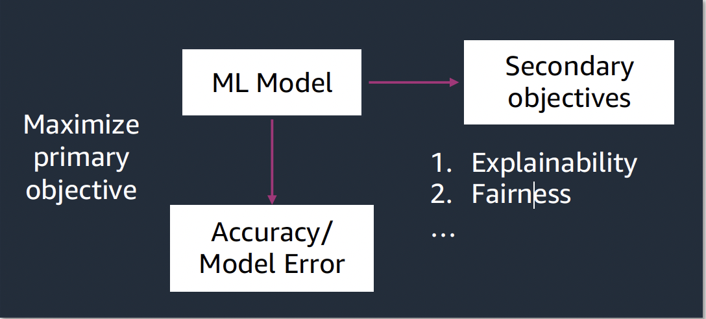
Tradeoffs in Responsible AI/ML
It is challenging to maximize all aspects of responsible AI simultaneously.
Preserving privacy makes data more coarse → potentially degrades model explainability.
Making model results and components more transparent → potentially security & privacy risk.
(https://github.com/aws-samples/aws-machine-learning-university-responsible-ai)

Slide 5
Common Biases in AI/ML Datasets

Slide 6
Reporting Bias
Occurs when the data collected is skewed due to a tendency to over report unusual or memorable events, leading to an inaccurate representation of real-world frequencies.
For example, a dataset of customer reviews for a restaurant might be biased towards positive reviews if the dataset is skewed towards positive feedback from satisfied customers, leading to inaccurate predictions for new reviews.
Historical Bias
Occurs when historical data reflects inequalities that existed in the world at that time.
For example, historical housing data that reflects discriminatory lending practices from the past may perpetuate these biases when used to make predictions about modern-day housing prices.
(https://developers.google.com/machine-learning/crash-course/fairness/types-of-bias)

Slide 7
Automation bias
Occurs when people overly rely on automated systems, even when those systems make errors, leading to a decreased ability to detect and correct mistakes.
For example, a pilot might rely too heavily on autopilot and fail to notice a critical warning, leading to a dangerous situation.
Selection Bias
Occurs when the training data is not representative of the population the model is intended to generalize to, leading to biased predictions.
For example, a dataset of primarily young, healthy patients might not accurately predict health outcomes for older or less healthy populations.
(https://developers.google.com/machine-learning/crash-course/fairness/types-of-bias)

Slide 8
Non-response (Participation) Bias
Occurs if data ends up being unrepresentative due to participation gaps in the data-collection process.
For example, a survey about online shopping habits might be biased if only people with access to the internet and a willingness to participate in surveys respond.
Sampling Bias
Occurs when the sample of data used to train a machine learning model is not representative of the population the model is intended to generalize to, leading to biased predictions.
For example, instead of randomly targeting consumers, the surveyor chose the first 200 consumers that responded to an email, who might have been more enthusiastic about the product than average purchasers.
(https://developers.google.com/machine-learning/crash-course/fairness/types-of-bias)

Slide 9
Group Attribution Bias
Occurs when a model assigns different attributes or outcomes to individuals based on their group membership, leading to unfair and discriminatory predictions.
Group attribution bias often manifests in the two following forms.
In-group bias
Occurs when a model is trained on data that disproportionately represents a particular group, leading to biased predictions that favor that group.
For example, a facial recognition model trained primarily on images of white individuals might be less accurate at recognizing faces of people of color.
Out-group homogeneity bias
Occurs when a model is trained on data that over represents a particular group, leading to the assumption that members of that group are more similar to each other than members of other groups.
For example, a dataset of customer reviews from a predominantly white population might incorrectly assume that all white customers have similar preferences and needs, leading to biased recommendations and marketing campaigns.
(https://developers.google.com/machine-learning/crash-course/fairness/types-of-bias)

Slide 10
Implicit Bias
Occurs when we make assumptions based on our own personal beliefs and experiences, without considering other perspectives.
For example, a gesture recognition model is trained to interpret a head shake as a "no" gesture, but this might be inaccurate in certain cultural contexts where a head shake has a different meaning.
Confirmation Bias
Occurs when when we unconsciously interpret data in a way that reinforces our preconceived notions.
For example, an ML practitioner's personal negative experience with a toy poodle influenced their selection of features for a dog aggression model, leading to potential bias in the model's predictions.
(https://developers.google.com/machine-learning/crash-course/fairness/types-of-bias)

Slide 11
Experimenter's Bias
Occurs when when a researcher continues to refine their model until it confirms their initial beliefs, even if the data doesn't fully support those beliefs.
For example, an ML practitioner repeatedly retrained the model until it confirmed their preconceived notion that toy poodles are aggressive, despite the initial model's findings.
(https://developers.google.com/machine-learning/crash-course/fairness/types-of-bias)

Slide 12
Fairness in
Machine Learning Life Cycle

Slide 13
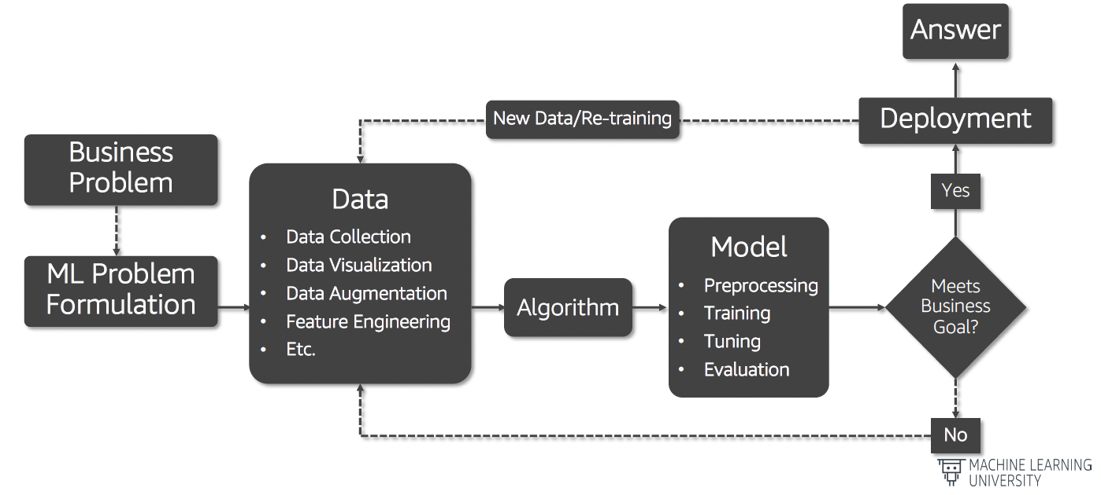
Machine Learning Life Cycle
(https://github.com/aws-samples/aws-machine-learning-university-responsible-ai)

Slide 14
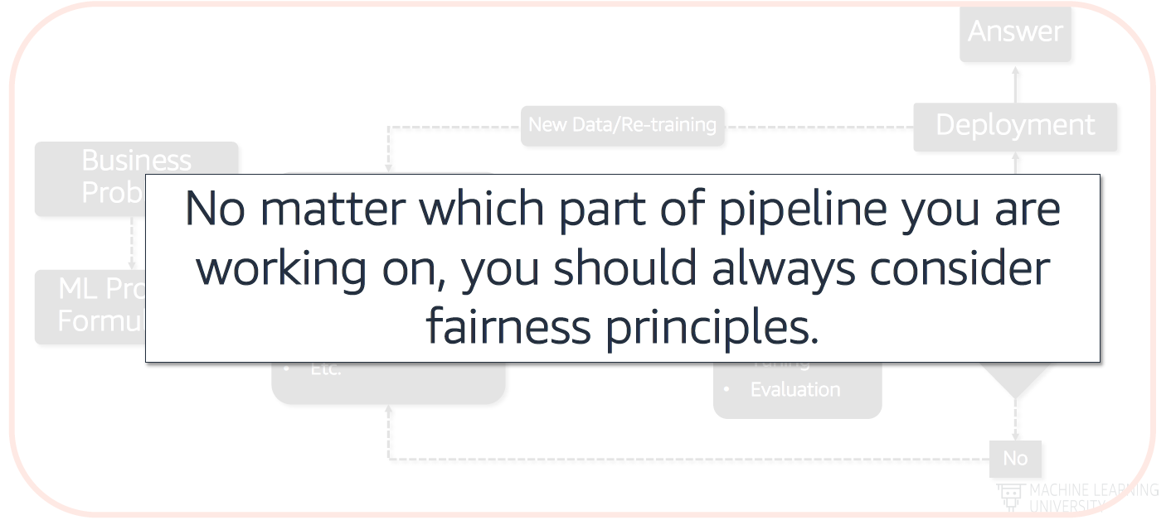
Machine Learning Life Cycle - Fairness Everywhere
(https://github.com/aws-samples/aws-machine-learning-university-responsible-ai)

Slide 15
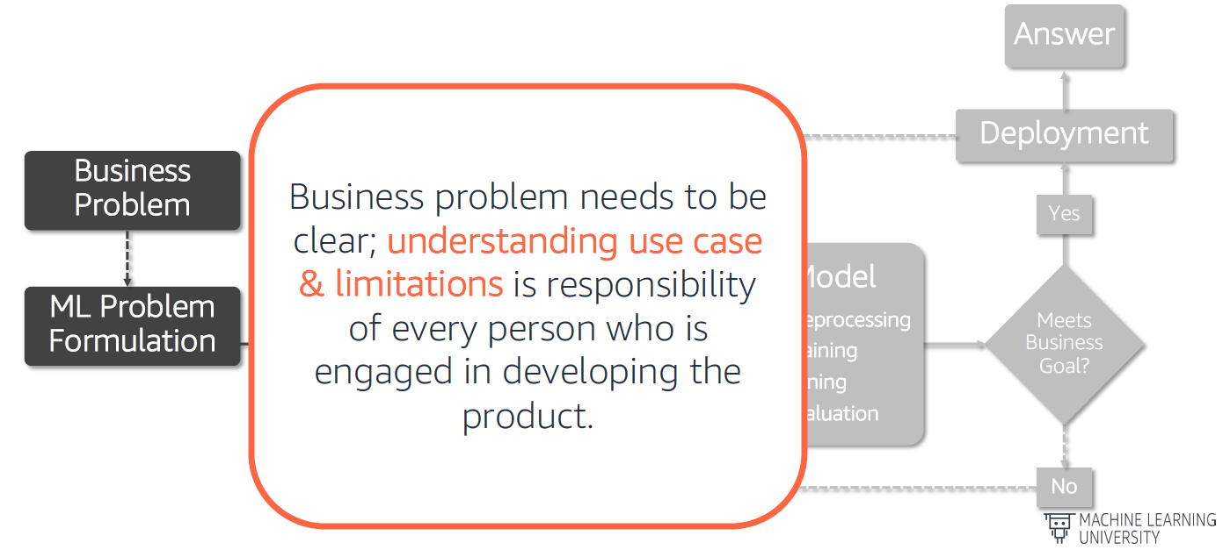
Machine Learning Life Cycle - Business Problem
(https://github.com/aws-samples/aws-machine-learning-university-responsible-ai)

Slide 16
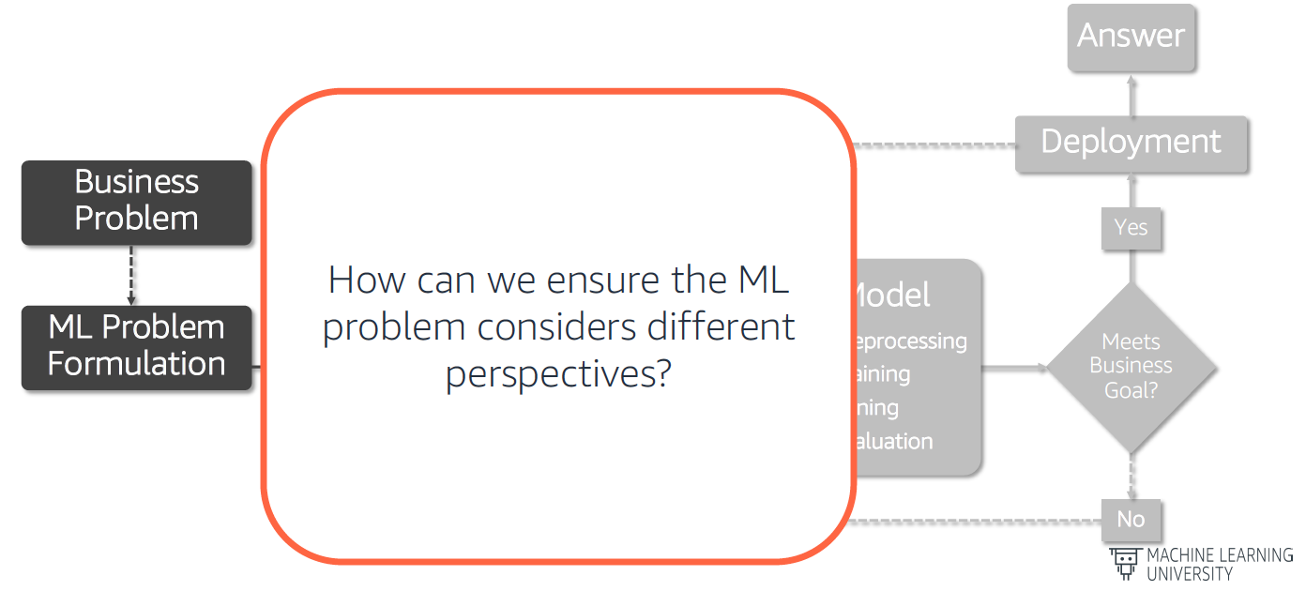
Machine Learning Life Cycle - ML Problem Formulation
(https://github.com/aws-samples/aws-machine-learning-university-responsible-ai)

Slide 17
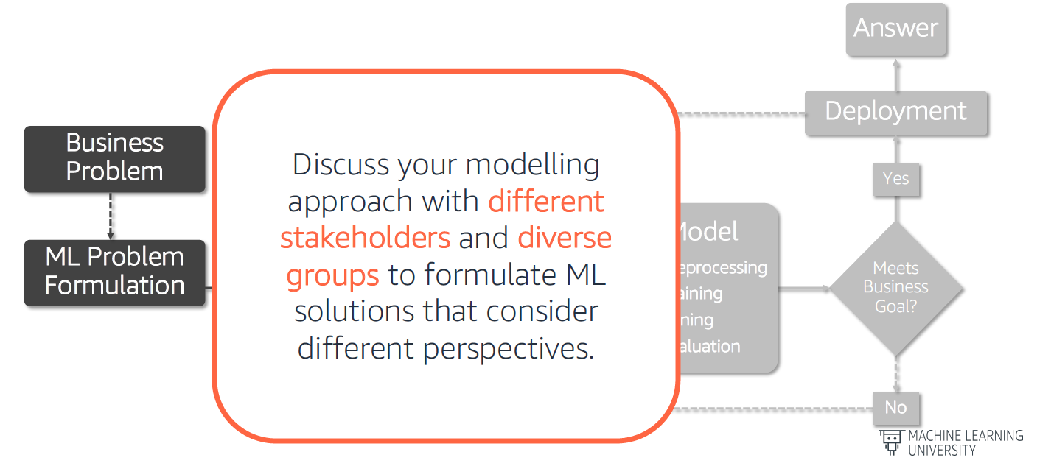
Machine Learning Life Cycle - ML Problem Formulation
(https://github.com/aws-samples/aws-machine-learning-university-responsible-ai)

Slide 18
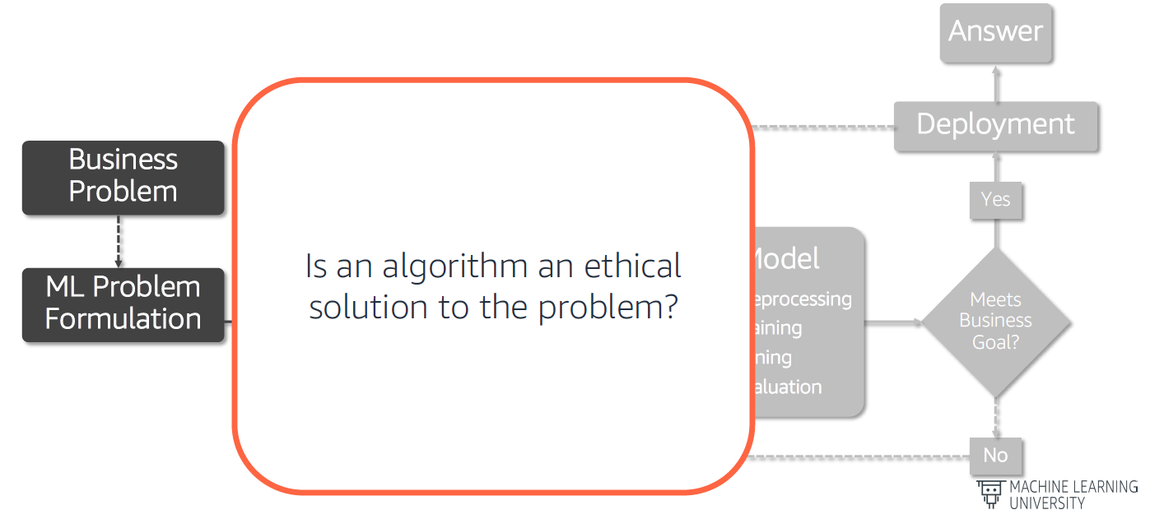
Machine Learning Life Cycle - ML Problem Formulation
(https://github.com/aws-samples/aws-machine-learning-university-responsible-ai)

Slide 19
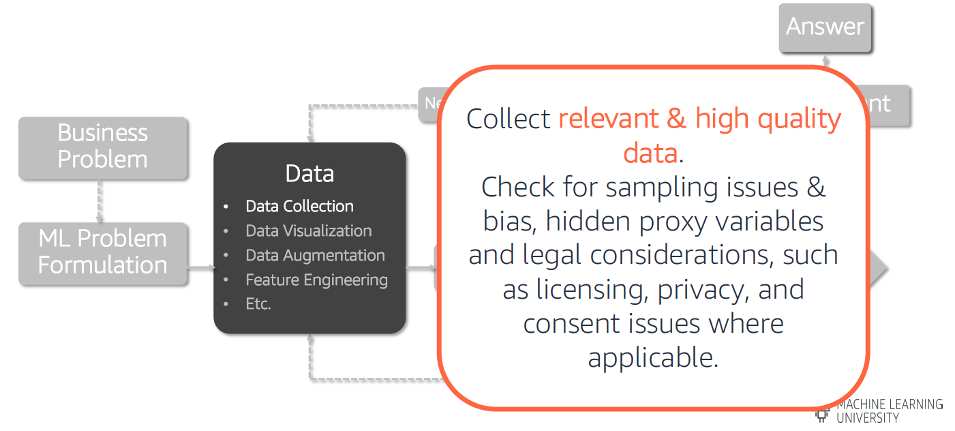
Machine Learning Life Cycle - Data Preparation
(https://github.com/aws-samples/aws-machine-learning-university-responsible-ai)

Slide 20
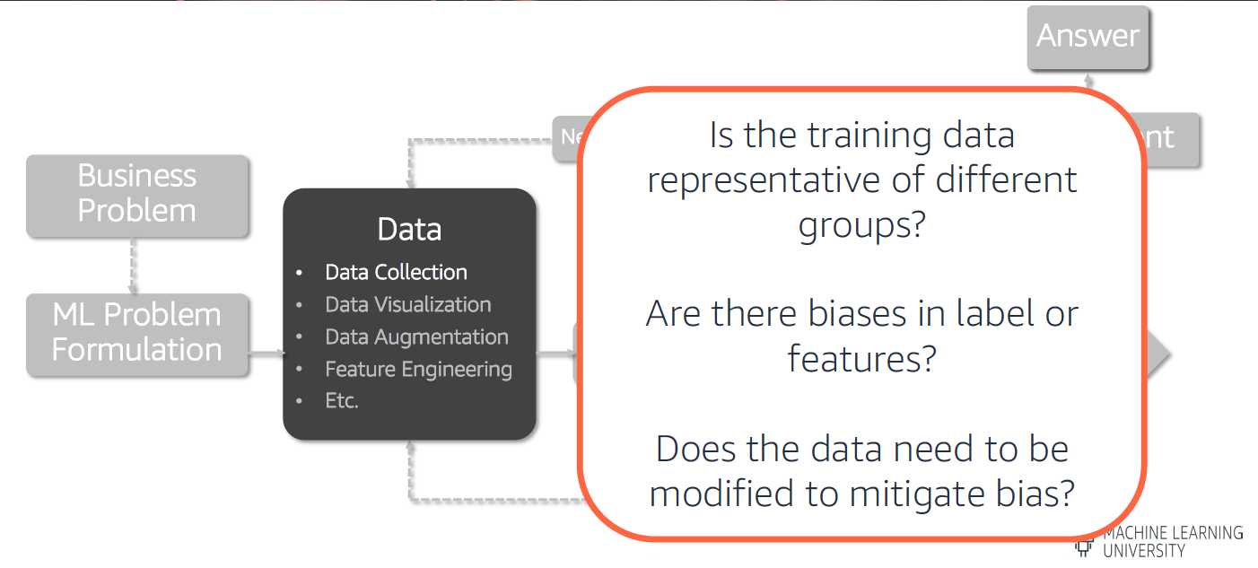
Machine Learning Life Cycle - Data Preparation
(https://github.com/aws-samples/aws-machine-learning-university-responsible-ai)

Slide 21
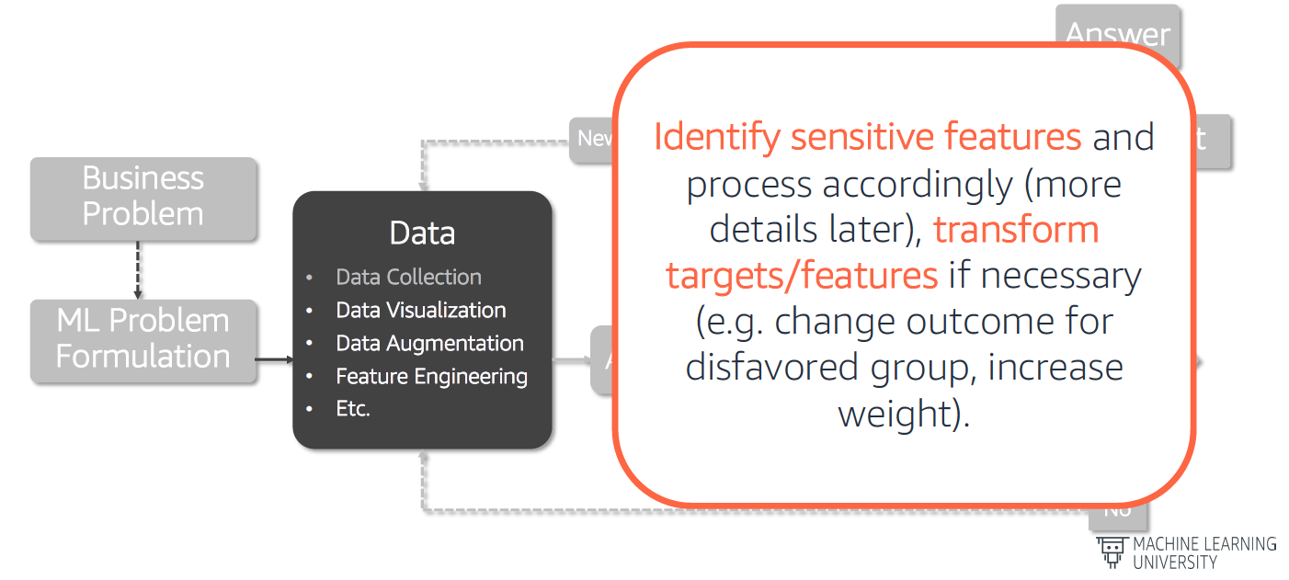
Machine Learning Life Cycle - Data Preparation
(https://github.com/aws-samples/aws-machine-learning-university-responsible-ai)

Slide 22
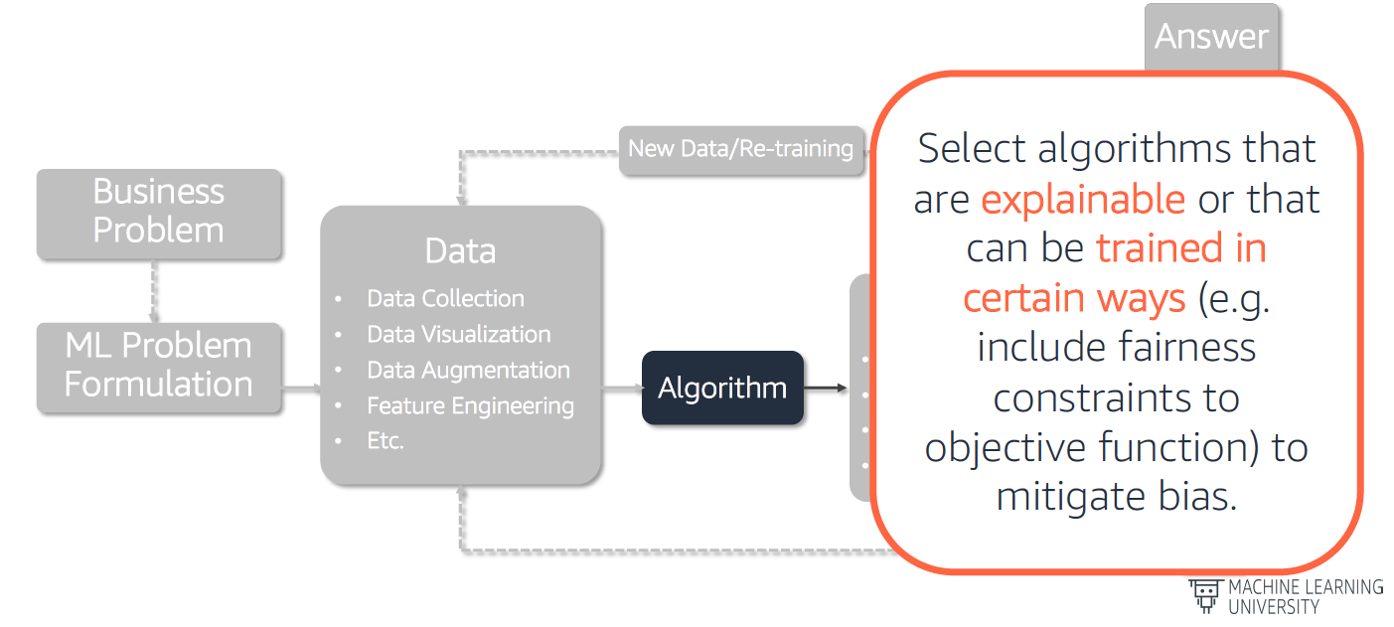
Machine Learning Life Cycle - Algorithm Selection
(https://github.com/aws-samples/aws-machine-learning-university-responsible-ai)

Slide 23
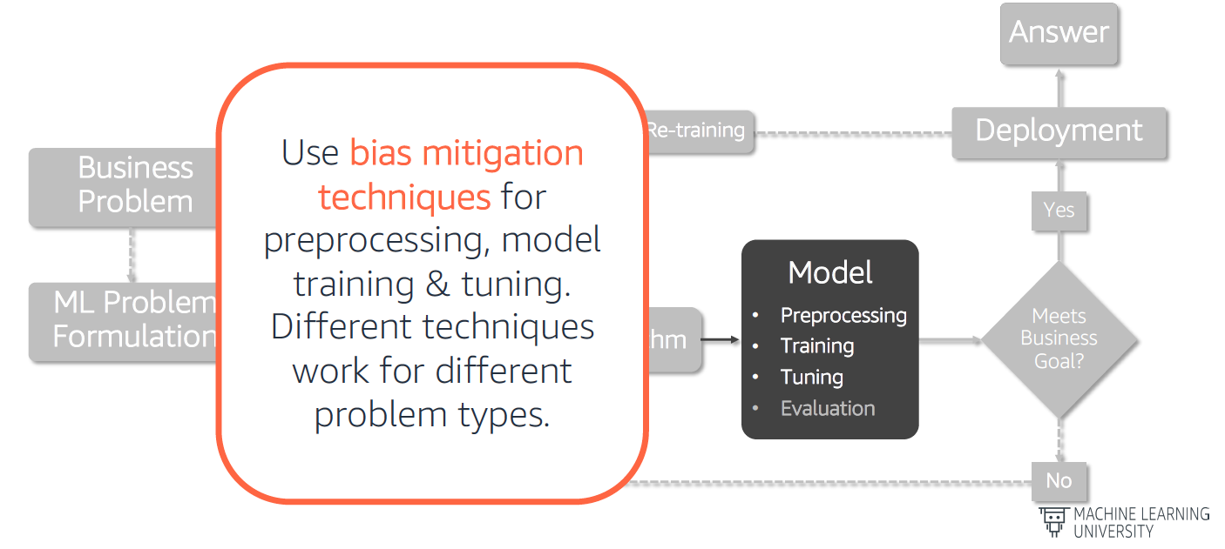
Machine Learning Life Cycle - Model Training and Tuning
(https://github.com/aws-samples/aws-machine-learning-university-responsible-ai)

Slide 24
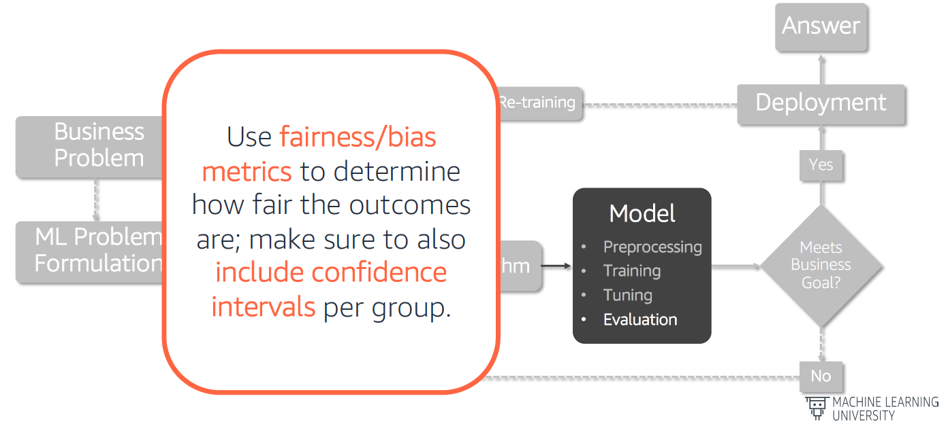
Machine Learning Life Cycle - Model Evaluation
(https://github.com/aws-samples/aws-machine-learning-university-responsible-ai)

Slide 25
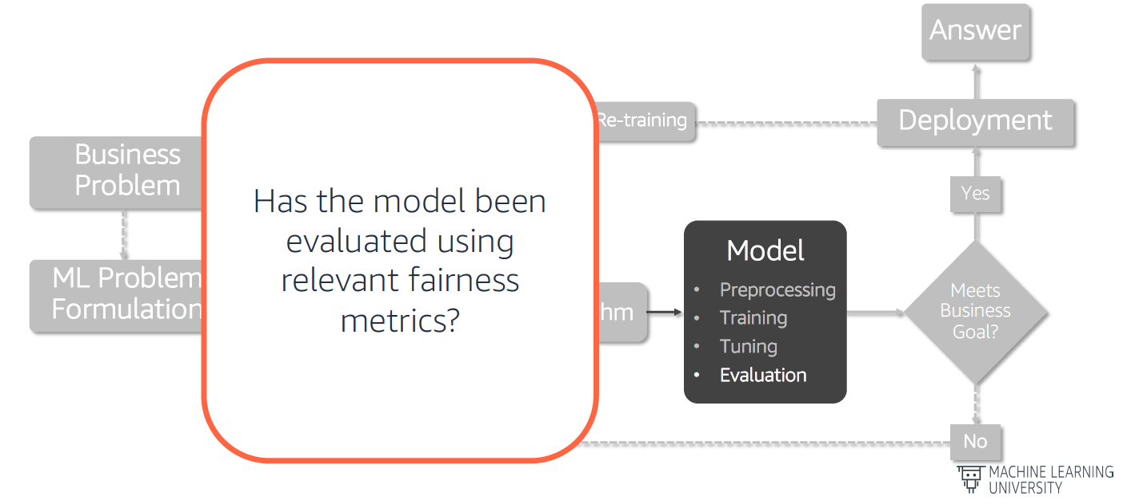
Machine Learning Life Cycle - Model Evaluation
(https://github.com/aws-samples/aws-machine-learning-university-responsible-ai)

Slide 26
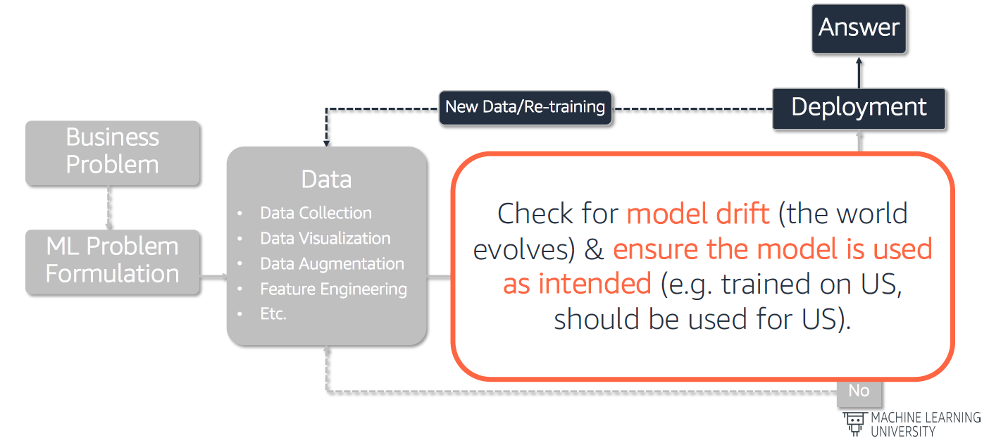
Machine Learning Life Cycle - Model Deployment
(https://github.com/aws-samples/aws-machine-learning-university-responsible-ai)

Slide 27
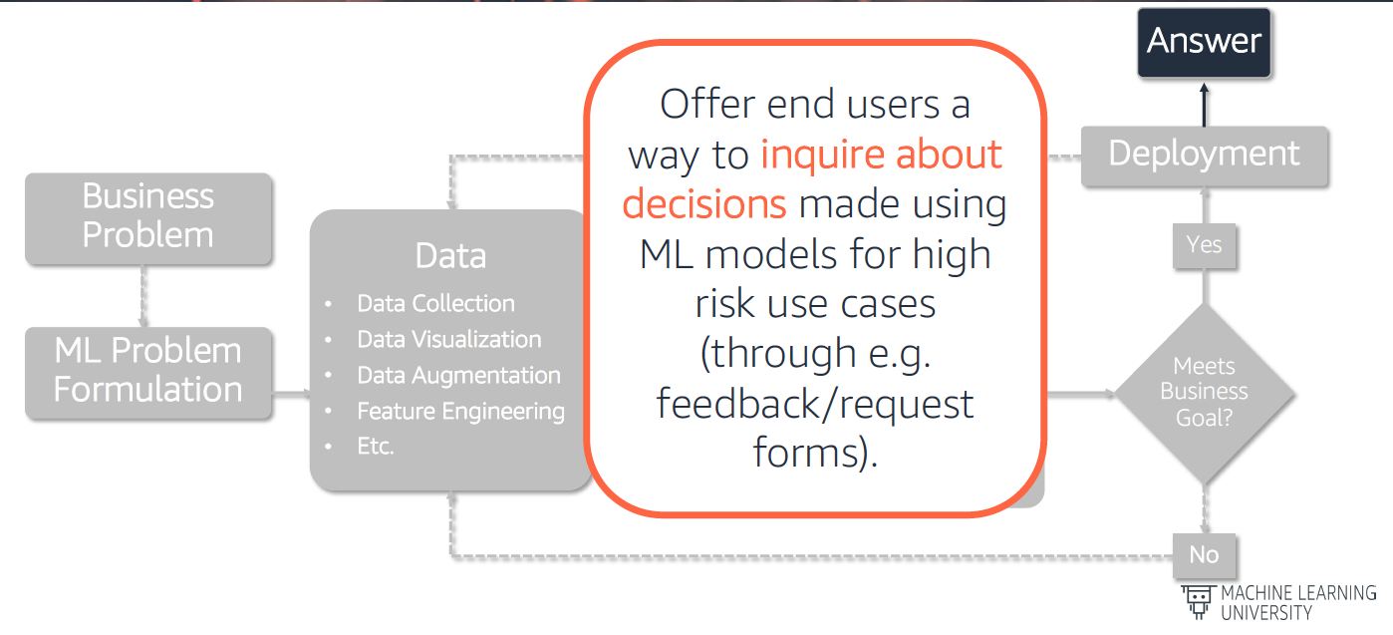
Machine Learning Life Cycle - Model Deployment
(https://github.com/aws-samples/aws-machine-learning-university-responsible-ai)

Slide 28
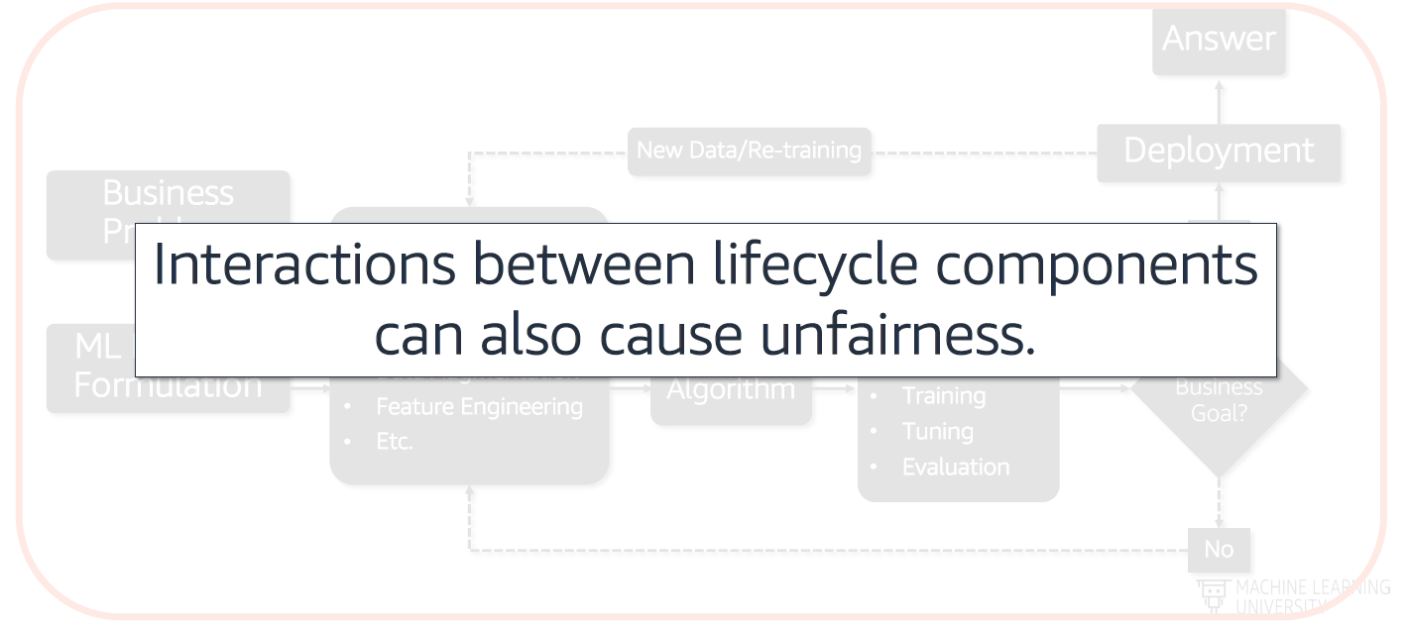
Machine Learning Life Cycle - Interactions
(https://github.com/aws-samples/aws-machine-learning-university-responsible-ai)

Slide 29
Fairness Metrics

Slide 30
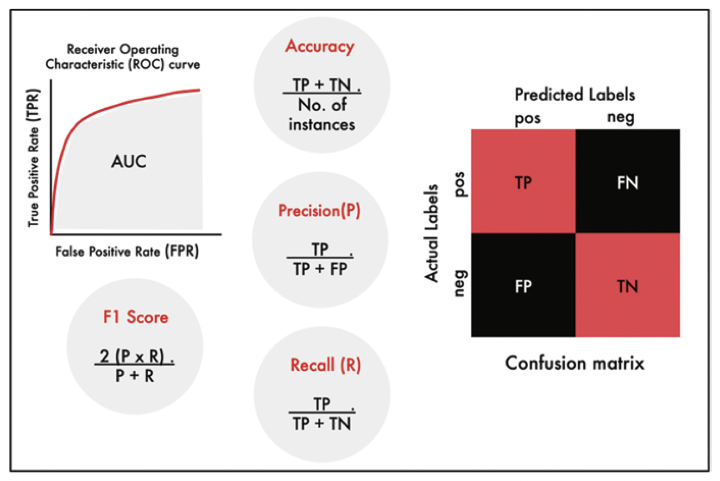
Accuracy Metrics and Their Relationship to Confusion Matrix
(Agarwal and Mishra, 2021, https://doi.org/10.1007/978-3-030-76860-7)

Slide 31
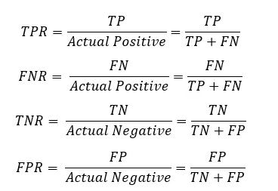
True Positive Rate (TPR), False Negative Rate (FPR),
True Negative Rate (TNR), and False Negative Rate (FNR)
(Vaibhav Jayaswal, 2020, https://towardsdatascience.com/performance-metrics-confusion-matrix-precision-recall-and-f1-score-a8fe076a2262)

Slide 32
Key Concepts to Define Fairness Metrics
Favorable Outcomes vs Unfavorable Outcomes
The “favorable” outcome (Ŷ_{fav}) is the one that the user desires, for a headphone buyer, it can be successful configuration of the wearable.
An “unfavorable” outcome (Ŷ_{unfav}) on the other hand is the one that the user does not desire, for a cancer patient getting a CT scan, it can be incorrect diagnosis.
Independent Features vs Protected Features
Independent features (𝑋) do not contain any person, racial or socioeconomic indicators that may be used for discrimination
Protected features (𝑆) are the ones that may contain such information, where 𝑆_{a} denoting privileged classes and 𝑆_{d} denoting unprivileged classes.
(Agarwal and Mishra, 2021, https://doi.org/10.1007/978-3-030-76860-7)

Slide 33
Fairness Definition
Fairness can be defined based on the relationship between the protected feature (𝑆), the actual (Y) and the predicted (Ŷ) outcomes.
Independence
Ŷ independent of 𝑆, if the predicted features and protected features are independent of each other.
Probability of being in a favorable (or non-favorable) class has nothing to do with the group of 𝑆.
Separation
Ŷ independent of 𝑆 given Y, if the predicted feature given the target value Y is independent of protected feature.
The predicted probability of being in any class, given their actual class, has nothing to do with their protected group membership.
Sufficiency
Y independent of 𝑆 given Ŷ, We expected protected class to be independent of actual value given the predicted value.
In simple words, the prediction should not depend on the protected group.
(Agarwal and Mishra, 2021, https://doi.org/10.1007/978-3-030-76860-7)

Slide 34
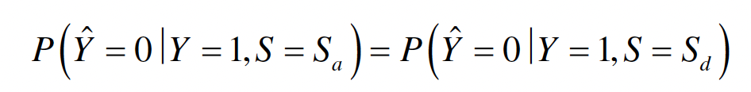
Fairness Metrics - Equal Opportunity
Both privileged and unprivileged groups have equal FNR.
A classifier satisfies this definition if both advantageous and disadvantageous groups have equal FNR.
No one group should be penalized by allowing the model to make higher mistakes compared to the other group.
Since TFR + FNR = 1, a classifier with equal FNRs will also have equal TPRs (also called sensitivity/recall).
(Agarwal and Mishra, 2021, https://doi.org/10.1007/978-3-030-76860-7)

Slide 35
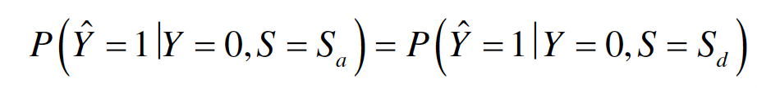
Fairness Metrics - Predictive Equality
Both privileged and unprivileged groups have equal FPR.
A classifier satisfies this definition if both advantageous and disadvantageous groups have equal FPR.
(Agarwal and Mishra, 2021, https://doi.org/10.1007/978-3-030-76860-7)

Slide 36
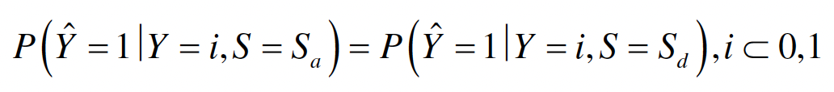
Fairness Metrics - Equalized Odds
Also known as disparate mistreatment, equalized odds requires that both advantages and disadvantageous groups have equal TPR and FPR.
This definition combines the previous two: a classifier satisfies the definition if advantageous and a disadvantageous groups have equal TPR and equal FPR.
(Agarwal and Mishra, 2021, https://doi.org/10.1007/978-3-030-76860-7)

Slide 37
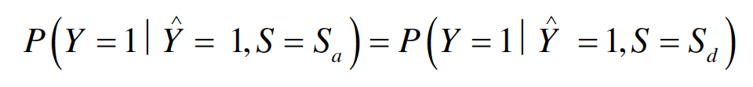
Fairness Metrics - Predictive Parity
Also known as outcome test, it requires that both advantages and disadvantageous groups have equal PPV (Positive predictive value)/precision.
The main idea behind this definition is that the percentage of correct positive predictions should be the same for both the groups of a protected class.
One significant advantage of Predictive Parity is that a perfectly predictive model is deemed as fair because both men and women would have a PPV of 1.
A disadvantage of this model is that it doesn’t necessarily reduce bias.
(Agarwal and Mishra, 2021, https://doi.org/10.1007/978-3-030-76860-7)

Slide 38
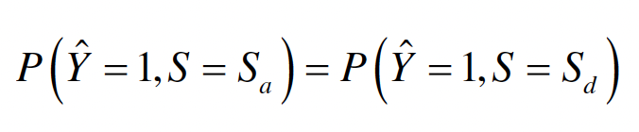
Fairness Metrics - Demographic Parity
Membership in a protected class should have no correlation with being predicted a favourable outcome.
It suggests that the composition of the set of individuals who are predicted the favourable outcome should reflect the percentage of applicants.
To achieve demographic parity:
For the privileged group, we reduce false positives and increase true negatives.
For the unprivileged group, we reduce false negatives and increase true positives.
(Agarwal and Mishra, 2021, https://doi.org/10.1007/978-3-030-76860-7)

Slide 39
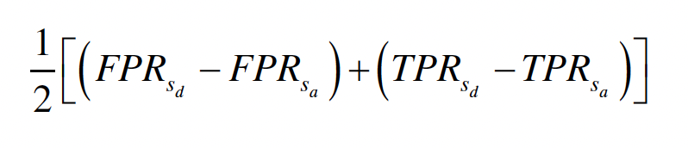
Fairness Metrics - Average Odds Difference
Average of difference in FPR and TPR for advantageous and disadvantageous groups.
This metric encompasses both the predictive equality difference (FPR to TNR diff) and equal opportunity difference. A lower difference (or a zero difference) would mean equal benefit (positive or favourable outcome) for both the group.
In an ideal scenario, we would expect near identical values, if not the same, for all the fairness metrics across protected class (i.e. the difference between them will be zero or near zero).
(Agarwal and Mishra, 2021, https://doi.org/10.1007/978-3-030-76860-7)

Slide 40
Bias Mitigation

Slide 41
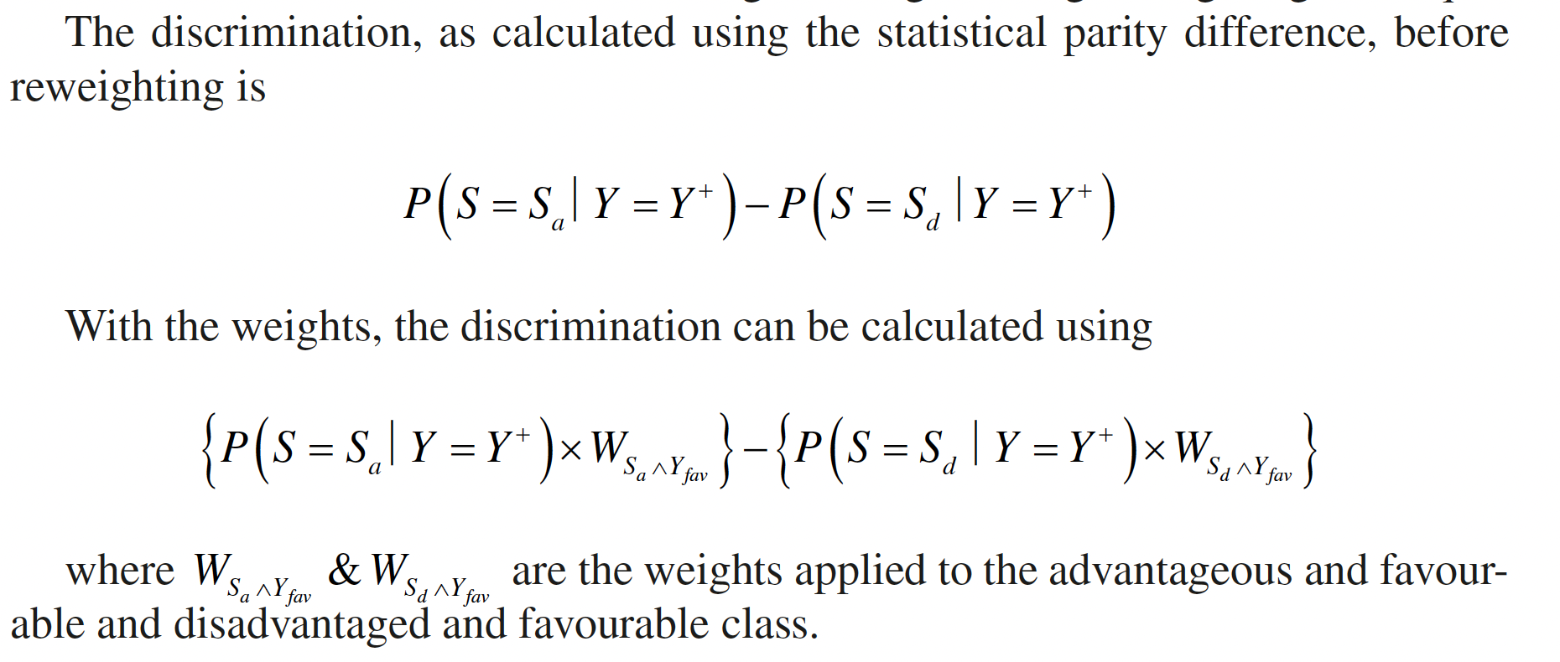
Reweighting the Data
The purpose of reweighting the data is to reduce the bias or the discrimination in the data.
Let’s consider a dataset D with a single protected feature S. The advantaged class is denoted by S_{a} and the disadvantaged class by S_{d}. Also, the favourable outcome is denoted by Y⁺ and the unfavourable outcome by Y⁻.
(Agarwal and Mishra, 2021, https://doi.org/10.1007/978-3-030-76860-7)

Slide 42
Benefits of Reweighting the Data
Reweighting the data is not only a highly effective way but also the first opportunity to intervene and fixx the bias in the data.
The best part about it is that you don’t alter the data itself and you do it before even choosing the algorithm for the model.
This makes it agnostic of the training algorithm and a highly explainable technique to reduce the bias.
It is limited in its ability to handle multiple protected features. However, you can overcome that by defining composite features by losing some explainability.
(Agarwal and Mishra, 2021, https://doi.org/10.1007/978-3-030-76860-7)

Slide 43
Steps for Reweighting the Data
Choose a protected feature to generate weights.
Generate weights and add them to the dataset.
Choose an algorithm to train a model using both unweighted and weighted data.
Calculate statistical parity differences for both models to compare the discrimination.
Generate the accuracy and fairness metrics to compare the difference between the two groups and between two models (with and without weights).
Repeat the above steps for all the protected features you want to analyse and compare to decide.
Based on your analysis, select a feature to reduce discrimination or combine features for better overall performance.
(Agarwal and Mishra, 2021, https://doi.org/10.1007/978-3-030-76860-7)

Slide 44
Additive Counterfactual Fairness (ACF)
The fundamental principle behind additive counterfactual fairness is related to causality. It aims to take out the impact of the protected feature from the model if it influences the output in a discriminatory way.
Its states that a protected feature should not be a cause for the model to be discriminatory. The predicted outcome should not change if the value of the protected feature is changed from a privileged group to an unprivileged group or vice versa.
A causal graph is counterfactually fair if the predicted outcome in the graph does not depend on a descendant of the protected attribute.
The ACF method aims to remove causal dependencies by modeling input variables as linear combinations of protected class variables. By calculating residuals, it effectively removes correlation between protected classes and input variables.
(Agarwal and Mishra, 2021, https://doi.org/10.1007/978-3-030-76860-7)

Slide 45
Key Features of Additive Counterfactual Fairness
ACF models can be implemented using any machine learning algorithm and are apt for most of regression and classification problems.
No need for composite features as it can tackle multiple protected features.
Can handle continuous and categorical protected features.
ACF may cause a small dip in the accuracy.
(Agarwal and Mishra, 2021, https://doi.org/10.1007/978-3-030-76860-7)

Slide 46
High Level Steps for Implementing ACF Model
Develop a separate model to predict each of the independent features (non-protected) using protected features as the predictor features.
Compute the residuals for each independent feature.
Develop a model to train on the residuals as features to predict the outcome.
(Agarwal and Mishra, 2021, https://doi.org/10.1007/978-3-030-76860-7)

Slide 47
Reject Option Classifier (ROC)
What if a model has made its predictions? How do we address the bias?
We need an approach that does not depend on feature engineering or model optimization to be able to reduce the bias.
The approach we take should be able to work on the predictions regardless of the model used to make the predictions.
The Reject Option Classifier (ROC) is a machine learning technique used to improve the accuracy of classification models by introducing a "reject" option. Instead of forcing the model to predict a class for every instance, ROC allows the model to abstain from making a prediction if it's uncertain about the classification.
(Agarwal and Mishra, 2021, https://doi.org/10.1007/978-3-030-76860-7)

Slide 48
Benefits of Reject Option Classifier (ROC)
By rejecting uncertain instances, ROC can reduce the number of misclassifications.
In applications where incorrect predictions have serious consequences (e.g., medical diagnosis), ROC can help mitigate risks by avoiding making predictions when the model is unsure.
ROC can provide insights into the model's decision-making process, as it explicitly indicates when it is uncertain about a classification.
It works with any probabilistic classifier with binary classification or any continuous output as long as you can put a decision boundary to do binary classification.
It requires neither modification of learning algorithm nor pre-processing.
It gives better control and explainability for bias reduction.
(Agarwal and Mishra, 2021, https://doi.org/10.1007/978-3-030-76860-7)

Slide 49
High Level Steps of Reject Option Classifier (ROC)
Training
The ROC model is trained on a dataset with labeled examples.
Prediction
When a new example is presented to the model, it predicts one of three classes: positive, negative, or reject.
Reject Threshold
A threshold is set to determine when an example should be rejected. If the model's confidence level is below the threshold, the example is rejected.
(Agarwal and Mishra, 2021, https://doi.org/10.1007/978-3-030-76860-7)

Slide 50
Responsible AI/ML Tools

Slide 51
IBM AI Fairness 360
AI Fairness 360 is an open-source toolkit developed by IBM to help developers identify and mitigate bias in machine learning models. It provides a comprehensive suite of metrics and algorithms for evaluating fairness, detecting bias, and addressing it.
Its key features include:
Metrics: The toolkit includes a wide range of metrics to assess fairness, such as disparate impact, demographic parity, and equal opportunity.
Bias detection: AI Fairness 360 can identify bias in a variety of machine learning models, including classification, regression, and clustering models.
Mitigation techniques: The toolkit provides several techniques for mitigating bias, such as reweighting, adversarial training, and counterfactual fairness.
User-friendly interface: The toolkit is designed to be easy to use, with a simple interface and clear documentation.
Available at https://github.com/Trusted-AI/AIF360

Slide 52
Microsoft Responsible AI Toolkit
Microsoft Responsible AI Toolkit is a comprehensive suite of tools and resources designed to help developers build ethical and responsible AI systems. It offers a range of capabilities to address various aspects of responsible AI, including:
Its key features include:
Fairness metrics: A collection of metrics to assess fairness in machine learning models, such as disparate impact, demographic parity, and equal opportunity.
Bias mitigation techniques: Tools for mitigating bias in machine learning models, such as reweighting, adversarial training, and counterfactual fairness.
Explainability techniques: Methods for explaining the decisions made by machine learning models, such as LIME and SHAP.
Privacy and security tools: Tools for protecting user privacy and ensuring the security of AI systems, such as differential privacy and secure multi-party computation.
Available at https://github.com/microsoft/responsible-ai-toolbox

