Slide 1

Practical AI/ML for Computational Biology and Chemistry
(Day 4)
Chuming Chen
chenc@udel.edu
Research Associate Professor
Computer and Information Sciences
Center for Bioinformatics and Computational Biology
Data Science Institute
Slides and notebooks: https://github.com/udel-cbcb/al_ml_workshop
June 16, 2022

Slide 2
ML Models and Model Evaluation

Slide 3

Lecture Outline
Review of Day 3
ML Models
ML Model Evaluation

Slide 4
Review of Day 3
Feature Engineering
Feature Scaling
Feature Selection
Live Demo
Feature Engineering:
Encode categorical data
Change numerical data distribution
Derive new input variables
Feature Scaling:
Numerical data
Data with outliers
Feature Selection:
Numerical data
Categorical data
Recursive feature elimination
Exercise

Slide 5
Supplementary Topics
Chi-square test of independence
Analysis of Variance (ANOVA) F-test
Mutual Information

Slide 6
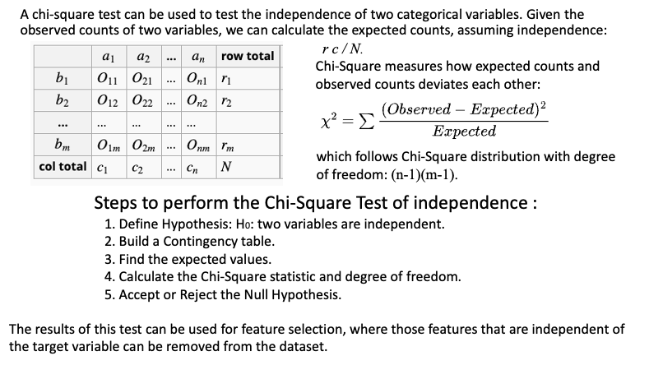
Chi-square test of Independence

Slide 7
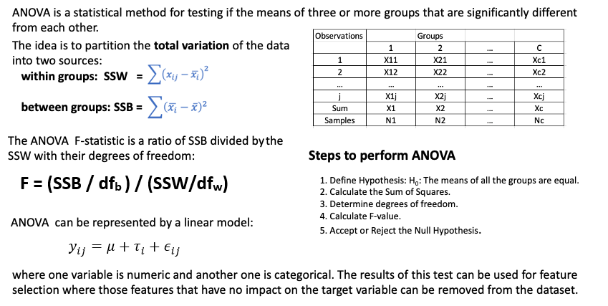
Analysis of Variance (ANOVA) F-test

Slide 8
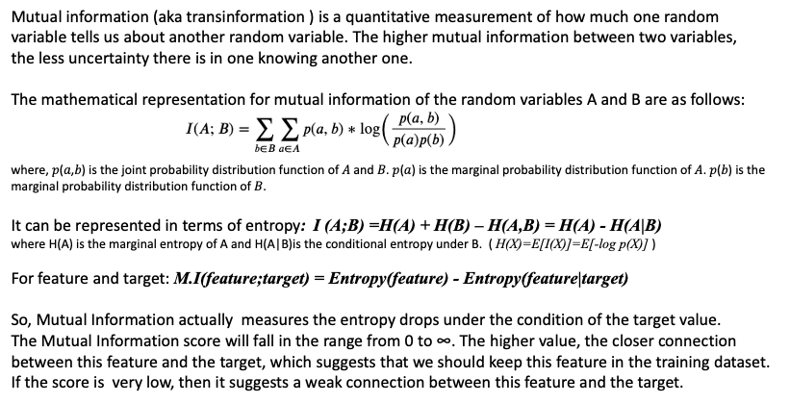
Mutual Information

Slide 9
Lecture Outline
Review of Day 3
ML Models
ML Model Evaluation

Slide 10

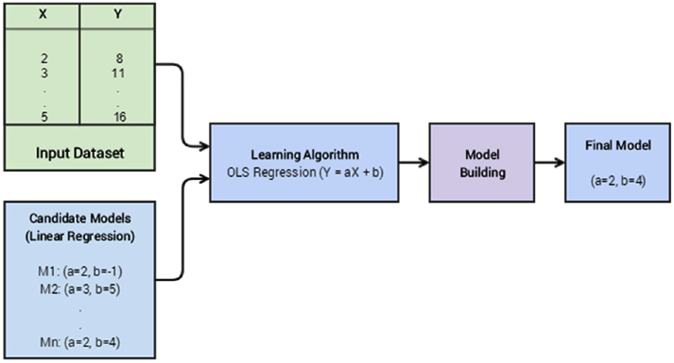
What is a Machine Learning Model?
A ML model can be described as a relationship between output or response variables and its corresponding input or dependent variables in a dataset. This relationship can be expressed as mathematical equations, functions or rules.
Model building (e.g. linear regression) is using a learning process to translate the input variables (independent) into the corresponding output (dependent) variables with the least error for a dataset.
(source: Sarkar et al. 2018)
Notes:
The idea is not to predict a correct output for every input but to generalize well over lots of data points such that the error is minimum and the same is maintained when you use this model over new data points.

Slide 11
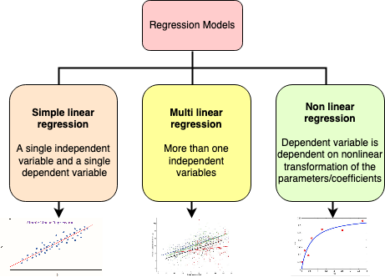
Regression Models
Supervised learning.
The input data is generally labeled with a real valued output variable (continuous instead of discrete).
Created in draw.io by C. Arighi
Notes:
Supervised learning.
The input data is generally labeled with a real valued output variable (continuous instead of discrete).
Major categories of regression models:
Simple linear regression
A single independent variable and a single dependent variable
Multiple linear regression
More than one independent variables
Non linear regression
dependent variable is dependent on nonlinear transformation of the parameters/coefficients
https://medium.com/@dhaval.sony.504/everything-in-short-about-simple-linear-regression-633fc9f8dd65

Slide 12
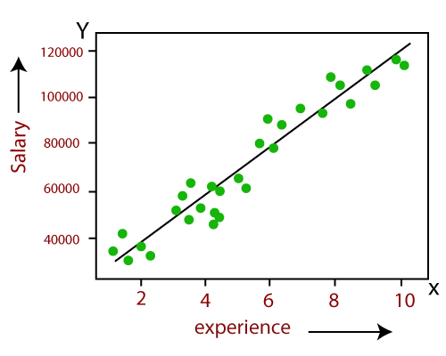
Simple Linear Regression
Shows the linear relationship between the independent variable (X-axis) and the dependent variable (Y-axis).
If there is only one input variable (x), then such linear regression is called simple linear regression. And if there is more than one input variable, then such linear regression is called multiple linear regression.
Popular applications:
Trend analysis
Forecasting/prediction
y=b₀+b₁x
(source: javatpoint.com)

Slide 13
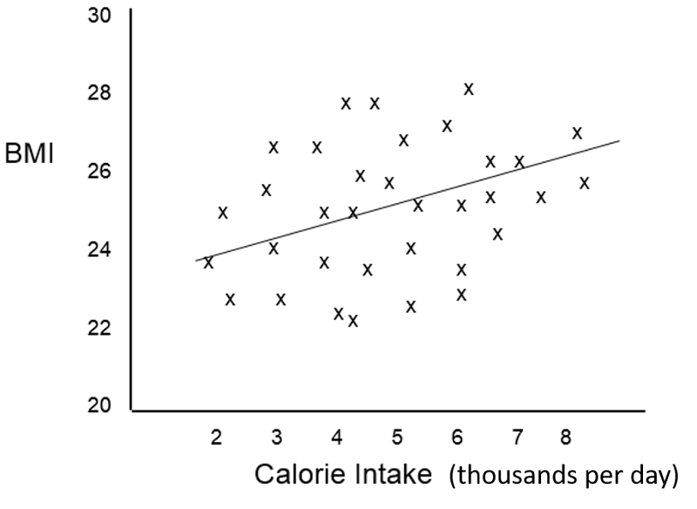

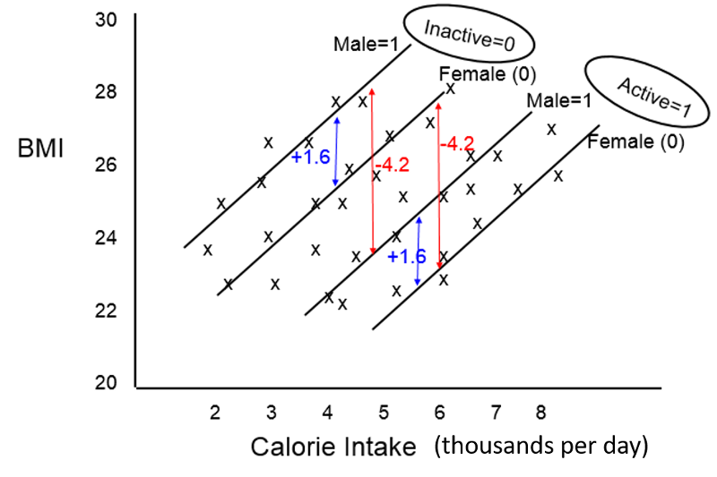
Multiple Linear Regression
Extension of simple linear regression
Take into account the effects of other independent predictors (risk factors) on the outcome of interest.
An equation for multiple linear regression has the general form shown below.
(Source: Wayne W. LaMorte 2021)
Where Y is a continuous measurement outcome (e.g., BMI), b0 is the "intercept" or starting value. X1, X2, X3, etc. are the values of independent predictor variables (i.e., risk factors), and b1, b2, b3, etc. are the coefficients for each risk factor.
BMI = 15.0 + 1.5 (cal) + 1.6 (if male) - 4.2 (if active)

Slide 14
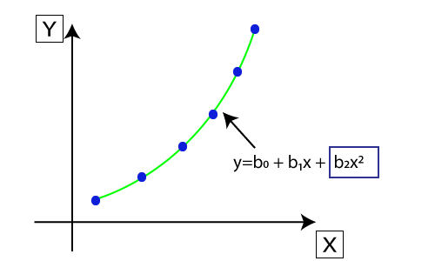
Non Linear Regression
It fits a nonlinear curve between the value of x and corresponding conditional values of y.
The original features are transformed into polynomial features of given degree and then modeled using a linear model. Which means the data points are best fitted using a polynomial line.
The model is still linear as the coefficients are still linear with quadratic.
(source: javatpoint.com)

Slide 15
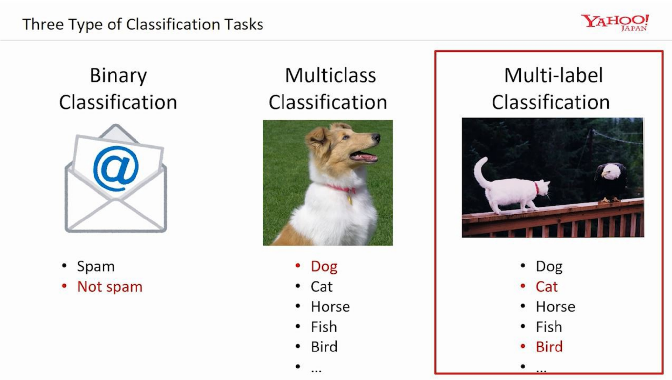
Classification Models
Supervised learning.
The output of a classification model is normally a label or a category to which the input data point may belong. It Involves a training set of data in which we have the data points labeled with their correct classes/categories.
Typical classification models:
Linear models (logistic regression, Naive Bayes, Support Vector Machine)
Non-parametric models (K-nearest neighbors)
Tree based methods (decision trees)
Ensemble methods (random forests)
Neural networks (MLPs)
source:medium.com
Notes:
Supervised learning.
The output of a classification model is normally a label or a category to which the input data point may belong. It Involves a training set of data in which we have the data points labeled with their correct classes/categories.
Typical classification models:
Linear models (logistic regression, Naive Bayes, Support Vector Machine)
Non-parametric models (K-nearest neighbors)
Tree based methods (decision trees)
Ensemble methods (random forests)
Neural networks (MLPs)
Classification objectives:
Binary classification
Multi-Class classification
Multi-Label classification

Slide 16
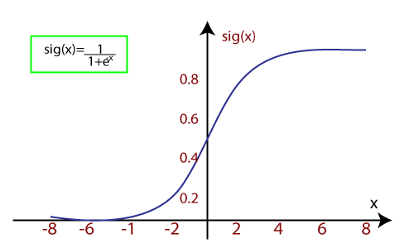
Logistic Regression
It uses sigmoid function or logistic function to model the data.
It is a predictive analysis algorithm which works on the concept of probability.
It uses the concept of threshold levels, values above the threshold level are rounded up to 1, and values below the threshold level are rounded up to 0.
Types of logistic regression:
Binary (0/1, pass/fail)
Multi (cats, dogs, lions)
Ordinal (low, medium, high)
(source: javatpoint.com)

Slide 17
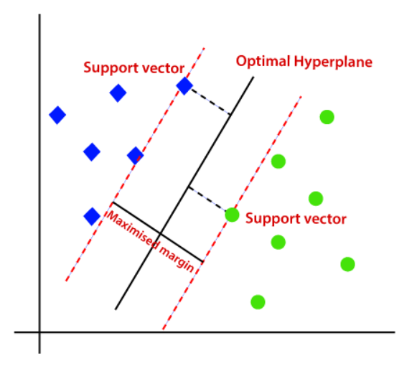
Support Vector Machine (SVM)
Can be used for regression as well as classification problems.
Kernel: It is a function used to map a lower-dimensional data into higher dimensional data.
Hyperplane: In general SVM, it is a separation line between two classes, but in SVR, it is a line which helps to predict the continuous variables and cover most of the data points.
Boundary line: Boundary lines are the two lines apart from hyperplane, which creates the largest margin for data points.
Support vectors: Support vectors are the data points which are nearest to the hyperplane and opposite class.
(source: medium.com)

Slide 18
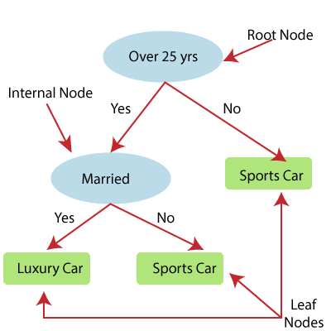
Decision Tree
Can be used for regression as well as classification problems.
It works for both categorical and numerical data.
It builds a tree-like structure in which each internal node represents the "test" for an attribute, each branch represent the result of the test, and each leaf node represents the final decision or result.
It is constructed starting from the root node/parent node (dataset), which splits into left and right child nodes (subsets of dataset).
These child nodes are further divided into their children node, and themselves become the parent node of those nodes.
(source: javatpoint.com)

Slide 19
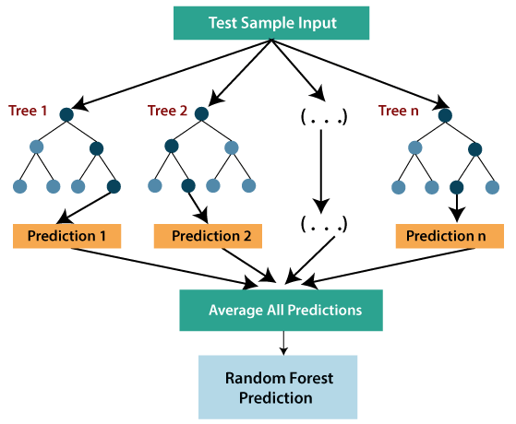
Random Forest
Can be used for regression as well as classification problems.
It is an ensemble learning method which combines multiple decision trees and predicts the final output based on the average of each tree output.
It uses Bagging or Bootstrap Aggregation technique of ensemble learning in which aggregated decision tree runs in parallel and do not interact with each other.
(source: javatpoint.com)

Slide 20
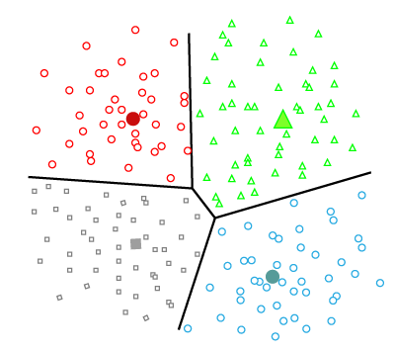
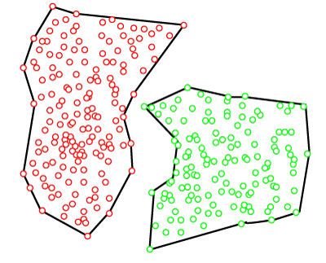
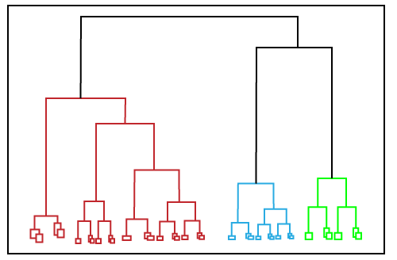
Clustering Models
Unsupervised learning.
A process of grouping similar data points together that do not have any pre-labeled classes or categories. The output is segregated group of data points. We don’t have pre-labeled data to train and build our model.
Clustering algorithms
Partition based clustering
Hierarchical clustering
Density based clustering

Slide 21
Partition Based Clustering
The most common example is K-Means clustering.
The dataset is divided into a set of K groups, where K is used to define the number of pre-defined groups.
The cluster center is created in such a way that the distance between the data points of one cluster is minimum as compared to another cluster centroid.
(source: javatpoint.com)

Slide 22
Hierarchical Clustering
Can be used as an alternative for the partition based clustering as there is no requirement of pre-specifying the number of clusters to be created.
The dataset is divided into clusters to create a tree-like structure, which is also called a dendrogram.
The observations or any number of clusters can be selected by cutting the tree at the certain level.
In a hierarchical clustering paradigm, we can either start with all the data points in one group (divisive clustering) or all the data points in different groups (agglomerative clustering).
(source: javatpoint.com)

Slide 23
Density Based Clustering
This method connects the highly-dense areas into clusters.
This algorithm does it by identifying different clusters in the dataset and connects the areas of high densities into clusters.
The dense areas in data space are divided from each other by sparser areas.
These algorithms can face difficulty in clustering the data points if the dataset has varying densities and high dimensions.
(source: javatpoint.com)

Slide 24
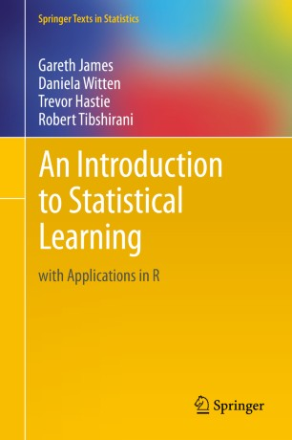
Deep Dive
To understand the theoretical and conceptual details of those ML algorithms, we recommend reading this book:
An Introduction to Statistical Learning by Tibshirani et al.
https://link.springer.com/book/10.1007/978-1-4614-7138-7

Slide 25
Lecture Outline
Review of Day 3
ML Models
ML Model Evaluation

Slide 26
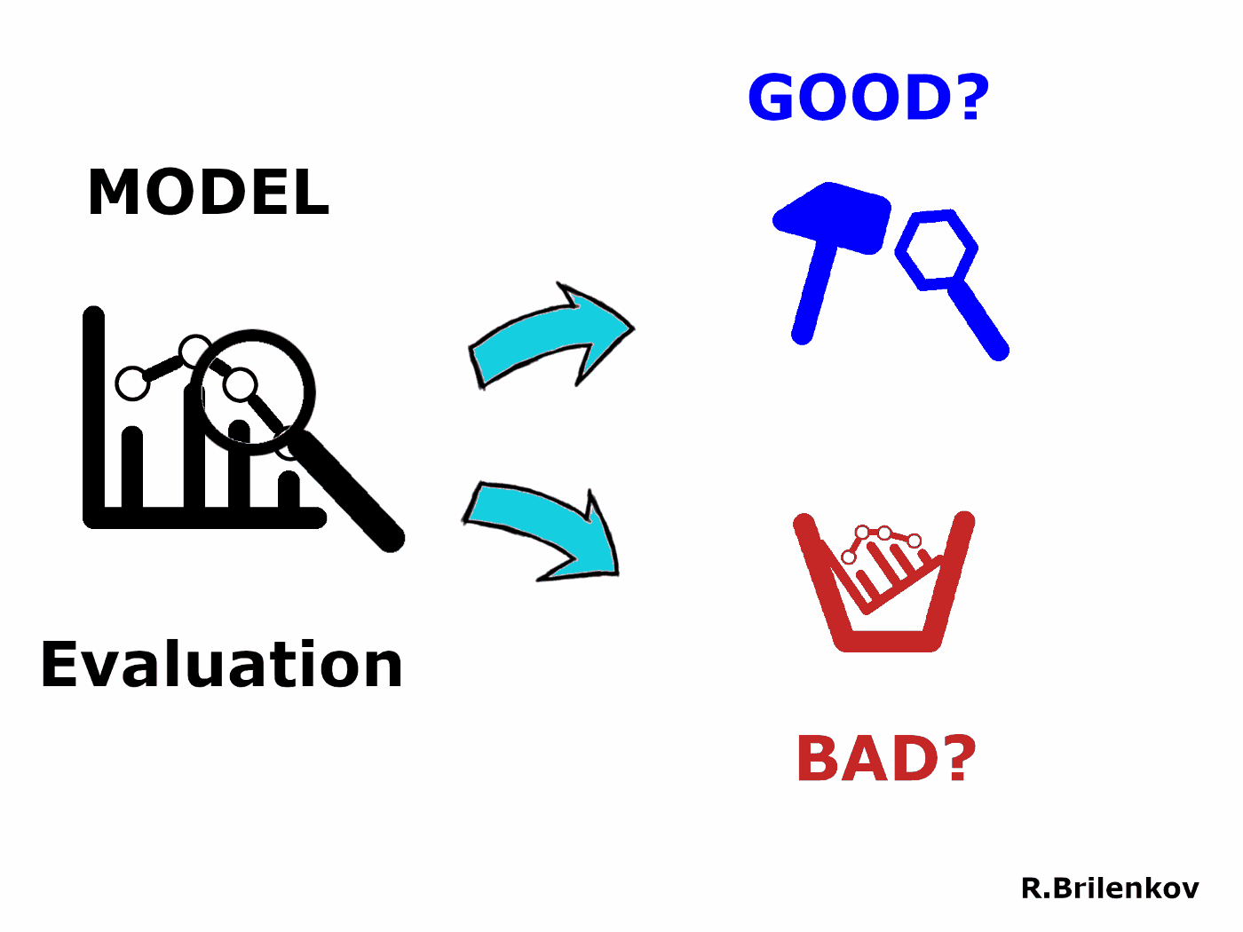
How can we evaluate a ML model?
Model development is an interactive process, model evaluation makes this process iterative.
Model evaluation helps us tuning the model hyperparameters.
Model evaluation also helps us deciding if we need to add any new features to our model or not.
Model evaluation uses some numerical measure or metric of model’s effectiveness to rank and select models.
(source: Brilenkov, 2021)

Slide 27
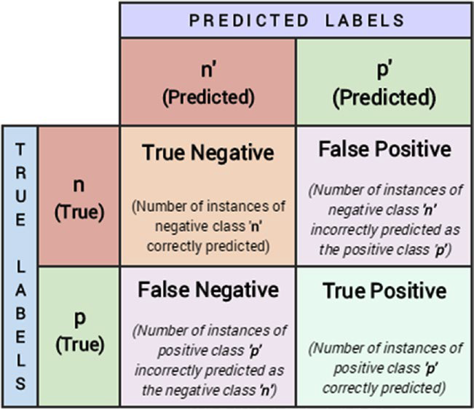
Confusion Matrix
One of the most popular ways to evaluate a binary classification as well as a multi-class classification model.
Created by comparing the predicted class label of a data point with its actual class label.
Repeated for the whole dataset and the comparison results are compiled in a matrix or table.
Can be used to calculate several metrics that are useful measures of model performance.
(source: Sarkar et al. 2018)

Slide 28


Performance Metrics
Accuracy:
Defined as the overall accuracy or proportion of correct predictions of the model.
Normally used when our classes are almost balanced and correct predictions of those classes are equally important.
Precision:
Also called positive predictive value.
Defined as the number of predictions that are actually correct or relevant out of all the predictions based on the positive class.
High precision model will identify a higher fraction of positive class.

Slide 29


Performance Metrics
Recall:
Also called sensitivity, is a measure to identify the percentage of relevant data points.
Defined as the number of instances of the positive class that were correctly predicted.
Used when we want to catch the most number of instances of a particular class even when it increases the false positives.
F1 Score:
The harmonic mean of precision and recall.
Helps us optimize a classifier for balanced precision and recall performance.

Slide 30
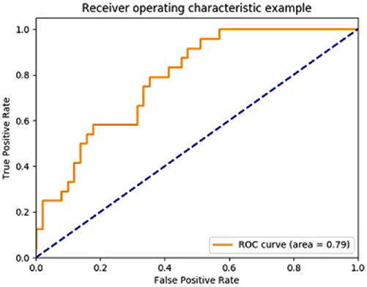
Receiver Operating Characteristic (ROC) Curve
Good for scoring classifiers. It returns a probability value or score for each class label.
Created by plotting the fraction of True Positive Rate (TPR) vs. False Positive Rate (FPR)
TPR is known as sensitivity or recall, which is the total number of correct positive results predicted among all the positive samples.
FPR is known as false alarms or (1 - specificity), determining the total number of incorrect positive predictions among all negative samples.
Ideally, the best prediction model would give a point on the top left corner (0, 1) indicating perfect classification (100% sensitivity & specificity). A diagonal line depicts a classifier that does a random guess.
(source: Sarkar et al. 2018)

Slide 31
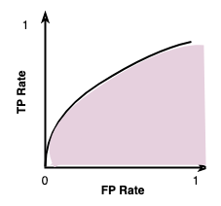
Area Under Curve (AUC)
The Area Under Curve (AUC) provides a numerical value for us to compare models.
The area under the black curve line is the area under the classifier’s ROC curve.
The ideal classifier will have the unit area under the curve. Based on this value we can compare two models, generally the model with the higher AUC score is a better one.
AUC

Slide 32
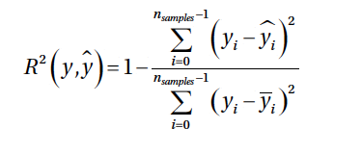

Evaluating Regression Models
Coefficient of Determination or R²:
Measures the proportion of variance in the dependent variable which is explained by the independent variable.
1 denotes a perfect regression model indicating that all the variance is explained by the independent variables.
Mean Squared Error (MSE):
Calculates the average of the squares of the errors or deviation between the actual values and the predicted values.
Lower values meaning a better regression models with less errors.

Slide 33
Evaluating Clustering Models
External Validation: validating the clustering model when we have some ground truth available as labeled data.
Homogeneity: if all of its clusters contain only data points that are members of a single class (based on true class labels).
Completeness: if all the data points of a specific ground truth class label are also elements of the same cluster.
V-measure: The harmonic mean of homogeneity and completeness scores gives us the V-measure value between 0 and 1 and usually higher values are better.
Internal Validation: validating the clustering model by defining metrics that capture the expected behavior of a good clustering model.
Compact groups. i.e. the data points in one cluster occur close to each other.
Well separated groups. i.e. two groups/clusters have as large distance among them as possible.

Slide 34

Quiz
What is the drawback of decision tree?
Works for both regression and classification problems
Works for both categorical and numerical data
Results are interpretable
Prone to overfitting
✔
Which of the followings are widely used metrics to assess a classification model?
Confusion matrix
F1-score
Area under the ROC curve
All of the above
✔
Which of the following is not good for evaluating clustering algorithm?
✔
Accuracy
Homogeneity
Completeness
V-measure
https://forms.gle/QAzAFUgtH2Ungynu6

Slide 35

References
Dipanjan Sarkar, Raghav Bali and Tushar Sharma. 2018. Practical Machine Learning with Python. A Problem-Solver's Guide to Building Real-World Intelligent Systems. Apress. (https://doi.org/10.1007/978-1-4842-3207-1), Chapter 5
Machine Learning Tutorial. (https://www.javatpoint.com/machine-learning)
Ruslan Brilenkov. Jun 2, 2021. 9 Types of Performance Evaluation for Classification Machine Learning Modeling. (https://medium.datadriveninvestor.com/9-types-of-performance-evaluation-for-classification-machine-learning-modeling-c6e73e97e528)
Wayne W. LaMorte. 2021. Multiple Linear Regression. (https://sphweb.bumc.bu.edu/otlt/MPH-Modules/PH717-QuantCore/PH717-Module12-MultipleRegression/PH717-Module12-MultipleRegression3.html)

Slide 36

Steps to plot a ROC curve
Order the outputs of the classifier by their scores (or the probability of being the positive class).
Start at the (0,0) coordinate.
For each example x in the sorted order:
If x is positive, move 1/pos up
If x is negative move 1/neg right
Here pos and neg are the fraction of positive and negative examples respectively
ROC space is between points (0,0) and (1,1)
Each prediction result from the confusion matrix occupies a point in this ROC space.
The best prediction model would give a point on the top left corner (0,1) indicating perfect classification (100% sensitivity and specificity)
A diagonal line depicts a classifier does a random guess.
ROC curve in the top half indicates a classifier better than average
(https://scikit-learn.org/stable/modules/model_evaluation.html#roc-metrics)

