Slide 1
Feature Engineering, Scaling, and Selection

Slide 2
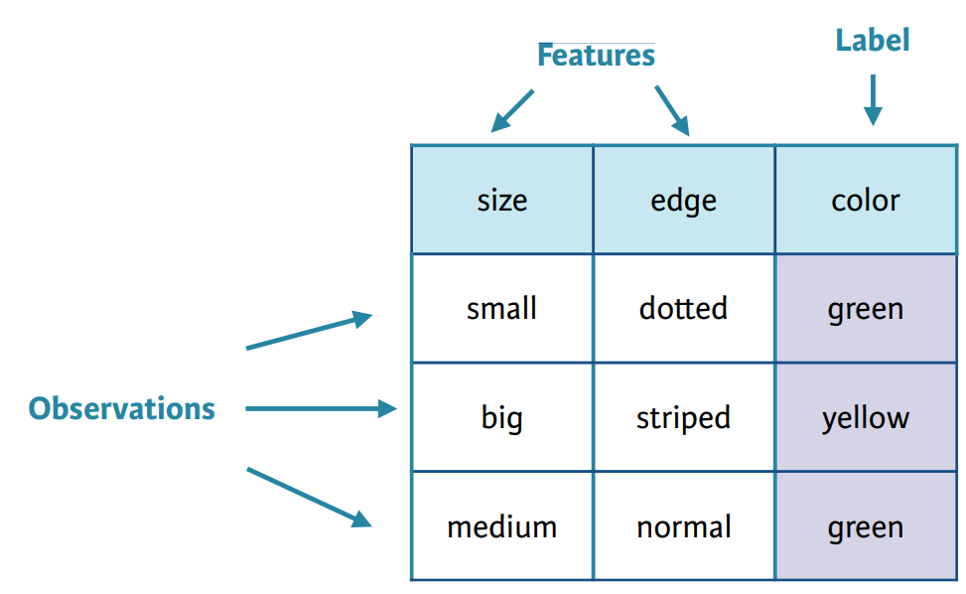
What are features?
The features are the input variables describing the data
Inherent raw features
Obtained directly from the dataset without data manipulation
Derived features
Usually obtained from feature engineering of existing data attributes
Source: https://zinayouhan33.medium.com/machine-learning-can-be-divided-into-3-categorizations-supervised-unsupervised-and-reinforcement-9a1b47460f5d

Slide 3
How to handle data features?
Feature Engineering
Feature Scaling
Feature Selection
ProcessedData
Features

Slide 4
Why do we need to do feature engineering?
Raw data cannot be used to build ML models directly
Provides better representation of data such that the data can be better understood by the ML algorithms.
Helps us build models on diverse data types therefore enables us to work on complex unstructured data.
Enables data scientists to take a step back and try to understand the domain problem better by taking inputs from the domain experts.
Notes:
Why do we need feature engineering? Well, Raw data cannot often be used to build ML models directly. Feature engineering is essential for model building and evaluation.
It provides a Better representation of data such that the data can be better understood by the ML algorithms
In general if you have the right feature set, even a simple model will perform well.
Feature engineering helps us build models on diverse data types therefore enables us to work on complex unstructured data.
Feature engineering enables data scientists to take a step back and try to understand the domain and the business problem better by taking inputs from domain experts.

Slide 5
Data Transformation
Data Transforms
Numerical
Categorical
Change scale
Change distribution
Engineer
Nominal
Ordinal
Standardized
Normalized
Robust
Power
Quantile
Discretize
binning
Polynomial
One-hot encoding
Dummy encoding
Label encoding
source: Brownlee, 2020

Slide 6
Feature engineering on numeric data
Binarization: a binary feature as opposed to a count base measure
Rounding: round off high precision percentages into numeric integers
Interactions: capture the interactions between feature variables as a part of the input feature set
Binning: transform continuous numeric values into discrete ones.
Statistical or Mathematical Transformation: to change the distribution of the data
Notes:
T

Slide 7
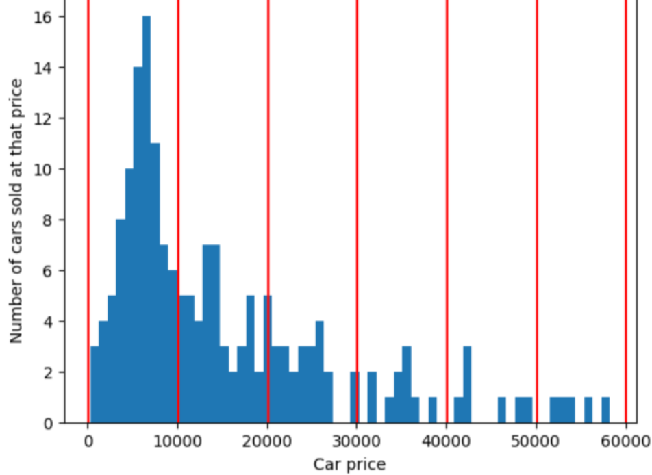
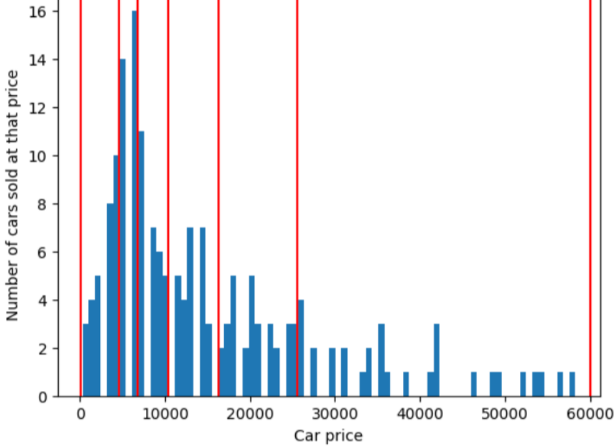
Binning/Discretization
Binning can be used for transforming continuous numeric values into discrete ones.
Fixed-Width Binning: pre-fixed range of values
Adaptive Binning: Use data distribution itself (Quantile) to decide the appropriate bins
Source: https://developers.google.com/machine-learning/crash-course

Slide 8
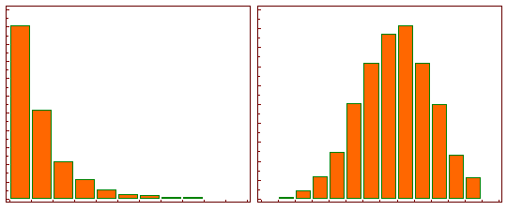
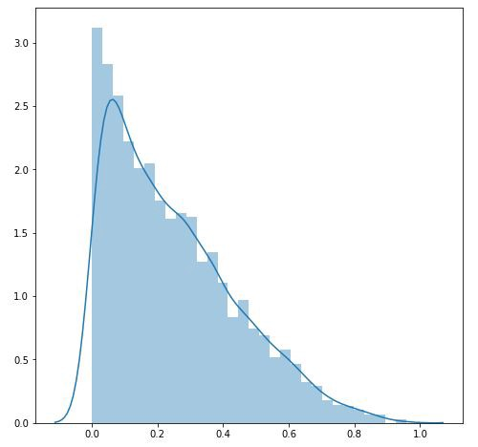
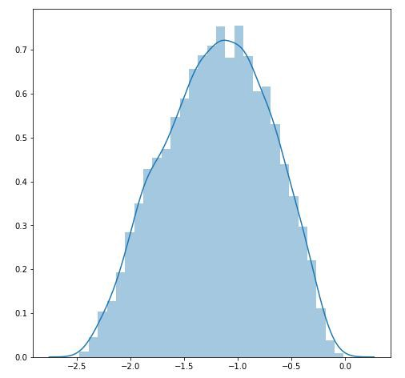
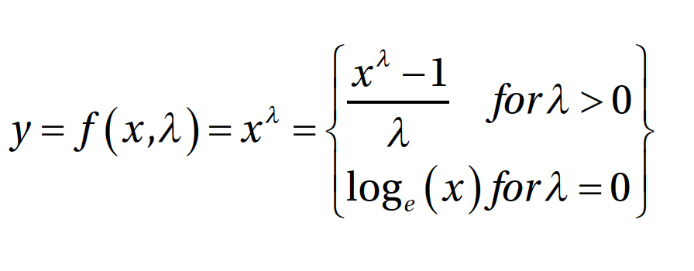
Statistical or Mathematical Transformation
Log Transformation: y = log_{b}(x)
This tends to make the skewed distribution as normal-like as possible.
Box-Cox Transformation:
It transforms non-normal dependent variables into a normal shape.
(Source: https://www.medcalc.org/manual/log-transformation.php)
(Source: https://towardsdatascience.com/box-cox-transformation-explained-51d745e34203)

Slide 9
Data Transformation
Data Transforms
Numerical
Categorical
Change scale
Change distribution
Engineer
Nominal
Ordinal
Standardized
Normalized
Robust
Power
Quantile
Discretize
binning
Polynomial
One-hot encoding
Dummy encoding
Label encoding
source: Brownlee, 2020

Slide 10
Transforming Categorical Features
Categorical features are often strings that need to be represented in numerical format
Data Transforms
Categorical
Encoding is the process of converting categorical or textual data into numerical format
Nominal
Ordinal
One hot encoding
Dummy encoding
Label encoding

Slide 11
Methods for Encoding Categorical Features
green | red | blue | orange
1 | 0 | 0 | 0
0 | 1 | 0 | 0
0 | 0 | 1 | 0
0 | 0 | 0 | 1
One-Hot Encoding
color
green
red
blue
orange
size
XS
S
M
L
XL
1
2
3
4
5
Label Encoding
Dummy Encoding
green | red | blue
1 | 0 | 0
0 | 1 | 0
0 | 0 | 1
0 | 0 | 0

Slide 12
Feature engineering on temporal data
Datasets where most attributes are time based and changed over time
Date-Based Features:
Each temporal value has a date component that can be used to extract useful information and features related to the date.
Time-Based Features:
Each temporal value has a time component that can be used to extract useful information and features related to the time.

Slide 13
Feature engineering on text data and images
It is challenge to extract useful information from text for building models. Because we are dealing with the unpredictable nature of the syntax, format, and content of the documents
It is not possible to directly use images for training models
There are specific strategies to deal with these data types

Slide 14
ProcessedData
Feature Engineering
Feature Scaling
Feature Selection
Features
source: Brownlee, 2020

Slide 15
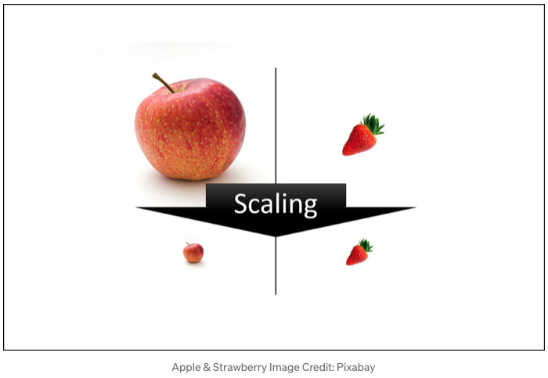
Feature Scaling
Technique to standardize the independent features present in the data into a fixed range
Data Transforms
Machine learning model just sees number
Scaling is performed to handle highly varying magnitudes or values or units
Numerical
Change scale
Standardized
Normalized
Robust
https://towardsdatascience.com/all-about-feature-scaling-bcc0ad75cb35

Slide 16
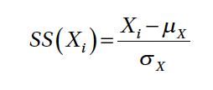
Standardized Scaling (Z-score scaling)
Standardize each value in a feature column by making the mean 0 and scaling the variance to be 1 from the values. This is also known as centering and can be denoted mathematically as
where each value in feature X is subtracted by the mean μ_{X} and the resultant is divided by the standard deviation σ_{X}.
You can also divide the resultant by the variance instead of the standard deviation if needed.

Slide 17
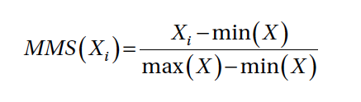
Min-Max Scaling
Scales all the data between 0 and 1
Mathematically we can represent this scaler as
where we scale each value in the feature X by subtracting it from the minimum value in the feature min(X) and dividing the resultant by the difference between the maximum and minimum values in the feature max(X) - min (X).

Slide 18

Robust Scaling
Robust scaling tries to use specific statistical measures to scale features without being affected by outliers. Mathematically this scaler can be represented as
where we scale each value of feature X by subtracting the median of X and dividing the resultant by Inter-Quartile Range of X (IQR) which is the range (difference) between the first quartile (25th %ile) and the third quartile (75th %ile).

Slide 19
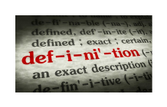
Feature Selection
Techniques for selecting a subset of input features that are most relevant to the target variable that is being predicted
Feature Selection
Dimensionality Reduction
Using large number of features leads to more complex models
The goal is to favor the simplest possible well performing model.
Unsupervised
Supervised
Intrinsic
Wrapper methods
Filter methods
Trees
RFE
Stats
Feature importance
source: Brownlee, 2020

Slide 20
Feature Selection Strategies
Feature Selection (supervised)
Intrinsic methods
Wrapper methods
Filter methods
Use ML models to rank and score feature variables based on their importance
Use a recursive approach to build multiple models using feature subsets and select the best subset of features giving us the best performing model
Use techniques select features purely based on metrics

Slide 21

References
Avi Chawla 7 Must-know Techniques for Encoding Categorical Features (https://blog.dailydoseofds.com/p/7-must-know-techniques-for-encoding-017)
Dipanjan Sarkar, Raghav Bali and Tushar Sharma. 2018. Practical Machine Learning with Python. A Problem-Solver's Guide to Building Real-World Intelligent Systems. Apress. (https://doi.org/10.1007/978-1-4842-3207-1), Chapter 4.
Jason Brownlee. 2019. A Gentle Introduction to Imbalanced Classification (https://machinelearningmastery.com/what-is-imbalanced-classification/)
Jason Brownlee. 2019. A Gentle Introduction to Uncertainty in Machine Learning (https://machinelearningmastery.com/uncertainty-in-machine-learning/)

