Slide 1
Overview of the FAIR Data Principles

Slide 2

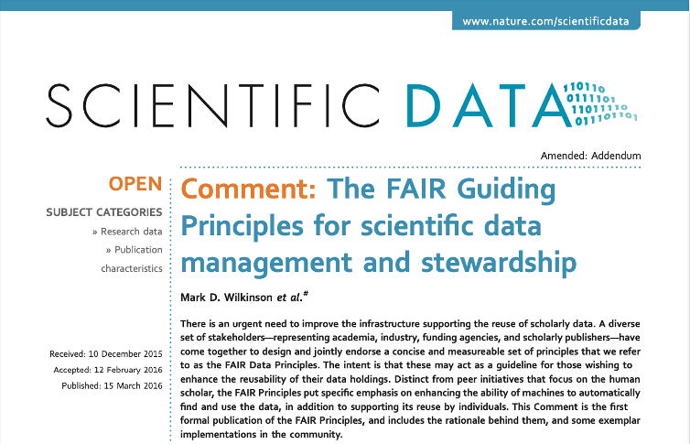




What is FAIR?

Slide 3
Findable
F1. (Meta)data are assigned a globally unique and persistent identifier
F2. Data are described with rich metadata
F3. Metadata clearly and explicitly includes the identifier of the data they describe
F4. (Meta)data are registered or indexed in a searchable resource

Slide 4
Accessible
A1. (Meta)data are retrievable by their identifier using a standardized communications protocol
A1.1 The protocol is open, free, and universally implementable
A1.2 The protocol allows for an authentication and authorization procedure, when necessary
A2. Metadata are accessible, even when the data are no longer available

Slide 5
Interoperable
I1. (Meta)data use a formal, accessible, shared, and broadly applicable language for knowledge presentation
I2. (Meta)data use vocabularies that follow FAIR principles
I3. (Meta)data include qualified references to other (meta)data

Slide 6
Reusable
R1. (Meta)data are richly described with a plurality of accurate and relevant attributes
R1.1 (Meta)data are released with a clear and accessible data usage license
R1.2 (Meta)data are associated with detailed provenance
R1.3 (Meta)data meet domain-relevant community standards

Slide 7
Common FAIR Challenges
No universal data search engine.
Long-term data storage costs.
Proprietary software formats.
Missing/incomplete metadata.

Slide 8
FAIRness
Metrics

Slide 9
Why FAIRness metrics?
The FAIR principles are aspirational
They do not strictly define how to achieve a state of “FAIRness”.
They describe a continuum of features, attributes, and behaviors that will move a digital resource closer to that goal.
FAIRness metrics (https://github.com/FAIRMetrics/Metrics)
Provides the qualitative and quantitative ways to measure the FAIRness of a digital resource.
(https://www.nature.com/articles/sdata2018118)

Slide 10
FAIR Maturity Indicators (Examples)
Findable: Unique ID, indexed metadata.
Accessible: Open protocols, persistent metadata.
Interoperable: Use of shared vocabularies and structured formats.
Reusable: License info, provenance, domain standards.
(https://www.nature.com/articles/sdata2018118)

Slide 11
FAIR Evaluation Services
Purpose:
Helps evaluate the FAIRness (Findable, Accessible, Interoperable, Reusable) of digital resources.
Functionality:
Assesses a resource based on FAIR metrics associated with each FAIR principle.
Benefits:
Researchers and data providers can utilize the FAIR Evaluator to identify areas for improvement in making their data more findable, accessible, interoperable, and reusable.
Available at https://fairsharing.github.io/FAIR-Evaluator-FrontEnd/

Slide 12

References
Wilkinson, M., Dumontier, M., Aalbersberg, I. et al. The FAIR Guiding Principles for scientific data management and stewardship. Sci Data 3, 160018 (2016). https://doi.org/10.1038/sdata.2016.18
Wilkinson, M., Sansone, SA., Schultes, E. et al. A design framework and exemplar metrics for FAIRness. Sci Data 5, 180118 (2018). https://doi.org/10.1038/sdata.2018.118
GO FAIR initiative: Make your data & services FAIR. https://www.go-fair.org/
FAIR Evaluation Services. https://fairsharing.github.io/FAIR-Evaluator-FrontEnd/#!/

