Slide 1
Overview of the
Data Science Life Cycle

Slide 2
What is the Data Science Life Cycle?

Slide 3
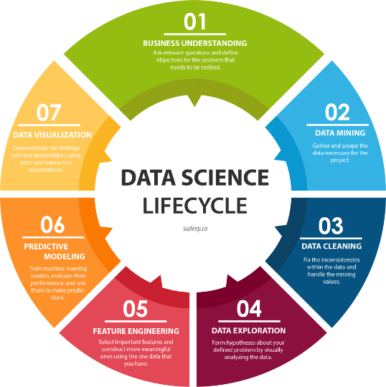
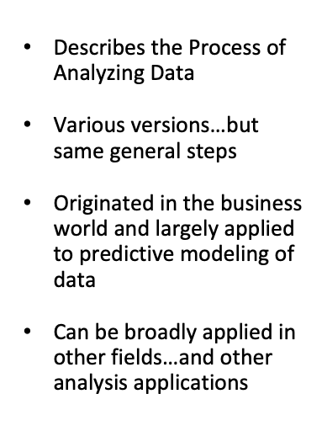

Slide 4
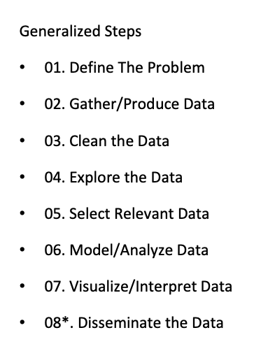

Slide 5
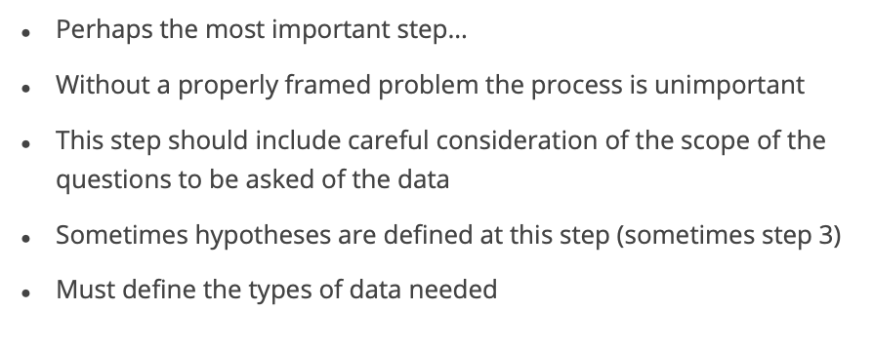
01. Define the Problem

Slide 6
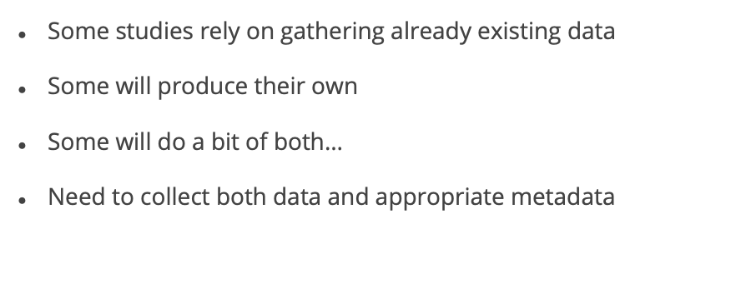
02. Gather/Produce Data

Slide 7
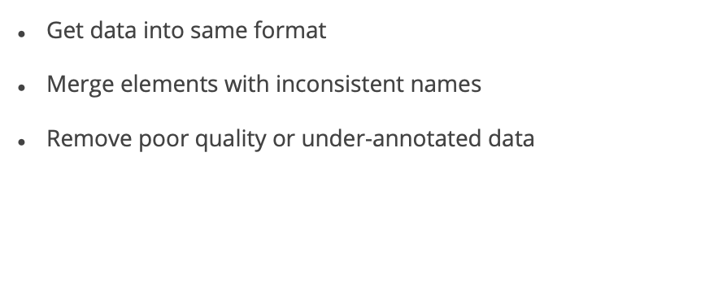
03. Clean the Data

Slide 8
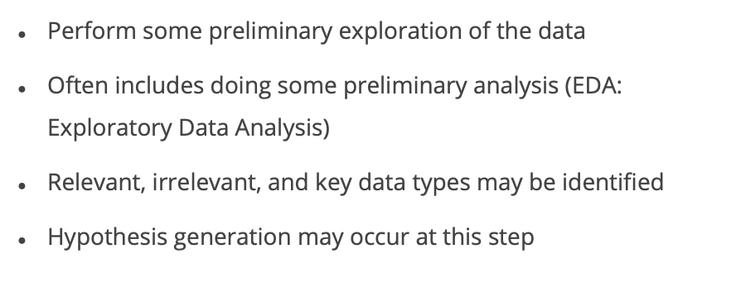
04. Explore the Data
Notes:
.

Slide 9
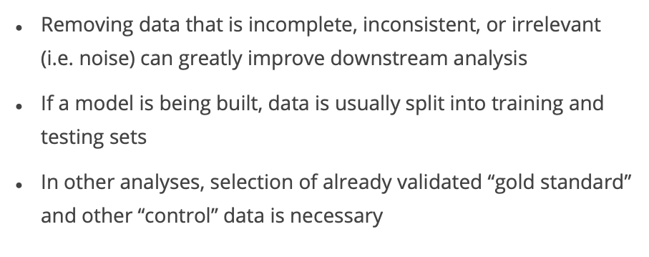
05. Select [Most] Relevant Data

Slide 10
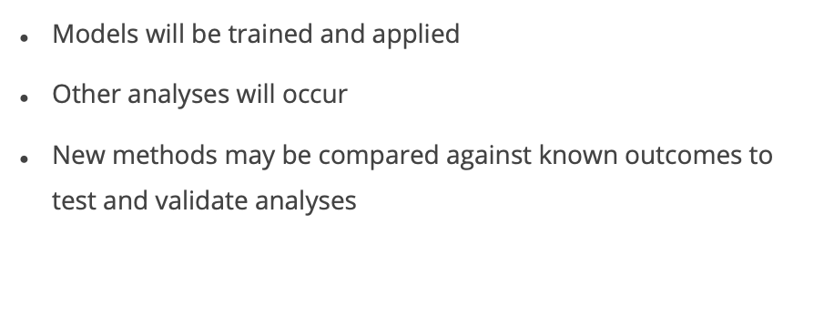
06. Model/Analyze the Data

Slide 11
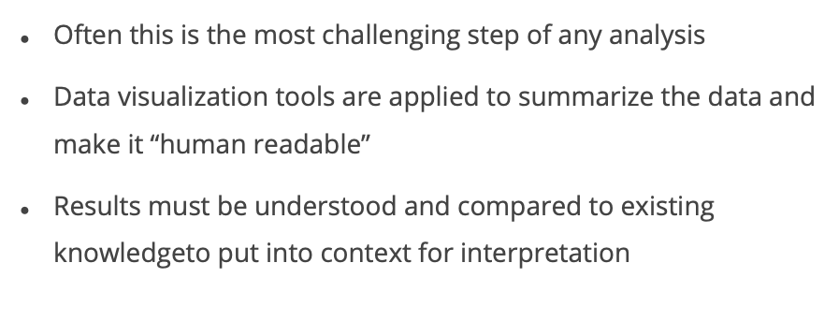
07. Visualize/Interpret the Data

Slide 12
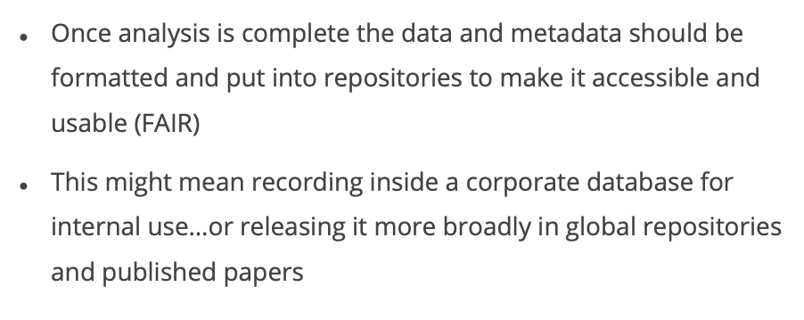
08. Maintain and Disseminate the Data

Slide 13

References
Jyosmitha Munnangi. Data Science project life cycle - Detailed Tour with Step by Step Explanation [2022]. https://medium.com/co-learning-lounge/complete-data-science-project-life-cycle-9eae6e4ed4c9

