Slide 1
Model-Centric vs Data-Centric
AI/ML

Slide 2
What is Model-Centric AI/ML?
Model-Centric AI/ML is a paradigm that focuses on optimizing the model architecture and training process to achieve the best possible performance. In this approach, the emphasis is on experimenting with different model architectures, hyperparameters, and training techniques to improve the model's accuracy and efficiency.
(Mahalle et al., 2023, Springer Nature, https://doi.org/10.1007/978-981-99-6353-9)

Slide 3
Key aspects of Model-Centric AI/ML
Model Architecture: Selecting or designing the appropriate model architecture, such as neural networks, decision trees, or support vector machines.
Hyperparameter Tuning: Adjusting hyperparameters like learning rate, batch size, and optimizer to optimize the training process.
Feature Engineering: Creating new features from existing data to improve model performance.
Model Selection: Choosing the best model from a set of candidate models based on performance metrics.
Model Training: Training the model on the available data using appropriate algorithms and optimization techniques.
Model Evaluation: Assessing the model's performance using various metrics like accuracy, precision, recall, and F1-score
(Mahalle et al., 2023, Springer Nature, https://doi.org/10.1007/978-981-99-6353-9)

Slide 4
Benefits of Model-Centric AI/ML
By carefully selecting and tuning models, and employing techniques like regularization and data augmentation, it can lead to:
Improved accuracy and generalization
Models can make more accurate predictions on unseen data.
Faster development and deployment
Efficient training and inference pipelines reduce development time.
Enhanced interpretability
Understanding how models make decisions can lead to better insights.
Accelerated innovation
Continuous experimentation and sharing of knowledge drive progress.
(Mahalle et al., 2023, Springer Nature, https://doi.org/10.1007/978-981-99-6353-9)

Slide 5
What is Data-Centric AI/ML?
Data-Centric AI/ML is a paradigm shift in the field of artificial intelligence and machine learning. It prioritizes the quality and quantity of data over complex model architectures. The fundamental idea is that improving the quality and quantity of data can lead to significant improvements in model performance, often surpassing the benefits of complex model tuning.
(Mahalle et al., 2023, Springer Nature, https://doi.org/10.1007/978-981-99-6353-9)

Slide 6
Key aspects of Data-Centric AI/ML
Data Quality: Ensuring data is accurate, consistent, and free from biases.
Data Quantity: Collecting sufficient data to train robust models.
Data Diversity: Ensuring data represents a wide range of real-world scenarios.
Data Labeling: Accurate and consistent labeling of data for supervised learning.
Data Augmentation: Creating new data from existing data to increase dataset size and diversity.
Data Cleaning and Preprocessing: Removing noise, outliers, and inconsistencies.
Data Versioning and Management: Tracking changes to data and ensuring reproducibility.
(Mahalle et al., 2023, Springer Nature, https://doi.org/10.1007/978-981-99-6353-9)

Slide 7
Benefits of Data-Centric AI/ML
Improved Model Performance: High-quality data leads to more accurate and reliable models.
Faster Development Time: Data-centric approaches can accelerate the development cycle.
Reduced Reliance on Complex Models: Simple models can often outperform complex ones with high-quality data.
Enhanced Explainability: Data-centric models can be more interpretable and easier to understand.
Increased Efficiency: By focusing on data, teams can work more efficiently and collaboratively.
(Mahalle et al., 2023, Springer Nature, https://doi.org/10.1007/978-981-99-6353-9)

Slide 8
Practical Consideration
While data-centric AI/ML focuses on improving data quality, model-centric AI/ML focuses on improving the model itself. In practice, a successful AI/ML project often involves a combination of both approaches, iteratively improving both the data and the model.

Slide 9
The Principles of Data-Centric
AI/ML

Slide 10
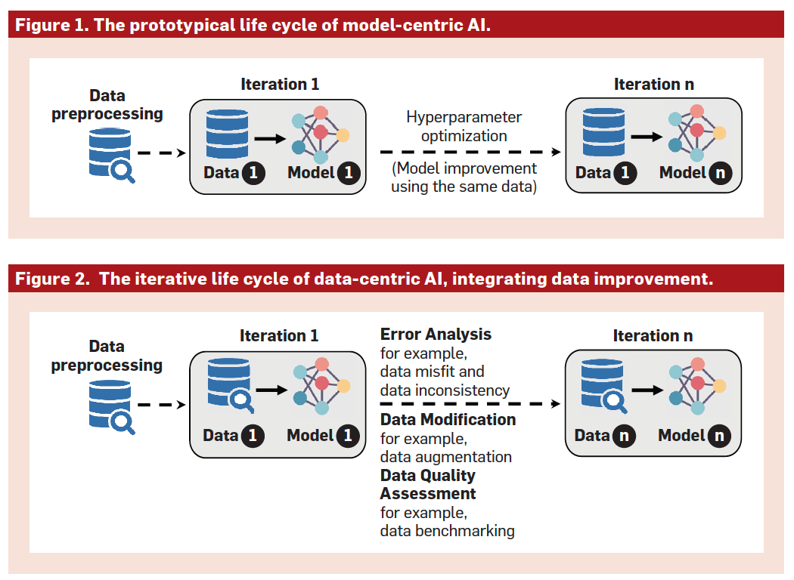
Lifecycle of Model-Centric and Data-Centric AI/ML
The prototypical model-centric approach in developing AI systems leaves little opportunity for systematically and progressively revising and improving data quality.
In the data-centric approach, the effectiveness of the AI system is assessed based on both the performance of the model and the quality of the data intertwined with the model. Data and models are both evaluated and refined through numerous iterations.
(Jarrahi et al., 2023, Communications of the ACM, https://doi.org/10.1145/3571724)

Slide 11
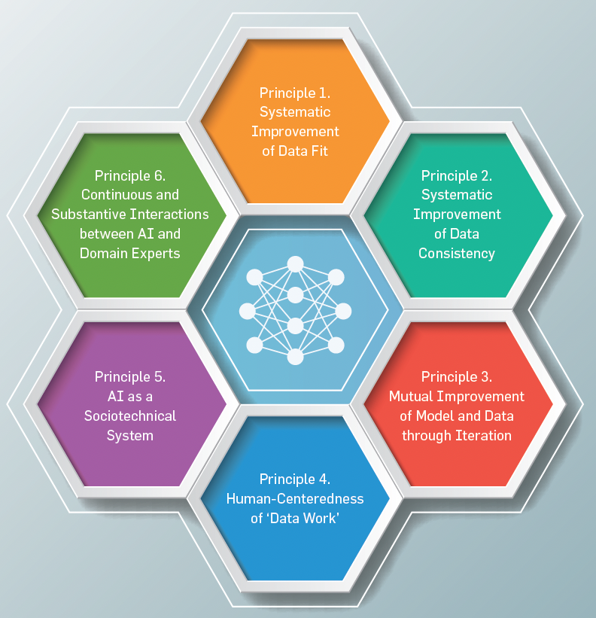
The Principles of Data-Centric AI/ML
(Jarrahi et al., 2023, Communications of the ACM, https://doi.org/10.1145/3571724)

Slide 12
Principle 1: Systematic Improvement of Data Fit
To achieve a good data fit, Data-Centric AI/ML advocates for an iterative approach:
Augmentation: Instead of collecting entirely new data, augmenting existing data through techniques like image transformations, speech slicing, or generative adversarial networks (GANs) can create more diverse and representative datasets.
Data Cleaning and Preparation: Cleaning and preparing existing data can improve its quality and relevance.
Identifying and Addressing Bias: Recognizing and mitigating biases in data collection and labeling is crucial. Over-sampling underrepresented classes can help balance datasets.
Continuous Learning: As models are trained and evaluated, new insights into data quality and model performance can emerge. This iterative process allows for continuous improvement of both data and models.
(Jarrahi et al., 2023, Communications of the ACM, https://doi.org/10.1145/3571724)

Slide 13
Principle 2. Systematic Improvement of Data Consistency
To ensure data consistency, Data-Centric AI/ML emphasizes the following:
Automated Tools: Leveraging automated tools like weakly supervised labeling and unsupervised algorithms can streamline the annotation process and improve consistency.
Inter-annotator Reliability: Assessing the agreement between different annotators using metrics like kappa coefficients can help identify and address inconsistencies.
Standardized Guidelines: Developing clear and consistent guidelines for annotation can reduce ambiguity and improve the quality of the data.
Continuous Monitoring and Improvement: Regular monitoring of data quality and consistency can help identify and rectify issues early on.
Data Provenance: Tracking the origin and evolution of data is essential for understanding its quality and potential biases.
Data Documentation: Documenting key metadata about the dataset, such as its purpose, collection process, and limitations, can improve transparency and facilitate collaboration.
(Jarrahi et al., 2023, Communications of the ACM, https://doi.org/10.1145/3571724)

Slide 14
Principle 3. Mutual Improvement of Model and Data through Iteration
In Data-Centric AI/ML, the relationship between data and model is iterative. This means that the model and data continually inform and improve each other. Key aspects of this principle include:
Error Analysis: Analyzing model errors helps identify specific data weaknesses, such as bias or insufficient representation of certain data points.
Data Augmentation and Refinement: By augmenting data with synthetic examples or refining existing data, the model can be trained on a more diverse and representative dataset.
Continuous Learning: As the model is deployed, it can be continuously updated with new data, allowing it to adapt to changing conditions and improve its performance.
Monitoring and Feedback: Monitoring the model's performance and identifying issues like concept drift or data drift can inform future data collection and model retraining.
Iterative Refinement: By iteratively refining both the model and the data, Data-Centric AI/ML aims to achieve optimal performance and generalization.
(Jarrahi et al., 2023, Communications of the ACM, https://doi.org/10.1145/3571724)

Slide 15
Principle 4. Human-Centeredness of ‘Data Work’
Data-Centric AI/ML recognizes the human element as a crucial factor in the data lifecycle. This principle emphasizes the following:
Data as a Human Endeavor: Data is not merely a technical resource but a human-crafted artifact. It is shaped by human decisions, biases, and values.
The Importance of Data Work: Data work, including data collection, cleaning, labeling, and curation, is essential for building high-quality AI systems. It requires careful consideration, expertise, and attention to detail.
Addressing Bias and Fairness: Data can be biased, reflecting societal inequalities and stereotypes. It's important to be aware of these biases and take steps to mitigate them.
Contextual Understanding: Data is always contextual, and its interpretation depends on the specific use case and the social and cultural factors that shape it.
Human-in-the-Loop: Humans should be involved in all stages of the AI lifecycle, from data collection to model deployment and monitoring.
Ethical Considerations: Ethical considerations, such as privacy, security, and fairness, should guide data practices.
(Jarrahi et al., 2023, Communications of the ACM, https://doi.org/10.1145/3571724)

Slide 16
Principle 5. AI as a Sociotechnical System
This principle recognizes that AI systems are not merely technical artifacts but complex sociotechnical systems that interact with humans and society. Key aspects of this principle include:
Human-Centered Design: AI systems should be designed with human needs and values in mind. This involves considering factors like privacy, fairness, and transparency.
Ethical Considerations: AI systems should be developed and deployed ethically, avoiding biases and discrimination.
User Experience: AI systems should be designed to be user-friendly and intuitive, empowering users to interact with the technology effectively.
Explainability: AI models should be interpretable, allowing humans to understand their decision-making processes.
Collaboration between Humans and AI: AI should augment human capabilities, rather than replace them. Collaboration between humans and AI can lead to more innovative and effective solutions.
(Jarrahi et al., 2023, Communications of the ACM, https://doi.org/10.1145/3571724)

Slide 17
Principle 6. Continuous and Substantive Interactions between AI and Domain Experts
Effective Data-Centric AI/ML requires strong collaboration between AI experts and domain experts. This principle highlights the importance of this partnership:
Domain Expertise: Domain experts provide valuable insights into the specific context and requirements of the AI application, helping to ensure that the data is relevant and representative.
Data Quality and Labeling: Domain experts can help ensure the quality of data by providing accurate and consistent labels and annotations.
Model Evaluation: Domain experts can assess the model's performance in real-world scenarios and provide feedback on its strengths and weaknesses.
Ethical Considerations: Domain experts can help identify and mitigate potential ethical implications of AI systems.
Continuous Improvement: By working together, AI experts and domain experts can iteratively improve both the data and the model.
(Jarrahi et al., 2023, Communications of the ACM, https://doi.org/10.1145/3571724)

Slide 18
Data-Centric
AI/ML Approaches

Slide 19
Data Acquisition
Data acquisition is a critical step in the Data-Centric AI/ML approach. It involves the following key activities:
Identifying Data Sources: Locating relevant data from various sources like databases, sensors, and social media.
Data Collection: Gathering data in a structured and efficient manner.
Data Cleaning: Removing errors, inconsistencies, and outliers.
Data Preparation: Transforming data into a suitable format for analysis.
Data Storage: Storing data securely and efficiently.
Effective data acquisition ensures that AI models have access to high-quality, relevant data, leading to improved performance and reliability.
(Mahalle et al., 2023, Springer Nature, https://doi.org/10.1007/978-981-99-6353-9)

Slide 20
Data Labeling
Data labeling is the process of assigning meaningful tags to data to make it understandable for machine learning models. It involves:
Collecting data from various sources.
Creating clear labeling guidelines.
Using tools to efficiently annotate data.
Employing human labelers to ensure accuracy.
Iteratively improving the labeling process.
Why Data Labeling Matters:
Improved Model Accuracy: Accurate labels lead to better model performance.
Increased Efficiency: Labeled data speeds up training and inference.
Enhanced Data Quality: Identifies and removes errors and inconsistencies.
Personalized Experiences: Enables tailored recommendations and predictions.
By investing in quality data labeling, organizations can develop more robust and effective AI models.
(Mahalle et al., 2023, Springer Nature, https://doi.org/10.1007/978-981-99-6353-9)

Slide 21
Data Annotation
Data annotation is the process of adding labels or tags to data to make it understandable for machines. This helps train AI models to recognize patterns and make accurate predictions. Common types of data annotation include:
Image annotation: Labeling objects within images.
Text annotation: Tagging text with keywords or sentiments.
Audio annotation: Labeling audio with speaker identification or speech recognition.
Video annotation: Labeling objects or events within videos.
Data annotation is a crucial step in developing effective AI applications.
(Mahalle et al., 2023, Springer Nature, https://doi.org/10.1007/978-981-99-6353-9)

Slide 22
Data Augmentation
Data augmentation is a technique to increase the size and diversity of a dataset by creating new, synthetic data. This helps improve model performance and generalization. Common techniques include:
Image data: Rotation, flipping, cropping, zooming, color jittering, adding noise.
Text data: Synonym replacement, back-translation, adding noise, shuffling words.
Audio data: Adding background noise, time stretching, pitch shifting.
Benefits of Data Augmentation:
Improved Model Performance: More data leads to better model training and generalization.
Reduced Overfitting: Prevents models from memorizing training data.
Increased Data Diversity: Enhances the model's ability to handle different variations.
Reduced Data Collection Costs: Reduces the need for extensive data collection efforts.
By effectively utilizing data augmentation, you can enhance the performance of your machine learning models and achieve better.
(Mahalle et al., 2023, Springer Nature, https://doi.org/10.1007/978-981-99-6353-9)

Slide 23
Data Deployment
Data deployment is the process of making data accessible and usable. Key steps include:
Data Storage: Choosing the right storage system (databases, data warehouses, or data lakes).
Data Architecture: Designing the data structure and how data will be organized.
Data Integration: Combining data from multiple sources into a unified format.
Data Access: Establishing secure and efficient ways to access data.
Data Governance: Implementing policies to ensure data security, accuracy, and compliance.
By effectively deploying data, organizations can unlock its value and drive data-driven decision-making.
(Mahalle et al., 2023, Springer Nature, https://doi.org/10.1007/978-981-99-6353-9)

Slide 24
Data-Centric AI/ML Tools
Data-centric AI tools are software applications that use AI and ML to analyze data and extract insights. They help automate data processing, improve accuracy, and enhance decision-making.
Key Types of Tools:
Data Visualization: Visualizing data to identify trends.
Predictive Analytics: Forecasting future outcomes.
Natural Language Processing (NLP): Analyzing and understanding text.
Recommendation Engines: Providing personalized recommendations.
Data Preparation and Cleaning: Preparing data for analysis.
Data Integration: Combining data from multiple sources.
By leveraging these tools, organizations can harness the power of their data to drive innovation and business growth.
(Mahalle et al., 2023, Springer Nature, https://doi.org/10.1007/978-981-99-6353-9)

Slide 25
Open-Source Software Tools Data-Centric AI/ML
cleanlab - automatically detect problems in a dataset to facilitate ML with messy, real-world data
refinery - assess and maintain natural language data
great expectations - validate, document, and profile data for quality testing
ydata-profiling - generate summary reports of tabular datasets stored as pandas DataFrame
cleanvision - automatically detect low-quality images in computer vision datasets
albumentations - data augmentation for computer vision
label-studio - interfaces to label and annotate data for many ML tasks
llamaindex - a data framework for LLM applications (Retrieval-Augmented Generation)
dspy - algorithmically optimize LLM prompts and bootstrap data
(https://dcai.csail.mit.edu/resources/)

Slide 26

References
Parikshit N. Mahalle, Gitanjali R. Shinde, Yashwant S. Ingle, Namrata N. Wasatkar. 2023. Data Centric Artificial Intelligence: A Beginner’s Guide. Springer Singapore. (https://doi.org/10.1007/978-981-99-6353-9)
Introduction to Data Centric AI. https://dcai.csail.mit.edu/resources/

