Slide 1
Data-Centric AI/ML Shifting Focus from Models to Data Quality

Slide 2
What is Model-Centric AI/ML?
Model-Centric AI/ML
Focus: Optimize model architecture, hyperparameters.
Key Activities: Feature engineering, model selection, training.

Slide 3
What is Data-Centric AI/ML?
Data-Centric AI/ML
Focus: Improve data quality, quantity, and consistency.
Key Activities: Data cleaning, labeling, augmentation

Slide 4
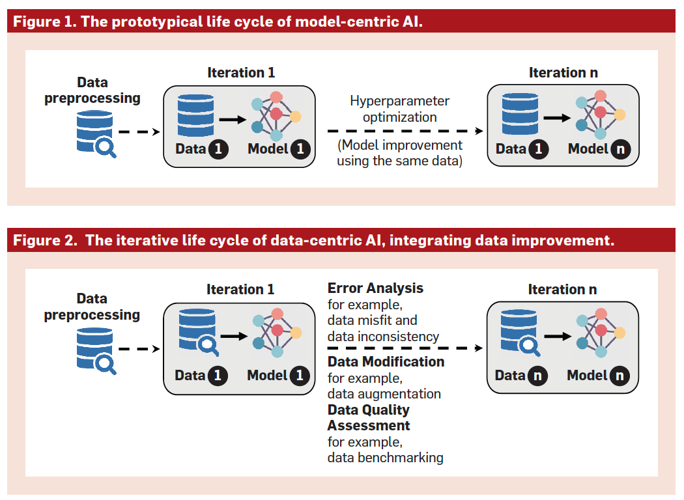
Lifecycle of Model-Centric and Data-Centric AI/ML
Key Difference
Model-centric asks "How can we build a better model for this data?"
Data-centric asks "How can we build better data for this problem?"
(Jarrahi et al., 2023, Communications of the ACM, https://doi.org/10.1145/3571724)

Slide 5
Why Data-Centric AI/ML?
Benefits
Higher accuracy with simpler models.
Faster development cycles.
Improved interpretability and fairness.
Quote: "Better data beats fancier algorithms" – Andrew Ng.

Slide 6
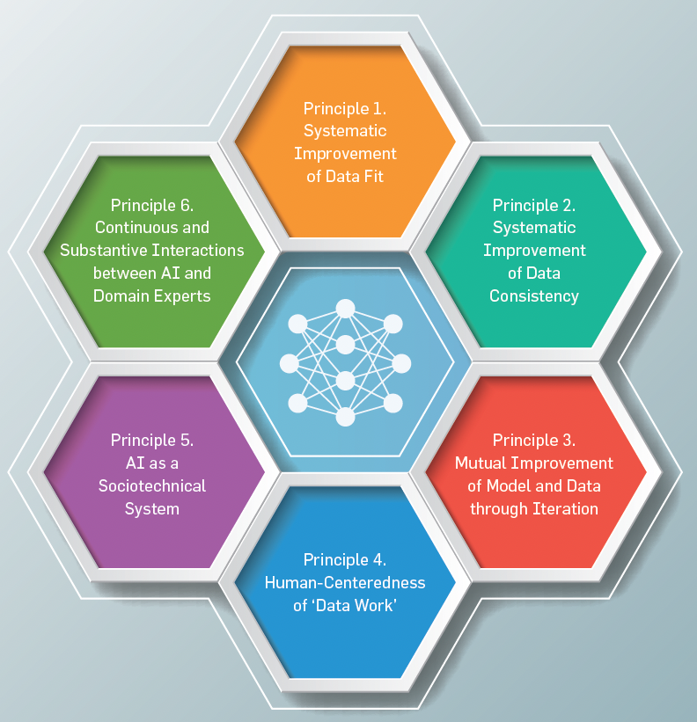
Core Principles of Data-Centric AI/ML
To achieve a good data fit, Data-Centric AI/ML advocates for an iterative approach:
Systematic Improvement of Data Fit
Augmentation, bias mitigation, continuous learning.
Systematic Improvement of Data Consistency
Automated tools, standardized guidelines.
Mutual Improvement of Model and Data through Iteration
Error analysis -> refine data -> retrain model
4. Human-Centeredness of ‘Data Work’
Address biases, ethical considerations
AI as a Sociotechnical System
Social technical systems, user-centric design, transparency
6. Continuous and Substantive Interactions between AI and Domain Experts
Cross-disciplinary partnership, data integrity, feedback loop
(Jarrahi et al., 2023, Communications of the ACM, https://doi.org/10.1145/3571724)

Slide 7
Key Techniques in Data-Centric AI/ML
Data Labeling: Accurate tags for supervised learning.
Augmentation: Synthetic data generation (e.g., image flipping)
Cleaning: Remove noise, outliers, inconsistencies.
(Mahalle et al., 2023, Springer Nature, https://doi.org/10.1007/978-981-99-6353-9)

Slide 8
Open-Source Software Tools Data-Centric AI/ML
cleanlab - automatically detect problems in a dataset to facilitate ML with messy, real-world data
refinery - assess and maintain natural language data
great expectations - validate, document, and profile data for quality testing
ydata-profiling - generate summary reports of tabular datasets stored as pandas DataFrame
cleanvision - automatically detect low-quality images in computer vision datasets
albumentations - data augmentation for computer vision
label-studio - interfaces to label and annotate data for many ML tasks
llamaindex - a data framework for LLM applications (Retrieval-Augmented Generation)
dspy - algorithmically optimize LLM prompts and bootstrap data
(https://dcai.csail.mit.edu/resources/)

Slide 9

References
Parikshit N. Mahalle, Gitanjali R. Shinde, Yashwant S. Ingle, Namrata N. Wasatkar. 2023. Data Centric Artificial Intelligence: A Beginner’s Guide. Springer Singapore. (https://doi.org/10.1007/978-981-99-6353-9)
Mohammad Hossein Jarrahi, Ali Memariani, Shion Guha. The Principles of Data-Centric AI. Communications of the ACM, Volume 66, Issue 8, Pages 84 – 92, Published: 25 July 2023 (https://doi.org/10.1145/3571724)
Introduction to Data Centric AI. https://dcai.csail.mit.edu/resources/

