Slide 1
Responsible AI/ML: Principles and Practices
Ensuring Fairness, Transparency, and Accountability in AI system

Slide 2
What are the goals of Responsible AI/ML?
Reward merit - Recognize and incentivize user achievements fairly
Eliminate bias - Never penalize users for inherent attributes beyond their control
Future-proof fairness - Maintain rigorous anti-bias standards as systems evolve
Enable equity - Support affirmative measures to redress historical disadvantages
(Agarwal and Mishra, 2021, https://doi.org/10.1007/978-3-030-76860-7)

Slide 3
Core Facets of Responsible AI/ML
Privacy & Security – Respect data privacy, legal compliance, and secure storage.
Fairness – Avoid harmful disparities across populations.
Explainability – Make model decisions understandable.
Robustness – Resist adversarial or misleading inputs.
Transparency – Enable informed user decisions.
Governance – Ensure responsible practices are enforced.
(https://github.com/aws-samples/aws-machine-learning-university-responsible-ai)

Slide 4
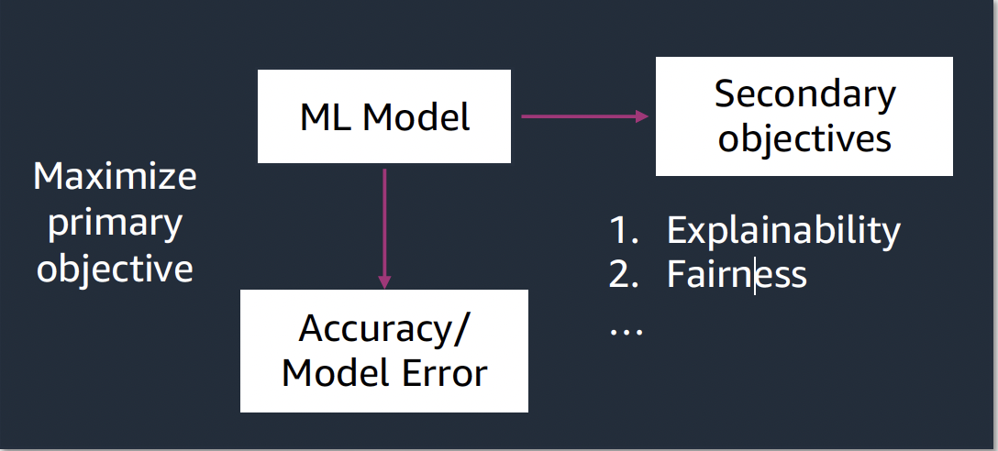
Tradeoffs in Responsible AI/ML
Transparency can conflict with privacy.
Data protection may reduce model interpretability.
No single solution maximizes all responsible AI goals.
(https://github.com/aws-samples/aws-machine-learning-university-responsible-ai)

Slide 5
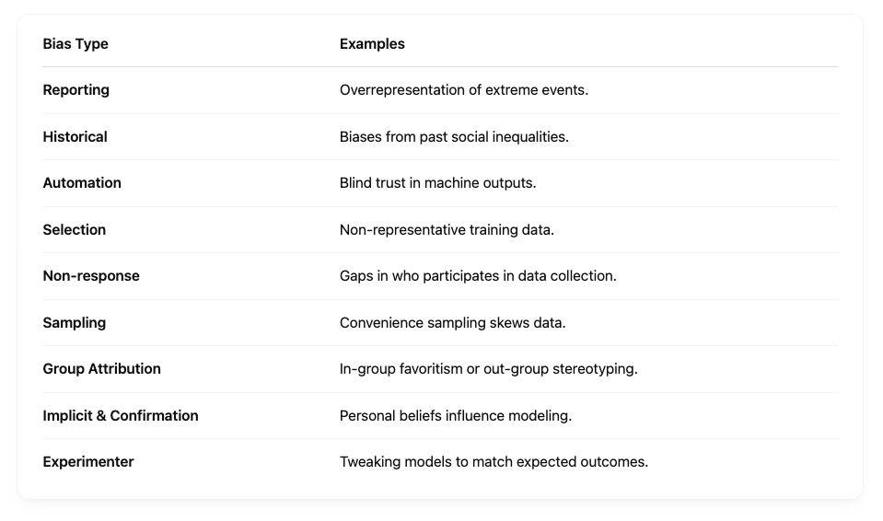
Common Biases in AI/ML
(https://developers.google.com/machine-learning/crash-course/fairness/types-of-bias)

Slide 6
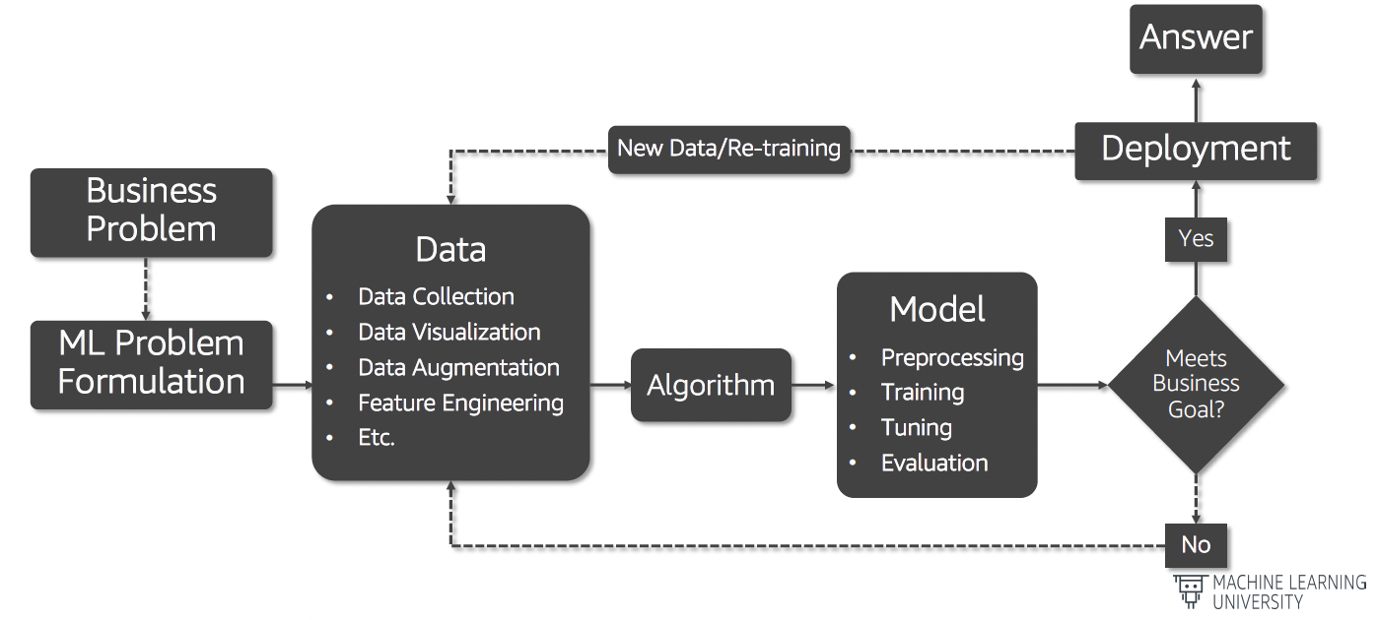
Fairness in the ML Lifecycle
Fairness must be embedded at every stage:
Problem formulation
Data preparation
Algorithm selection
Model training/evaluation
Deployment and interaction
(https://github.com/aws-samples/aws-machine-learning-university-responsible-ai)

Slide 7
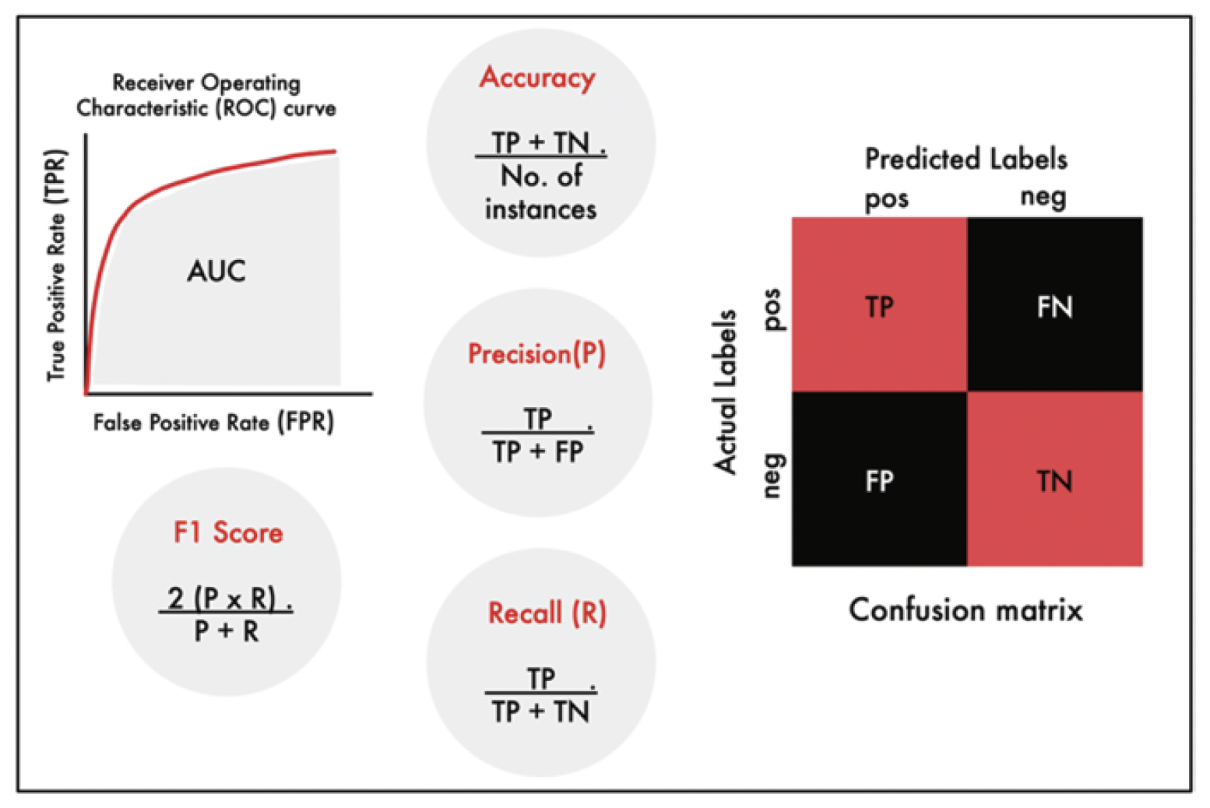
Fairness Metrics
Equal Opportunity: Equal false negative rates (FNR) across groups.
Predictive Equality: Equal false positive rates (FPR).
Equalized Odds: Equal FPR and TPR across groups.
Predictive Parity: Equal precision (PPV).
Demographic Parity: Group membership should not affect outcomes.
Average Odds Difference: Combines FPR and TPR differences between groups.
(Agarwal and Mishra, 2021, https://doi.org/10.1007/978-3-030-76860-7)

Slide 8
Bias Mitigation Techniques
Reweighting
Adjust data weights to balance representation.
Easy to apply and model-agnostic.
Additive Counterfactual Fairness (ACF)
Removes discriminatory influence of protected attributes.
Handles multiple protected features without losing interpretability.
Reject Option Classifier (ROC)
Abstains from uncertain predictions.
Useful in high-risk scenarios (e.g., medical).
Quote: "Reweighting data can reduce bias without altering the dataset itself."
(Agarwal and Mishra, 2021, https://doi.org/10.1007/978-3-030-76860-7)

Slide 9
Responsible AI Tools
IBM AI Fairness 360
Open-source fairness toolkit.
Includes bias detection and mitigation methods like reweighting, adversarial debiasing, etc. (https://github.com/Trusted-AI/AIF360)
Microsoft Responsible AI Toolkit
Offers fairness, explainability, and privacy tools.
Supports LIME, SHAP, and differential privacy. (https://github.com/microsoft/responsible-ai-toolbox)
Call to Action: "Explore these tools to audit your models for fairness gaps."

Slide 10

References
Sray Agarwal, Shashin Mishra. 2021. Responsible AI - Implementing Ethical and Unbiased Algorithms. Publisher: Springer Cham. (https://doi.org/10.1007/978-3-030-76860-7)
Machine Learning University, Responsible AI. (https://github.com/aws-samples/aws-machine-learning-university-responsible-ai)
Google’s ML Crash Course: Types of Bias. (https://developers.google.com/machine-learning/crash-course/fairness/types-of-bias)
IBM AI Fairness 360 (https://github.com/Trusted-AI/AIF360)
Microsoft Responsible AI Toolkit (https://github.com/microsoft/responsible-ai-toolbox)

