Slide 1
Overview of the
FAIR Data Principles

Slide 2
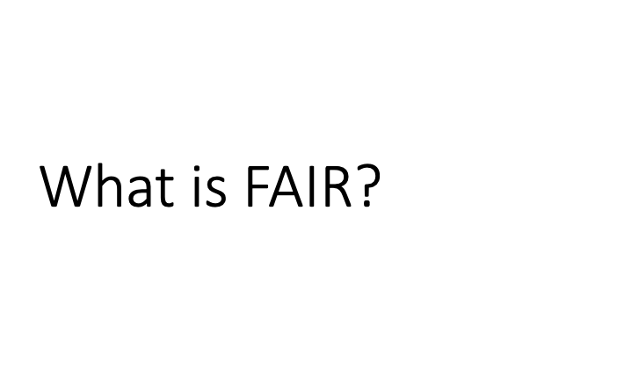





Slide 3
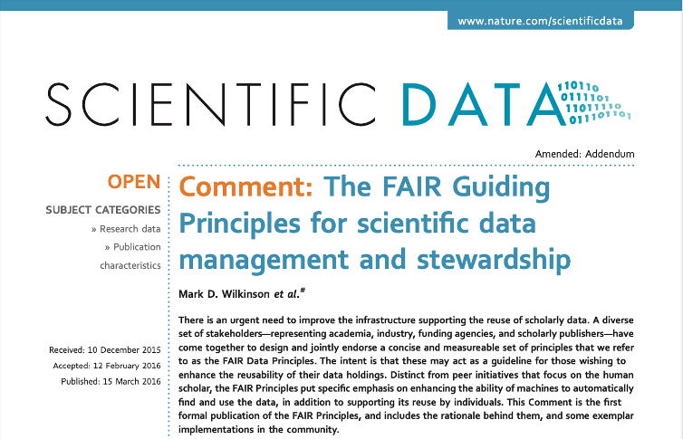


Slide 4
What is the goal of FAIR data?
FAIR was introduced in a 2016 paper to improve the Findability, Accessibility, Interoperability, and Reusability of digital data (Wilkinson et al. 2016)
Broadly, the goal is to make data more freely available and usable
More narrowly, there is great benefit for the individual researcher
If your data is easy to use, more people will use it
(Which means more citations)

Slide 5


Slide 6
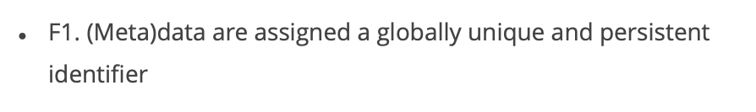
Findable

Slide 7
What is Metadata?
Data that describes your data
Any data you collect along the way that is not the “main” data
One person’s data is another person’s metadata
Examples:
Sampling locations
Bacterial strain
Sequencing platform and statistics
Assay type and conditions (Lab Methods)
Analysis type and parameters (Analysis Methods)

Slide 8
Findable
F1. (Meta)data are assigned a globally unique and persistent identifier
F2. Data are described with rich metadata
F3. Metadata clearly and explicitly includes the identifier of the data they describe
F4. (Meta)data are registered or indexed in a searchable resource

Slide 9
Accessible
A1. (Meta)data are retrievable by their identifier using a standardized communications protocol
A1.1 The protocol is open, free, and universally implementable
A1.2 The protocol allows for an authentication and authorization procedure, when necessary
A2. Metadata are accessible, even when the data are no longer available

Slide 10
Accessible
Individuals are responsible for
Making data available in the free and open resource
Or, for storing sensitive/private data with the proper protocols
Keeping metadata, even if primary data can no longer be stored
Metadata is often valuable on its own
Usually smaller and cheaper to store
Making custom scripts available in a public repository like GitHub
Provide submitted manuscripts as pre-prints

Slide 11
Interoperable
I1. (Meta)data use a formal, accessible, shared, and broadly applicable language for knowledge presentation
I2. (Meta)data use vocabularies that follow FAIR principles
I3. (Meta)data include qualified references to other (meta)data

Slide 12
Interoperable
Individuals are responsible for
Storing (meta)data in standard formats
If using proprietary software, export your data in a standard format that can be opened by other programs
Using ontologies/controlled vocabularies to tag your data
Ontologies have structure and standardized descriptions, so all researchers and computers know what is in your (meta)data
This also makes your data more Findable
Using standardized language to describe your data when writing/presenting
Jargon is a large barrier to entry for people from even slightly different fields

Slide 13
Reusable
R1. (Meta)data are richly described with a plurality of accurate and relevant attributes
R1.1 (Meta)data are released with a clear and accessible data usage license
R1.2 (Meta)data are associated with detailed provenance
R1.3 (Meta)data meet domain-relevant community standards

Slide 14
Reusable
Individuals are responsible for
Ensuring that other researchers know how your data can be used
Release your data with a usage license
It should be clear how each piece of (meta)data was produced (detailed provenance)
Another researcher should be able to tell where each piece of data originated
Making (meta)data available in a common, expected format
The more similar datasets are, the better

Slide 15
Potential obstacles to FAIR data
THERE ARE MANY!!! Some Examples:
Findable: No universal search engine for all data
Accessible: So much data…how can we keep it available?
Interoperable: Proprietary software formats limit universal access
Reusable: Incomplete metadata
Can you think of more?

Slide 16
FAIRness
Metrics

Slide 17
Why FAIRness metrics?
The FAIR principles are aspirational
They do not strictly define how to achieve a state of “FAIRness”.
They describe a continuum of features, attributes, and behaviors that will move a digital resource closer to that goal.
FAIRness metrics (https://github.com/FAIRMetrics/Metrics)
Provides the qualitative and quantitative ways to measure the FAIRness of a digital resource.
(https://www.nature.com/articles/sdata2018118)

Slide 18
The quality of a FAIR metric
Clear: anyone can understand the purpose of the metric.
Realistic: it should be simple enough for a resource to comply.
Discriminating: it should measure something important for FAIRness, distinguish the degree to which that resource meets that objective, and be able to provide instruction as to what would maximize that value.
Measurable: the assessment can be made in an objective, quantitative, machine-interpretable, scalable, and reproducible manner.
Universal: it should be applicable to all digital resources.
(https://www.nature.com/articles/sdata2018118)

Slide 19
FAIRness Maturity Indicator - Findable
F1. (Meta)data are assigned a globally unique and persistent identifier
Identifier Uniqueness (Gen2_MI_F1A)
Identifier Persistence (Gen2_MI_F1B)
F2. Data are described with rich metadata
Structured Metadata (Gen2_MI_F2A)
Grounded Metadata (Gen2_MI_F2B)
F3. Metadata clearly and explicitly includes the identifier of the data they describe
Use of GUIDs in metadata (Gen2_MI_F3)
F4. (Meta)data are registered or indexed in a searchable resource
Metadata indexed in a searchable resource (Gen2_MI_F4)

Slide 20
FAIRness Maturity Indicator - Accessible
A1. (Meta)data are retrievable by their identifier using a standardized communications protocol
A1.1 The protocol is open, free, and universally implementable
Open protocol for (meta)data retrieval (Gen2_MI_A1.1)
A1.2 The protocol allows for an authentication and authorization procedure, when necessary
Protocol supports authentication/authorization (Gen2_MI_A1.2)
A2. Metadata are accessible, even when the data are no longer available
Metadata persistence (Gen2_MI_A2)

Slide 21
FAIRness Maturity Indicator - Interoperable
I1. (Meta)data use a formal, accessible, shared, and broadly applicable language for knowledge presentation
Use a Knowledge Representation Language (soft) (Gen2_MI_I1A)
Use a Knowledge Representation Language (strict) (Gen2_MI_I1B)
I2. (Meta)data use vocabularies that follow FAIR principles
Uses FAIR Vocabularies (loose) (Gen2_MI_I2A)
Uses FAIR Vocabularies (strict) (Gen2_MI_I2B)
I3. (Meta)data include qualified references to other (meta)data
Qualified outward links (Gen2_MI_I3)

Slide 22
FAIRness Maturity Indicator - Reusable
R1. (Meta)data are richly described with a plurality of accurate and relevant attributes
R1.1 (Meta)data are released with a clear and accessible data usage license
Metadata contains link to license (Gen2_MI_R1.1)
R1.2 (Meta)data are associated with detailed provenance
Detailed Provenance (FM-R1.2)
R1.3 (Meta)data meet domain-relevant community standards
Meets Community Standards (FM-R1.3)

Slide 23
FAIR Evaluation Services
Purpose:
Helps evaluate the FAIRness (Findable, Accessible, Interoperable, Reusable) of digital resources.
Functionality:
Assesses a resource based on FAIR metrics associated with each FAIR principle.
Benefits:
Researchers and data providers can utilize the FAIR Evaluator to identify areas for improvement in making their data more findable, accessible, interoperable, and reusable.
Available at https://fairsharing.github.io/FAIR-Evaluator-FrontEnd/

Slide 24

References
Wilkinson, M., Dumontier, M., Aalbersberg, I. et al. The FAIR Guiding Principles for scientific data management and stewardship. Sci Data 3, 160018 (2016). https://doi.org/10.1038/sdata.2016.18
GO FAIR initiative: Make your data & services FAIR. https://www.go-fair.org/
Wilkinson, M., Sansone, SA., Schultes, E. et al. A design framework and exemplar metrics for FAIRness. Sci Data 5, 180118 (2018). https://doi.org/10.1038/sdata.2018.118
FAIR Evalutaion Services. https://fairsharing.github.io/FAIR-Evaluator-FrontEnd/#!/

