Slide 1
AI/ML Basic Concepts

Slide 2
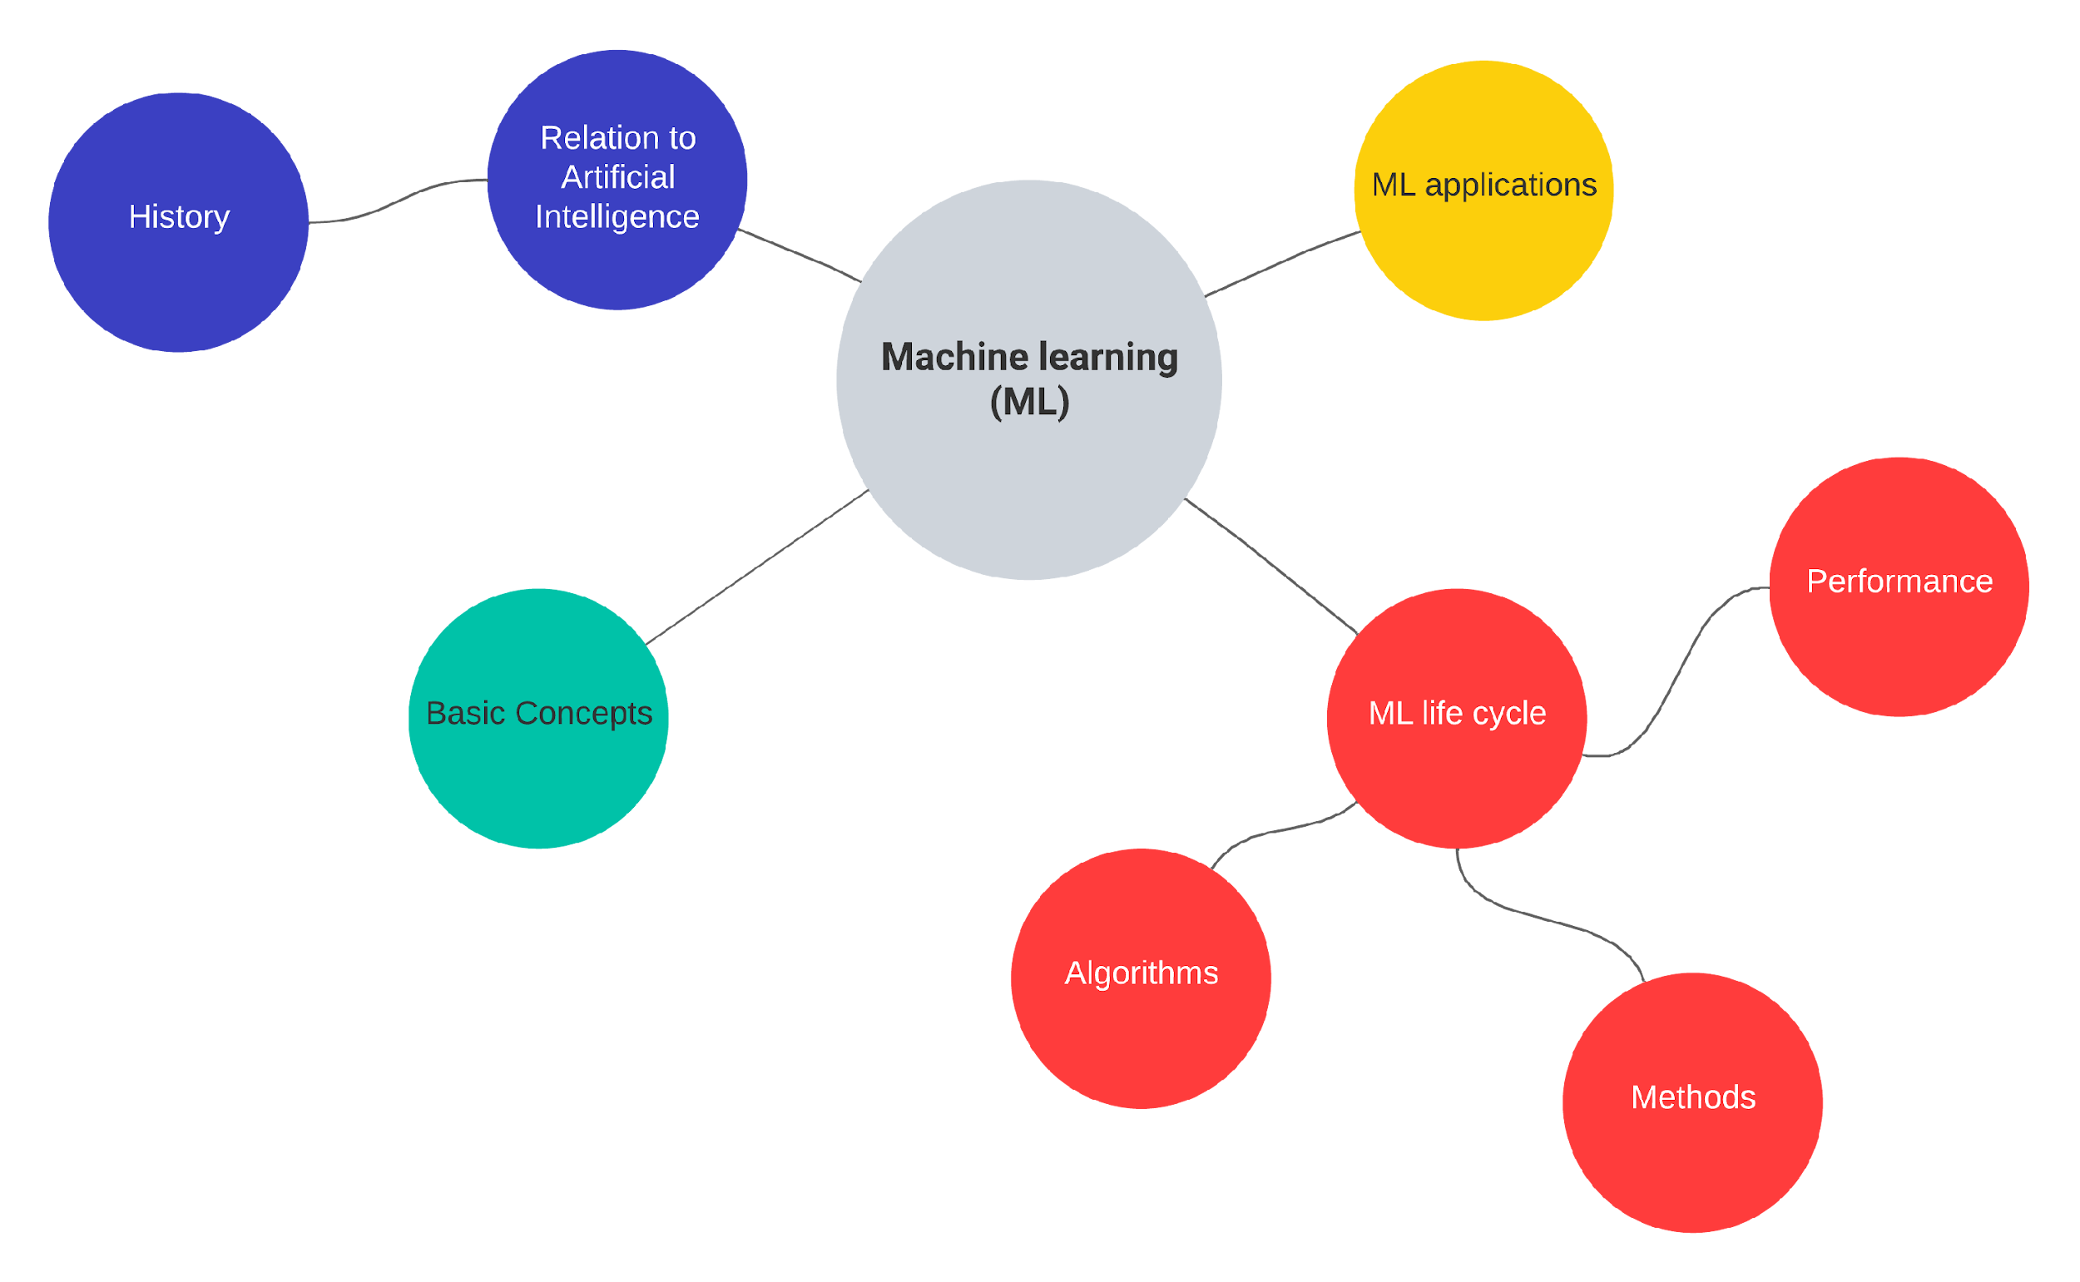

Slide 3
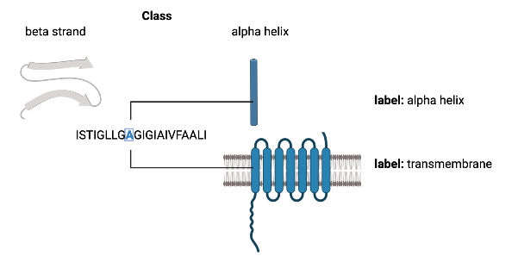
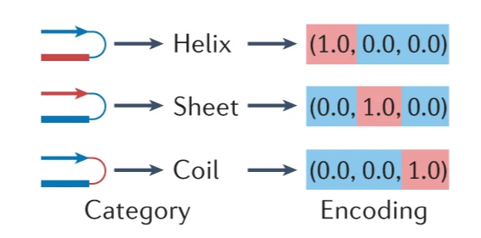
Classes and Labels
Labels: When the set of values are not mutually exclusive
Classes: A discrete set of mutually exclusive values returned by a classifier
Created in Biorender
Classes and labels are usually represented by an encoding (e.g. one-hot encoding).
(source: Greener et al. 2022)

Slide 4
Loss or Cost Functions
The mathematical functions that measure the amount of ‘disagreement’ between the obtained and ideal outputs in ML.
In supervised ML, the loss function would be a measure of deviation from the predicted output relative to the ground truth output.
e.g. mean squared error loss for regression problem and binary cross entropy loss for classification problems.

Slide 5
Parameters and Hyperparameters
Parameters:
Models usually contain adjustable parameters whose values can be changed over the training process to achieve the best performance of the model.
e.g. in a simple regression model, each feature has a parameter that is multiplied by the feature value and these are added together to make the prediction.
Hyperparameters:
Are adjustable values that are not considered part of the model itself in that they are not updated during the training process, but still have impact on the training of the model and its performance.
e.g. learning rate, which controls the rate with which the model’s parameters are changed during training.

Slide 6
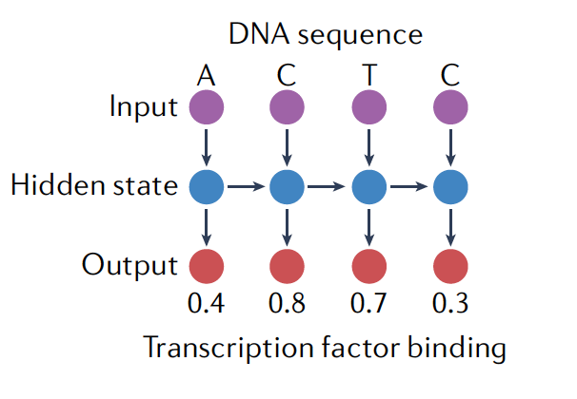
Inductive Bias
The set of assumptions made in the learning algorithm that leads it to favor a particular solution to a learning problem over others.
Often programmed into the model using its specific mathematical form and/or by using a particular loss function.
For example, the inductive bias of recurrent neural networks (RNNs) is that there are sequential dependencies in the input data such as a DNA sequence. This dependence is explicitly accounted for in the mathematical form of an RNN.
(source: Greener et al. 2022)

Slide 7
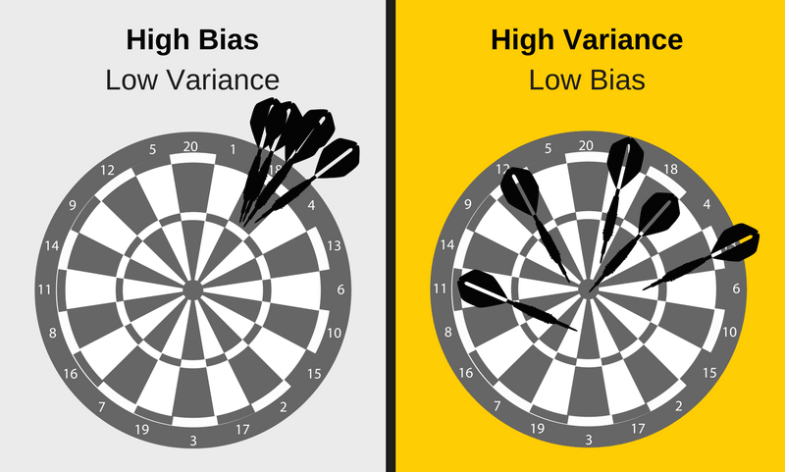
Bias and Variance
Bias | Variance
Phenomenon that skews the result of an algorithm in favor or against an idea. | Changes in the model when using different portions of the training data set.
Difference between your model’s expected predictions and the true values | High variance algorithms will produce drastically different models depending on the training set
Bias vs. variance refers to the accuracy vs. consistency of the models trained by your algorithm
Source:https://elitedatascience.com/bias-variance-tradeoff

Slide 8
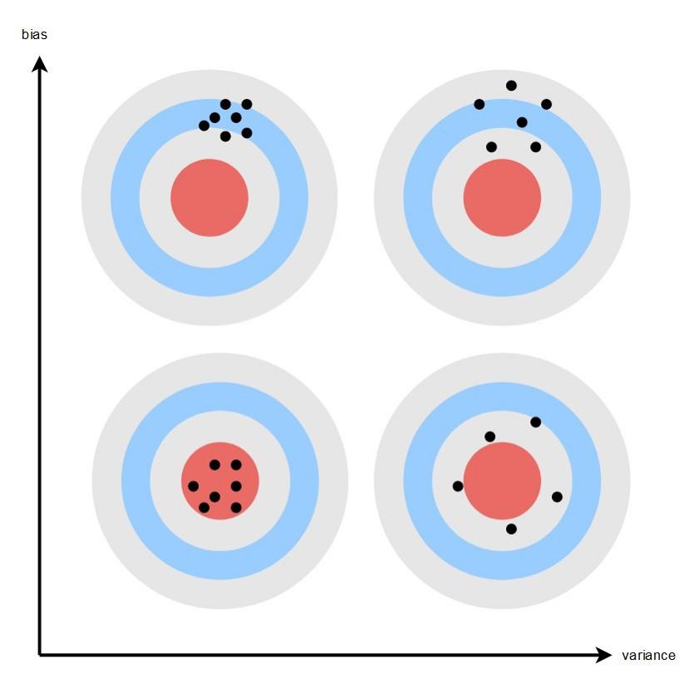
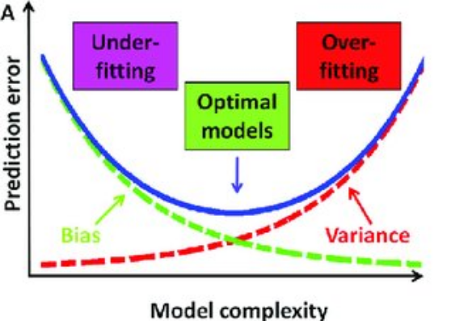
Bias-Variance Tradeoff
BIAS
Variance
Source: Seth Mottaghinejad,
https://towardsdatascience.com/bias-and-variance-but-what-are-they-really-ac539817e171
Source: DOI: 10.1016/j.aca.2015.04.045

Slide 9
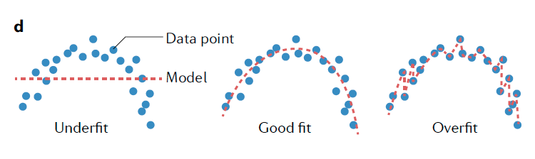
Generalization in ML
how well the concepts learned by a machine learning model apply to specific examples not seen by the model when it was learning
(source: Greener et al. 2022)
Overfitting and underfitting are major cause of poor model performance

Slide 10
Bias-Variance Tradeoff
The variance of a model describes how much the trained model changes in response to training on different training datasets.
In general, we like models with very low bias and low variance, although these objectives are often in conflict as a model with low bias will often learn different signals on different training sets.
Controlling the bias–variance trade-off is key to avoiding overfitting or underfitting.

Slide 12
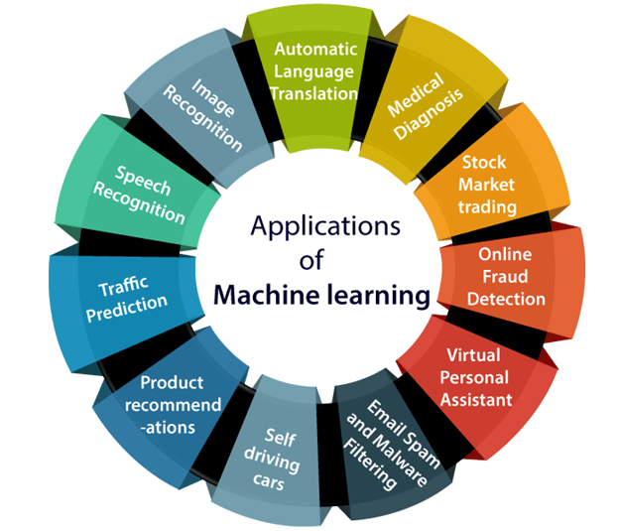
Machine learning applications
(source: javatpoint.com)

Slide 13

References
Artem Oppermann. Artificial Intelligence vs. Machine Learning vs. Deep Learning. Oct 29, 2019. (https://towardsdatascience.com/artificial-intelligence-vs-machine-learning-vs-deep-learning-2210ba8cc4ac)
Dipanjan Sarkar, Raghav Bali and Tushar Sharma. 2018. Practical Machine Learning with Python. A Problem-Solver's Guide to Building Real-World Intelligent Systems. Apress. (https://doi.org/10.1007/978-1-4842-3207-1), Chapter 1, 2.
Machine Learning Tutorial. (https://www.javatpoint.com/machine-learning)
Greener, J.G., Kandathil, S.M., Moffat, L. et al. A guide to machine learning for biologists. Nat Rev Mol Cell Biol 23, 40–55 (2022). https://doi.org/10.1038/s41580-021-00407-0
Robert Hoyt and Robert Muenchen, Introduction to biomedical data science, Chapter 9.

