Slide 1
Data Collection and Preparation

Slide 2

Data Collection and Preparation

Slide 3
Data Collection
Understanding the data for the problem to solve is important!
Case study (1990’s):
Predicting mortality of hospital patients with pneumonia from their findings at initial presentation. Identify high-risk patients who needed hospital admission while allowing low-risk patients to be treated as outpatients.
ML models learned: pneumonia patients with a history of asthma had a lower risk of death than the general population
Issues with dataset: confounding issues, better outcome of asthmatic patients because of quick ICU treatment. Use of data subsequent to the admission.
Sources: Cooper GF, et al. doi: 10.1016/s0933-3657(96)00367-3.
Stephen Nawara (https://conlanscientific.com/posts/category/blog/post/danger-in-machine-learning-human-error/)

Slide 4

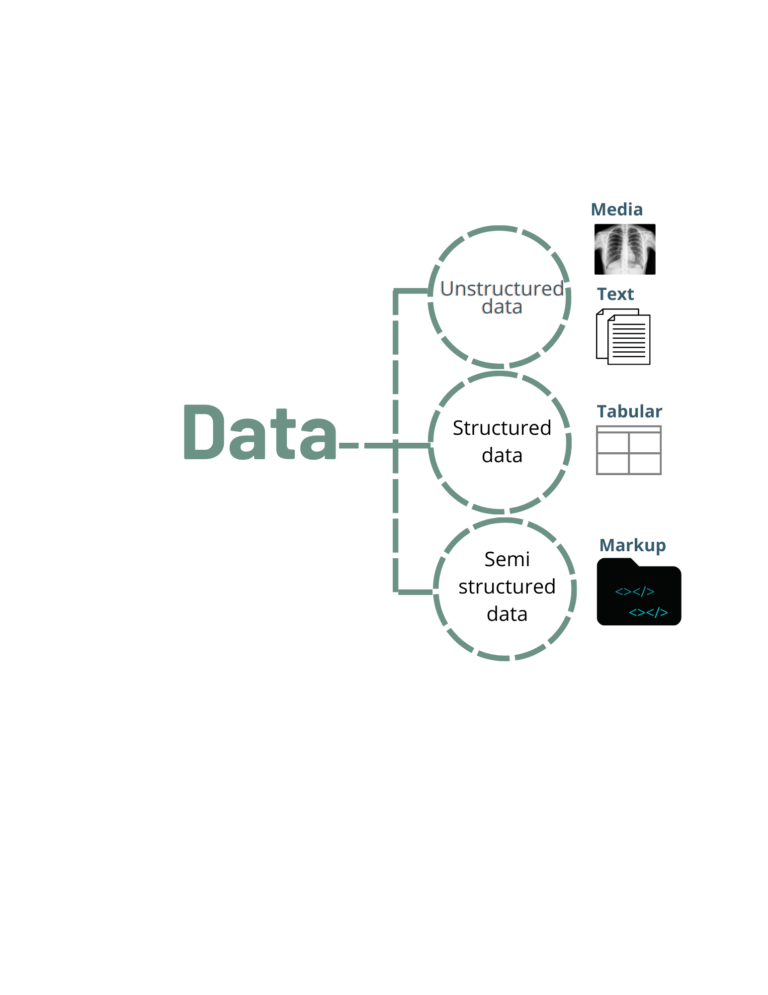

Data and Data Formats
Data are examples or cases from a given domain that characterize the problem we want to solve
Data may adopt different forms
images, videos, text
spreadsheet, database table, CSV, TSV
XML, JSON, HTML
Source: PNG EGG

Slide 5
Comma Separated Values (CSV)
One of the most widely available formats of data
Tabular, data attributes are delimited by a “,” (a comma)
May contain an optional header row
Optionally enclose each of the attributes in single or double quotes
Changing the delimiter to a tab makes a TSV (or a tab separated values) file
Human-readable
delimiter
Header
Admission_DATE,Discharge_DATE or date of Death,Outcome,Patient Age,Gender,Sample Collection Date ,What kind of Treatment provided ,Ventilated (Y/N),Red blood cell distribution width,Monocytes(%),White blood cell count,Platelet Count,Lymphocyte Count,Neutrophils Count
8/10/20,8/8/20,Not Recovered,51,Male,8/10/20,"antibiotics, O2",Yes,13.2,3.3,21,462,0.44,19.43
7/24/20,8/5/20,Not Recovered,65,Female,7/24/20,"Paracetamol, Antibiotics, O2",Yes,40,3,8.79,180.66,4.39,7.56
7/22/20,8/8/20,Recovered,32,Male,7/22/20,"Antibiotics, O2",No,11.7,5.3,9.9,336,3.47,5.34
7/19/20,8/5/20,Recovered,36,Female,7/19/20,"Antibiotics, O2",No,13,5,9.95,240.1,0.8,8.66
attribute
Sample from COVID-19 Complete Blood Count (CBC) Database Tawsifur Rahman et al.

Slide 6
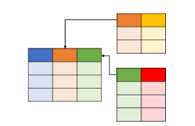
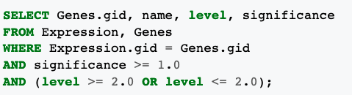
Structured Query Language (SQL)
Relational tables in relational databases
Access data via SQL queries directly
The second way of interacting with databases is the Object Relational Mapper (ORM) method
SQL-based tools can connect to Python (via libraries like SQLAlchemy)
Requires database management

Slide 7
eXtensible Markup Language (XML)
Books.xml
<?xml version="1.0" encoding="UTF-8"?> <bookstore> <book category="children"> <title lang="en">Harry Potter</title> <author>J K. Rowling</author> <year>2005</year> <price>29.99</price> </book> <book category="web"> <title lang="en">XQuery Kick Start</title> <author>James McGovern</author> <author>Per Bothner</author> <author>Kurt Cagle</author> <author>James Linn</author> <author>Vaidyanathan Nagarajan</author> <year>2003</year> <price>49.99</price> </book> <book category="web" cover="paperback"> <title lang="en">Learning XML</title> <author>Erik T. Ray</author> <year>2003</year> <price>39.95</price> </book> </bookstore>
Markup language that defines rules for encoding data/documents to be shared across the Internet
XML was designed to carry data with focus on what data is
Less readable with verbose tags. Tags are custom made
Source: W3School (https://www.w3schools.com/xml/)

Slide 8
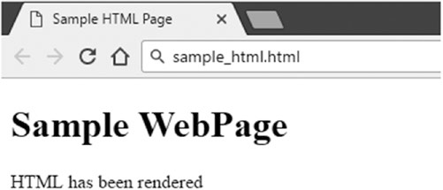
Hyper Text Markup Language (HTML)
A markup language similar to XML.
Focus is on how data looks, mainly used by web browsers and similar applications to render web pages for consumption.
Readable but unstructured
<!DOCTYPE html>
<html>
<head>
<title>Sample HTML Page</title>
</head>
<body>
<h1>Sample WebPage</h1>
<p>HTML has been rendered</p>
</body>
</html>

Slide 9
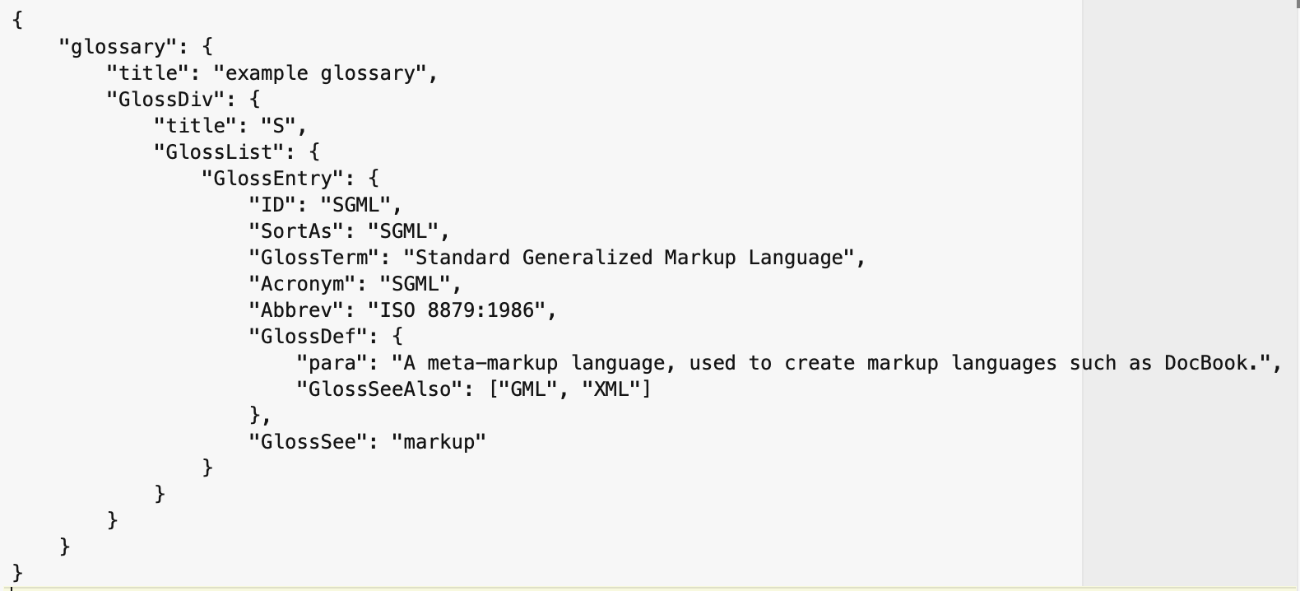
Java Script Object Notation (JSON)
Lightweight data-exchange format
A text format that is language independent with certain defined conventions
Human-readable format
Easy to parse in most programming/scripting languages.
Structure: JSON is built on two structures,
a collection of name(key)-value pairs
an ordered list of values.
Source: JSON (https://www.json.org/json-en.html)
https://rest.uniprot.org/uniprotkb/P31749.json

Slide 10

What is data preparation?
Process of transforming raw data into a clean, structured and meaningful format suitable to train and evaluate a machine learning model.
Machine Learning algorithms expect numbers
Statistical noise and errors in the data need to be corrected
Model performance also depends on the quality of data
Source: https://www.thecads.com/

Slide 11








Some of the steps in data preparation
Data Cleaning
Data Transformation
Feature Selection
Feature Engineering
Dimensionality Reduction

Slide 12
Data Cleaning
The goal is to identify and address specific observations that may be incorrect.
Involves fixing systematic problems or errors in messy data.
Involves deep domain expertise to correct specific data.
Data cleaning
Basic
Outliers
Missing
Redundancy
Corrections
Mark
Impute
source: Brownlee, 2020

Slide 13
Data Transformation
Change the type or distribution of data variables.
Operations are generally performed separately for each variable.
Data Transforms
Numerical
Categorical
Change scale
Change distribution
Engineer
Nominal
Ordinal
Normalize
Standardize
Robust
Power
Quantile
Discretize
Polynomial
One hot encoding
Dummy encoding
Label encoding
source: Brownlee, 2020

Slide 14
Feature Selection
Techniques for selecting a subset of input features that are most relevant to the target variable that is being predicted
Feature Selection
Dimensionality Reduction
Irrelevant and redundant input variables can distract or mislead learning algorithms possibly resulting in lower predictive performance.
The goal is to favor the simplest possible well performing model.
Unsupervised
Supervised
Intrinsic
Wrapper methods
Filter methods
Trees
RFE
Stats
Feature importance
source: Brownlee, 2020

Slide 15
Feature Engineering
The process of transforming raw data into features that better represent a pattern to the learning algorithms
Reliance on domain knowledge makes it difficult to generalize feature engineering into a one-size-fits-all approach
Some common techniques can be applied across different datasets, including:
Introducing boolean flag variables to indicate certain conditions
Computing group or global summary statistics, such as the mean
Decomposing compound variables, like extracting individual components from a date-time field
Creating copies of numerical input variables that have been changed with a simple mathematical operation.
source: Brownlee, 2020

Slide 16
Dimensionality Reduction
The curse of dimensionality
Goal is to create a projection of the data into a lower-dimensional space that still preserves the most important properties of the original data.
Dimensionality Reduction
Manifold learning
Model based
Matrix factorization
SOM
tSNE
LDA
PCA
SVD
source: Brownlee, 2020

Slide 17

References
Cooper GF, Aliferis CF, Ambrosino R, et al. An evaluation of machine-learning methods for predicting pneumonia mortality. Artif Intell Med. 1997;9:107–138. doi: 10.1016/s0933-3657(96)00367-3.
Jason Brownlee. 2020. Data Preparation for Machine Learning. (https://machinelearningmastery.com/data-preparation-techniques-for-machine-learning/)
Chirag Goyal. Data Leakage And Its Effect On The Performance of An ML Model. July 23, 2021 (https://www.analyticsvidhya.com/blog/2021/07/data-leakage-and-its-effect-on-the-performance-of-an-ml-model/)
Stephen Nawara. Danger in Machine Learning: Human Error. (https://conlanscientific.com/posts/category/blog/post/danger-in-machine-learning-human-error/, accessed 03/15/2025)

