Slide 1
Overview of the
Data Science Life Cycle

Slide 2
What is the Data Science Life Cycle?

Slide 3
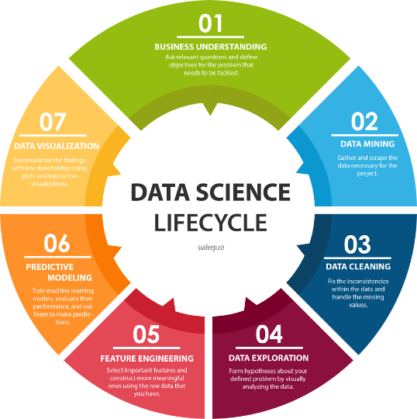
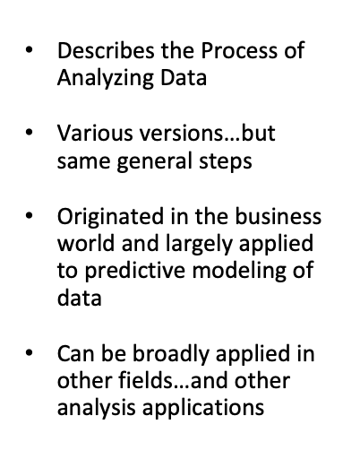

Slide 4
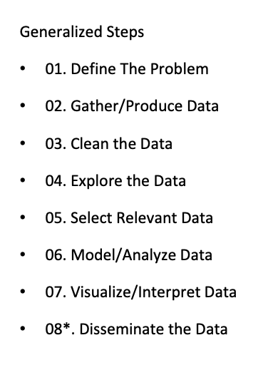

Slide 5
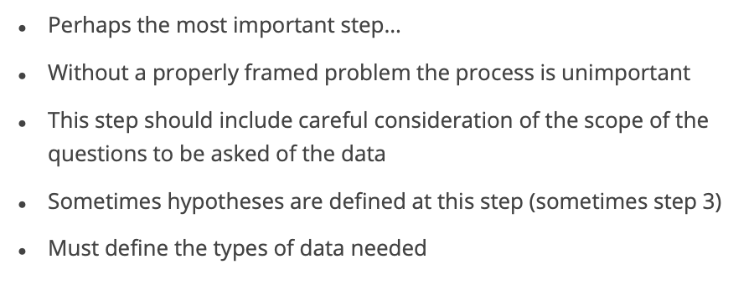
01. Define the Problem

Slide 6
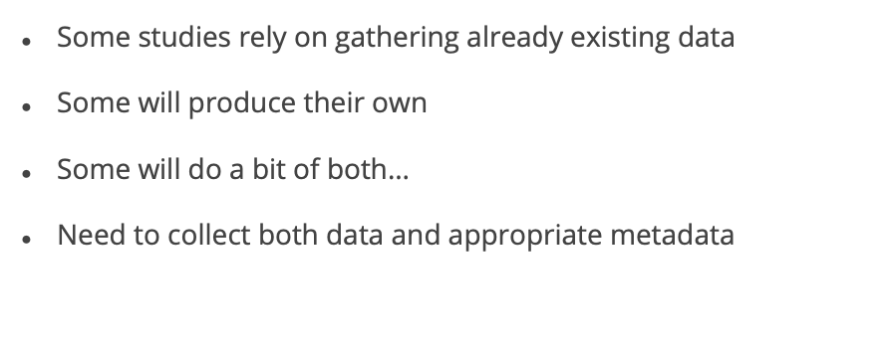
02. Gather/Produce Data

Slide 7
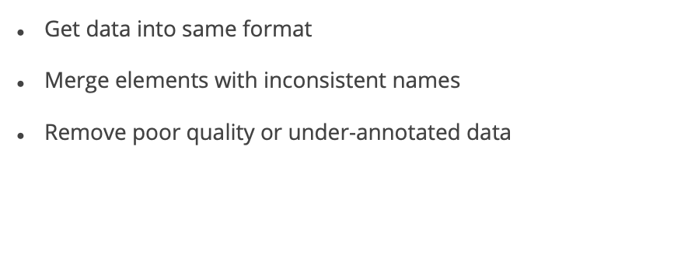
03. Clean the Data

Slide 8
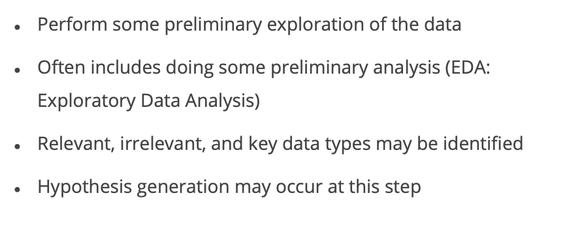
04. Explore the Data

Slide 9
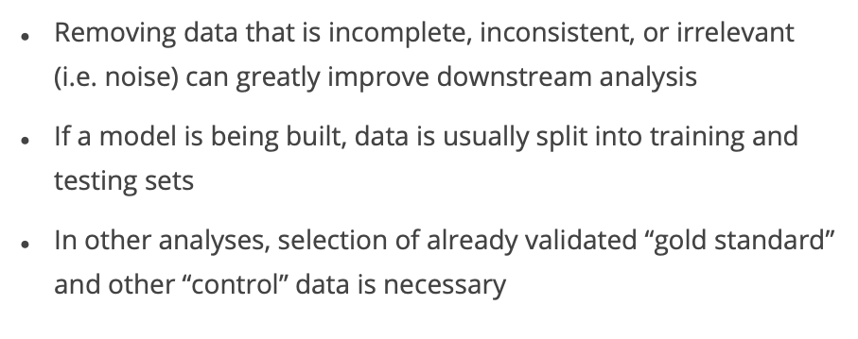
05. Select [Most] Relevant Data

Slide 10
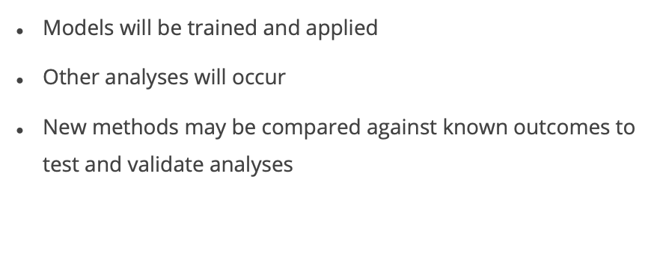
06. Model/Analyze the Data

Slide 11
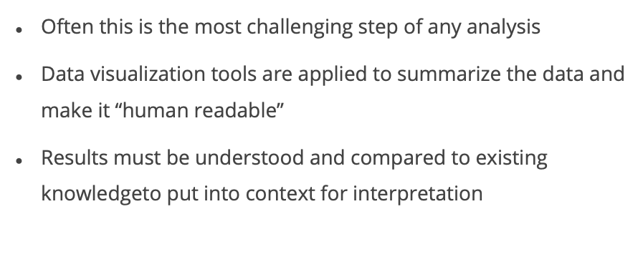
07. Visualize/Interpret the Data

Slide 12
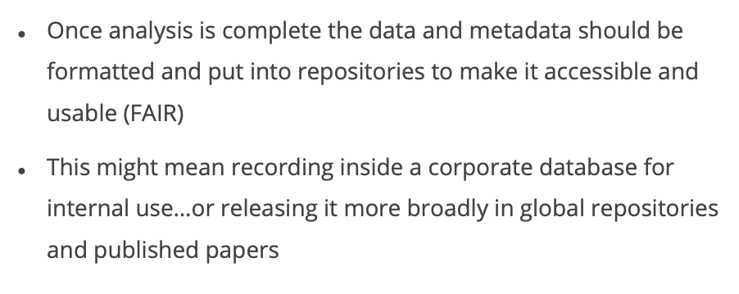
08. Maintain and Disseminate the Data

