Slide 1

Practical AI/ML for Computational Biology and Chemistry
(Day 1)
Chuming Chen
chenc@udel.edu
Research Associate Professor
Computer and Information Sciences
Center for Bioinformatics and Computational Biology
Data Science Institute
Slides and notebooks: https://github.com/udel-cbcb/al_ml_workshop
June 13, 2022

Slide 2
Introduction to AI/ML

Slide 3

Lecture Outline
Overview of Artificial Intelligence and Machine Learning
Key concepts in AI/ML
Python AI/ML Ecosystem

Slide 4
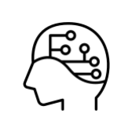
Overview of Artificial Intelligence (AI)
What is AI?
“The science and engineering of making intelligent machines, especially intelligent computer programs”. John McCarthy (one of the founders of AI discipline)
The goal of AI has been to create the systems that can understand, think, learn, and behave like humans.
Notes:
While exploiting the power of the computer systems, humans have been wondering “Can a machine think and behave like humans do?”
AI is about making a computer, a computer-controlled robot, or a software think intelligently in a way similar to how humans think.

Slide 5
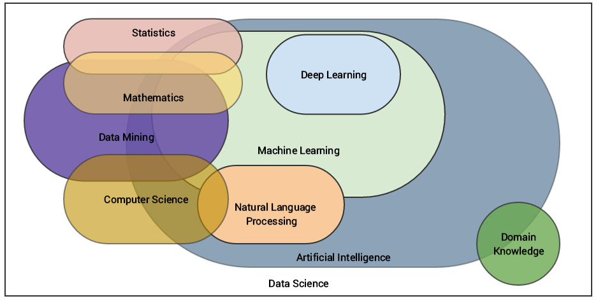
AI is a multidisciplinary field
(source: Sarkar et al. 2018)

Slide 6
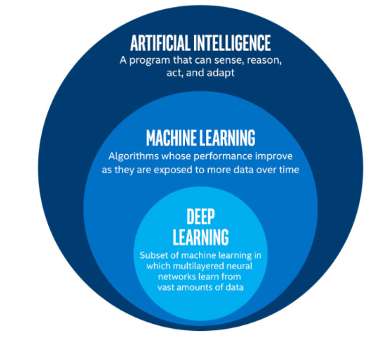
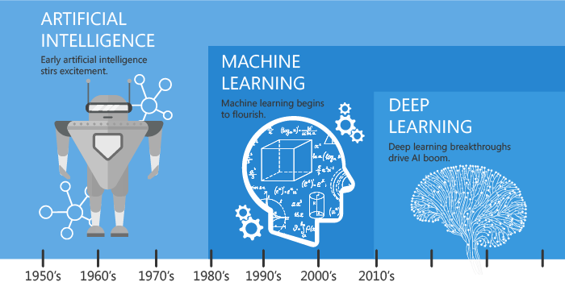
Artificial intelligence is a broad field
(source: Oppermann, 2019)
Notes:
You add here the evolution and introduce machine learning and deep learning, and that will help with transitioning to next slides

Slide 7
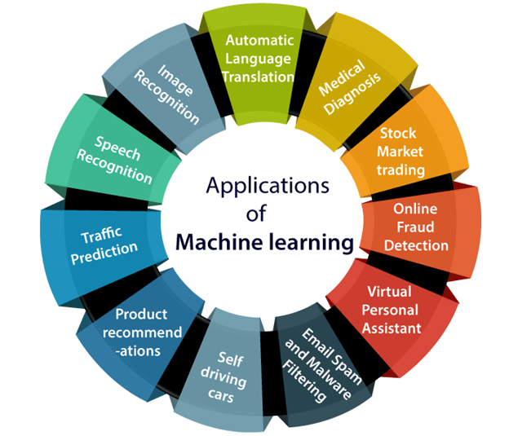
AI/ML applications
(source: javatpoint.com)

Slide 8
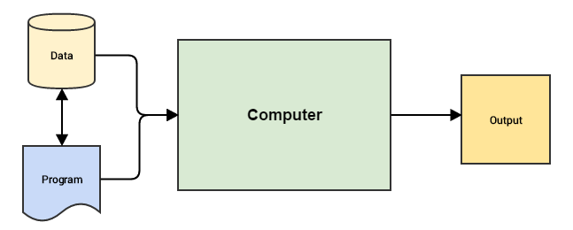
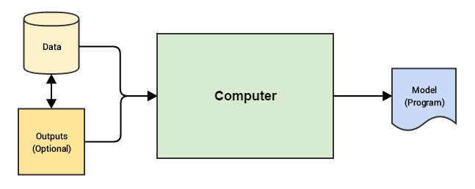
AI/ML is a Data Driven Approach
Leverages data to get actionable insights and make better decisions
Traditional Paradigm
Machine Learning Paradigm
Programs (logics, rules, codes) enable computers to work on data, perform computations, and generate output
Input data and expected outputs are used to train computer to learn inherent patterns, creating a model that can help predict output for new input data
(source: Sarkar et al. 2018)
Notes:
Traditional programming paradigms basically involve the user or programmer to write a set of instructions or operations using code that makes the computer perform specific computations on data to give the desired results.
For problems that cannot be programmed inherently need a different approach where we use the data itself to drive decisions instead of using programmable logic to make these decisions.
The Machine Learning paradigm tries to take into account data and expected outputs or results if any and uses the computer to build the program,
which is also known as a model. This program or model can then be used in the future to make necessary decisions and give expected outputs from new inputs.

Slide 9
What is Machine Learning?
“A computer program is said to learn from experience E with respect to some class of tasks
T and performance measure P, if its performance at tasks in T, as measured by P, improves
with experience E.” - Professor Tom Mitchell (1997)
The Task, T
The Experience, E
The Performance, P
Exact problem to solve
Classification or categorization
Regression
Anomaly detection
Translation
Clustering or grouping
Transcriptions
Learning algorithm or model learns inherent pattern from data
Supervised learning
Unsupervised learning
Semi-supervised learning
Reinforcement learning
A quantitative measure or metric used to see how well the model is performing the task T with experience E
Accuracy
Precision
Recall
F1 score
Error/Misclassification rate
Notes:
Tom Mitchell is at Carnegie Mellon University

Slide 10
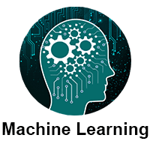
Machine Learning Methods
The amount of human supervision involvement
The ability to learn from incremental data
The approach to generalization from data
Supervised learning
Unsupervised learning
Semi-supervised learning
Reinforcement learning
Batch (offline) learning
Online learning
Instance based learning
Model based learning
(source: javatpoint.com)

Slide 11
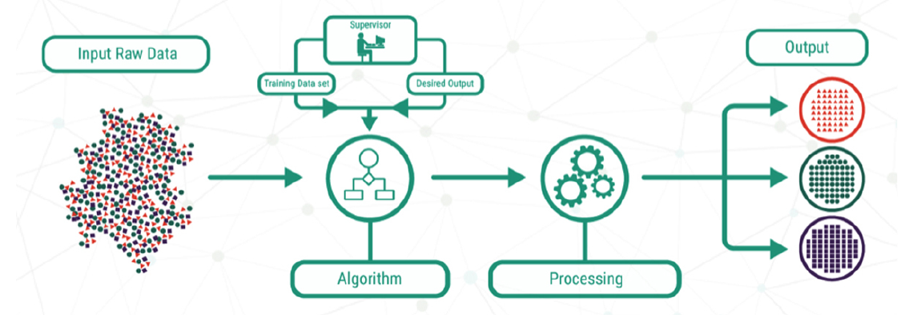
Supervised Learning
To model the relationship between the inputs and their corresponding outputs from the training data, as labeled by humans, to predict output responses for new data inputs
Source: Lucidchart
Two classes of algorithms:
Classification
Regression
Examples, prediction of :
Protein secondary structure
Genome accessibility to genome-regulatory factors
Free energy change of protein folding after a point mutation

Slide 12
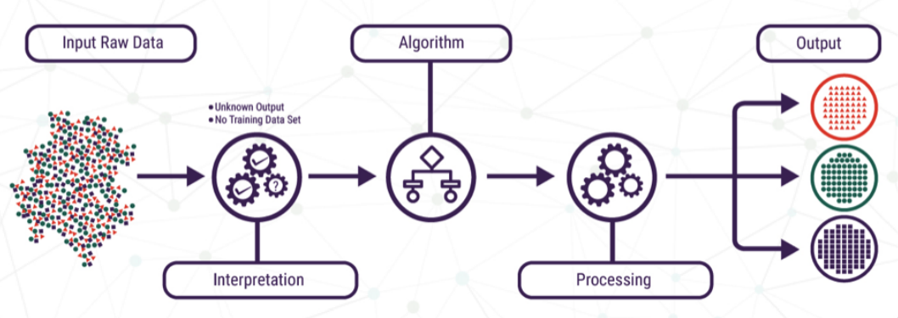
Unsupervised Learning
To learn inherent latent structures, patterns and relationships from given data without any help or supervision like providing annotations in the form of labeled outputs or outcomes
Source: Lucidchart
Popular algorithms:
Clustering
Dimensionality Reduction
Anomaly Detection
Association Rule Mining
Examples:
Finding subsets of patients with similar expression levels in a gene expression study.
Predicting mutation effects from gene sequence co-variation.

Slide 13
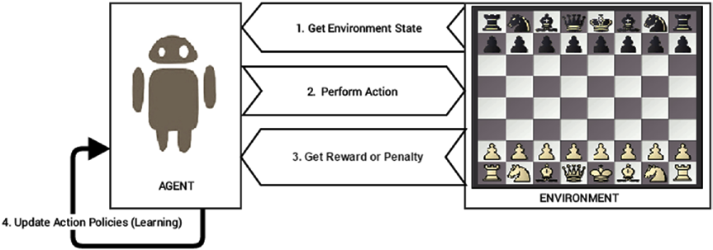
Reinforcement Learning
Usually an agent is trained over a period of time with regard to the type of actions it performs on the environment.
Steps:
Prepare agent with set of initial policies and strategy
Observe environment and current state
Select optimal policy and perform action
Get corresponding reward (or penalty)
Update policies if needed
Repeat Steps b-e iteratively until agent learns the most optimal policies
(source:Sarkar et al. 2018)

Slide 14
Batch (Offline) vs Online Learning
The model is trained using all the available training data in one go
Once the training is done and the model completes the learning with a good performance, it is deployed into production.
The model doesn’t keep learning over a period of time continuously with the new data.
BATCH LEARNING
ONLINE LEARNING
The model is trained with data in multiple incremental batches
It keeps on learning over a period of time based on new data samples without having to re-run the whole model on previous data samples
Suitable in real-world applications where the model might need to keep learning and re-training on new data samples as they arrive

Slide 15
Instance vs Model Based Learning
Use the raw data points themselves to figure out outcomes for newer, previously unseen data samples instead of building an explicit model on training data and then testing it out
A simple example would be a K-nearest neighbor algorithm
INSTANCE-BASED LEARNING
MODEL-BASED LEARNING
Typically an iterative process takes place where the input data is used to extract features and models are built based on various model parameters (known as hyperparameters)
Hyperparameters are optimized to select the model that generalizes best on the data (training/test)
Finally, the best model is used to make predictions or decisions

Slide 16
Lecture Outline
Overview of Artificial Intelligence and Machine Learning
Key concepts in AI/ML
Python AI/ML Ecosystem

Slide 17
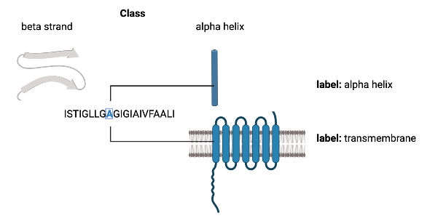
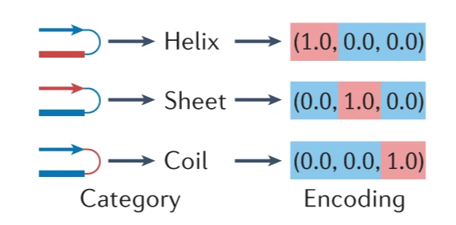
Classes and Labels
Classes: A discrete set of mutually exclusive values returned by a classifier
Labels: When the set of values are not mutually exclusive
Created in Biorender
Classes and labels are usually represented by an encoding (e.g. one-hot encoding).
(source: Greener et al. 2022)
Notes:
e.g. a residue in a protein structure can be in only one of multiple secondary structure classes, but could simultaneously be assigned the non-exclusive labels of being a ɑ-helical and transmembrane.

Slide 18
Loss or Cost Functions
The mathematical functions that measure the amount of ‘disagreement’ between the obtained and ideal outputs in ML.
In supervised ML, the loss function would be a measure of deviation from the predicted output relative to the ground truth output.
e.g. mean squared error loss for regression problem and binary cross entropy loss for classification problems.
Notes:
Example:https://neptune.ai/blog/cross-entropy-loss-and-its-applications-in-deep-learning
Imagine you want to descend from the top of a big mountain on a cloudy day. How do you choose the right direction to walk until you get to the bottom?
You will have to look at all possible directions and select a direction that makes you descend the most. You step towards the chosen direction, thereby decreasing the height, repeating the same process, always decreasing the height until you reach your goal = the bottom of the mountain.
Notice that we’re using height to measure how far we are from the bottom. Decreasing the height means that we’re closer to our goal. We can refer to the height as the error function (measures/calculates how far we are from the bottom).

Slide 19
Parameters and Hyperparameters
Parameters:
Models usually contain adjustable parameters whose values can be changed over the training process to achieve the best performance of the model.
e.g. in a simple regression model, each feature has a parameter that is multiplied by the feature value and these are added together to make the prediction.
Hyperparameters:
Are adjustable values that are not considered part of the model itself in that they are not updated during the training process, but still have impact on the training of the model and its performance.
e.g. learning rate, which controls the rate with which the model’s parameters are changed during training.

Slide 20
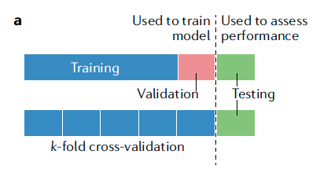
Training, Validation and Testing
Training:
models often require training dataset, which involves automatically adjusting the parameters of a model to improve its performance.
Validation:
Validation dataset is used to monitor but not influence the training process so as to detect potential overfitting.
Testing:
Once a model is trained, it can be tested on data not used for training (hold-out set).
Cross validation:
Dataset for training the model is split into k evenly sized partitions (for example, five or ten) to form k different training and validation sets, and the performance is compared across each partition to select the best hyperparameters.
(source: Greener et al. 2022)

Slide 21
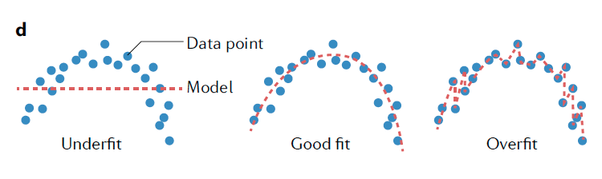
Overfitting and Underfitting
Overfitting:
Learning the noise in the training data
Can be caused by using a model with too many parameters or by continuing training after it has learned the true relationship between the variables
Underfitting:
Failing to learn the underlying relationship between the variables
Can be caused by using a model without sufficient complexity to learn the signal
(source: Greener et al. 2022)

Slide 22
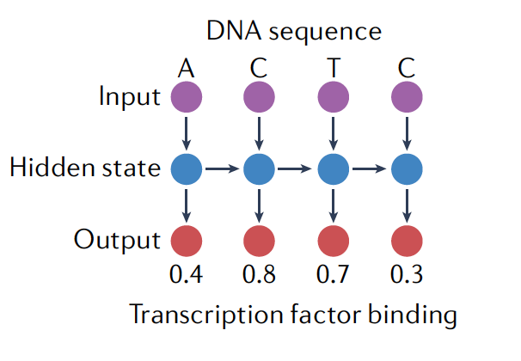
Inductive Bias
The set of assumptions made in the learning algorithm that leads it to favor a particular solution to a learning problem over others.
Often programmed into the model using its specific mathematical form and/or by using a particular loss function.
For example, the inductive bias of recurrent neural networks (RNNs) is that there are sequential dependencies in the input data such as a DNA sequence. This dependence is explicitly accounted for in the mathematical form of an RNN.
(source: Greener et al. 2022)
Notes:
Figure legend from article: A recurrent neural network (RNN) processes each part of a sequential input using the same learned parameters, giving an output and an updated hidden state for every input. The hidden state is used to carry information about the preceding parts of the sequence. In this case the probability of transcription factor binding is predicted for each base in a DNA sequence. The RNN is expanded to show how each output is generated using the same layers; this should not be confused with using different layers for each output.

Slide 23
Bias-Variance Tradeoff
The variance of a model describes how much the trained model changes in response to training on different training datasets.
In general, we like models with very low bias and low variance, although these objectives are often in conflict as a model with low bias will often learn different signals on different training sets.
Controlling the bias–variance trade-off is key to avoiding overfitting or underfitting.
Notes:
A model with a high bias can have stronger constraints on the trained model, whereas a model with low bias makes fewer assumptions about the property being modeled, and can, in theory, model a wide variety of function types.

Slide 24
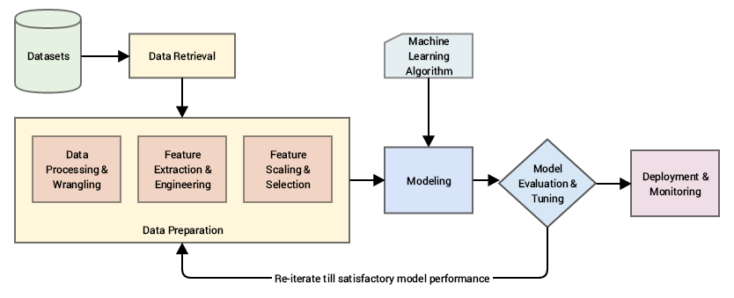
Standard Machine Learning Pipeline
(source: Sarkar et al. 2018)
Notes:
Data retrieval: This is mainly data collection, extraction, and acquisition from various data sources and data stores
Data preparation: In this step, we pre-process the data, clean it, wrangle it, and manipulate it as needed. Initial exploratory data analysis is also carried out.
Data processing and wrangling: Mainly concerned with data processing, cleaning, munging, wrangling and performing initial descriptive and exploratory data analysis
Feature extraction and engineering: Here, we extract important features or attributes from the raw data and even create or engineer new features from existing features.
Feature scaling and selection: Data features often need to be normalized and scaled to prevent Machine Learning algorithms from getting biased. Besides this, often we need to select a subset of all available features based on feature importance and quality.
Modeling: In the process of modeling, we usually feed the data features to a Machine Learning method or algorithm and train the model, typically to optimize a specific
cost function in most cases with the objective of reducing errors and generalizing the representations learned from the data
Model evaluation and tuning: Built models are evaluated and tested on validation datasets and, based on metrics like accuracy, F1 score, and others, the model performance is evaluated. Models have various parameters that are tuned in a process called hyperparameter optimization to get models with the best and optimal results
Deployment and monitoring: Selected models are deployed in production and are constantly monitored based on their predictions and results.

Slide 25
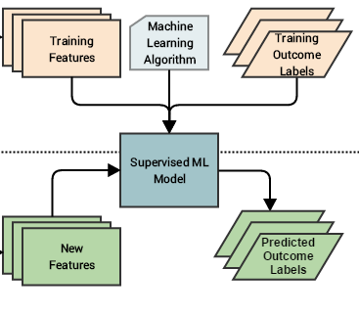
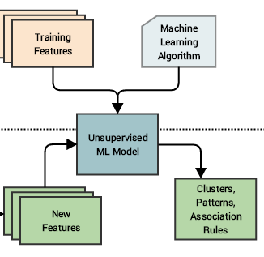
Supervised vs Unsupervised ML Pipeline
training
prediction
(Adapted from Sarkar et al. 2018)

Slide 26
Lecture Outline
Overview of Artificial Intelligence and Machine Learning
Key concepts in AI/ML
Python AI/ML Ecosystem

Slide 27
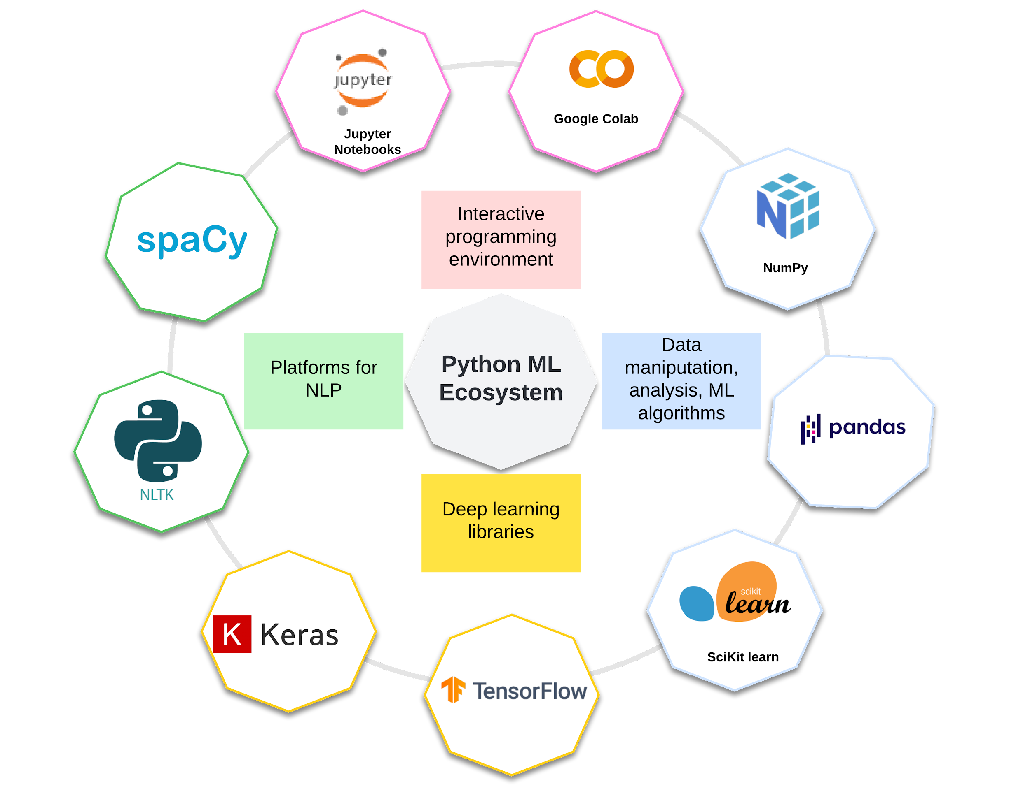
Allows sharing of code, data, results
Jupyter notebook from Google, Runs in the cloud, no need of any set up
Industrial strength NLP. Efficient text analytics for large-scale corpora
Fundamental package for scientific computing.
Adds support to core Python libraries for multi-dimensional arrays (and matrices) and fast vectorized operations on these arrays
Leading platform for programming using text data
Easy to use set of tools for data manipulation, wrangling and analysis.
High level Deep learning platform that can run on top of Tensorflow
Indispensable framework for data science and ML, with a large set of ML algorithm implementations
Open source software library for ML by Google
Created in Lucidchart by C. Arighi
Notes:
Jupyter Notebooks (https://jupyter.org/)
an interactive programming environment allow data scientists to share the code, data, and insightful results in a single place to support reproducible research.
Google Colaboratory (Colab) (https://colab.research.google.com/)
Colab is a free Jupyter notebook environment that runs entirely in the cloud.
It does not require a setup and the notebooks that you create can be simultaneously edited by your team members - just the way you edit documents in Google Docs.
NumPy (https://numpy.org/)
the fundamental package for scientific computing in Python.
It adds support to core Python libraries for multi-dimensional arrays (and matrices) and
fast vectorized operations on these arrays.
Pandas (https://pandas.pydata.org/)
an important Python library for data manipulation, wrangling, and analysis.
It functions as an intuitive and easy-to-use set of tools for performing operations on data.
Scikit-learn (https://scikit-learn.org/)
one of the most important and indispensable Python frameworks for Data Science and Machine Learning in Python.
It implements a wide range of Machine Learning algorithms.
Deep Learning Libraries
Tensorflow (https://www.tensorflow.org/):
an open source software library for Machine Learning released by Google
Keras (https://keras.io/):
a high-level Deep Learning framework for Python, which is capable of running on top of both Theano and Tensorflow.
Natural Language Toolkit (NLTK, https://www.nltk.org)
A leading platform for building Python programs to work with text data.
Spacy: industrial strength natural language processing, targets efficient text analytics for large scale corpora.

Slide 28

Quiz
Which one of the following is not an Artificial Intelligence discipline?
✔
Neuroscience
Mathematics
Data Science
Computer Science
What are the characteristics of Machine Learning algorithms?
Performing some task
Gain experience over time
Improve their performance
All of the above
✔
Which of the following is not supervised learning?
Linear regression
Decision tree
Principal Component Analysis
Support Vector Machine
✔
https://forms.gle/YNtPTesxCdUB2Kce8

Slide 29

References
Artem Oppermann. Artificial Intelligence vs. Machine Learning vs. Deep Learning. Oct 29, 2019. (https://towardsdatascience.com/artificial-intelligence-vs-machine-learning-vs-deep-learning-2210ba8cc4ac)
Dipanjan Sarkar, Raghav Bali and Tushar Sharma. 2018. Practical Machine Learning with Python. A Problem-Solver's Guide to Building Real-World Intelligent Systems. Apress. (https://doi.org/10.1007/978-1-4842-3207-1), Chapter 1, 2.
Machine Learning Tutorial. (https://www.javatpoint.com/machine-learning)
Greener, J.G., Kandathil, S.M., Moffat, L. et al. A guide to machine learning for biologists. Nat Rev Mol Cell Biol 23, 40–55 (2022). https://doi.org/10.1038/s41580-021-00407-0

