Slide 1

Practical AI/ML for Computational Biology and Chemistry
(Day 1)
Chuming Chen
chenc@udel.edu
Research Associate Professor
Computer and Information Sciences
Center for Bioinformatics and Computational Biology
Data Science Institute
Slides and notebooks: https://github.com/udel-cbcb/al_ml_workshop
June 13, 2022

Slide 2
AI/ML Applications
in Biology and Chemistry

Slide 3

Lecture Outline
Comparison of different AI/ML algorithms
Recommendations for the use of AI/ML strategies for different data types
Multi-omics Data Analysis
Protein structure prediction with AlphaFold

Slide 4
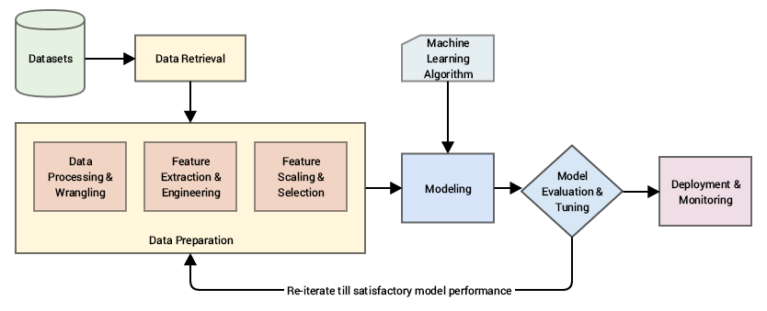
Standard Machine Learning Pipeline
(source: Sarkar et al. 2018)
Notes:
Data retrieval: This is mainly data collection, extraction, and acquisition from various data sources and data stores
Data preparation: In this step, we pre-process the data, clean it, wrangle it, and manipulate it as needed. Initial exploratory data analysis is also carried out.
Data processing and wrangling: Mainly concerned with data processing, cleaning, munging, wrangling and performing initial descriptive and exploratory data analysis
Feature extraction and engineering: Here, we extract important features or attributes from the raw data and even create or engineer new features from existing features.
Feature scaling and selection: Data features often need to be normalized and scaled to prevent Machine Learning algorithms from getting biased. Besides this, often we need to select a subset of all available features based on feature importance and quality.
Modeling: In the process of modeling, we usually feed the data features to a Machine Learning method or algorithm and train the model, typically to optimize a specific
cost function in most cases with the objective of reducing errors and generalizing the representations learned from the data
Model evaluation and tuning: Built models are evaluated and tested on validation datasets and, based on metrics like accuracy, F1 score, and others, the model performance is evaluated. Models have various parameters that are tuned in a process called hyperparameter optimization to get models with the best and optimal results
Deployment and monitoring: Selected models are deployed in production and are constantly monitored based on their predictions and results.

Slide 5
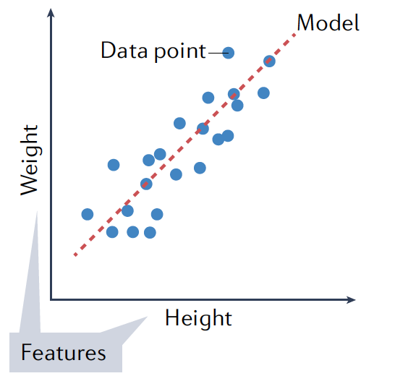
Regression (Ridge and LASSO/elastic)
Supervised learning, finds the relationship between a dependent variable (the observed property) and one or more independent variables (features)
Type of data | Example applications
-Labeled -Fixed number of features | -Predicting weight based on height -Protein variant effect prediction -Chemical/biochemical reaction kinetics -Estrogen receptor binding prediction
Advantages | Disadvantages
-Easy to interpret -Easy to train -Good benchmark | -Cannot learn complex feature relationships -Overfits with a large number of features
(source: Greener et al. 2022)

Slide 6
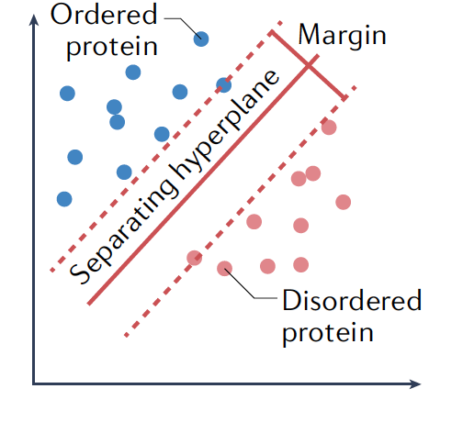
Support Vector Machine (SVM)
Supervised ML algorithm that transforms the original input data into their transformed versions (called the ‘latent representation’), such that data belonging to separate categories can be divided by a clear gap that is made as wide as possible.
Type of data | Example applications
-Labeled -Fixed number of features | -Prediction of disorder protein -Protein function prediction -Transmembrane-protein topology prediction
Advantages | Disadvantages
-Can perform both linear and non-linear classification and regression analysis | -Scaling to large datasets is often difficult
(source: Greener et al. 2022)
Notes:
Transforms the original input data into their transformed versions (called the ‘latent representation’), such that data belonging to separate categories can be divided by a clear gap that is made as wide as possible. In this case we show a prediction of whether a protein is ordered or disordered, with the axes representing dimensions of the transformed data.

Slide 7
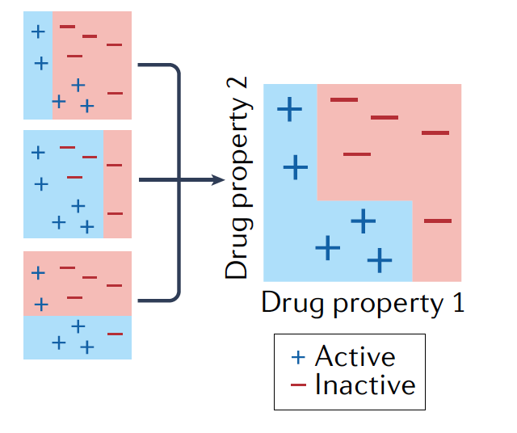
Gradient Boosting (e.g. XGBoost)
Uses an ensemble of weak prediction models, typically decision trees, to make predictions.
For example, active drugs can be predicted from molecular descriptors such as molecular weight and the presence of particular chemical groups. Individual predictors are combined in a stage-wise manner to make the final prediction
Type of data | Example applications
-Labeled -Fixed number of features | -Gene expression profiling
Advantages | Disadvantages
-Learns how important each feature is to the prediction -Individual decision trees are human understandable -Less sensitive to feature scaling and normalization so easier to train and tune | -Can struggle to learn underlying signal if noise is present -Less appropriate for regression analysis
(source: Greener et al. 2022)
Notes:
Uses an ensemble of weak prediction models, typically decision trees, to make predictions. For example, active drugs can be predicted from molecular descriptors such as molecular weight and the presence of particular chemical groups. Individual predictors are combined in a stage-wise manner to make the final prediction.
Type of data
Labelled
Fixed number of features
Example applications
Gene expression profiling
Advantages
Learns how important each feature is to the prediction
Decision trees are human-readable, allowing interpretation of how a decision is made
Less sensitive to feature scaling and normalization so easier to train and tune
Disadvantages
Can struggle to learn underlying signal if noise is present
Less appropriate for regression analysis

Slide 8
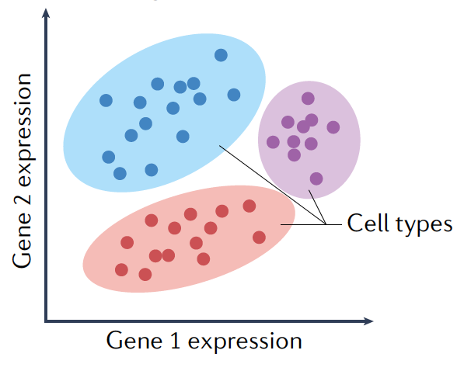
Clustering
Unsupervised learning, uses one of various algorithms to group sets of similar objects (for example, grouping cell types on the basis of gene expression profiles)
Type of data | Example applications
-Unlabeled -Fixed number of features | -Differential gene expression analysis -Model selection in protein structure prediction
Advantages | Disadvantages
-For low-dimensional data, good clustering is easily identifiable -Cluster validation metrics are available to assess performance | -Scaling to large datasets is difficult for some methods -Noisy datasets sometimes yield contradictory results
(source: Greener et al. 2022)
Notes:
Uses one of various algorithms to group sets of similar objects (for example, grouping cell types on the basis of gene expression profiles).
Type of data
Unlabelled
Fixed number of features
Example applications
Differential gene expression analysis
Model selection in protein structure prediction
Advantages
For low-dimensional data, good clustering is easily identifiable
Cluster validation metrics are available to assess performance
Disadvantages
Scaling to large datasets is difficult for some methods
Noisy datasets sometimes yield contradictory results

Slide 9
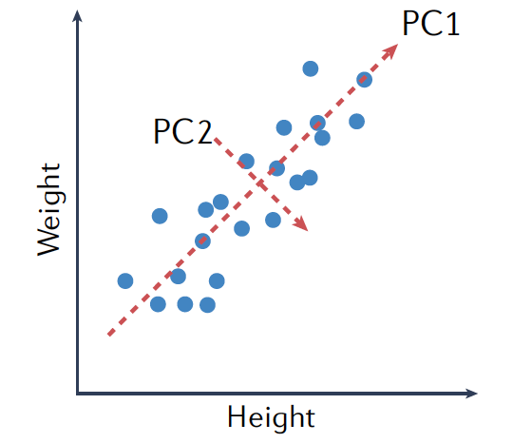
Dimensionality Reduction (e.g. PCA)
Unsupervised learning, reduce the number of feature variables by extracting or selecting a set of principal or representative features
Type of data | Example applications
-Unlabeled -Large and fixed number of features | -Single-cell transcriptomics -Analysis of molecular-dynamics trajectories
Advantages | Disadvantages
-Provide visual representation of data -Goodness-of-fit evaluations usually available to assess performance | -Hard to preserve both global and local differences in data -Scaling to large number of samples is difficult for some methods
(source: Greener et al. 2022)
Notes:
Finds a series of feature combinations that best describe the data. It is commonly used for dimensionality reduction. In the case of the height and weight of a person, the first principal component (PC1), corresponding to a linear combination of height and weight, describes the strong positive correlation, whereas PC2 might describe other variables that do not correlate strongly with those, such as percentage body fat or muscle mass.
Type of data
Unlabelled
Large and fixed number of features
Example applications
Single-cell transcriptomics
Analysis of molecular-dynamics trajectories
Advantages
Provide visual representation of data
Goodness-of-fit evaluations usually available to assess performance
Disadvantages
Hard to preserve both global and local differences in data
Scaling to large number of samples is difficult for some methods

Slide 10
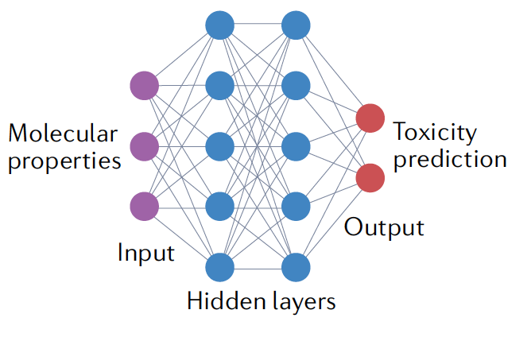
Multilayer perceptron (MLP)
Basic deep neural network, consists of nodes (shown as circles) that represent numbers: an input value, an output value or an internal (hidden) value. Nodes are arranged in layers with connections, indicating learned parameters, between every node of a layer and every node of the next layer
Type of data | Example applications
-Labeled -Fixed number of features | -Protein secondary structure prediction -Drug toxicity prediction
Advantages | Disadvantages
-Can fit datasets with fewer layers than other complex architectures (like CNN) -Easier and faster to train | -Easy to overfit -Large number of parameters -Hard to interpret
(source: Greener et al. 2022)
Notes:
Consists of nodes (shown as circles) that represent numbers: an input value, an output value or an internal (hidden) value. Nodes are arranged in layers with connections, indicating learned parameters, between every node of a layer and every node of the next layer. For example, molecular properties can be used to predict drug toxicity as the prediction can be made from some complicated combination of independent input features.
Type of data
Labelled
Fixed number of features
Example applications
Protein secondary structure prediction
Drug toxicity prediction
Advantages
Can fit datasets with fewer layers than other complex architectures
such as convolutional neural networks
Easier and faster to train
Disadvantages
Easy to overfit
Large number of parameters
Hard to interpret

Slide 11
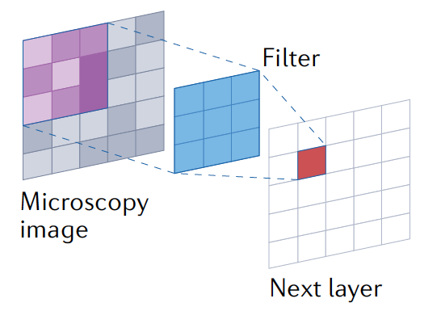
Convolutional neural network (CNN)
Deep neural network, uses filters that move across the input layer to calculate the values in the next layer. The filters operating across the whole layer mean that parameters are shared, allowing similar entities to be detected regardless of location.
Type of data | Example applications
-Spatial data arranged in a grid. e.g., 2D image (pixels), 3D volumes (voxels) -Allows variable input size | -Protein residue-residue contact and distance prediction -Medical image recognition
Advantages | Disadvantages
-Variable input size -Learns patterns irrespective of location in the input | -The amount of the input that is considered when predicting the output for each pixel, can be limited. -Hard to train deeper architectures that use many layers and make more complex predictions
(source: Greener et al. 2022)
Notes:
Uses filters that move across the input layer to calculate the values in the next layer. The filters operating across the whole layer mean that parameters are shared, allowing similar entities to be detected regardless of location. A 2D CNN is shown operating on a microscopy image, but 1D and 3D CNNs also find applications in biology. For example, biological sequences can be considered 1D and magnetic resonance imaging data can be considered 3D.
Type of data
Spatial data arranged in a grid. e.g. 2D image (pixels),
3D volumes (voxels)
Allows variable input size
Example applications
Protein residue-residue contact and distance prediction
Medical image recognition
Advantages
Variable input size
Learns patterns irrespective of location in input
Disadvantages
The amount of input that is considered when predicting the output for each pixel can be limited.
Hard to train deeper architectures that use many layers to increase the receptive field and make more complex predictions

Slide 12
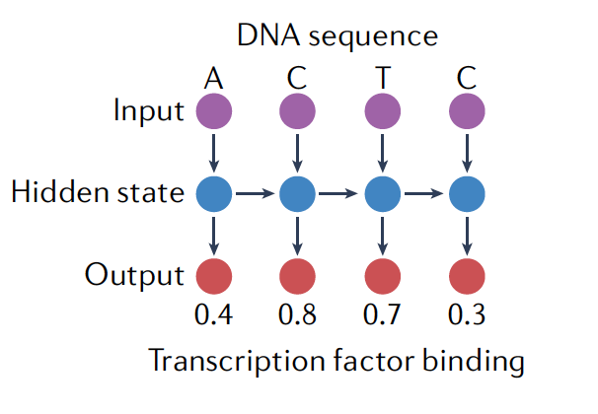
Recurrent neural network (RNN)
Deep neural network, given an output and an updated hidden state for every input, RNN processes each part of a sequential input using the same learned parameters
Type of data | Example applications
-Sequential data, e.g. biological sequences or time-series data -Allows variable input size | -Probability of transcription factor binding -Protein engineering -Clinical event prediction
Advantages | Disadvantages
-Variable input size -Sequences are found in many areas of biology | -Long training times -High computing memory requirements
(source: Greener et al. 2022)
Notes:
Given an output and an updated hidden state for every input, RNN processes each part of a sequential input using the same learned parameters, The hidden state is used to carry information about the preceding parts of the sequence. In this case the probability of transcription factor binding is predicted for each base in a DNA sequence.
Type of data
Sequential data, e.g. biological sequences or time-series data
Allow variable input size
Example applications
Protein engineering
Clinical event prediction
Advantages
Variable input size
Sequences are found in many areas of biology
Disadvantages
Long training times
High computing memory requirements

Slide 13
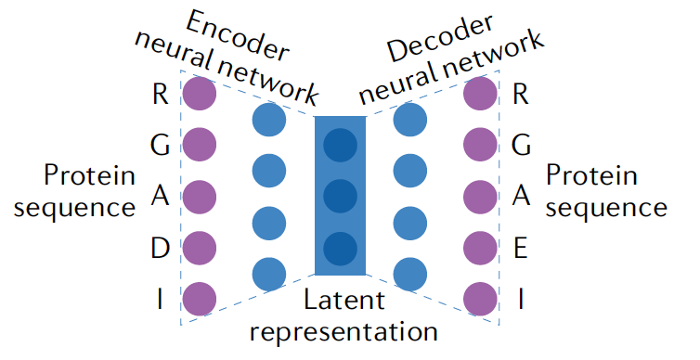
Autoencoders/Transformers
Deep neural network, consist of an encoder neural network, which converts an input into a lower-dimensional latent representation, and a decoder neural network, which converts this latent representation back to the original input form
Type of data | Example applications
-Labelled or unlabelled data -Fixed or variable input size depending on architecture | -Protein and gene engineering -Prediction of DNA methylation -Neural population dynamics
Advantages | Disadvantages
-Latent space provides low-dimensional representation that can be used to visualize input data -Can generate new samples, which is useful in areas such as protein design | -Latent space specific to data in training set and may not be appropriate to other datasets -Testing newly generated samples often requires wet laboratory experiments
(source: Greener et al. 2022)
Notes:
Consists of an encoder neural network, which converts an input into a lower-dimensional latent representation, and a decoder neural network, which converts this latent representation back to the original input form. For example, protein sequences can be encoded and the latent representation used to generate novel protein sequences. In the example, four of the five residues are the same as the input after encoding and decoding by the autoencoder, indicating an accuracy of 80% on this sequence.
Type of data
Labelled or unlabelled data
Fixed or variable input size depending on architecture
Example applications
Protein and gene engineering
Prediction of DNA methylation
Neural population dynamics
Advantages
Latent space provides low-dimensional representation that can be used to visualize input data
Can generate new samples, which is useful in areas such as protein design
Disadvantages
Latent space specific to data in training set and may not be appropriate to other datasets
Testing newly generated samples often requires wet laboratory experiments

Slide 14
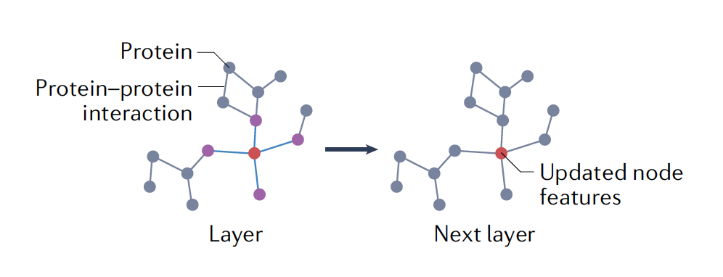
Graph convolutional network (GCN)
Uses information from connected nodes in a graph to update node properties in the network by combining predictions from all neighbouring nodes. The updated node properties form the next layer in the network and and were used to predict the desired property in the output layer
Type of data | Example applications
-Data characterized by connections between entities (spatial, interaction or association) -Allows variable input size | -Predicting protein-protein interaction -Predicting drug properties -Interpreting molecular structures -Knowledge extraction
Advantages | Disadvantages
-Variable graph sizes supported -Learns patterns by following graph connectivity so predictor uses most relevant associations | -High computing memory requirements for large, densely connected graphs -Hard to train deeper architectures
(source: Greener et al. 2022)
Notes:
Uses information from connected nodes in a graph, such as a protein–protein interaction network, to update node properties in the network by combining predictions from all neighbouring nodes. The updated node properties form the next layer in the network and predict the desired property in the output layer.
Type of data
Data characterized by connections between entities (spatial, interaction or association)
Allows variable input size
Example applications
Predicting drug properties
Interpreting molecular structures
Knowledge extraction
Advantages
Variable graph sizes supported, which is important because most graphs in biology have variable size
Learns patterns by following graph connectivity so predictor uses most relevant associations
Disadvantages
High computing memory requirements for large, densely connected graphs
Hard to train deeper architectures

Slide 15
Lecture Outline
Comparison of different AI/ML algorithms
Recommendations for different data types
Multi-omics Data Analysis
Protein structure prediction with AlphaFold

Slide 16
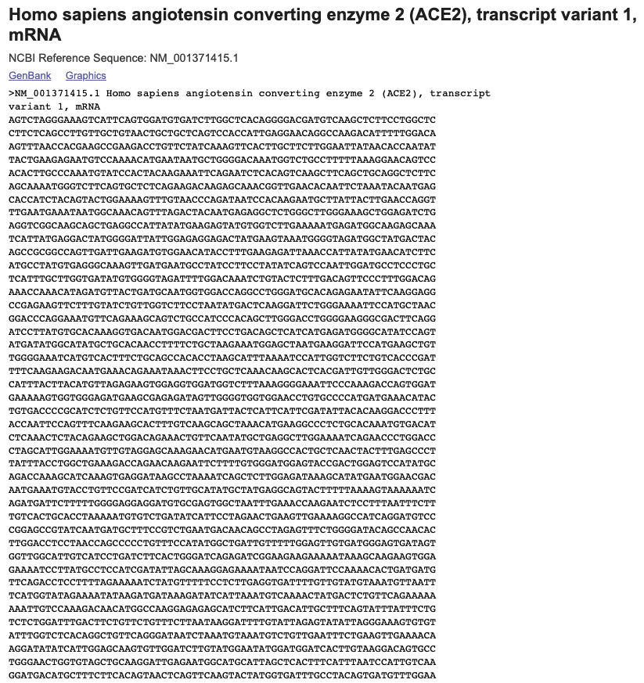

Nucleotide Sequence
Example prediction tasks
DNA accessibility
3D genome organization
Enhancer-promoter interactions
Recommended models
1D CNNs
RNNs
Transformers
Challenges
Repetitive regions in genome
Very long sequences
(source: Genbank)

Slide 17
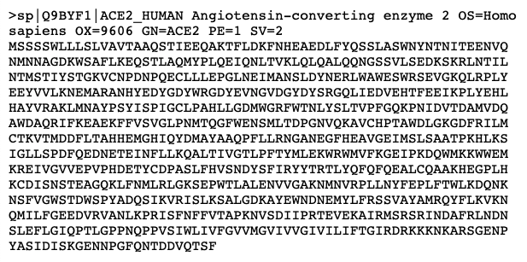
Protein Sequence
Example prediction tasks
Protein structure
Protein function
Protein-protein interactions
Recommended models
2D CNNs and residual networks using co-variation data
Multilayer perceptrons with windowing
Transformers
Challenges
Data leakage (from homology) can make validation difficult
(source: UniProt)

Slide 18
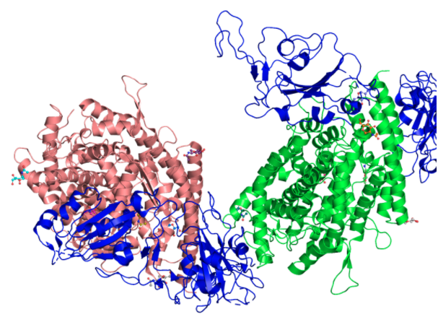
Protein 3D Structure
Example prediction tasks
Protein model refinement
Protein model quality assessment
Change in stability upon mutation
Recommended models
GCNs using molecular graph
3D CNNs using coordinates
Clustering
Challenges
Lack of data, particularly on protein complexes
Lack of data on disordered proteins
(source: PDBe)

Slide 19
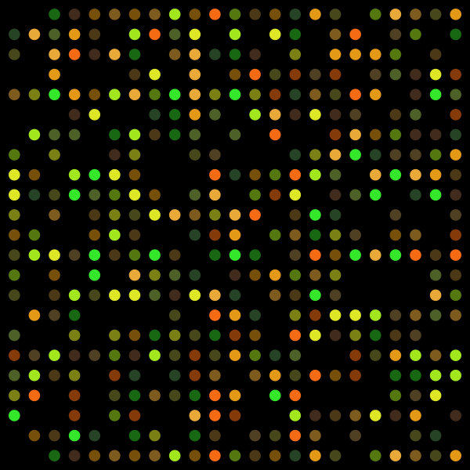
Gene Expression
Example prediction tasks
Intergenic interactions or co-expression
Organization of transcription machinery
Recommended models
Clustering
CNNs
Autoencoders
Challenges
Unclear link between co-expression and function
High dimensionality
High noise
(source: kurzweilai.net)

Slide 20
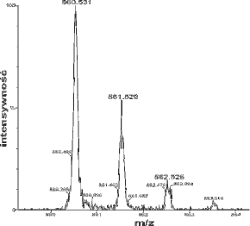
Mass Spectrometry
Example prediction tasks
Detecting peaks in spectra
Metabolite annotation
Recommended models
CNNs using spectral data
Traditional ML methods using derived features
Challenges
Lack of standardized benchmarks
Normalization required between different datasets
(source: wikipedia)

Slide 21
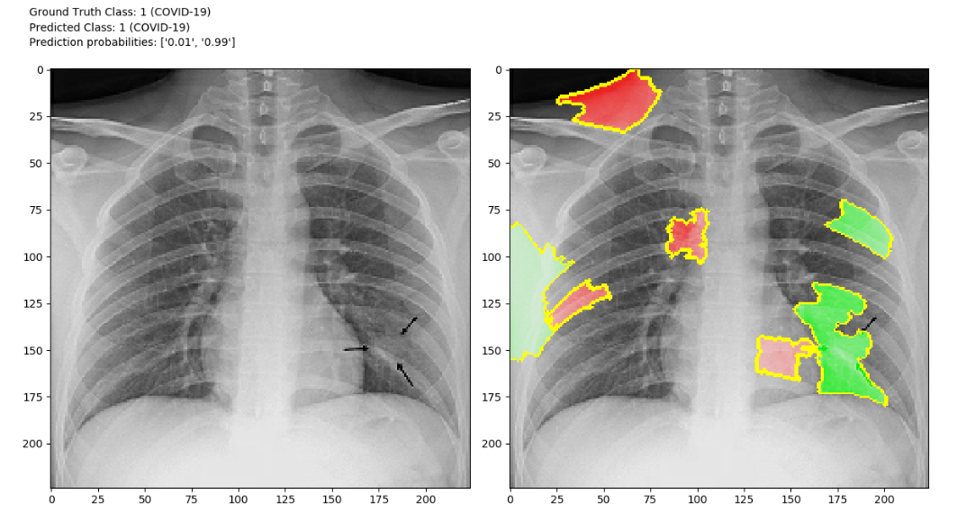
Images
Example prediction tasks
Medical image recognition
Cryo-EM image reconstruction
Recommended models
2D CNNs and residual networks
Autoencoders
Traditional ML methods using image features
Challenges
Systematic difference in data collection affect prediction
Hard to obtain large datasets of consistent data
(source: Ross, 2020)

Slide 22
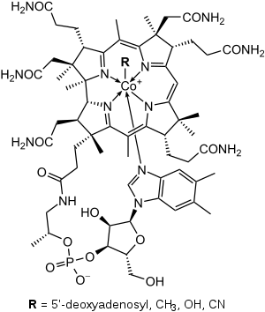
Molecular Structure
Example prediction tasks
Antibiotic activity
Drug toxicity
Protein-ligand docking
Novel drug discovery
Recommended models
CNNs using molecular graph
Traditional ML methods or multilayer perceptrons using molecular properties
RNNs using text-based representations of molecular structure such as SMILES
Autoencoders
Challenges
Experimental data available for only a tiny fraction of possible small molecules
(source: wikipedia)

Slide 23
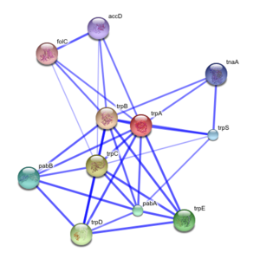
Protein-protein Interaction Network
Example prediction tasks
Polypharmacology side effects
Protein function
Recommended models
CNNs
Graph embedding
Challenges
Interaction networks can be incomplete
Cellular location affects whether proteins interact
(source: wikipedia)

Slide 24
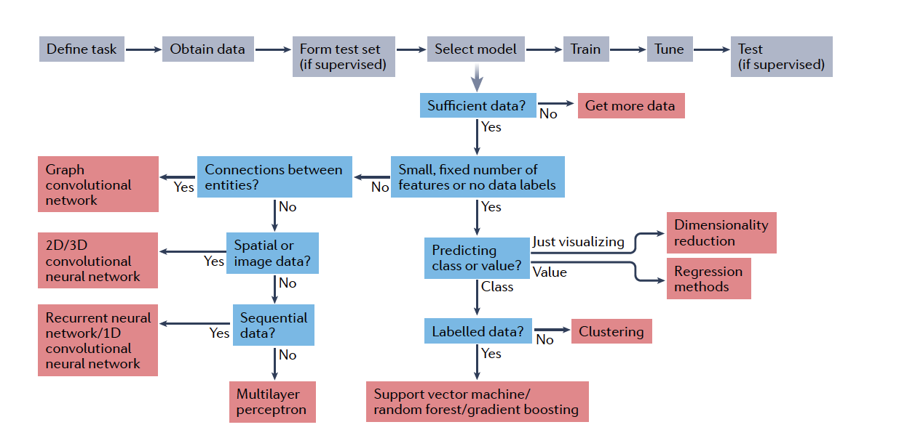
How to choose a Machine Learning method?
(source: Greener et al. 2022)

Slide 25
Lecture Outline
Comparison of different AI/ML algorithms
Recommendations for the use of AI/ML strategies for different data types
Multi-omics Data Analysis
Protein structure prediction with AlphaFold

Slide 26
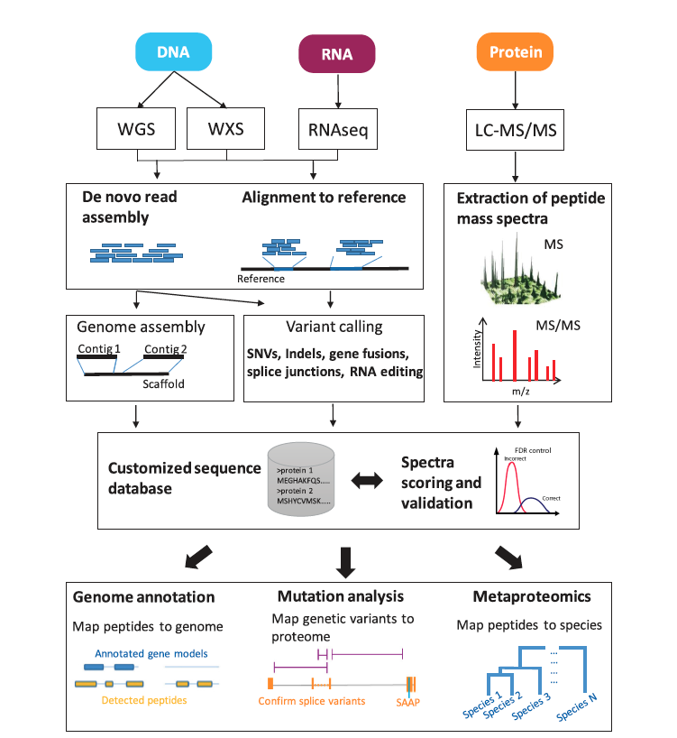
Sequence-centric Proteogenomics
(source: Ruggles et al. 2017)
Notes:
Sequencing-based technologies are used to sequence DNA (WGS, WXS) and RNA (RNA-seq)
Short sequencing reads assembled into genomes, exomes, transcriptomes by de novo or reference based assembly methods.
Sample specific aberrations are detected and nucleotide sequences are transformed into personalized, amino acid-centric sequence databases.
Peptide mass spectra derived by LC-MS/MS analysis are then scored and validated against the personalized database
Depending on the scope of the proteogenomic project, these peptides can then be used to
aid genome annotation by detection of peptides in unannotated genome regions;
identify tumor-specific mutations translated into the proteome as well as novel protein splice variants;
detect species-specific peptides in microbial communities.

Slide 27
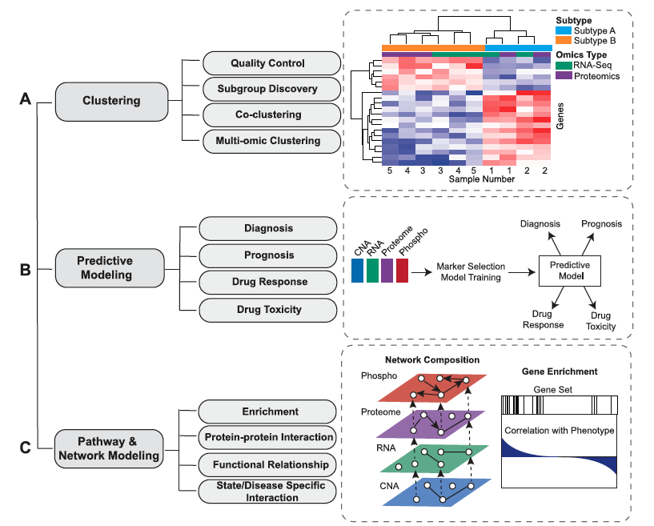
Integrative modeling of proteogenomic data
Use statistical and machine learning approaches to do integrative modeling and analysis of proteogenomic data.
A - Clustering techniques can be used to do
multi-omic hierarchical clustering analysis.
B - Multiple data modalities can be used to do predictive modeling for disease diagnosis, prognosis, drug response and drug toxicity.
C - Proteogenomic pathway and network modeling can be used to inform network composition and pathway and GO term enrichment.
(source: Ruggles et al. 2017)

Slide 28
Lecture Outline
Comparison of different AI/ML algorithms
Recommendations for the use of AI/ML strategies for different data types
Multi-omics Data Analysis
Protein structure prediction with AlphaFold

Slide 29
AlphaFold
AlphaFold, a state-of-the-art AI system developed by DeepMind, is able to computationally predict protein structures with unprecedented accuracy and speed.
These predictions are freely and openly available to the global scientific community in partnership with EMBL’s European Bioinformatics Institute (EMBL-EBI) https://alphafold.ebi.ac.uk/
Notes:
Determining de novo 3D structure of proteins is one of the fundamental grand challenges in biology, and solving it has the potential to dramatically deepen our understanding of human health, disease and our environment, with implications for areas like drug design and sustainability

Slide 30
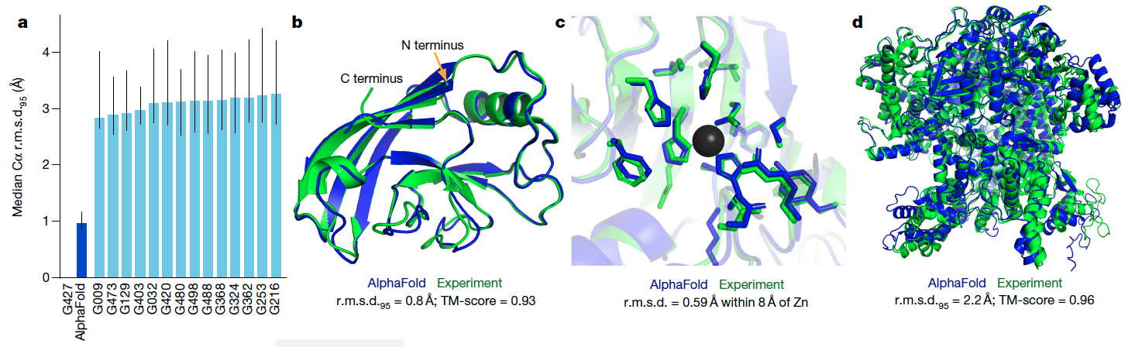
AlphaFold Produces Highly Accurate Structures
a -The performance of AlphaFold on the CASP14 dataset (n = 87 protein domains) relative to the top-15 entries (out of 146 entries).
b - Prediction of CASP14 target T1049 (PDB 6Y4F, blue) compared with the true (experimental) structure (green).
c - CASP14 target T1056 (PDB 6YJ1). An example of a well-predicted zinc-binding site (AlphaFold has accurate side chains even though it does not explicitly predict the zinc ion).
d - CASP target T1044 (PDB 6VR4)—a 2,180-residue single chain—was predicted with correct domain packing (the prediction was made after CASP using AlphaFold without intervention)
(source: Jumper et al. 2021)

Slide 31
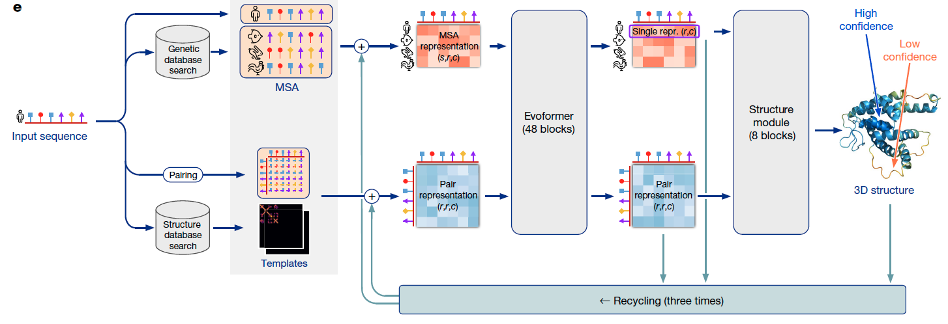
AlphaFold Model Architecture
(source: Jumper et al. 2021)
Incorporating novel neural network architectures and training procedures based on the evolutionary, physical and geometric constraints of protein structures.
Jointly embed multiple sequence alignments (MSAs) and pairwise features, a new output representation and associated loss that enable accurate end-to-end structure prediction.
Use of intermediate losses to achieve iterative refinement of predictions.

Slide 32

Quiz
Which of the following tasks can we use ML algorithms to solve?
Protein structure prediction
Prediction of chemical reactions
Medical image recognition
All of the above
✔
What prediction task can’t we use molecule structure data for?
Drug toxicity
Intergenic interactions or co-expression
Protein-ligand docking
Novel drug generation
✔
What prediction task can’t we use Graph Convolutional Network for?
Predicting drug properties
Interpreting molecular structures
Protein-protein interaction
Protein clustering
https://forms.gle/EXCdBPjwjAP1mkUK7
✔

Slide 33
References
Greener, J.G., Kandathil, S.M., Moffat, L. et al. A guide to machine learning for biologists. Nat Rev Mol Cell Biol 23, 40–55 (2022). (https://doi.org/10.1038/s41580-021-00407-0)
What is a random forest? (https://www.tibco.com/reference-center/what-is-a-random-forest
Gene-expression data to hit one million deposited data sets). (https://www.kurzweilai.net/gene-expression-data-to-hit-one-million-deposited-data-sets)
Matt Ross. Mar 29, 2020. COVID-CXR: An open source explainable deep CNN model for predicting the presence of COVID-19 in chest X-rays. (https://towardsdatascience.com/covid-cxr-an-open-source-explainable-deep-cnn-model-for-predicting-the-presence-of-covid-19-in-75a83b26cab5)
Ruggles KV, Krug K, Wang X, Clauser KR, Wang J, Payne SH, Fenyö D, Zhang B, Mani DR. Methods, Tools and Current Perspectives in Proteogenomics. Mol Cell Proteomics. 2017 Jun;16(6):959-981. doi: 10.1074/mcp.MR117.000024. Epub 2017 Apr 29. PMID: 28456751; PMCID: PMC5461547.
Jumper, J., Evans, R., Pritzel, A. et al. Highly accurate protein structure prediction with AlphaFold. Nature 596, 583–589 (2021). https://doi.org/10.1038/s41586-021-03819-2

