Slide 1
ML Models and Model Evaluation

Slide 2
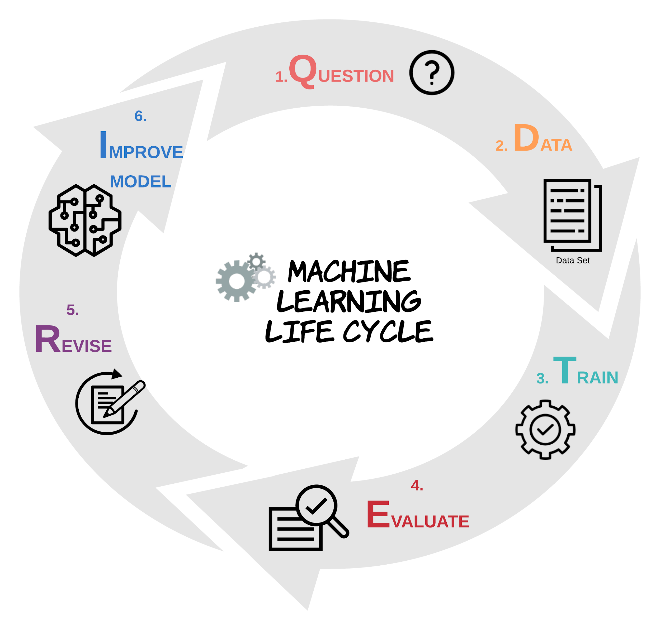

Slide 3
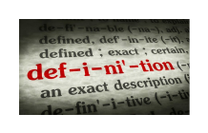
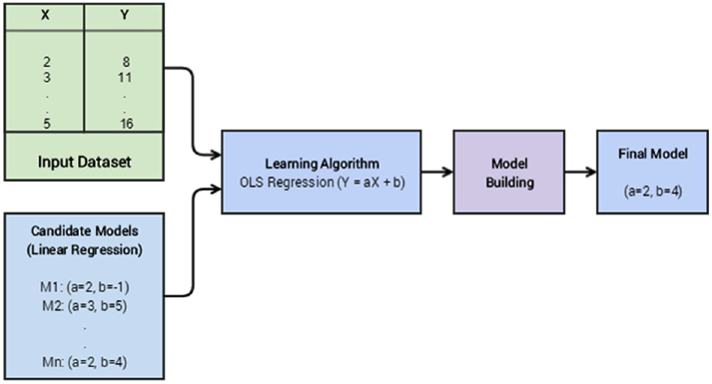
What is a Machine Learning Model?
A relationship between output or response variables and its corresponding input or dependent variables in a dataset.
This relationship can be expressed as mathematical equations, functions or rules.
source: Sarkar et al. 2018

Slide 4
Machine learning
Supervised
Unsupervised
Reinforcement
Regression
Classification
Clustering
Association

Slide 5
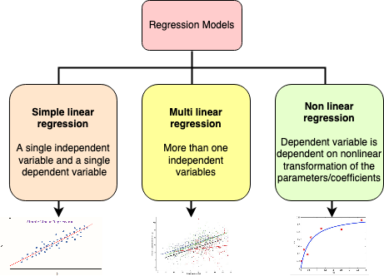
Regression Models
Machine learning
Supervised
Regression
The input data is generally labeled with continuous numerical values
y=b₀+b₁x₁
y=b₀+b₁x₁+b₂x_{2+….}+b_{n}x_{n}
y=b₀+b₁x₁+b₂x²_{1+….}+b_{n}x^{n}₁
Created in draw.io by C. Arighi

Slide 6
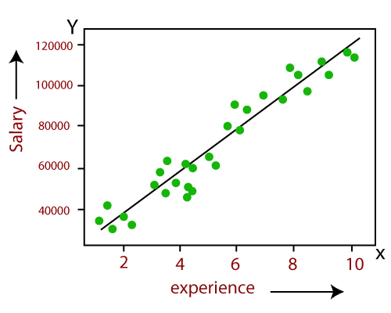
Simple Linear Regression
Shows the linear relationship between the independent variable (X-axis) and the dependent variable (Y-axis).
Only one input variable
Popular applications:
Trend analysis
Forecasting/prediction
y=b₀+b₁x₁
source: javatpoint.com

Slide 7
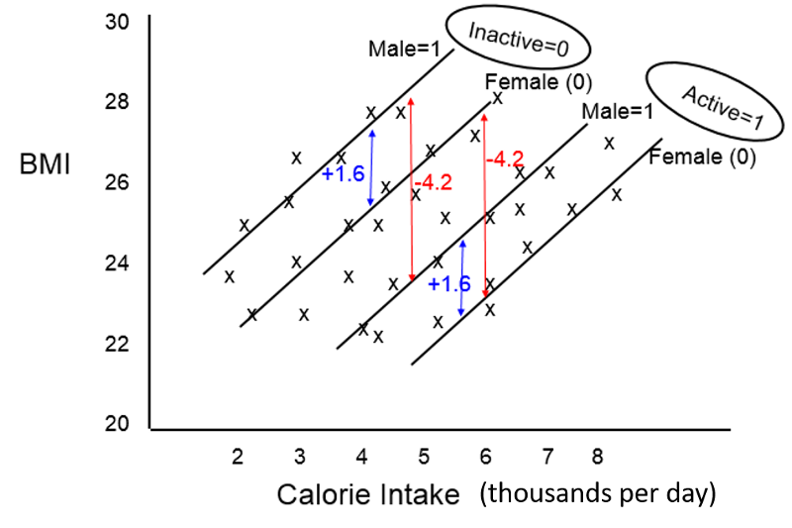

Multiple Linear Regression
Extension of simple linear regression
Takes into account the effects of other independent predictors (risk factors) on the outcome of interest.
An equation for multiple linear regression has the general form shown below.
BMI = 15.0 + 1.5 (cal) + 1.6 (if male) - 4.2 (if active)
Source: Wayne W. LaMorte, 2021

Slide 8
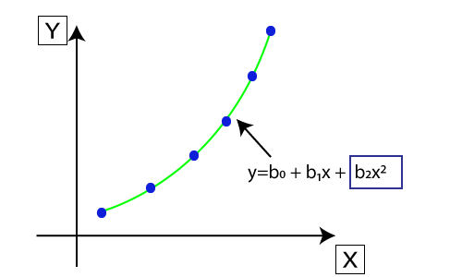
Non Linear Regression: polynomial
y
y
It fits a nonlinear curve between the value of x and corresponding conditional values of y.
The original features are transformed into polynomial features of given degree and then modeled using a linear model.
y=b₀+b₁x+b₂x²
x
source: javatpoint.com

Slide 9
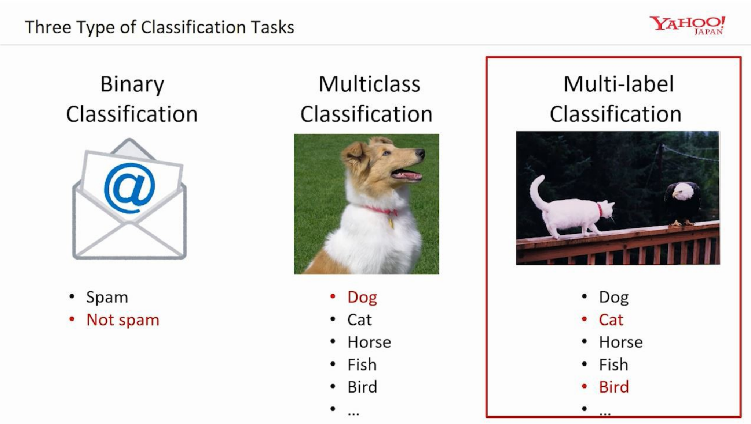
Classification Models
Machine learning
Supervised
Classification
The output of a classification model is normally a label or a category to which the input data point may belong.
Typical classification models:
Linear models (logistic regression, Naive Bayes, Support Vector Machine)
Non-parametric models (K-nearest neighbors)
Tree based methods (decision trees)
Ensemble methods (random forests)
Neural networks (MLPs)
source:medium.com

Slide 10
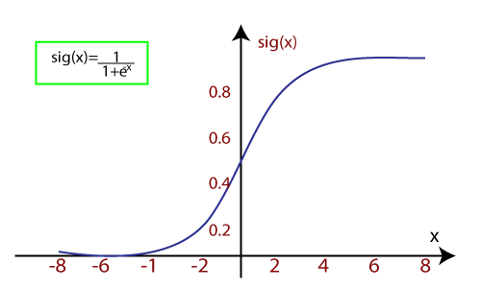
Logistic Regression
It uses sigmoid function or logistic function to model the data.
Decision boundary is the threshold value above which we will map the probability to class 1, and below the threshold to class 0
Types of logistic regression:
Binary (0/1, pass/fail)
Multinomial (cats, dogs, lions)
Ordinal (low, medium, high)
source: javatpoint.com

Slide 11
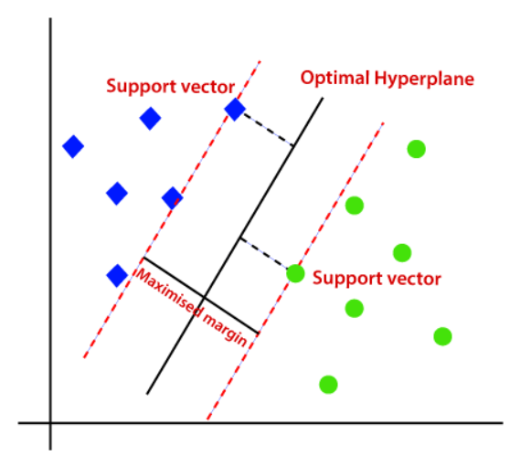
Support Vector Machine (SVM)
Can be used for regression as well as classification problems.
Finds the optimal hyperplane to separate data points of different classes with the maximum margin
Support vectors are the data points which are nearest to the hyperplane and opposite class.
source: medium.com

Slide 12
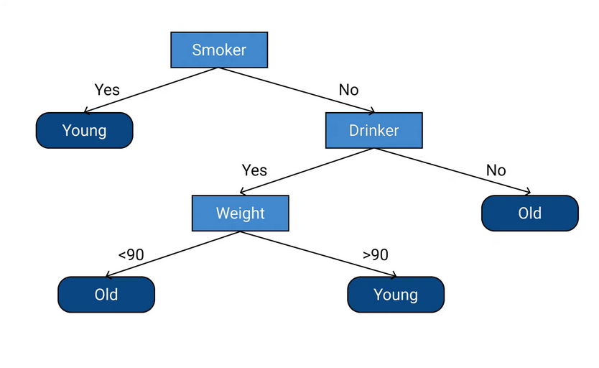
Decision Tree
(root)
Can be used for regression as well as classification problems.
It works for both categorical and numerical data.
It builds a tree-like structure in which each internal node represents the "test" for an attribute, each branch represent the result of the test, and each leaf node represents the final decision or result.
(internal node)
(outcome)
Prediction task: if the people will die at a younger age (<70) or older age.
source: upgrad.com

Slide 13
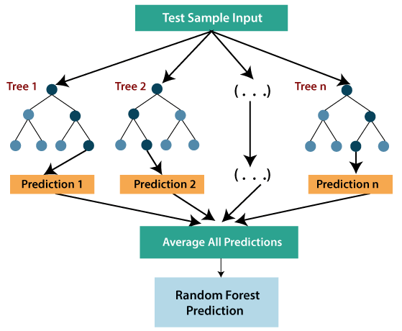
Random Forest
Can be used for regression as well as classification problems.
It is an ensemble learning method which combines multiple decision trees and predicts the final output based on the average of each tree output.
It uses Bagging or Bootstrap Aggregation technique of ensemble learning in which aggregated decision tree runs in parallel and do not interact with each other.
source: javatpoint.com

Slide 14
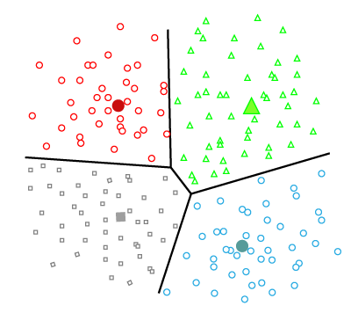
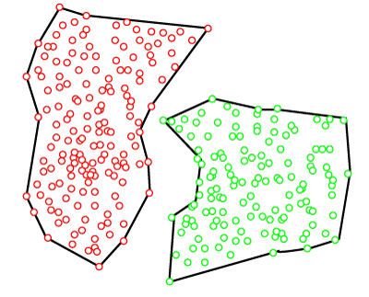
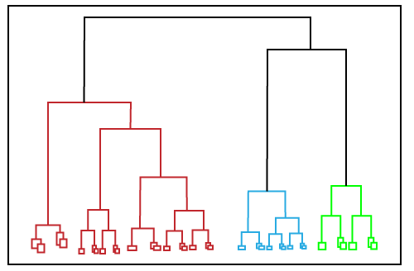
Clustering Models
Machine learning
Unsupervised
Clustering
A process of grouping similar data points together that do not have any pre-labeled classes or categories. The output is segregated group of data points.
Clustering algorithms
Partition based clustering
Hierarchical clustering
Density based clustering

Slide 15
Partition Based Clustering
The most common example is K-Means clustering.
The dataset is divided into a set of K groups, where K is used to define the number of pre-defined groups.
The cluster center is created in such a way that the distance of points within each cluster as close as possible to their centroid
source: javatpoint.com

Slide 16
Hierarchical Clustering
The dataset is divided into clusters to create a tree-like structure, which is also called a dendrogram.
The observations or any number of clusters can be selected by cutting the tree at the certain level.
In a hierarchical clustering paradigm, we can either start with all the data points in one group (divisive clustering) or all the data points in different groups (agglomerative clustering).
source: javatpoint.com

Slide 17
Density Based Clustering
This algorithm identifies different clusters in the dataset and connects the areas of high densities into clusters.
The dense areas in data space are divided from each other by sparser areas.
These algorithms can face difficulty in clustering the data points if the dataset has varying densities and high dimensions.
source: javatpoint.com

Slide 19
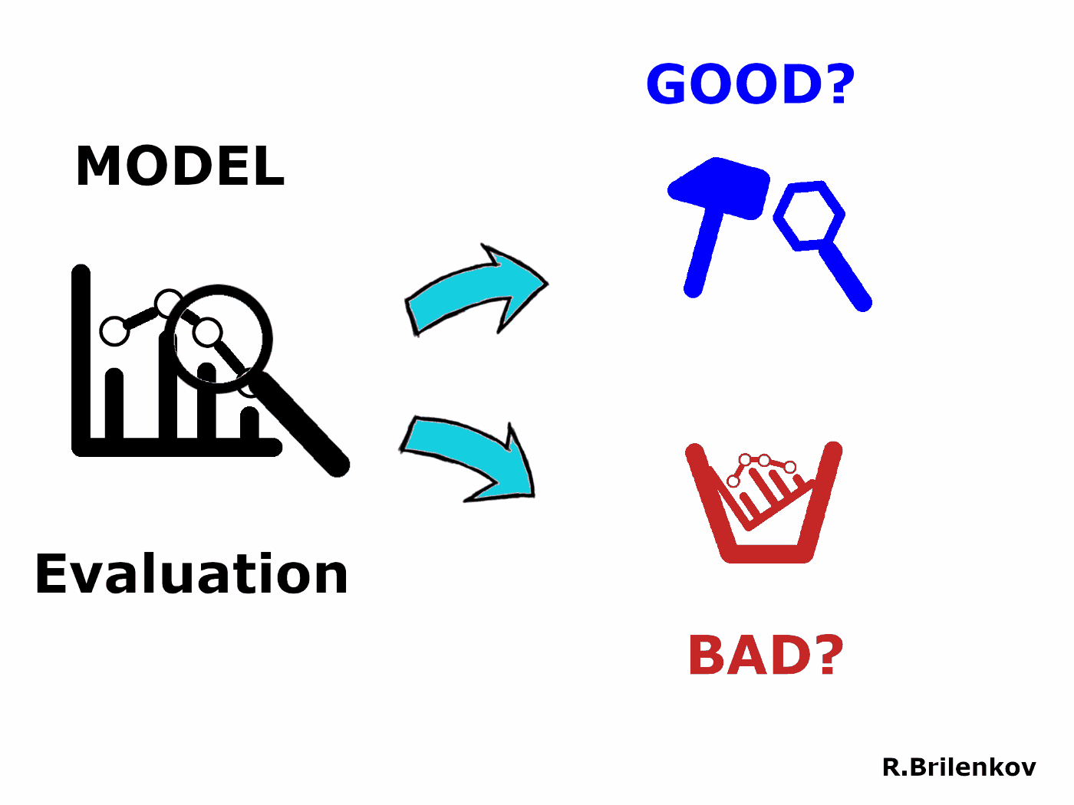
Model Evaluation
Model evaluation makes the development process iterative.
Enables tuning the model hyperparameters.
Helps us deciding if we need to add any new features to our model or not.
Uses some numerical measure or metric of model’s effectiveness to rank and select models.
source: Brilenkov, 2021

Slide 20
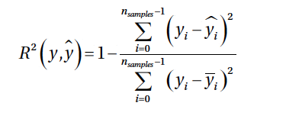

Evaluating Regression Models
Machine learning
Supervised
Regression
Coefficient of Determination or R²:
Measures the proportion of variance in the dependent variable which is explained by the independent variable.
R²=1 denotes a perfect regression model indicating that all the variance is explained by the independent variables.
Mean Squared Error (MSE):
Calculates the average of the squares of the errors or deviation between the actual values and the predicted values.
Lower values meaning a better regression models with less errors.

Slide 21
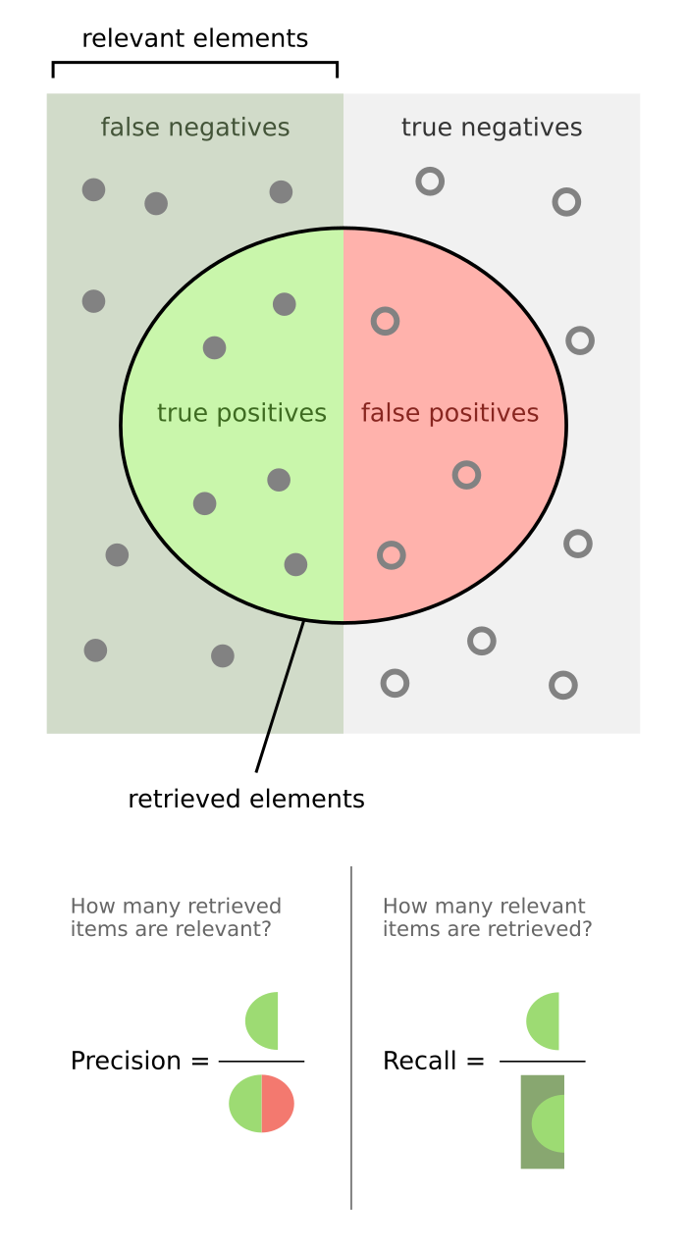
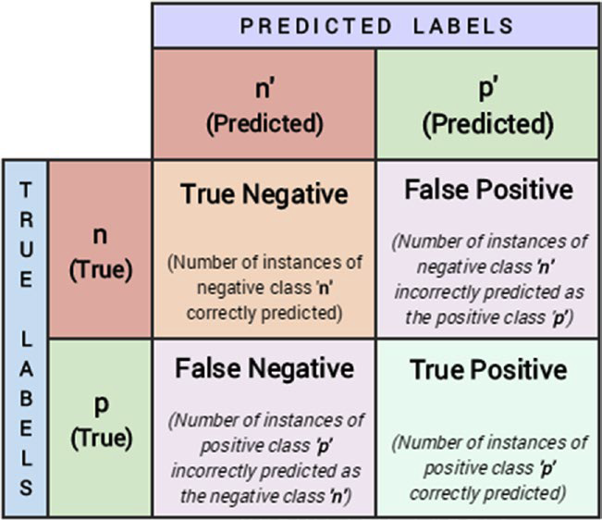
Confusion Matrix
Machine learning
Supervised
Classification
(predicted as relevant)
source: Sarkar et al. 2018
source: Walber https://en.wikipedia.org/wiki/Precision_and_recall

Slide 22


Performance Metrics
Precision or positive predictive value is defined as the number of predictions that are actually correct or relevant out of all the predictions based on the positive class.
High precision model will identify a higher fraction of positive class.
Recall or sensitivity, is a measure to identify the percentage of relevant data points.
Defined as the number of instances of the positive class that were correctly predicted.
Used when we want to catch the most number of instances of a particular class even when it increases the false positives.
source: Walber https://en.wikipedia.org/wiki/Precision_and_recall

Slide 23


Performance Metrics
F1 Score:
The harmonic mean of precision and recall.
Helps us optimize a classifier for balanced precision and recall performance.
Accuracy:
Defined as the overall accuracy or proportion of correct predictions of the model.
Normally used when our classes are almost balanced and correct predictions of those classes are equally important.

Slide 24
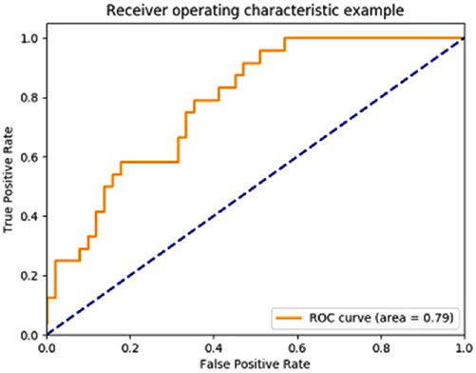
Receiver Operating Characteristic (ROC) Curve
Good for scoring classifiers. It returns a probability value or score for each class label.
Created by plotting the True Positive Rate (TPR) vs. False Positive Rate (FPR) at various thresholds
Ideally, the best prediction model would give a point on the top left corner (0, 1) indicating perfect classification (100% sensitivity & specificity). A diagonal line depicts a classifier that does a random guess.
Sensitivity/recall
source: Sarkar et al. 2018

Slide 25
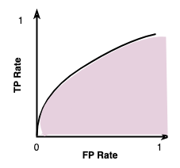
Area Under Curve (AUC)
The Area Under Curve (AUC) provides a numerical value for us to compare models.
The area under the black curve line is the area under the classifier’s ROC curve.
The perfect classifier will have AUC=1. Based on this value we can compare two models, generally the model with the higher AUC score is a better one.
AUC

Slide 26
Evaluating Clustering Models
Machine learning
Unsupervised
Clustering
External metrics
Internal metrics
Homogeneity
Completeness
Compactness
Separation
Are all the points within a given cluster from the same true label?
Are all points of a given class grouped into the same cluster?
V-measure

Slide 27

References
Dipanjan Sarkar, Raghav Bali and Tushar Sharma. 2018. Practical Machine Learning with Python. A Problem-Solver's Guide to Building Real-World Intelligent Systems. Apress. (https://doi.org/10.1007/978-1-4842-3207-1), Chapter 5
Machine Learning Tutorial. (https://www.javatpoint.com/machine-learning)
Ruslan Brilenkov. Jun 2, 2021. 9 Types of Performance Evaluation for Classification Machine Learning Modeling. (https://medium.datadriveninvestor.com/9-types-of-performance-evaluation-for-classification-machine-learning-modeling-c6e73e97e528)
Wayne W. LaMorte., 2021. Multiple Linear Regression. (https://sphweb.bumc.bu.edu/otlt/MPH-Modules/PH717-QuantCore/PH717-Module12-MultipleRegression/PH717-Module12-MultipleRegression3.html)

